Slide 1
Cryptography

Slide 2
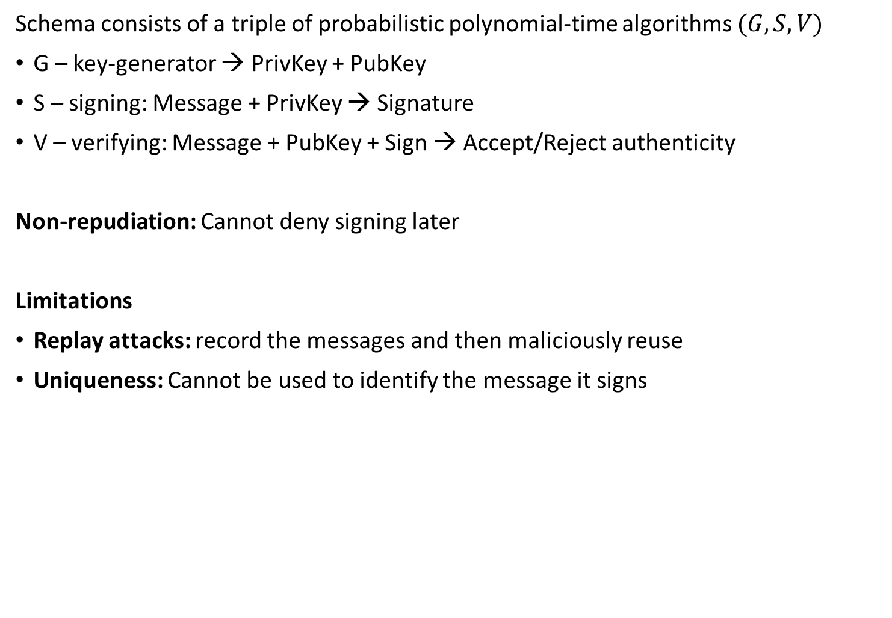
Digital Signature
Schema consists of a triple of probabilistic polynomial-time algorithms $(G, S, V)$
G – key-generator → PrivKey + PubKey
S – signing: Message + PrivKey → Signature
V – verifying: Message + PubKey + Sign → Accept/Reject authenticity
Non-repudiation: Cannot deny signing later
Limitations
Replay attacks: record the messages and then maliciously reuse
Uniqueness: Cannot be used to identify the message it signs
Notes:
https://en.wikipedia.org/wiki/Digital_signature

Slide 3
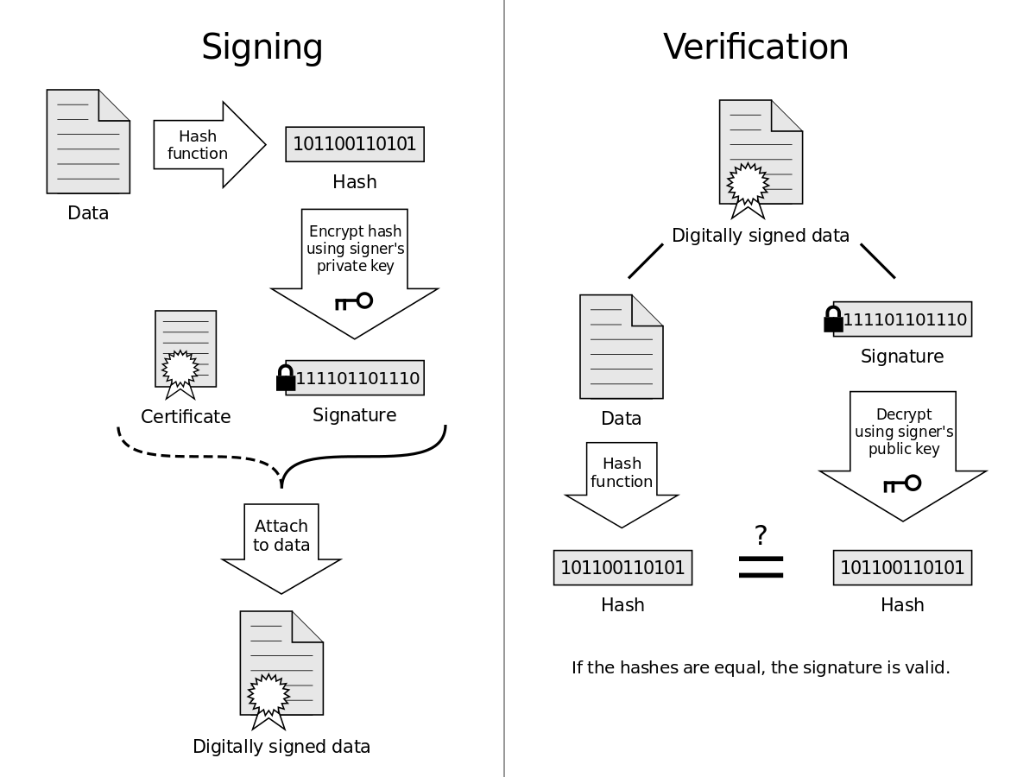
Signing and Verification
Notes:
k - nonce (random)
G - generator
r - random point on the curve
d - private key
z - message hash
-1 - modular inverse

Slide 4

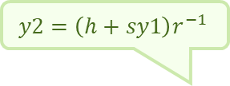


Digital Signature Algorithm (DSA)
p, q are large prime numbers where $p=qa+1$
E.g., $\left(|p|,|q|\right)∈\{(2048,224), (2048, 256), …\}$
$g∈ ℤ_{p}^{∗}$ has order of q, i.e., $g^{q}=1$
Schnorr group is a group generated by g
→ Prevent effective computing of discrete log
Signing message m
Compute message hash: $h=hash\left(m\right)$
if $length(h)>log⁡(q)$ → cut right bits
Choose secret nonce: $r∈ ℤ_{q}^{∗}$
Compute: $y1=\left(g^{r} mod p\right) mod q$
$q^{r}$ computed upfront
Compute: $y2=\left(h+sy1\right)r^{−1} mod q$
$r^{−1}$ computed upfront
Signature: $Y=\left(y1,y2\right)$
in case of $y1=0∨y2=0$try again with a different r
Proof
${(g^{h}v^{y1})}^{y3} mod p) mod q=\left({\left(g^{h}g^{sy1}\right)}^{y3} mod p\right)mod q=\left(\left(g^{\left(h+sy1\right)y3}\right) mod p\right)mod q=$
= $\left(g^{r} mod p\right) mod q=y1$
Key generation:
1. Choose privKey: $s∈ ℤ_{q}^{∗}$
2. Compute pubKey: $v=g^{s} mod p$
Signature verification
$1≤ y1,y2< q$
$y3 =y2^{−1}$
Validate: $\left({\left(g^{h}v^{y1}\right)}^{y3}mod p\right)mod q =y1$
otherwise exposes y
otherwise exposes y
pubKey: $v=g^{s} mod p$
$$y2=\left(h+sy1\right)r^{−1}$$
Notes:
https://en.wikipedia.org/wiki/Digital_Signature_Algorithm
https://cs.wikipedia.org/wiki/Grupa
https://en.wikipedia.org/wiki/Schnorr_group

Slide 5
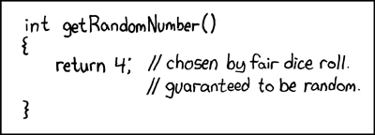
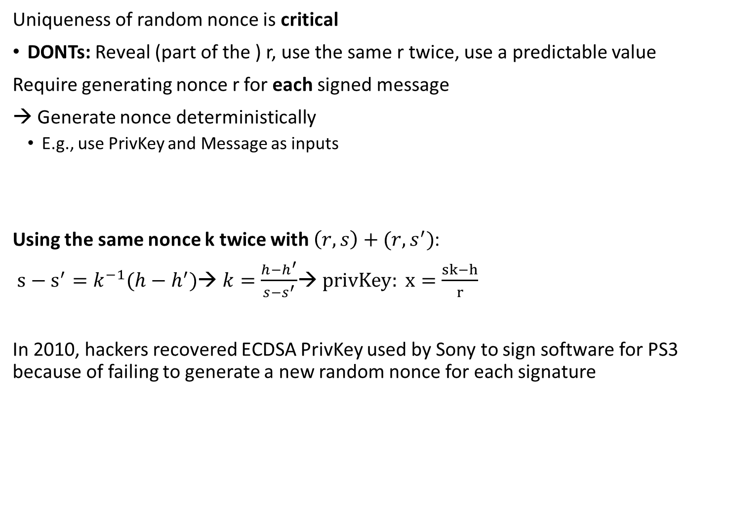



Nonce Generation
Uniqueness of random nonce is critical
DONTs: Reveal (part of the ) r, use the same r twice, use a predictable value
Require generating nonce r for each signed message
→ Generate nonce deterministically
E.g., use PrivKey and Message as inputs
Using the same nonce k twice with $\left(r, s\right)+(r,s^{′})$:
$s−s^{′}=k^{−1}(h−h^{′})$→ $k=\frac{h−h^{′}}{s−s^{′}}$→ $privKey: x=\frac{sk−h}{r}$
In 2010, hackers recovered ECDSA PrivKey used by Sony to sign software for PS3 because of failing to generate a new random nonce for each signature
$$r=g^{k}$$
$$s=\left(h+xr\right)k^{−1}\sim y2=\left(h+sy1\right)r^{−1}$$
$$h=hash(M)$$
Notes:
https://en.wikipedia.org/wiki/Elliptic_Curve_Digital_Signature_Algorithm

Slide 6
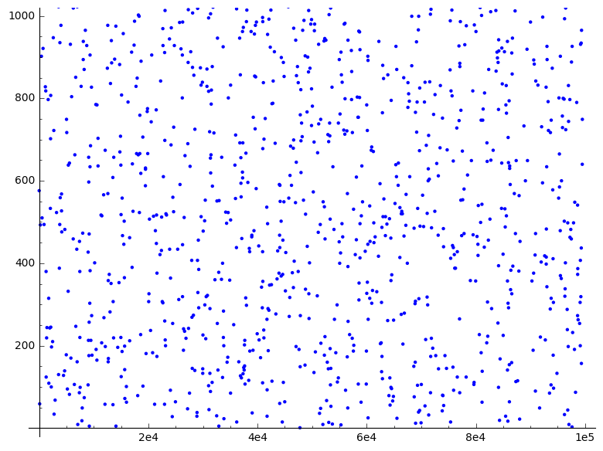
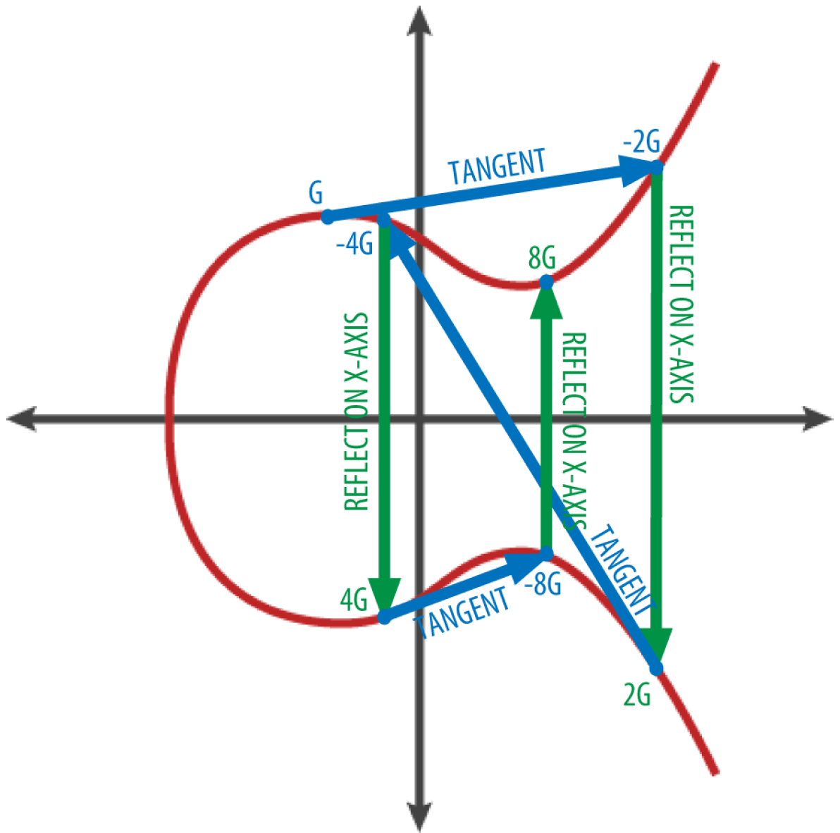
Digital Signatures [overview]
digital signature
asymmetric - one-way functions
based on elliptic curve multiplications
ECDSA - Elliptic Curve Digital Signature Algorithm
y² = x³ + ax + b; x,y,a,b ∈ Z_{p} ↬
pub_key = private_key * G
f(x, y): y² mod p = (x³ + 7) mod p
p = 2²⁵⁶ - 2³² – 2⁹ – 2⁸ – 2⁷ – 2⁶ – 2⁴ – 2⁰
reverse operation
finding the EC discrete logarithm
known as a hard problem
Schnorr Signatures
linear
aggregation of signatures
Taproot 2021 ↬
NDMI100
NMMB212
Notes:
nad konecnym telesem, p = prvocislo
Úvod do kryptografie - Andrew Kozlik / SL
EC: adding a point to itself is the equivalent of drawing a tangent line on the point and finding where it intersects the curve again, then reflecting that point on the x-axis
https://btc-slovnik.cz/pages/crypto.html

Slide 7




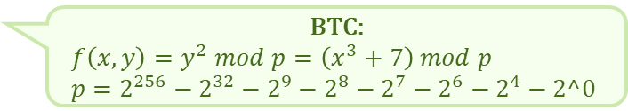

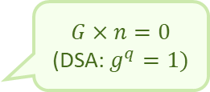
ECDSA (Elliptic Curve Digital Signature Algorithm)
$$G×n=0$$
(DSA: $g^{q}=1)$
Elliptic Curve + DSA
Elliptic Curves
$y^{2}=x^{3}+ax+b;x,y,a,b∈$ $ℤ_{p}^{}$
Signing message m
Compute message hash: $h=hash\left(m\right)$
if $length(h)>log⁡(q)$ → cut right bits
Choose secret nonce: $k∈[1,n−1]$
Calculate curve point $C=\left(x,y\right)=k×G$
Compute: $r=x mod n$
Compute: $s=\left(h+rd\right)k^{−1} mod n$
Signature: $S=\left(r,s\right)$
in case of $r=0∨s=0$try again with a different curve point
Proof
$C=u×G+v×Q=u×G+vd×G=\left(u+vd\right)×G=\left(hs^{−1}+rds^{−1}\right)×G$
$=\left(h+rd\right)s^{−1}×G=\left(h+rd\right){\left(h+rd\right)}^{−1}{\left(k^{−1}\right)}^{−1}×G=k×G$
Key generation: (CURVE, G, n)
Choose privKey: $d∈ℤ_{n}^{}$
Compute pubKey: $Q=d×G$
Signature verification
$1 ≤r,s<n$
Compute $u={hs}^{−1} mod n, v={rs}^{−1} mod n$
Calculate the curve point $(x,y)=u×G+v×Q$
Validate: $r=x mod n$
BTC:
$f\left(x,y\right)=y^{2} mod p=\left(x^{3}+7\right) mod p$
$p=2^{256}−2^{32}−2^{9}−2^{8}−2^{7}−2^{6}−2^{4}−2^0$
pubKey: $Q=d×G$
$$u={zs}^{−1}, v={rs}^{−1}$$
$$s=\left(h+rd\right)k^{−1}$$
Notes:
https://www.karlin.mff.cuni.cz/~kozlik/udk_mat/dl.pdf
https://en.wikipedia.org/wiki/Elliptic_Curve_Digital_Signature_Algorithm
https://btc-slovnik.cz/pages/crypto.html
https://learnmeabitcoin.com/technical/cryptography/elliptic-curve/ecdsa/
nad konecnym telesem, p = prvocislo
Úvod do kryptografie - Andrew Kozlik / SL
EC: adding a point to itself is the equivalent of drawing a tangent line on the point and finding where it intersects the curve again, then reflecting that point on the x-axis

Slide 8
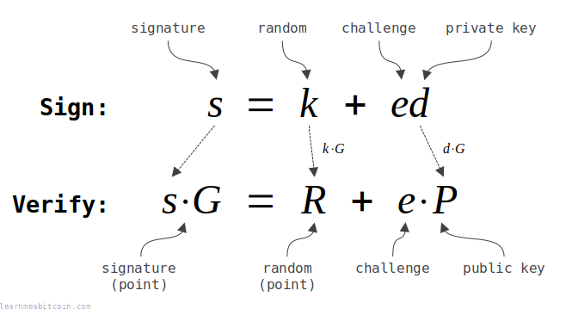
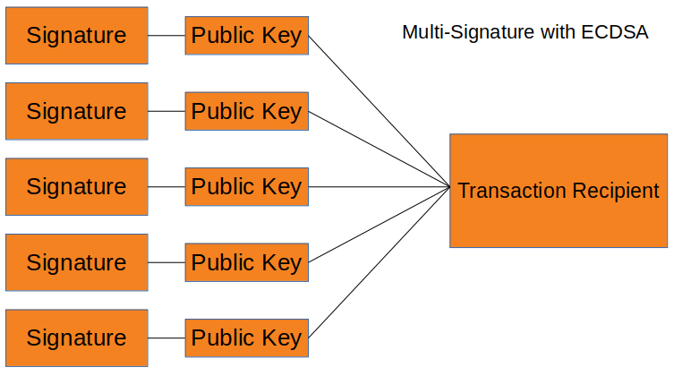
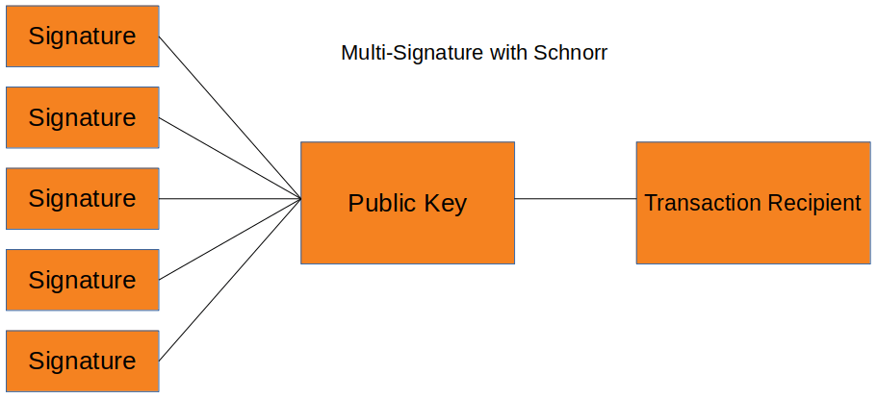
Schnorr Signatures [overview]
Claus Peter Schnorr 1991
US patent until 2008
 June 2025
superior to ECDSA
linear
PubKey = PubKey_{A} + PubKey_{B}
sign = sign_{A} + sign_{B}
key aggregation
multiple signatures ⇝ one signature
complex tx looks like a simple tx
space efficient
tx analysis much more difficult
↬
Notes:
https://learnmeabitcoin.com/technical/cryptography/elliptic-curve/schnorr/
https://en.wikipedia.org/wiki/Schnorr_signature
https://link.springer.com/content/pdf/10.1007/BF00196725.pdf

Slide 9

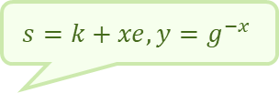

Schnorr Signatures
p, q are large prime numbers $(p=qa+1)$
$g∈ ℤ_{p}^{∗}$ has order of q, i.e., $g^{q}=1$
Schnorr group is a group generated by g
→ Prevent effective computing of d. log
Signing a message M
Choose secret nonce: $k∈ℤ_{q}^{∗}$
Compute $r=g^{k} mod p$
Compute $e=hash\left(r∥M\right)∈ℤ_{q}^{}$
Compute $s=(k+ex) mod q$
Signatures $S=(s,e)$
Proof
$r_{v}=g^{s}y^{e}=g^{k+xe}g^{−xe}=g^{k}=r$→ $e_{v}=hash\left(r_{v}∥M\right)=hash\left(r∥M\right)=e$
Key generation
Choose privKey $x∈ℤ_{q}^{∗}$
Compute pubKey: $y=g^{−x}$
Signature verification
Compute $r_{v}=g^{s}y^{e}$
Compute $e_{v}=hash(r_{v}∥M)$
Validate $e_{v}=e$
concatenation
$$s=k+xe, y=g^{−x}$$
Notes:
https://learnmeabitcoin.com/technical/cryptography/elliptic-curve/schnorr/
https://www.karlin.mff.cuni.cz/~kozlik/udk_mat/dl.pdf

