Slide 1
Computer Systems
Operating systems
Jakub Yaghob

Slide 2
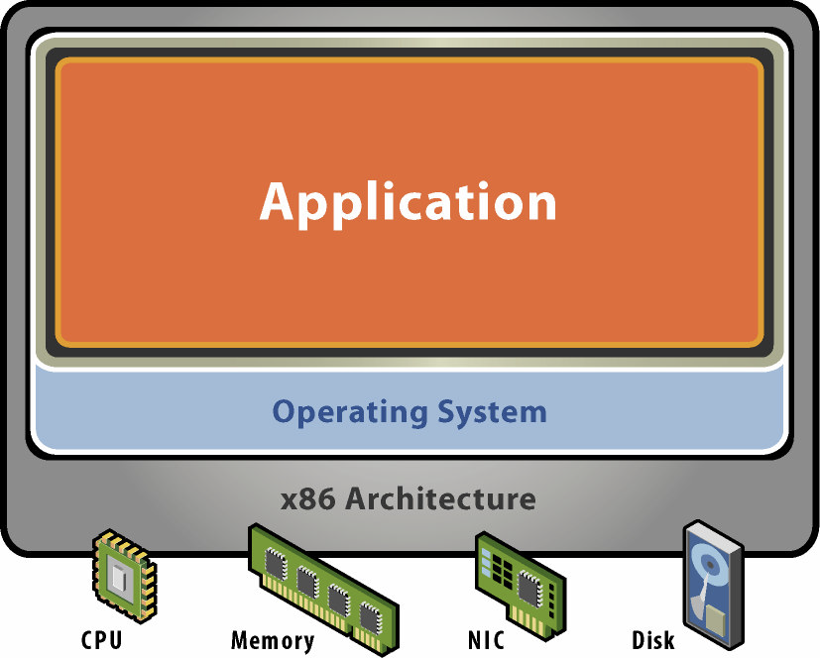
Operating system – role
Abstract machine
  Presented by kernel API
    System calls
  Hide HW complexity
Resource manager
  All HW managed by OS
  Sharing HW among applications

Slide 3
CPU modes
User mode
  Available to all application
  Limited or no access to some resources
    Registers, instructions
Kernel (system) mode
  More privileged
  Used by OS or by only part of OS
  Full access to all resources

Slide 4
Architecture – monolithic
Monolithic systems
  Big mess – no structure
  “Early days”
    Linux
  Collection of procedures
    Each one can call another one
  No information hiding
  Efficient use of resources, efficient code
  Originally no extensibility
    Now able to load modules dynamically
Entry point
Service
proc
Utility
proc

Slide 5
Architecture – layered
Evolution of monolithic system
  Organized into hierarchy of layers
  Layer n+1 uses exclusively services supported by layer n
  Easier to extend and evolve

Slide 6
Architecture – microkernel
Microkernel architecture
  Move as much as possible from the kernel space to the user space
  Communication between user modules
    Message passing
    Client/server
  Extendable
  Secure
  Reliable
Svc 1
Svc 2
App
μKernel

Slide 7
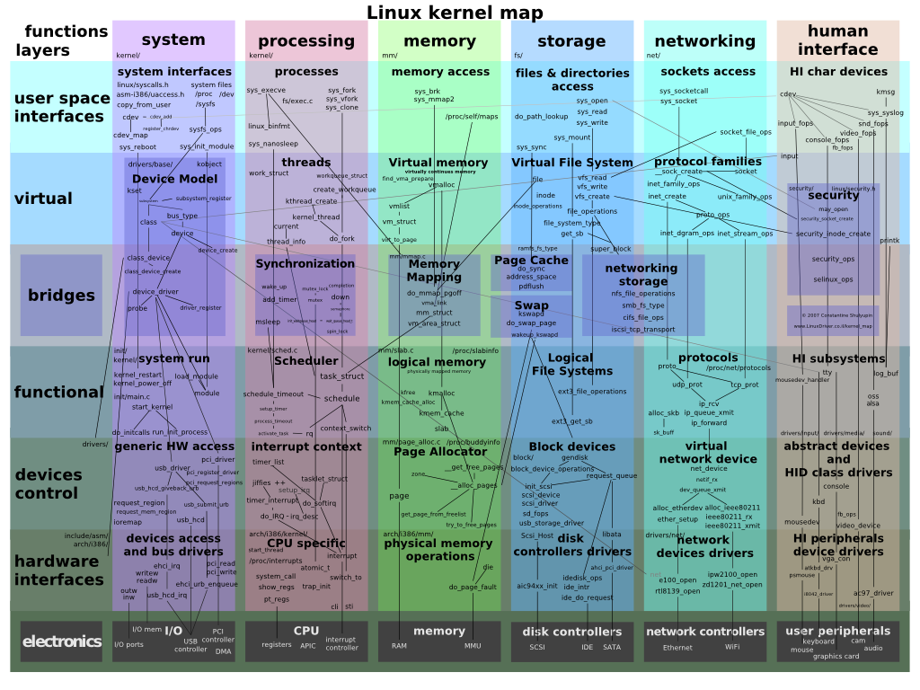
Linux kernel architecture

Slide 8
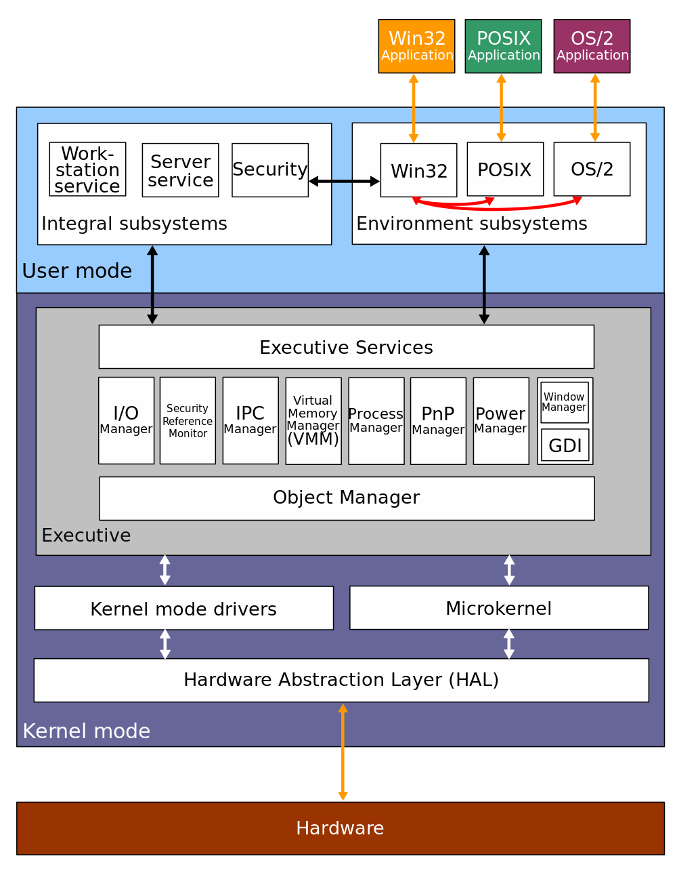
Windows kernel architecture

Slide 9
Devices
Terminology
  Device
    “a thing made for a particular purpose”
  Device controller
    Handles “electrically” connected devices
      Signals on a “wire”, A/D converters
    Devices connected in a topology
  Device driver
    SW component, part of OS
    Abstract interface to the upper layer in OS
    Specific for a controller or a class/group of controllers

Slide 10
Devices topology
Bus
DC
Ring
DC
Dev1
Dev2
Dev3
Dev1
Dev3
Dev2
Tree
DC
Dev1
Dev2
Star
DC
Dev1
Dev2
Hub1
Dev3
Dev4
Dev3
Dev4

Slide 11
Device handling
Application issues an I/O request
Language library makes a system call
Kernel decides, which device is involved
Kernel starts an I/O operation using device driver
Device driver initiates an I/O operation on a device controller
Device does something
Device driver checks for a status of the device controller
When data are ready, transfer data from device to the memory
Return to any kernel layer and make other I/O operation fulfilling the user request
Return to the application
User I/O libraries
User
Device independent
I/O
Kernel
Device
driver
Device
driver
Device
controller
Device
controller
HW
Device
Device

Slide 12
Device intercommunication
Polling
  CPU actively checks device status change
Interrupt
  Device notifies CPU that it needs attention
  CPU interrupts current execution flow
  IRQ handling
  CPU has at least one pin for requesting interrupt
DMA (Direct Memory Access)
  Transfer data to/from a device without CPU attention
  DMA controller
  Scatter/gather

Slide 13
Interrupt types
External
  HW source using an IRQ pin
  Masking
Exception
  Unexpectedly triggered by an instruction
  Trap or fault
  Predefined set by CPU architecture
Software
  Special instruction
  Can be used for system call mechanism

Slide 14
Interrupt request handling
What happens, when an interrupt occurs?
  CPU decides the source of the interrupt
    Predefined
    IRQ controller
  CPU gets an address of interrupt handler
    Fixed
    Interrupt table
  Current stream of instructions is interrupted, CPU begins execution of interrupt handler’s instructions
    Usually between instructions
    Privilege switch usually happens, interrupt handler is part of a kernel
  Interrupt handler saves the CPU state
  Interrupt handler do something useful
  Interrupt handler restores the CPU state
  CPU continues with original instruction stream
IRQ
controller
#INT
INT
CPU

Slide 15
Processing
Program
  A passive set of instruction and data
  Created by a compiler/linker
Process
  An instance of a program created by OS
  It contains program code and data
    Process address space
  The program is “enlivened” by an activity
    Instructions are executed by CPU
  Owns other resources
Thread
  One activity in a process
  Stream of instructions executed by CPU
  Unit of kernel scheduling
Fiber
  Lighter unit of scheduling
  Cooperative scheduling
    Running fiber explicitly yields
Code
T1
T2
Static data
Stack for thread 1
Stack for thread 2
Heap

Slide 16
Processing
Scheduler
  Part of OS
  Uses scheduling algorithms to assign computing resources to scheduling units
Multitasking
  Concurrent executions of multiple processes
Multiprocessing
  Multiple CPUs in one system
  More challenging for the scheduler
Context
  CPU (and possibly other) state of a scheduling unit
    Registers (including PC)
Context switch
  Process of storing the context of a scheduling unit, which is now paused, and restoring the context of another scheduling unit, which resumes its execution

Slide 17



Real-time scheduling
Real-time scheduling
  RT process has a start time (release time) and a stop time (deadline)
  Release time – time at which the process must start after some event occurred
  Deadline – time by which the task must complete
    Hard – no value to continue computation after the deadline
    Soft – the value of late result diminishes with time after the deadline

Slide 18
Unit of scheduling state
Created
  Awaits admission
Terminated
  Until parent process waits for result
Ready
  Wait for scheduling
Running
  CPU assigned
Blocked
  Wait for resources
Created
Terminated
(zombie)
Running
Ready
Blocked

Slide 19
Multitasking
Cooperative
  OS does not initiate context switch
  Unit of scheduling must explicitly and voluntarily yield control
  All processes must cooperate
  Scheduling in OS reduced on starting the process and making context switch after the yield
Preemptive
  Each running unit of scheduling has assigned a time-slice
  OS needs some external source of interrupt
    Timer
  If the unit of scheduling blocks or is terminated before the time-slice ends, nothing interesting will happen
  If the unit of scheduling consumes the whole time-slice, it will be interrupted by the external source, OS will make context switch, and the unit of scheduling is moved to the READY state

Slide 20
Scheduling
Objectives
  Maximize CPU utilization
  Fair allocation of CPU
  Maximize throughput
    Number of processes that complete their execution per time unit
  Minimize turnaround time
    Time taken by a process to finish
  Minimize waiting time
    Time a process waits in READY state
  Minimize response time
    Time to response for interactive applications

Slide 21
Scheduling – priority
Priority
  A number expressing the importance of the process
  Unit of scheduling with greater priority should be scheduled before unit of scheduling with lower priority
  Static priority
    Assigned at the start of the process
      Users hierarchy or importance
  Dynamic priority
    Adding fairness to the scheduling
    The priority of the process is the sum of a static priority and dynamic priority
    Once in a time the dynamic priority is increased for all READY units of scheduling
    The dynamic priority is initialized to 0 and is reset to 0 after the unit of scheduling is scheduled for execution

Slide 22
Scheduling algorithms – non-preemptive
First Come, First Serve (FCFS)
  Simple queue, process enters the queue on the tail, the head process has CPU assigned and runs, then is removed from the queue
Shortest Job First
  Maximizes throughput
  Expected job execution time must be known in advance
Longest Job first

Slide 23
Scheduling algorithms – preemptive
Round Robin
  Like FCFS, there is a queue
  Each unit of scheduling has assigned time-slice
  If the unit of scheduling consumes whole time-slice or is blocked, it will be assigned to the tail of the queue
CPU
US
US
US
US

Slide 24
Scheduling algorithms – preemptive
Multilevel feedback-queue
  Multiple queues
    Each level has assigned greater time-slice
  If the unit of scheduling consumes the whole time-slice, it will be assigned to the lower queue
  If the unit of scheduling blocks before consuming the whole time-slice, it will be assigned to the higher queue
  Schedule head unit of scheduling from the highest non-empty queue
CPU
US
US
US
US
US
US
US
US
US
US
US
US

Slide 25
Scheduling algorithms - preemptive
Completely fair scheduler (CFS)
  Implemented in Linux kernel
  Processes are in red-black tree
    Indexed by execution time
  Maximum execution time
    Time-slice calculated for each process
    The time waiting to run divided by the total number of processes
  Scheduling algorithm
    The leftmost node is selected (lowest execution time)
    If the process completes its execution, it is removed from scheduling
    If the process reaches its maximum execution time or is somehow stopped or interrupted, it is reinserted into the tree based on its new execution time

Slide 26
File
File
  Collection of related information
    Stored on secondary storage (?)
    Abstract stream of data
  Operations
    Open, close, read, write, seek
  Access
    Sequential, random
  Type
    Extension
  Attributes
    Name, timestamps, size, access, …

Slide 27
File directory
Directory
  Collection of files
    Efficiency – a file can be located more quickly
    Naming – better navigation for users
    Grouping – logical grouping of files
  Usually represented as a file of a special type
  Store file attributes
  Hierarchy or structure
    Root
  Operations
    Create/delete/rename file/subdirectory
    Search for a name
    List members

Slide 28
File system
File system
  Controls, how and where data are stored
  Creates an abstraction for files and directories
  Responsibility
    Name translation
    File data location
    Free blocks management
      Bitmap, linked list
  Local file system
    Stored on HDD, SSD, removable media
    FAT, NTFS, ext234, XFS, …
  Network file system
    Access to files/directories over a network stack
    NFS, CIFS/SMB, …

Slide 29
FAT
File Allocation Table (FAT)
  Simple, old, MS-DOS, many variants used today
  One structure (FAT) for managing free blocks and file data location
  Directory
    Sequence of entries with fixed size and attributes
      Starting cluster, name+ext, size, timestamps, attributes
    Root in fixed position
Directory
FAT
Boot record
FAT1
a.txt
2
0
3
10
4
0
5
-1
13
6
0
7
0
8
5
9
0
FAT2
b.txt
3
10
15
11
0
12
0
13
8
Root directory
14
-1
15
14
16
0
17
0
Data

Slide 30
ext2
Second extended file system (ext2)
  Simple, old, Linux
  Inode (index node)
    Represents one file/directory
  Directory
    Sequence of entries with fixed structure
      Inode, name
Data
block
Superblock
Info
Boot record
Descriptor
Data
block
Block group 0
Block 0
Data
block
Data bitmap
Inode bitmap
Block 1
Block group 1
Data
block
Inode table
Block 11
Data block
Block 12 (I)
Block 0
Data
block
Block group N
Block 13 (DI)
Block 14 (TI)
Block 127

Slide 31
Hard disc mechanics
arm
track
spindle
sector
platter
RW head
Other names
  Block – the same sector on all platters
  Cluster – the same track on all platters
  Flying height – distance between head and platter (~5 nm)
  Rotational speed – 5400, 7200, 10k, 15k rpm

Slide 32
Disk scheduling algorithms
What?
  Scheduling of I/O requests for the disk
  Originally done by OS, now by disk itself
Why?
  Disk access time = Seek Time + Rotational Latency + Transfer time
    Seek Time – time to locate the arm to a track (~ms)
    Rotational latency – time to rotate a sector to the fixed position of heads
    Transfer time – time to transfer data
  Minimize disk access time for multiple I/O requests
Examples
  All algorithms demonstrated with the same pattern of I/O requests and initial position
    I/O requests - 82, 170, 43, 61, 24, 16, 190
    Initial position - 50

Slide 33
Disk scheduling algorithms
FCFS
  First Come First Served
  Pros
    Fair chance for all requests
    Simple, good for light load
  Cons
    No optimization – usually not the best
0
16
24
43
50
61
82
170
190
199

Slide 34
Disk scheduling algorithms
SSTF
  Shortest Seek Time First
  Pros
    Average access time decreases
    Increased throughput
  Cons
    Possible starvation for distant requests, when new short seek requests arrive
0
16
24
43
50
61
82
170
190
199

Slide 35
Disk scheduling algorithms
SCAN
  Elevator
    Has direction
  Pros
    High throughput – good for heavy loads
    Low variance in access time
  Cons
    Long waiting times for new request just visited by the arm
0
16
24
43
50
61
82
170
190
199

Slide 36
Disk scheduling algorithms
CSCAN
  Circular SCAN
  Pros
    More uniform time compared to SCAN
0
16
24
43
50
61
82
170
190
199

Slide 37
Disk scheduling algorithms
LOOK/CLOOK
  Like SCAN/CSCAN but does not visit ends of the disk
FSCAN
  Two queues
  Compute algorithm only for 1st queue, new requests are inserted to the 2nd one
0
16
24
43
50
61
82
170
190
199

Slide 38
Virtual memory
Basic concepts
  All memory accesses from instructions work with virtual address
    Virtual address space
    Even instruction fetch
  Operating memory provides physical memory
    Physical address space
    Always 1-dimensional
    Memory controller uses physical addresses
  Translation mechanism
    Implemented in HW (MMU)
    Translates a virtual address to a physical address
    The translation (mapping) may not exist
      Exception
    Two basic mechanisms – segmentation, paging

Slide 39
Virtual memory
VAS = process address space
PAS = available memory
Code
Constants
VA
Initialized static data
Uninitialized static data
MMU
Stack for thread 1
PA
Stack for thread n
Heap

Slide 40
Virtual memory
Why?
  More address space
    VAS can be larger then PAS
      IA-32 can have larger PAS then VAS
    Add a secondary storage as a memory backup/swap
    This is no longer the primary reason today
  Security
    Process address space separation
    “Separation” of logical segments in a process address space

Slide 41
Segmentation
Concepts
  Virtual (process) address space divided into logical segments
  Segments are numbered
  Virtual address has two parts
    [segment number; segment offset]
    Offsets 0-based for each segment
  Segment table
    In memory, for each process
    Stores base physical address, length, and attributes for each segment
    Indexed by the segment number
    Segment fault
Code
Seg table
Constants
VA
offs
Heap
seg
offs
Constants
offs
Initialized static data
+
Uninitialized static data
Stack for thread
BPA
Stack for thread
Code
len
Heap

Slide 42
Paging
Concepts
  VAS divided into equal parts
    Page, 2^{n} size
  PAS divided into equal parts
    Frame, equal size with page
  VA 1-dimensional
  Page table
    In memory, for each process
    Indexed by a page number
    Each entry contains a frame number and attributes (P)
    Page fault
0
0
1
Physical address
1
2
Virtual address
P-1
n-1
0
N-1
n-1
0
f
offs
f
offs
p
offs
p
offs
f
2^{N-n}-1
2^{P-n}-1

Slide 43
Page table – 1-level
0
1
0
2
1
2
14
456
17
123
17
222
1111
NA
456
3333
222
Page fault
2^{P-n}-1
2^{N-n}-1
2^{N-n}-1

Slide 44
Page table – problems
Size
  1-level page table, 32-bit VA/PA, 4k pages/frames (12 bits)
    Size of the page table entry?
    Size of the page table?
  Do we really need the whole VA?
  Multilevel page tables
    1st level always in memory
    Other levels can be missing
Speed
  Each memory access from an instruction means at least one other memory access to the page table
  TLB (Translation Lookaside Buffer)
    Associative memory
    Cache for translating page number to a frame number
    0-level page tables

Slide 45
Page table – 2-level
Virtual address
31
21
11
0
PT index 1
PT index 2
offset
10
PT1
10
PT2
PTAR
offs
4k
4k
1024 entries
4k
1024 entries

Slide 46
Page table – real AMD64 example

Slide 47
Paging – address translation
Steps for address translation
  Take page number from VA, keep offset
  Check TLB for mapping
    If exists, retrieve frame number, otherwise continue
  Go through page table
    Divide page number into multiple PT indices
    Index 1st level PT
      If there is no mapping for 2nd level PT, raise page fault exception
      Retrieve PA for 2nd level PT and continue
    Go through all levels of PTs
      If there is no mapping in any PT level, raise page fault exception
      If all PT levels are mapped, retrieve frame number
    Save retrieved mapping to TLB
  Update A and D bits in page table/TLB
  Assemble PA by “gluing” the retrieved frame number and the original offset from VA

Slide 48
Paging – page fault exception handling
An instruction raises the page fault exception
OS interrupt handler
Determine the cause of the fault
  Unauthorized access
    Out of allocated virtual space
    Store to R/O page, access to kernel memory
  Valid address but not mapped
Create mapping
  Find a free frame
    Either there is one unoccupied
    Or find a victim
      Page replacement algorithms
      Save dirty victim frame
      Remove mapping from TLB
  Load content to the free frame
  Construct/fill corresponding page tables
Return back from handler and retry the instruction

Slide 49
Page replacement algorithms
Using
  Any situation, when you need to find a victim from a limited space
  Frames, TLB, cache, …
Optimal page algorithm
  Replace the page that won’t be used for the longest period of time
  Lowest page-fault rate
  Theoretical, we don’t have an oracle for foretelling the future

Slide 50
Page replacement algorithms
Clock
  Frames organized in a circular manner
  Clock hand points to the next frame to replace
  If the frame has A!=0, set A=0 and advance the hand
  If the frame has A==0, select this frame
0
A=0
A=1
5
1
A=1
A=0
A=1
4
2
A=0
A=0
3
A=1

Slide 51
Page replacement algorithms
NRU
  Not Recently Used
  Clear A bits periodically
  Use A and D bits to classify frames into four classes
  Select random frame from the lowest non-empty class
Class | A | D
0 | 0 | 0
1 | 0 | 1
2 | 1 | 0
3 | 1 | 1

Slide 52
Page replacement algorithms
LRU
  Least Recently Used
  Use the recent past as a prediction of the near future
  Replace the page that hasn’t been referenced for the longest time
  Existing HW implementations
    Cache
    Bit matrix
  SW implementation
    Stack
    Too complicated and space consuming
    Use an approximation

Slide 53
Page replacement algorithms
NFU
  Not Frequently Used
  Each frame has a counter
  Periodically scan page table and increase the counter for a frame, when A==1
    Always clear A
  Select the frame with lowest counter
  Problem: frames that were previously heavy used will never be selected
  Aging
    Periodically divide counters by 2

Slide 54
Advanced paging
Shared memory
  Part of a virtual memory space shared amongst processes
    The block is probably placed on different starting virtual address
Memory-mapped files
  File as a backing store for paging
  Direct access to the file content using CPU instructions
  Problems with file size and with appending data
File
VAS1
VAS2
VAS
PAS
PT1
PT2

Slide 55
Virtual machine and containers
VM = Emulation of a computer system
  Full virtualization
    Substitute for a real machine, allows execution of entire OS
    Hypervisor shares real HW, native execution, virtual HW
    Isolation, encapsulation, compatibility
  Process VM
    Runs as an application inside OS
    Provides platform-independent programming environment
      Abstract machine (instructions, memory, registers, …)
      Java VM, .NET CLR
    Slow execution
      JIT, AOT
Container = OS-level virtualization
  OS kernel allows existence of multiple isolated user space instances

Slide 56
Physical machine
Physical HW
  CPU, RAM, disks, I/O
  Underutilized HW
SW
  Single active OS
  OS controls HW

Slide 57
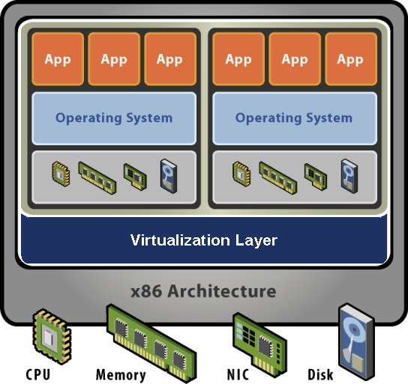
Virtual machine
HW-level abstraction
  Virtual HW: CPU, RAM, disks, I/O
Virtualization SW
  Decouples HW and OS
  Multiplexes physical HW across multiple guest VMs
  Strong isolation between VMs
  Manages physical resources, improves utilization
  Encapsulation – VM represented as a set of files, can be easily distributed

