Slide 1
Data
NSWI153 - Advanced Programming of Web Applications
2025/2026
Petr Škoda
https://github.com/skodapetr
https://www.ksi.mff.cuni.cz

Slide 2
Data storage
Where can / should you store application data?
MSSQL / MySQL / Oracle / …
Relational database
NoSQL database
On-premise
Cloud (IaaS, PaaS, SaaS, DBaaS)
architecture / design / …
Notes:
Resources:
https://docs.microsoft.com/en-us/azure/azure-sql/database/sql-database-paas-overview?view=azuresql

Slide 3
Case-study: Open data portal catalog
Virtuoso (SPARQL)
Linked Data Fragments
Apache Solr
CouchDB
Memory
(GraphQL)
API
Notes:
Resources:
https://data.gov.cz/datové-sady
https://solr.apache.org/
https://couchdb.apache.org/

Slide 4
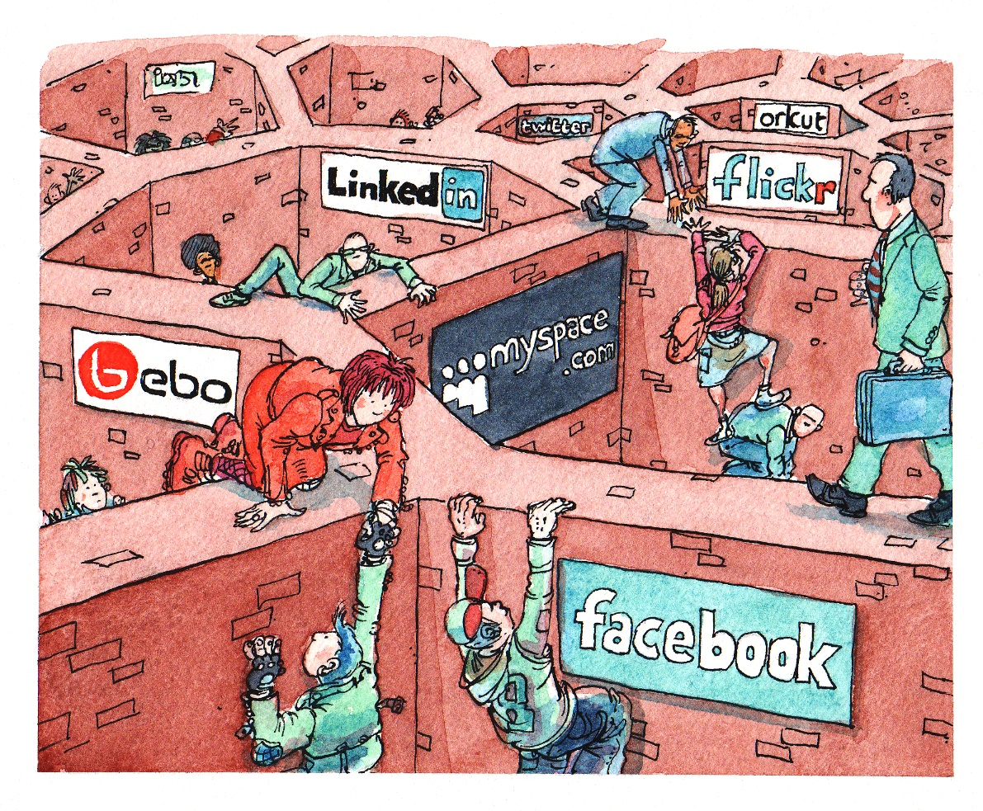
Motivation
Data coupled with applications
Data silos
Glory of REST
NSWI144 - Data on the Web
Who is in charge?
Programmer
Developer
Software Engineer
Data Engineer
Notes:
Resources:
https://www.w3.org/2010/Talks/0303-socialcloud-tbl/#(2)

Slide 5
Semantic web
The Semantic Web, sometimes known as Web 3.0, is an extension of the World Wide Web through standards set by the World Wide Web Consortium (W3C).
The goal of the Semantic Web is to make Internet data machine-readable.
Schema.org
Schema.org is a collaborative, community activity with a mission to create, maintain, and promote schemas for structured data on the Internet, on web pages, in email messages, and beyond.
We can store data in a webpage using Microdata or JSON-LD.
Employ URL for resources instead of documents (RDF).
Notes:
Resources:
https://en.wikipedia.org/wiki/Semantic_Web
https://schema.org/

Slide 6
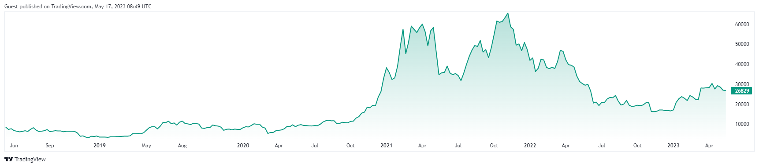
Decentralization
Centralized Internet
SOLID (Tim Berners-Lee)
Web 3.0 / 2.5 / ..
OpenPGP (web of trust)
Resource Description Framework(RDF)
URL as a data identifier
Blockchain
This is not an investment recommendation!
Notes:
Resources:
https://cryptography.fandom.com/wiki/Web_of_trust

Slide 7

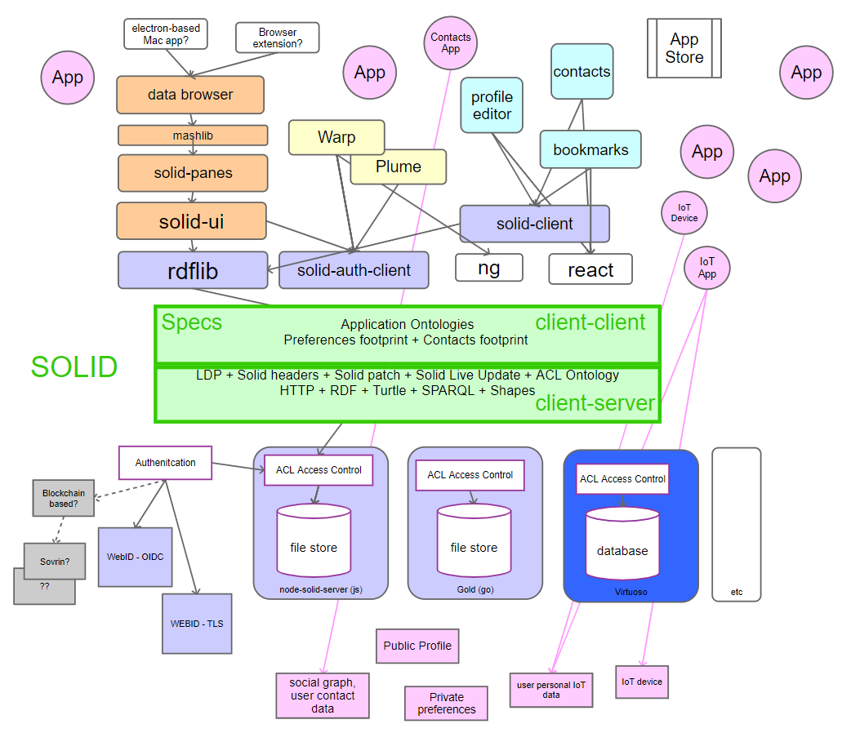
Data/Document storage
SOLID (SOcial LInked Data)
Set of conventions and tools
Decoupling of data from applications
User choice (Pods)
Dereferenceable, REST API, SPARQL
Application profiles
Technology
RDF, SPARQL, Linked Data Platform, Linked Data Notifications, WebID, WebID ACLs, WebID-TLS, WebID-OIDC, FOAF, Schema.org, …
Notes:
Resources:
https://solidproject.org/
https://rawgit.com/solid/solid/master/diagrams/solid-architecture.svg

Slide 8
File System
InterPlanetary File System (IPFS)
Location-based vs Content-based addressing
Cryptographic hash of the content.
InterPlanetary Name System (IPNS)
DNSLink
Database
// Listen for updates from peers
db.events.on("replicated", address => {
console.log(db.iterator({ limit: -1 }).collect())
})
// Add an entry
const hash = await db.add("world")
console.log(hash)
// Query
const result = db.iterator({ limit: -1 }).collect()
console.log(JSON.stringify(result, null, 2))
const ipfs = await IPFS.create()
const orbitdb = await OrbitDB.createInstance(ipfs)
// Create / Open a database
const db = await orbitdb.log("hello")
await db.load()
Notes:
Resources:
https://ipfs.io/
https://filecoin.io/blog/posts/introducing-web3-storage/
https://www.youtube.com/watch?v=94HH5D23WWI
https://www.pinata.cloud/
https://github.com/orbitdb/orbit-db
https://docs.textile.io/threads/

Slide 9
Decentralized application (DAPP) 1 / 2
Smart Contracts
Runs on Ethereum blockchain
Solidity / Vyper / …
Accessible and transparent
contract Coin {
address public minter;
mapping (address => uint) public balances;
constructor() { minter = msg.sender; }
function mint(address receiver, uint amount) public {
require(msg.sender == minter);
balances[receiver] += amount;
}
...
emit Sent(msg.sender, receiver, amount);
…
}
Coin.Sent().watch({}, '', function(error, {args}) {
console.log("Coin transfer " +
args.from + " -> " +args.to);
console.log("Balances now:\n" +
"Sender: " + Coin.balances.call(args.from) +
"Receiver: " + Coin.balances.call(args.to));
});
Notes:
Resources:
https://ethereum.org/en/smart-contracts/
https://ethereum.org/en/developers/docs/smart-contracts/
https://docs.soliditylang.org/en/latest/introduction-to-smart-contracts.html
https://github.com/ChainSafe/web3.js

Slide 10
Decentralized application (DAPP) 2 / 2
Use cases:
DEcentralized Finance
NFTs
Gaming
Web 3.0
Why
Decentralization
Censorship resistant
Trustless
Transparency
ERC-20 Tokens build on Smart contracts
often Ether.
Application
Backend - Smart Contracts
(hardhat, ..)
Frontend - JS, CSS, HTML, ..
(web3.js)
Notes:
Application:
httsp://uniswap.org
https://github.com/Uniswap
https://etherscan.io/ - we can see contracts for given coins there
https://www.openzeppelin.com/
https://www.argent.xyz/ - Best application for block chain is a wallet …
Developer:
https://hardhat.org/ - Framework
https://trufflesuite.com/ - Framework
https://web3js.org/#/ - Library for communicating with Smart contracts
https://github.com/ethers-io/ethers.js - Library for communicating with Smart contracts
https://trufflesuite.com/ganache/ - Your local bock chain

