Slide 1
Browser APIs
NSWI153 - Advanced Programming of Web Applications
2025/2026
Petr Škoda
https://github.com/skodapetr
https://www.ksi.mff.cuni.cz

Slide 2
Showcase
HTML5TEST
html5test.com (dead)
html5test.co

Slide 3
Navigation
Location Object
Parsed URL (host, pathname, hash, .. )
assign(…), reload(…), replace(…)
Window Object
open(url, target, windowFeatures)
onload
onbeforeunload
onunload
location
addEventListener(load', event => { });
window.onload = event => { };
document.location === window.location
Notes:
Source:
https://developer.mozilla.org/en-US/docs/Web/API/Window/location
https://developer.mozilla.org/en-US/docs/Web/API/Location

Slide 4
History
The Concept of History
Inherited from original browsing concept.
The user reads a page, then browses on another page.
Not entirely suitable for modern web applications.
State (view) of the application may change, yet the browser is still on the same page
History object
back(…), forward(…), go(…), …
pushState(state, unused, url)
repalceState(stateObj, unused, url)
state
Window Object
history
onpopstate
Notes:
Source:
https://medium.com/javascript-dots/how-to-use-history-api-on-javascript-401e4673cd5f

Slide 5
Web pages
Visibility API
Document.visibilityState
Document.onvisibilitychange
Scrolling:
Element.scrollIntoView(…)
Element.scrollTo(…)
Element.scrollBy(..,)

Slide 6
Multiple windows / tabs
State
Session-specific state
Application-wide intermediate state
Application-wide persisted state
Window Messaging
Window.onmessage
Window.postMessage(…)

Slide 7
Mouse and pointer
Capturing Mouse Movement
Special cases of dragging mouse gesture
Continuous delivery of mouse events
Element.setCaputure(…)
Deprecated: This feature is no longer recommended
Element.setPointerCapture(…)
Element.releasePointerCapture(…)
Locking the Mouse Pointer
The pointer gets locked within one element
The cursor is hidden
Element. requestPointerLock(…)
Experimental
Document.exitPointerLock(…)
Screen
Element.requestFullscreen(…)

Slide 8
Text
Text Selection
Operate on ranges
  rangeCount, getRangeAt(…),
  addRange(…), removeRange(…),
  removeAllRanges()
Document.getSelection()
Start : anchorNode, anchorOffset
End: focusNode, focusOffset
Clipboard
Navigator.clipboard
Promised base API
Permission "clipboard-read"
Clipboard.read(…)
Clipboard.readText(…)
Clipboard.write(…)
Clipboard.writeText(…)
Document.execCommand()
Deprecated

Slide 9
Showcase
Code editor
CodeMirror
Ace
Monaco

Slide 10
Portable devices
Screen Orientation
Screen.orientation
type, angle, onchange, …
Ambient Light
AmbientLightSensor
Vibration
Navigator.vibrate(…)
[100,30,100,30,100,30,200,30,200,30,200,30,100,30,100,30,100]

Slide 11
Geolocation
The best means available
Public IP geolocation information
WiFi networks in the vicinity and their signal strengths
GSM/CDMA cell identifiers
Embedded GPS locator
Geolocation API
Navigator.geolocation
Geolocation.getCurrentPosition(…)
TimeStamp, GeolocationCoordinates
Geolocation.watchPosition(…)
Geolocation.clearWatch(…)

Slide 12
Web notifications
Web Notifications API
Displayed outside the page at system level
Notification.permission
Notification.requestPermision()
new Notification(…)
new Notification(
'To do list', {
body: ‘Long notification text',
icon: ‘./images/icon.png'
});

Slide 13
Multimedia
Animation Frames
Window.requestAnimationFrame(callback)
Window.cancelAnimationFrame(…)
Video
<video>
Accessibility concerns
Audio
<audio>
Web Audio API
<video controls width="250">
<source
src="/media/flower.webm"
type="video/webm">
<source
src="/media/flower.mp4"
type="video/mp4">
Sorry, your browser doesn't support embedded videos.
</video>

Slide 14
Canvas
HTML 5 element for JS drawing
Can be sized using CSS
with, height define resolution of the viewport
Canvas is cleared when resized.
Canvas context (2D, webGL)
<canvas
id="mycanvas“
width="640“
height="480">
Your browser does not support HTML5 canvas.
</canvas>
const context = mycanvas.getContext("2d");

Slide 15
Canvas 2D
Features:
Drawing rectangles, paths
Setting drawing styles
Color gradients, patterns
Text rendering
Linear transformations
Compositing, clipping paths
Context state stack
Retrieving/drawing image data, saving canvas as image
Drawing images/video on canvas
Libraries:
PixiJS
Paper.js
Fabric.js
two.js
Easel.js
Graphics2D.js
Chart.js
…
OUT OF DATE
Notes:
Source:
https://github.com/plotly/plotly.js/

Slide 16
Canvas WebGL
Web API for OpenGL
Based on OpenGL ES 3.0 specification
'webgl' context
Libraries:
Three.js
…
var gl = canvas.getContext('webgl');
gl.viewport(0, 0, canvas.width, canvas.height);
gl.clearColor(0.0, 0.0, 0.0, 1.0);
...
Notes:
Source:
http://en.wikipedia.org/wiki/List_of_3D_graphics_libraries

Slide 17
Web Cryptography
Encrypting/Decrypting data
Signing data (asymmetric decryption)
Hashing functions (integrity, security tokens, …)
Arsenal of mainstream algorithms
RSA, AES, SHA, …
Web Cryptography API
Crypto
CryptoKey
SubtleCrypto
  encrypt(algorithm, key, data)
  decrypt(…)
  sign(algorithm, key, data)
  verify(algorithm, key, signature, data)
  digest(algorithm, data)

Slide 18
WebSocket Protocol
Extension of HTTP(S) Protocols
Two-way communication
Persistent connections
Layered over TCP or SSL/TLS connection
Defined in detail in RFC 6455
Handshake is compatible with HTTP handshake
Simple message-based communication
User can specify custom sub-protocols
(i.e., the contents and semantics of the messages)

Slide 19
WebSocket example
GET /chat HTTP/1.1
Host: server.example.com
Upgrade: websocket
Connection: Upgrade
Sec-WebSocket-Key: dGhlIHNhbXBsZSBub25jZQ== Origin: http://example.com
Sec-WebSocket-Protocol: chat, superchat
Sec-WebSocket-Version: 13
HTTP/1.1 101 Switching Protocols
Upgrade: websocket
Connection: Upgrade
Sec-WebSocket-Accept: s3pPLMBiTxaQ9kYGz...
Sec-WebSocket-Protocol: chat

Slide 20
WebSocket Protocol FRAME
Data Frames
Message may be fragmented
Text message in UTF8
Binary messages are interpreted only by the application
Control Frames
Close frame initiates graceful connection shutdown
Ping/pong frames verify the connection is still alive
0
4
8
16
32
Ctrl. bits
Op. Code
Mask
Length
Extended Length (if length > 125)
Extended Length (if length == 127)
Extended Length (if length == 127)
Masking Key (if mask == 1)
Masking Key (continuation)
Payload Data
Payload Data
Optional: 2023/2024
Notes:
Ctrl. bits: 0 – final fragment , rest is reserved
Op. code: payload type x0 : continuation frame, x1 : text frame, x2 : binary frame, x3-x7 : reserved (non control), x8 : connection close, x9 : ping, xA : pong, xB-xF : reserved (control)
As of security we can employ SSL/TLS instead of TCP (same as HTTP and HTTPS).
Payload can be masked using XOR. This is to prevent cache-poisoning.
The cache-poisoning attack aims at old (not-well-written) HTTP proxies. It tries to send seemingly legitimate HTTP request from the client and HTTP response from the server inside the web socket protocol (as strings). If a cache interprets the TCP content (despite the fact it is interleaved by Websocket headers), it might get polluted (possibly with malicious content). The browser uses masking to scramble the requests (not cryptographically, just to fool proxies) by random XOR keys, so the attacker cannot prepare data that would seem like a HTTP request.
Fragmentation - First frame defines the type; other frames are defined as continuation frames. Last frame has the appropriate control bit set.

Slide 21
WebSocket API
WebSocket object:
constructor(url, protocols)
send(data)
close(code, reason)
onopen
onmessage
onerror
onclose
// Create WebSocket connection.
const socket = new WebSocket('ws://localhost:8080');
// Listen for messages
socket.addEventListener('message', function (event) {
console.log('Message from server ', event.data);
});

Slide 22
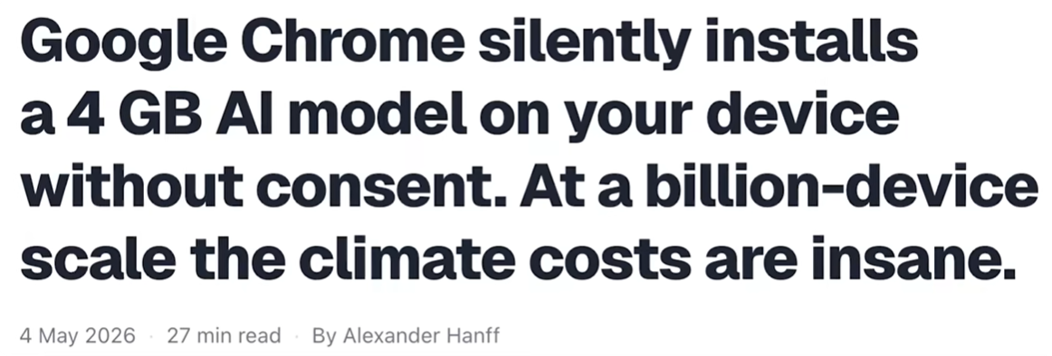
Prompt API

