Slide 1
Write once
Run anywhere
NSWI153 - Advanced Programming of Web Applications
2025/2026
Petr Škoda
https://github.com/skodapetr
https://www.ksi.mff.cuni.cz

Slide 2
Showcase
Is Java/* taking over web applications?
https://znalosti.gov.sk
IDSKHeaderWebNav
PyScript
PyScript Example

Slide 3

Async task from C# with WPF
private async void ButtonClickAsync(
object sender, RoutedEventArgs e)
{
// Modify UI object in UI thread.
txt.Text = "started";
// Run a method in another thread.
await HeavyMethodAsync(txt);
// Modify UI object in UI thread.
txt.Text = "done";
}
internal async Task HeavyMethodAsync(TextBox textBox)
{
textBox.Dispatcher.Invoke(() =>
{
// UI operation goes inside of Invoke
textBox.Text += ".";
});
}

Slide 4
Multiplatform
iOS, Android, Linux, Windows, Web, …
Shared code ~ business logic
Unified experience
Native applications
JavaScript, HTML, and CSS ?
Experience with native development … optional?
Responsive (display) vs Adaptive (inputs)

Slide 5
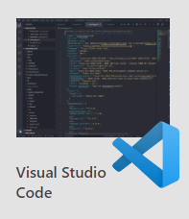
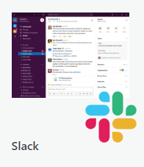
Container 1 / 2
Electron (since 2013)
Electron & Node & Chromium
Linux, macOS, Windows
Built with Electron
Electron Forge (full build pipeline)
npm init
npm install --save-dev electron
npm install --save-dev @electron-forge/cli
npx electron-forge import
npm run make
...
npx create-electron-app@latest my-electron-app
Electron Forge is an all-in-one tool for packaging and distributing Electron applications. It combines many single-purpose packages to create a full build pipeline that works out of the box, complete with code signing, installers, and artifact publishing.
Notes:
Source:
https://www.electronjs.org/
https://www.electronforge.io/

Slide 6

Electron : Developer perspective
Entry point (main.js) is running in Nodejs
Context Isolation : main & renderer
webPreferences.preload
Inter-Process Communication
Web Workers
main.js
const { app, BrowserWindow } = require('electron');
const createWindow = () => {
const win = new BrowserWindow(
{ width: 800, height: 600 });
win.loadFile('index.html’);
}
app.whenReady().then(() => createWindow() });
app.on('window-all-closed', () => { app.quit() });
…
const { contextBridge } = require('electron’);
contextBridge.exposeInMainWorld('myAPI', {
doAThing: () => {},
});
window.myAPI.doAThing();
Notes:
Source:
https://www.electronjs.org/
https://www.electronjs.org/docs/latest/tutorial/context-isolation
https://www.electronjs.org/docs/latest/tutorial/ipc

Slide 7

Showcase
Electron
Governance
Introduction
Notes:
Resources:
https://www.electronjs.org/docs/latest/tutorial/tutorial-first-app

Slide 8

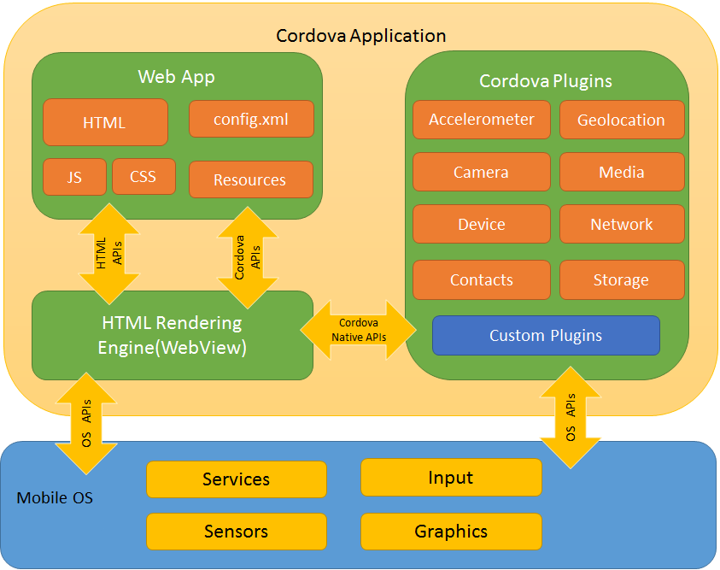
Container 2 / 2
Cordova
Only runtime
HTML5, CSS3, JavaScript
Android, iOS, (OS X), (Windows), Electron
Custom events: pause, backbutton, ..
Ionic
Framework
Custom components
Vue, React, Angular
Notes:
Source:
https://github.com/phonegap
https://cordova.apache.org/
https://ionicframework.com/

Slide 9


Demo
Cordova & Ionic
Migrate from Cordova →
Cordova
Ionic
Ionic Tab Layout
XAML

Slide 10
JavaScript bridge
React Native
React style rendering, JavaScript
React primitives render to native platform UI
Native Modules for access to native API
Part of legacy architecture, next Turbo Native Modules and Fabric Native Components.
There is React Native for Web
import React from 'react';
import {Text, View} from 'react-native';
…
const [text, setText] = useState("");
return (
<View>
<TextInput onChangeText={value => setText(value)} defaultValue={text} />
</View>
);
React Developer != React Native Developer
Notes:
Source:
https://reactnative.dev/
https://reactnativepaper.com/
https://necolas.github.io/react-native-web/docs/

Slide 11

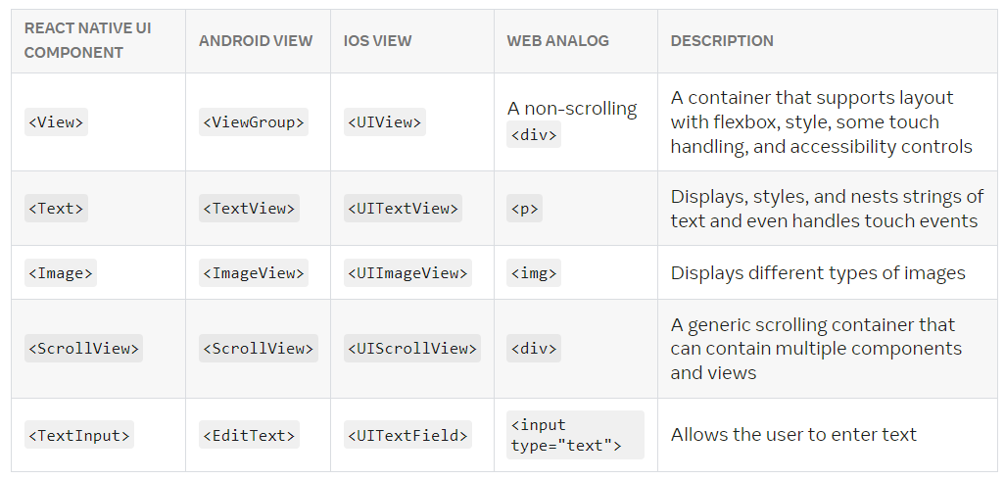
React Native : Components
Selected core components:
Notes:
Resources:
https://reactnative.dev/docs/intro-react-native-components

Slide 12
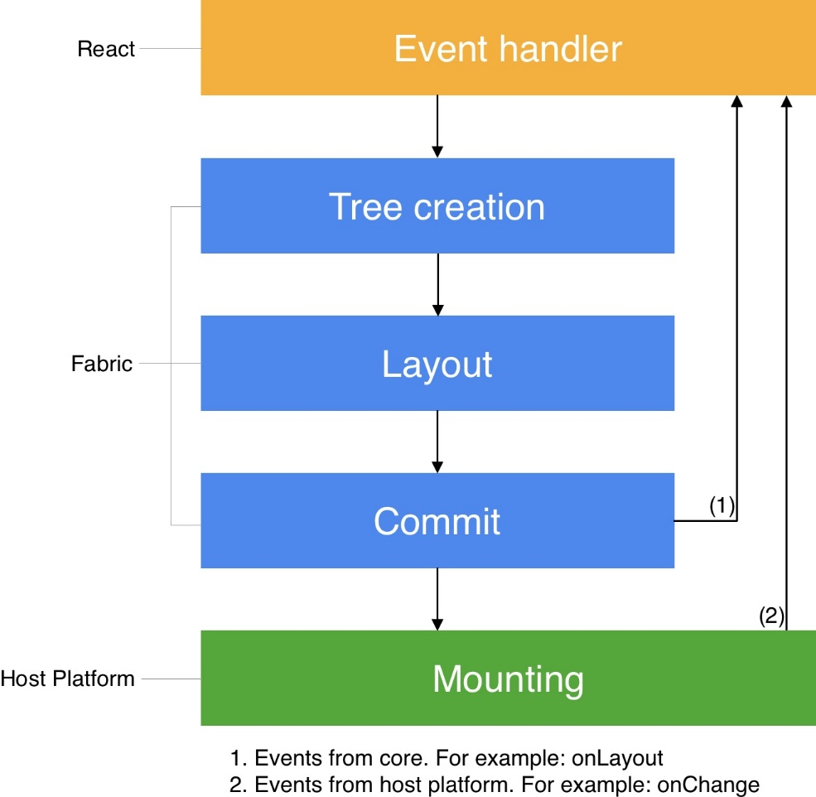
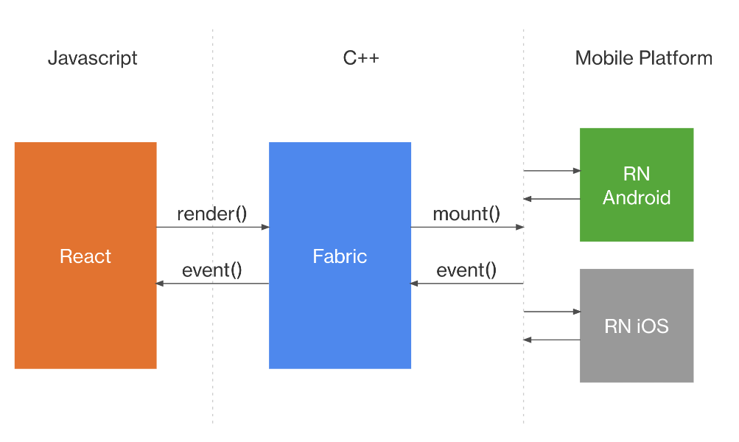
React Native
Rendering system (Fabric) implemented in C++
Render pipeline: render, commit, mount
View Flattening
Threads: UI thread, JavaScript, Background
Notes:
Source:
https://reactnative.dev/architecture/overview
https://www.yogalayout.dev/

Slide 13


Compile to native code
Flutter (since 2017)
Mobile, Web, Desktop, Embedded
Dart compiled to Native Code
Widgets: AppBar, Center, Column, Text, Icon …
pubspec.yaml
Flock (since Oct, 2024)
Flock stays up to date with Flutter, and also adds new community features.
Future<http.Response> fetchAlbum() {
return http.get(Uri.parse('https://localhost:8080/users/001'));
}
Notes:
Source:
https://flutter.dev/
https://getflocked.dev/blog/posts/we-are-forking-flutter-this-is-why/

Slide 14

Flutter 1 / 2
import 'package:flutter/material.dart';
void main() { runApp(const MyApp()); }
class MyApp extends StatelessWidget {
const MyApp({super.key});
@override
Widget build(BuildContext context) {
….
}
}
return MaterialApp(
title: 'Welcome to Flutter',
home: Scaffold(
appBar: AppBar( title: const Text('Welcome to Flutter’) ),
body: Column(
children: [
Center( child: Text('Hi!’) ),
ElevatedButton (
onPressed: () { …. },
child: Text('Next’),
),
],
),
),
);

Slide 15
Flutter 2 / 2
Stateful / Stateless components in the build function.
State extracted to State class.
ChangeNotifier / ChangeNotifierProvider / Consumer
return ChangeNotifierProvider(
create: (context) => MyState(),
child: …
)
My App
class MyState extends ChangeNotifier {
var current = WordPair.random();
void getNext() {
current = WordPair.random();
notifyListeners();
} }
Page
Watches & Uses
var appState = context.watch<MyState>();
…
Text(appState.current.asLowerCase
…
appState.getNext()
Widget
Widget

Slide 16
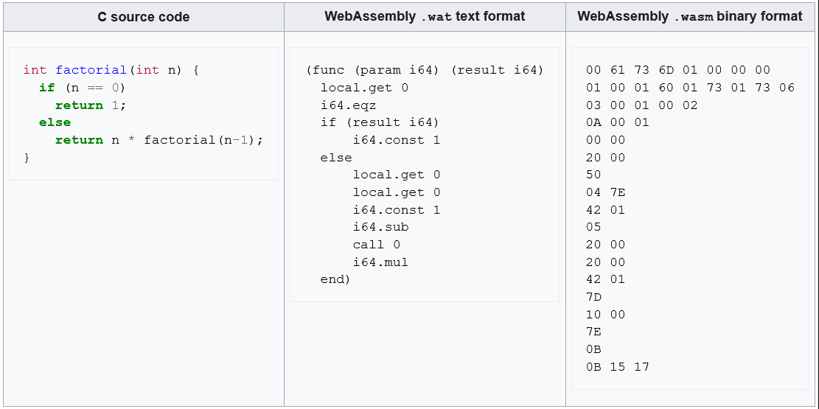

WebAssembly : going native fast ..
WebAssembly (Wasm) is an open specification for portable executables for stack-based virtual machine. The standard specify the binary file format (*.wasm) and text format (*.wat). The first one aims to be executed by web browsers at near-native speed. The second is human readable ...
Deprecated
Notes:
Sources:
http://asmjs.org/
https://developer.mozilla.org/en-US/docs/WebAssembly/
https://reneeshah.medium.com/how-webassembly-gets-used-the-18-most-exciting-startups-building-with-wasm-939474e951db
https://webassembly.org/
https://www.w3.org/TR/wasm-core-2/

Slide 17



Compiling to WebAssembly
Many languages can be compiled into Wasm:
C / C++
Rust
AssemblyScript like TypeScript.
#include <stdio.h>
int main() {
printf("Hello World\n");
return 0;
}
emcc hello.c -o hello.html
use wasm_bindgen::prelude::*;
#[wasm_bindgen]
extern "C" {
pub fn alert(s: &str);
}
#[wasm_bindgen]
pub fn greet(name: &str) {
alert(&format!("Hello, {}!", name));
}
Deprecated
cargo install wasm-pack
cargo new --lib hello-wasm
npx asc add.ts -o add.wasm
Notes:
Sources:
http://asmjs.org/
https://emscripten.org/
https://developer.mozilla.org/en-US/docs/WebAssembly/

Slide 18
WebAssembly and JavaScript
Defined by WebAssembly JavaScript Interface and WebAssembly Web API specifications.
Selected Concepts from Wasm-JavaScript: Module, Memory, Table, Instance, …
WebAssembly.instantiateStreaming(fetch('myModule.wasm')).then(obj => {
// Call an exported function:
obj.instance.exports.exported_func();
// or access the buffer contents of an exported memory:
var i32 = new Uint32Array(obj.instance.exports.memory.buffer);
// or access the elements of an exported table:
var table = obj.instance.exports.table;
...
});
Notes:
Sources:
https://developer.mozilla.org/en-US/docs/WebAssembly/
https://developer.mozilla.org/en-US/docs/WebAssembly/Loading_and_running

Slide 19
WASI
WASI (WebAssembly System Interface) is a standardized API specification for access to system resources from Wasm.
Runtimes:
Wasmtime
Wasmer
WasmEdge
WAMR
V8 (Node.js / Deno)
lib/wasi.js
...
Notes:
Resources:
https://wasi.dev/

