Slide 1
Server Architecture
NSWI153 - Advanced Programming of Web Applications
2025/2026
Petr Škoda
https://github.com/skodapetr
https://www.ksi.mff.cuni.cz

Slide 2
Starting point
<<component>>
client
<<component>>
server
<<component>>
database
GET /api/v1/users
SELECT id FROM users
GET /api/v1/users/001
SELECT * FROM users WHERE …

Slide 3

Web application: full-stack developer
Visual Framework
Angular Material
Reactstrap
Bootstrap
Vuetify
UI Framework
Angular.js
React
Vue.js
Vanilla JS
Redux
Server Language
PHP
Python
NodeJS
Java
HTTP Binding
Flask
Express.js
Jetty
Tomcat
Spring
???
RabbitMQ
Celery
CouchDB
Nginx
<<actor>>
browser
<<component>>
web server
<<component>>
database
user-service

Slide 4
Client side
@Route("/home")
public class HomeView extends VerticalLayout {
public HomeView() {
TextField textField = new TextField();
Button addButton = new Button("Add");
addButton.addClickListener(event -> {
Notification.show(textField.getValue());
});
add(textField, addButton);
}
}
TextField textField = new TextField();
Notes:
Source:
https://vaadin.com/

Slide 5
Demo
Vaadin
'Create your UI in Java'
Flow
Events
Components
Pricing
Hilla
Notes:
Sources:
https://vaadin.com/examples-and-demos

Slide 6
Event handling
What can go wrong ?
var connection = database.connect();
Button addButton = new Button("Add");
addButton.addClickListener(event -> {
connection.addItem(textField.getValue());
});
connection.close();
public interface Bank {
void transfer(
String from,
String to,
int amount);
}

Slide 7
Background jobs

Slide 8
Resource intensive / long running task
Web workers
<<component>>
client
Vertical scaling
<<component>>
server
Horizontal scaling
<<component>>
server
<<component>>
server
Stateless vs Stateful
<<component>>
server
Notes:
Source:
https://purple.telstra.com/blog/design-patterns-for-handling-long-running-tasks

Slide 9
Background jobs / message queues
<<component>>
broker
<<component>>
consumer
<<component>>
worker
Task Queue
<<component>>
producer
Task Queue
<<component>>
worker
Task Queue
<<component>>
result backend
Notes:
Sources:
https://www.oreilly.com/library/view/pattern-oriented-software-architecture/9781119963998/chap12-sec005.html

Slide 10
Example: Celery
Python
Asynchronous distributed task queue
Advanced Message Queuing Protocol (AMQP)
Components: Producer, Consumer, Message Broker, Result Backend
from celery import Celery
app = Celery('tasks', broker='...’)
@app.task
def add(x, y):
return x + y
from tasks import add
add.delay(4, 4)
Configuration ….
Notes:
Sources:
https://github.com/celery/celery
https://www.amqp.org/
https://www.abhishek-tiwari.com/amqp-rabbitmq-and-celery-a-visual-guide-for-dummies/
https://coderbook.com/@marcus/how-to-send-celery-messages-to-remote-worker/
https://docs.celeryq.dev/en/stable/getting-started/backends-and-brokers/index.html
https://docs.celeryq.dev/projects/kombu/en/latest/introduction.html
https://www.distributedpython.com/2018/07/03/simple-celery-setup/
Sources (deprecated):
http://bunkat.github.io/later/
https://github.com/mher/node-celery

Slide 11
Monitoring

Slide 12
Demo
Flower
Notes:
Source:
https://prankweb.cz/service/flower/
https://prankweb.cz/www/prankweb-synchronization-report.html

Slide 13
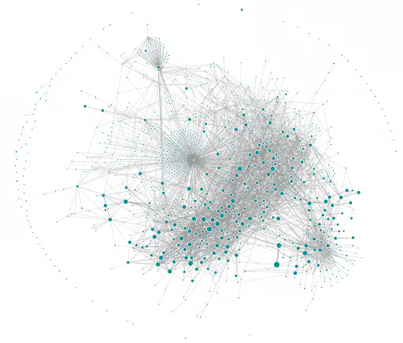
Motivation: Where is the bug?
<<component>>
service
<<component>>
service
<<component>>
service
<<component>>
service
<<component>>
service
<<component>>
service
<<component>>
service
<<component>>
service
<<component>>
service
<<component>>
service
HTTP/1.1 500 Internal Server Error
Notes:
Source:
https://martinfowler.com/bliki/CircuitBreaker.html
https://www.uber.com/en-CZ/blog/microservice-architecture/

Slide 14

Monitoring
What to monitor?
Logs are text records of events, in general, they do not capture overall system status.
Logging
Log Aggregation
Metrics as numerical data on system state and resource use.
Service Monitoring
Infrastructure Monitoring
How to monitor?
Source
Collector
Processor / Presenter
Tracing is about tracking a request, and related information, across services.
Notes:
Sources:
https://epsagon.com/observability/5-ways-to-understand-distributed-system-logging-and-monitoring/
https://medium.com/@vagrantdev/
https://bookkeeper.apache.org/docs/getting-started/conceptsdistributed-logging-best-practices-and-lesson-learned-d52143fae266
https://github.com/apache/distributedlog
https://makeameme.org/meme/i-want-it-dc80ca9282

Slide 15
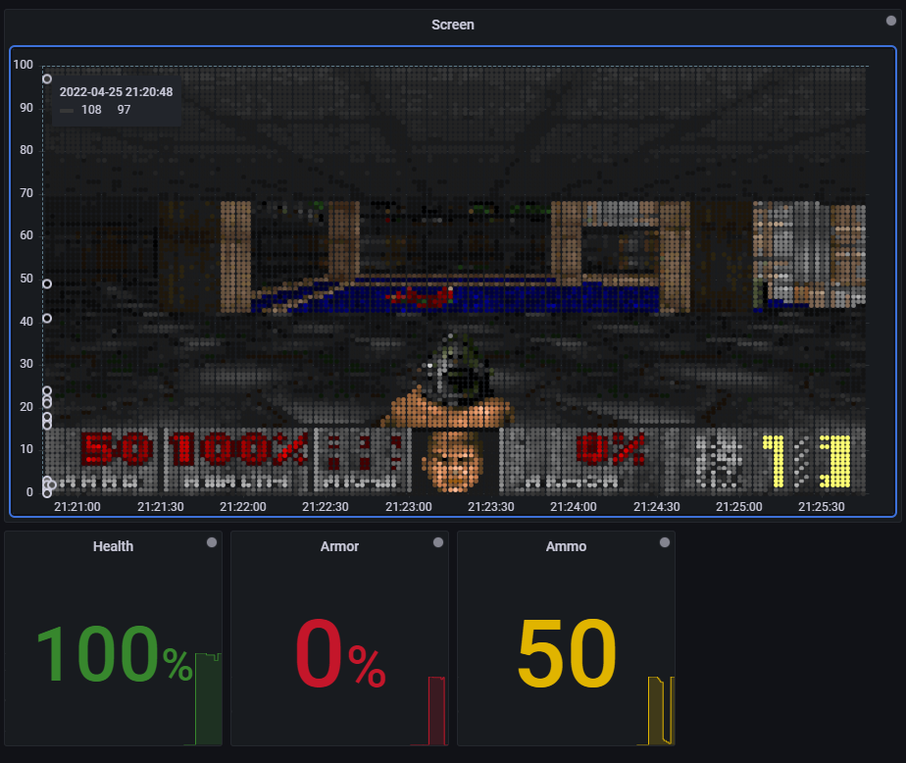
Example
Prometheus
Time series
Multidimensional data
Pull/Push via HTTP
Alerts
…
Grafana
Dashboards
Monitor, analyze, alert
Metrics, logs, traces
…
<<component>>
node_exporter
<<component>>
Prometheus
<<component>>
Grafana
Notes:
Sources:
https://grafana.com/docs/grafana/latest/getting-started/getting-started-prometheus/
https://grafana.com/
https://grafana.com/blog/2022/03/31/can-grafana-run-doom/
https://prometheus.io/

Slide 16

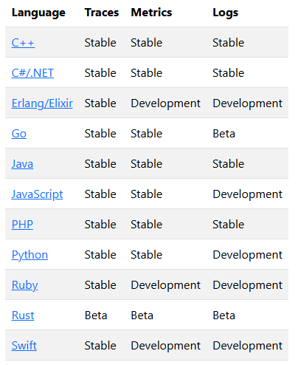
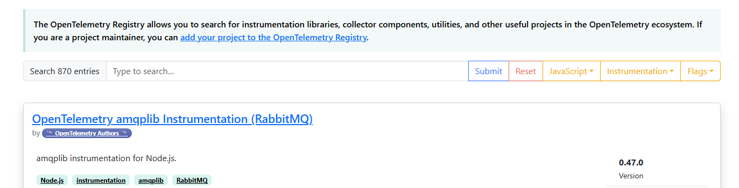
OpenTelemetry
Since 2019, the OpenTelemetry (OTel) is "an observability framework and toolkit designed to facilitate the generation, export, collection of telemetry data such as traces, metrics, and logs.".
It is not an observability backend, e.g. Prometheus, Jeager, ...
Signals are datapoint collected, metrics, logs, traces.
Context provides metadata: when, where, what.
const sdk = new NodeSDK({
traceExporter: new ConsoleSpanExporter(),
metricReader: new PeriodicExportingMetricReader({
exporter: new ConsoleMetricExporter(),
}),
instrumentations: [getNodeAutoInstrumentations()],
});
Semantic conventions provides best practices, e.g. naming.
Notes:
Resources:
https://opentelemetry.io/docs/what-is-opentelemetry/
https://github.com/open-telemetry
https://www.jaegertracing.io/
https://opentelemetry.io/docs/languages/js/getting-started/nodejs/
https://opentelemetry.io/docs/concepts/instrumentation/libraries/
https://opentelemetry.io/ecosystem/registry/
https://www.dynatrace.com/news/blog/what-is-opentelemetry-2/

Slide 17
Architecture

Slide 18
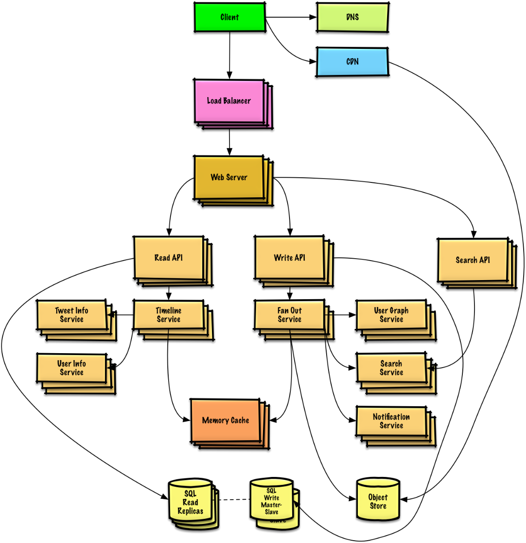
Architecture
Multiple Components
Client, Web-Server, Broker, Worker …
Quality Attributes
Modifiability, Testability, Integrability, Performance, Availability, …
System design primer
Introduction to Software Engineering - NSWI041
…
Notes:
Source:
https://github.com/donnemartin/system-design-primer

Slide 19
Starting point
<<actor>>
browser
<<component>>
web server
<<component>>
database

Slide 20
Background Jobs
Message queues
Receive hold and deliver messages
(A)synchronous execution
Task queues
Back pressure
<<component>>
message queue
<<component>>
message consumer
<<component>>
client
<<component>>
server
<<component>>
database
Example of our solution with Celery.
Notes:
Source:
https://kafka.apache.org/
https://www.rabbitmq.com/

Slide 21
Application state
Stateful
Context of previous transaction.
Stateless
No stored information. Every operation is made as if from scratch for the first time.
<<component>>
client
<<component>>
server
<<component>>
database
Application state in the database, servers are stateless.
Notes:
Source:
https://www.redhat.com/en/topics/cloud-native-apps/stateful-vs-stateless

Slide 22
Proxy
The client perform a request to proxy and proxy makes a request to the server (proxy) on the client behalf. Next it forwards the response from server back to the client.
By adding functionality, we can get different types of proxies ...
SSL termination, compression, caching, monitoring, …
Static content
Multiple locations
A proxy often serves multiple purposes.
<<component>>
client
<<component>>
proxy
<<component>>
server
<<component>>
database
Notes:
Source:
https://github.com/donnemartin/system-design-primer
https://refactoring.guru/design-patterns/proxy
https://ngrok.com/blog-post/reverse-proxy-vs-api-gateway

Slide 23
Reverse proxy
A reverse proxy acts as a single representation of the server. It can simplify the integration by providing a single endpoint, protect the server by hiding the internals, etc ...
By adding functionality, we can get different types of proxies ...
Centralize internal services and provide unified interface
Hide information about servers (implementation detail)
<<component>>
server
<<component>>
reverse proxy
<<component>>
client
<<component>>
server
<<component>>
database
The reverse proxy provide a unified API, e.g., /api/v1/users and /api/v1/articles.
Notes:
Source:
https://github.com/donnemartin/system-design-primer

Slide 24
Cache
Improve loading time, reduce server load
Client-side caching
Multiple locations (Client, CDN, Web server, Database, Application, …)
Cache invalidation
<<component>>
cache-aside
<<component>>
client
<<component>>
cache
<<component>>
server
<<component>>
database
Notes:
Source:
https://github.com/donnemartin/system-design-primer
https://www.apollographql.com/docs/react/caching/cache-configuration/
https://varnish-cache.org/
https://memcached.org/

Slide 25
Load balancer
Distribute requests to computing resources
Pick a server -> forwards to server -> forwards response to a client
SW or HW implementation
Horizontal scaling
Sticky session
<<component>>
client
<<component>>
load balancer
<<component>>
server
<<component>>
database
Load balancer distribute requests to multiple servers.
Notes:
Source:
https://github.com/donnemartin/system-design-primer
https://www.haproxy.org/

Slide 26
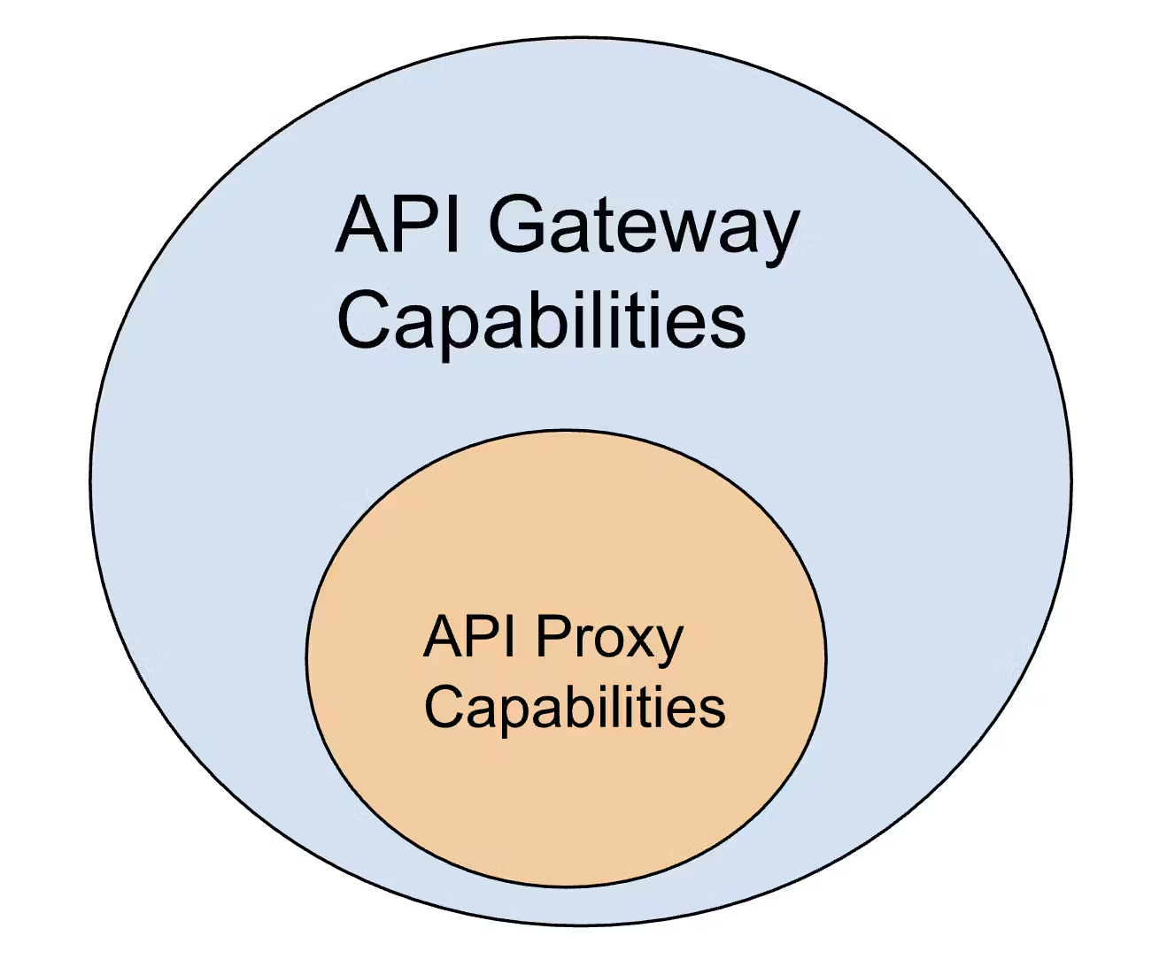
API Proxy / Gateway /....
Combination of the above, but with added domain/API specific logic. Focused on managing complex API ecosystems and interaction orchestration.
API management
Mocking, version control, request/response transformation, ...
Authorization, authentication
OAuth flows, JWT tokens, OpenID, ...
Developer experience
API specification (Open API), ...
Service discovery
Notes:
Source:
https://tyk.io/blog/api-proxy-vs-api-gateway-what-works-for-you/
https://konghq.com/blog/engineering/api-gateway-vs-api-proxy-understanding-the-differences
https://konghq.com/blog/learning-center/what-is-an-api-proxy
https://apidog.com/blog/api-proxy-vs-api-gateway-explained/
https://blog.openreplay.com/api-gateway-patterns-and-practices/

Slide 27
Content delivery network (CDN)
Distributed network of proxy servers, minimize distance to user ~ location based
Mostly static content like CSS, HTML, JS, …
Edge computing
<link href="https://cdn.jsdelivr.net/npm/bootstrap@5.1.3/dist/css/bootstrap.min.css" rel="stylesheet“ crossorigin="anonymous">
<<component>>
CDN
<<component>>
client
<<component>>
server
<<component>>
database
Static content is served from a CDN. Our servers only deal with dynamic content.
Notes:
Source:
https://github.com/donnemartin/system-design-primer
https://www.techtarget.com/searchdatacenter/definition/edge-computing

Slide 28
Database
Modern Database Concepts - NDBI040
Principles of Distributed Systems - NSWI035
Database Applications - NDBI026
…
<<component>>
database
<<component>>
database

Slide 29
Example: PrankWeb
<<component>>
monitoring
(NodeJs)
<<component>>
monitoring
(Flower)
<<component>>
administration
<<component>>
message consumer
(Python, Java, …)
<<component>>
frontend
(React)
<<component>>
message queue
(RabbitMQ)
<<component>>
client
(browser)
<<component>>
reverse proxy
(Nginx)
<<component>>
web server
(Python)
<<component>>
database
(File System)
Notes:
Source:
https://github.com/cusbg/prankweb

Slide 30
Architectures
…
Data-driven
Microservices
System Design
Event-driven
Service Oriented (SOA)
Notes:
Sources:
https://www.ibm.com/cloud/learn/soa
https://docs.microsoft.com/en-us/azure/architecture/patterns/sidecar
https://microservices.io/
http://datacentricmanifesto.org/
https://www.karanpratapsingh.com/courses/system-design
https://www.geeksforgeeks.org/what-is-system-design-learn-system-design/

