Slide 1
Application Programming Interface
NSWI153 - Advanced Programming of Web Applications
2025/2026
Petr Škoda
https://github.com/skodapetr
https://www.ksi.mff.cuni.cz

Slide 2
Application Programming Interface (API)
<<component>>
client
<<component>>
server
<<component>>
database
Get list of all nodes.
Get all nodes identifiers.
Get detail of a single node.

Slide 3
Remote Procedure Call (RPC)

Slide 4
Remote Procedure Call (RPC)
A high-level framework for network-based resource sharing (1976)
It eliminates the need for application-specific communication protocols and support software, ... The framework consists of a network-
wide protocol for invoking arbitrary named functions in a remote process, and machine-dependent system software that interfaces one applications program to another via the protocol. The protocol provides mechanisms for supplying arguments to remote functions
and for retrieving their results; ..
<<component>>
client
<<component>>
server
Serialized arguments
Stub
Serialized response
Notes:
Resources:
https://dl.acm.org/doi/10.5555/910306
https://dl.acm.org/doi/10.1145/1499799.1499878

Slide 5
RPC Message
XML-RPC
Generic RPC over HTTP that uses XML for messages
JSON-RPC
Like XML RPC, but uses JSON instead
<?xml version="1.0"?>
<methodCall>
<methodName>examples.getTheStuff</methodName>
<params>
<param>
<value><i4>42</i4></value>
</param>
</params>
</methodCall>
{
"jsonrpc": "2.0",
"method": "subtract",
"params": [42, 23],
"id": 1
}
{
"jsonrpc": "2.0",
"result": 19,
"id": 1
}
Notes:
Resources:
http://xmlrpc.scripting.com/
https://www.jsonrpc.org/specification

Slide 6


Showcase
tRPC
Notes:
Resources:
https://trpc.io/

Slide 7
Web Services
RPC-based services
Simple Object Access Protocol (SOAP)
  A successor to XML-RPC
  More extensible
  Protocol neutral
  Shifts paradigm from RPC to message passing
Web service description language (WSDL)
Universal description discovery and integration (UDDI)
Notes:
Resources:
https://jakub.klímek.com/nswi145

Slide 8
Representational State Transfer (REST)

Slide 9
REST
Originally an architecture for distributed systems called "Representational State Transfer".
Roy T. Fielding , Dissertation, Doctor of Philosophy 2000
Architectural Styles and the Design of Network-based Software Architectures
Components (CHAPTER 5)
  Client-Server
  Stateless
  Cache
  Uniform Interface "The central feature that distinguishes the REST architectural style from other"
  Layer System
  Code-On-Demand
Protocol neutral
Roy T. Fielding Blog

Slide 10
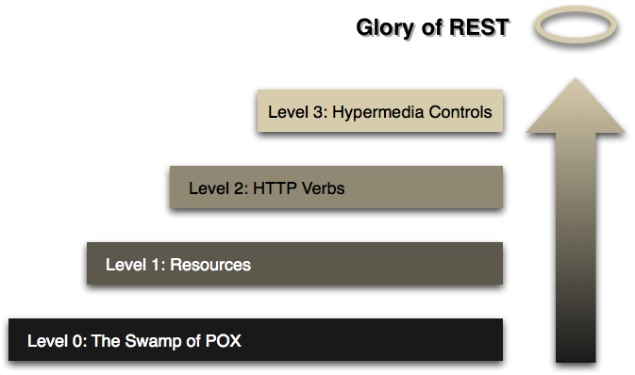
Glory of REST 1 / 3
Notes:
Resources:
https://martinfowler.com/articles/richardsonMaturityModel.html
Roy T. Fielding , Dissertation, Doctor of Philosophy 2000

Slide 11
Glory of REST 2 / 3
Level 0 : The Swamp of POX
Plain Old XML (POX)
URL design
Level 2 : HTTP Verbs
HTTP Verbs
GET, POST, PUT, DELETE, PATCH, OPTIONS, ..
Status codes
200, 201, 304, 401, 403, 405 …
URL query arguments
Non-RESTful actions
Level 1 : Resources
Endpoint for each resource
Self-descriptive resources
Static / Dynamic resources
Resource design (document, image, service, non-virtual object, … )
URL design

Slide 12
Glory of REST 3 / 3
Level 3 : Hypermedia Controls
Content Negotiation
Hypertext as the Engine of Application State (HATEOAS)
JSON Hypermedia API Language:
{ "_links": {
"self": { "href": "/orders/523" },
"warehouse": { "href": "/warehouse/56" },
"invoice": { "href": "/invoices/873" }
},
"currency": "USD",
"status": "shipped",
"total": 10.20
}
JSON API:
{"data": {
"id": "13e1892765c5",
"type": "reservation",
"links": { "self": "https://jcg.com/res/13e1892765c5" },
"attributes": { "from": "2020-01-01", "to": "2020-01-05", "vehicle": "Skoda" },
"relationships": {
"customer": { "links": {
"self": "https://jcg.com/res/13e1892765c5/relationships/customer",
"related": "https://jcg.com/res/13e1892765c5/customer" }
} } } }
{
"@context": "http://schema.org/",
"@type": "Person",
"name": "Petr Škoda",
"jobTitle": "?",
"url": "https://github.com/skodapetr"
}
Notes:
Resources:
https://martinfowler.com/articles/richardsonMaturityModel.html
https://www.javacodegeeks.com/restful-services-with-hateoas-hypermedia-the-secret-ingredient-of-rest.html
https://json-ld.org/playground/
https://tools.ietf.org/id/draft-kelly-json-hal-02.html (JSON Hypermedia API Language )
https://jsonapi.org/format/ (JSON:API)
http://amundsen.com/media-types/collection/ (Collection+JSON)
https://github.com/kevinswiber/siren (SIREN)

Slide 13
REST reality check 1 / 2
Resources are identified by URIs
Operations are performed by HTTP requests
RESTful:
Client-server model
Stateless
Cache
Uniform interface
Layered system
Code-On-Demand
HTTP + JSON ~ REST
"REST APIs must be hypertext-driven"
Ray Fielding, 2008

Slide 14
REST reality check 2 / 2
 | /gallery | /gallery/kittens | /gallery/kittens/kitten01
GET | Get the list of all galleries (JSON) | Get the list of photos in the gallery (JSON) | Get the image (WEBP)
POST | Create a new gallery | Create a new image in a gallery | N/A
PUT | Replace list of galleries (atypical) | Replace entire list of photos in gallery | Replace / Insert the image
DELETE | Empty the whole application | Remove all photos of a gallery | Remove the given image
HEAD
OPTIONS
...
For more see Roy T. Fielding , Dissertation, Doctor of Philosophy 2000
Architectural Styles and the Design of Network-based Software Architectures

Slide 15
OpenAPI
formerly known as Swagger API
Notes:
Resources:
https://swagger.io/
https://www.w3.org/Submission/wadl/

Slide 16
OpenAPI
OpenAPI separated from Swagger tools in 2015 and gain sponsorship from big players. It provides a language agnostic way to describe/specify API using YAML or JSON.
Features:
Values restriction, defaults, …
Multiple servers
Security specification
Components
…
Notes:
Resources:
https://swagger.io/specification/

Slide 17
OpenAPI example
openapi: 3.0.0
servers:
- url: 'https://example.com/api'
info:
title: My API
version: 1.0.1
description: Personal API for public
contact:
name: Petr Skoda
email: skoda@ksi.ms.mff.cuni.cz
termsOfService: 'https://example.com/api/terms-of-use'
license:
name: 'The MIT License (MIT)'
url: 'https://opensource.org/licenses/MIT'

Slide 18
Demo
Swagger Editor
Notes:
Resources:
https://editor.swagger.io/
https://github.com/swagger-api/swagger-editor

Slide 19
OpenAPI eco-system
Visual editor
IDE Plugins
Code generators
Documentation generator / browser
Testing and validation
Monitoring
Mockup
…
SwaggerHub
Notes:
Resources:
https://marketplace.visualstudio.com/items?itemName=42Crunch.vscode-openapi
https://plugins.jetbrains.com/plugin/14837-openapi-swagger-editor
https://swagger.io/tools/
https://stoplight.io/open-source/prism (Prism - mockup server, using NodeJs, from StopLight)
https://github.com/OpenAPITools/openapi-generator (Generator)

Slide 20
GraphQL
Notes:
Command driven API

Slide 21
Problem statement
{ articles {
title
author { name }
comments {
author { name }
content
} }
Article
REST API:
/article
/article/1
/author
/author/1
/article/1/comments
…
Author
Comment

Slide 22
GraphQL sales edition …
Aggregate data from multiple UI components.
Create a representation of your data that feels familiar and natural (graph).
Ensure that all of your data is statically typed, and these types inform what queries the schema supports.
Reduce the need for breaking changes but utilize a built-in mechanism for deprecations when you need to.
Access to a powerful tooling ecosystem with GUIs, editor integrations, code generation, linting, analytics, and more.
Notes:
Resources:
https://graphql.org/faq/ (2022)

Slide 23
GraphQL
2012, released 2015 by Facebook
Last specifications from 2021, 2025 managed with GitHub releases.
Language agnostic
Huge Ecosystem
GraphQL Foundation since 2019
Annual report
Resources
  https://graphql.org/blog/
  @graphql
  @graphqlsummit
Notes:
Resources:
https://graphql.org/

Slide 24
Demo
National Open Data Catalog : GraphQL
Query
Response
{ datasets { data {
iri
title {
cs
} } } }
{“data": { "datasets": { "data": [
{ "iri": "https://example.com/88", "title": { "cs": "Číselník" } },
{ "iri": "https://example.com/67", "title": { "cs": "Seznam" } }]
} } }
Notes:
Resources:
https://data.gov.cz/datové-sady
https://data.gov.cz/graphql

Slide 25
GraphQL schema
Single endpoint (unlike REST)
For input and output objects
Types:
  Scalar: Int, Float, String, Boolean, ID
  List
  Enumerations
  Interface
  Union
  Input types
schema {
query: Query
mutation: Mutation
}
type Character {
name: String
appearsIn: [Episode!]
}
interface IdentifiedType { id: ID! }
type Human implements IdentifiedType {
id: ID!
name: String!
}
union SearchResult = Human | Droid | Starship
Notes:
Resources:
https://graphql.org/

Slide 26
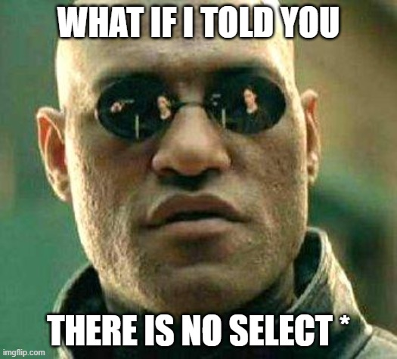
GraphQL introspection
{
__schema {
types {
name
fields { name type { name } }
}
}
}
Notes:
Resources:
https://graphql.org/

Slide 27
GraphQL Query
Aliases
Fragments
Variables (with fragments)
Directives
Mutations
…
query Hero(
$episode: Episode,
$withFriends: Boolean! = true
) {
hero(episode: $episode) {
… baseInformation
friends @include(if: $withFriends) {
name
}
}
}
fragment baseInformation on Character {
name
}
Notes:
Resources:
https://graphql.org/learn

Slide 28
GraphQL eco-system
GraphQL.js
Apollo Server / Apollo Client
graphql-hooks
GraphiQL
Graphene
Apache Camel
Relay
...

Slide 29
GraphQL reality check 1 / 2
Graph data
Schema design
Single endpoint (unlike REST)
Pagination
Caching
Filters
input QueryDatasetArguments {
filters: datasetFilter
offset: Int
limit: Int
}
{
datasets (
offset:0 limit:1
filters: {isPartOf: ""} ) {
data {
iri
title { cs }
} } }

Slide 30
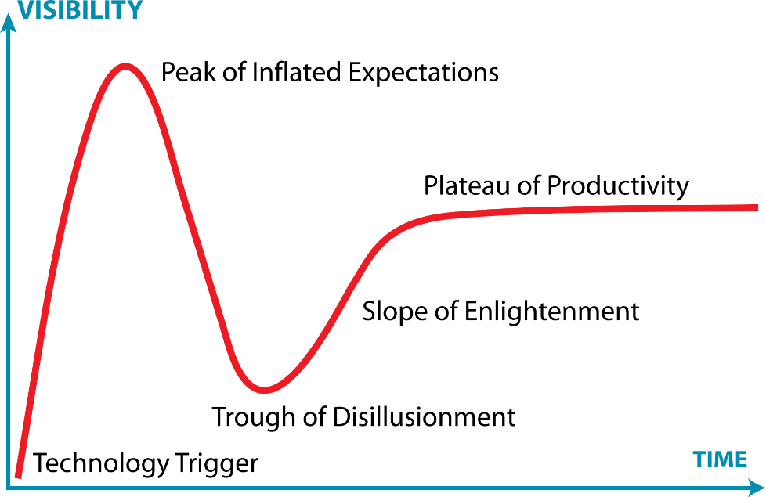
GraphQL reality check 2 / 2
GraphQL hype train vs "why not use graphql" ~ about 1070 results (2022)
GraphQL is the better REST, ….
No more Over- and Under-fetching
No more versioned APIs
Rapid Product Iterations on the Frontend
Insightful Analytics on the Backend
Notes:
Resources:
https://en.wikipedia.org/wiki/Gartner_hype_cycle

Slide 31
Showcase
State of API
Notes:
Sources:
https://www.postman.com/state-of-api/2025/

Slide 32
AI Agents & APIs
Who was / is / will be the client?

Slide 33
Who is calling the API?
The vision : Semantic Web
The reality : LLMs read everything
The basic premise: machines could not read human language.
A solution is for humans to annotate data with formal ontologies (RDF, OWL) and use machine-readable formats (WSDL, OpenAPI) for APIs. The goal is / was to make the web a global database for programs.
Yet, adoption was slow and is mostly domain focused.
LLMs understand natural language, HTML, JSON, code - without formal annotation.
An AI agent can browse a web page, read an API documentation page, and call the API. The "caller" is no longer always a human or hand-coded program.
APIs need to be designed for agents as clients too.

Slide 34
Model-Context-Protocol (MCP)
Open-sourced 2024-11-25 by Anthropic. It is a standard for providing a context to AI assistants. The context consists of tools and data-sources.
Main components:
MCP Client
MCP Server
MCP Hosts
MCP is using JSON-RPC for two-way communication.
Use standard input/output (stdio) or HTTP POST for transport. You can implement custom transport.
There are bindings for different languages, e.g. TypeScript, Python, ...
Notes:
Resources:
https://github.com/modelcontextprotocol/servers
https://www.anthropic.com/news/model-context-protocol

Slide 35
MCP : Features
Resources
Read-only data exposed by the server (like GET). File contents, DB rows, API responses. Identified by URI. No side effects.
E.g. { uri: "file:///logs/app.log", mimeType: "text/plain" }
Prompts
Reusable prompt templates defined by the server. Clients surface them to users and LLMs. Shared interaction patterns across teams or products.
E.g. "Summarize this GitHub issue" - with issue as argument.
Tools
Actions the LLM can invoke, like POST - may have side effects.
E.g. create_issue, send_email, run_query, …
Sampling (limited support)
Server requests an LLM completion via the client. Human-in-the-loop: user can review/modify before the model responds. Enables servers to reason without embedding a model.
E.g. server -> create message -> client -> LLM -> client -> server

Slide 36
LLM Tool Use / Function Calling
The LLM decides which API to call, constructs the arguments, and acts on the result. For this to happen, we need to provide the LLM with tool definition - name, description, and parameters. The definition is part of the context and LLM can generate response with a request to invoke the tool. The host can then invoke the tool and provide the tool response back to LLM as a new message.
{
"name": "get_weather",
"description": "Get current weather for a city",
"parameters": {
"type": "object",
"properties": {
"city": {
"type": "string",
"description": "City name, e.g. Prague" } } }
server.tool(
"get-alerts", "Get weather alerts for a state", // name, description
{ state: z.string().length(2).describe("Two-letter state code (e.g. CA, NY)") }, // Input schema
async ({ state }) => { ... } // Handler function
);
Notes:
Resources:
https://platform.openai.com/docs/guides/function-calling
https://docs.anthropic.com/en/docs/build-with-claude/tool-use

Slide 37
Demo
MCP Inspector + .... Desktop
Cancelled
Notes:
Resources:
https://modelcontextprotocol.io/quickstart/server
https://github.com/modelcontextprotocol/inspector
https://modelcontextprotocol.io/docs/tools/inspector

Slide 38
AI Agents and APIs
What happens when an LLM can call any API? A new programming model emerges.
Reason -> Act loop
Model thinks, calls a tool, observes the result, thinks again. Repeat until done. This is a basic idea for many agentic systems.
think -> call(arguments) -> read result -> think -> answer
Orchestration
One model coordinates multiple specialized agents or tools. Tools an APIs are exposed via an "API".
planner -> coder agent + test agent + deploy agent
Human in the loop
Agent pauses at risky actions for approval. APIs must signal reversibility and scope of impact.
"About to delete 3 files — confirm?"

