Slide 1
Deployment
NSWI153 - Advanced Programming of Web Applications
2025/2026
Petr Škoda
https://github.com/skodapetr
https://www.ksi.mff.cuni.cz

Slide 2
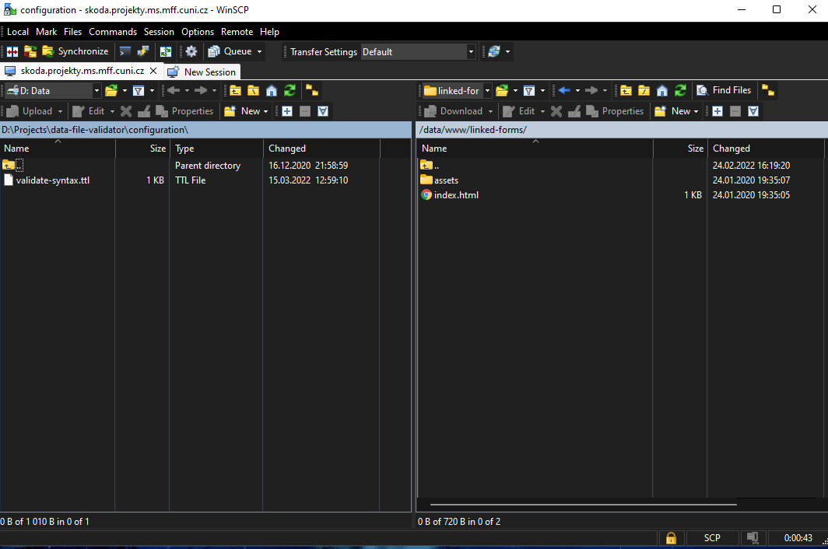
Starting point
Tools: WinSCP / SCP / SSH
Advantages
Near zero setup
Disadvantages
Manual
Single environment
Error prone
Notes:
Resources:
https://winscp.net/eng/download.php

Slide 3

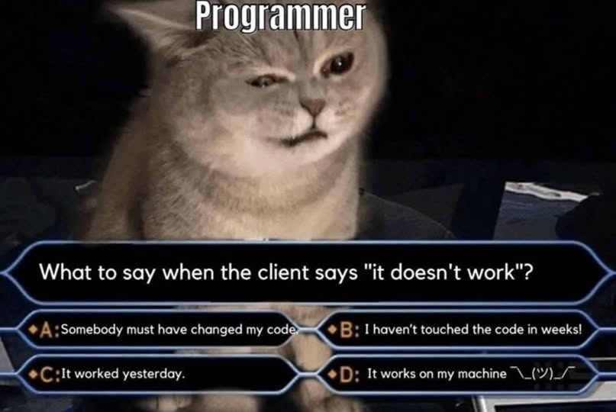
Deployment
Notes:
Resource:
https://www.geekytees.co.uk/product/it-works-on-my-machine/

Slide 4
Deployment script
Advantages
Easy setup
Shareable
Environment variables
Disadvantages
Manual
Single environment
Dependencies (bash / make)
Team
deploy.sh
#!/usr/bin/env bash
npm run build
scp –r ./dist skoda@server:/opt/script
Makefile
build:
npm run build
deploy: build
scp –r ./dist skoda@server:/opt/script
Build server
Production server
Build
Deploy

Slide 5

Ansible
Automation platform.
Playbook with YAML syntax.
Inventory with hosts (remote machines).
Use SSH and OS credentials (certificates) to access remote machines.
Task is not executed if the system is in a desired state.
Plugins
- hosts: webik
tasks:
- name: Stop service
service:
name: octopus-service
state: stopped
- name: Pull resources
git:
repo: '.....'
dest: /opt/octopus
version: main
- name: Build
shell: npm ci
args:
chdir: /opt/octopus
- …
pip install ansible
Notes:
Resources:
https://www.ansible.com/
https://github.com/linkedpipes/etl/tree/develop/deploy/ansible
https://github.com/ansible
https://ansible.readthedocs.io/projects/ansible-core/devel/getting_started/index.html

Slide 6
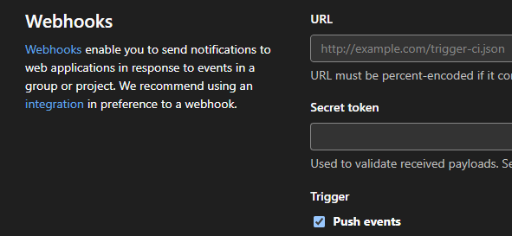
Webhook
Advantages
Automatic
Easy setup
Cloud services
Disadvantages
Single environment
Deployment failures
Localhost
Script
Configuration (repository, branch, secret ..)
Verify request (signature)
Execute "git fetch ...", "npm install", ...
Notes:
Resource:
netlify.com/pricing/

Slide 7
Deployment
Notes:
Let us think a little bit more about deployment.

Slide 8
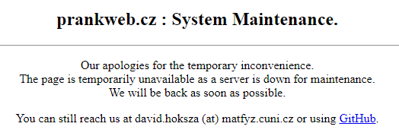
Downtime / New version
Server Maintenance
Fast, easy and functional?
Planned / scheduled maintenance.
Blue-green deployment
Switch from one deployment to another.
Canary deployment
Allows you to roll out new code/features to a subset of users.
Notes:
Resources:
https://www.split.io/glossary/canary-deployment/
https://circleci.com/blog/canary-vs-blue-green-downtime/
https://harness.io/blog/continuous-verification/blue-green-canary-deployment-strategies/

Slide 9
Multiple components
Applications consists of multiple components
Multiple versions of a library / runtime / component / application
Database updates
<<component>>
web browser
<<component>>
web server
<<component>>
application server
<<component>>
database

Slide 10
Configuration
XML / YAML -- the whole idea is to get the application configuration out. So, it can be set by operators.
Sources of a configuration:
Base URL
Database server
Instance name
Service URL
Storage / file system
Environment variable
…

Slide 11
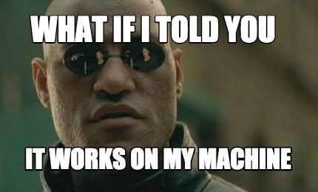
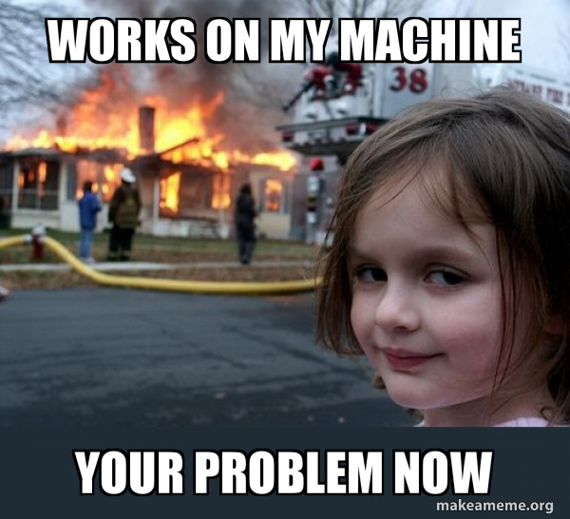
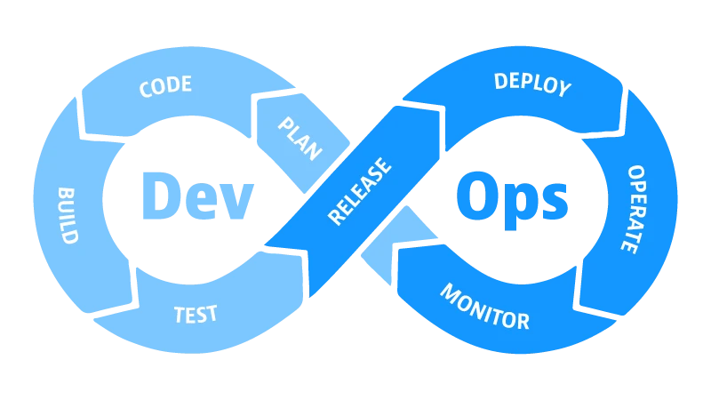
Operator?
Developer vs. Operator
Developer & Operator
with DevOps
Notes:
Resources:
https://www.memecreator.org/meme/what-if-i-told-you-it-works-on-my-machine/
https://makeameme.org/meme/works-on-my-069a992b9c
https://memegenerator.net/instance/65760293/am-i-the-only-one-around-here-say-works-on-my-machine-one-more-time
https://memeshappen.com/meme/55254/SAY-IT-WORKS-IN-MY-MACHINE
https://makeameme.org/meme/works-on-my-5bc45d
https://www.dynatrace.com/news/blog/what-is-devops/

Slide 12
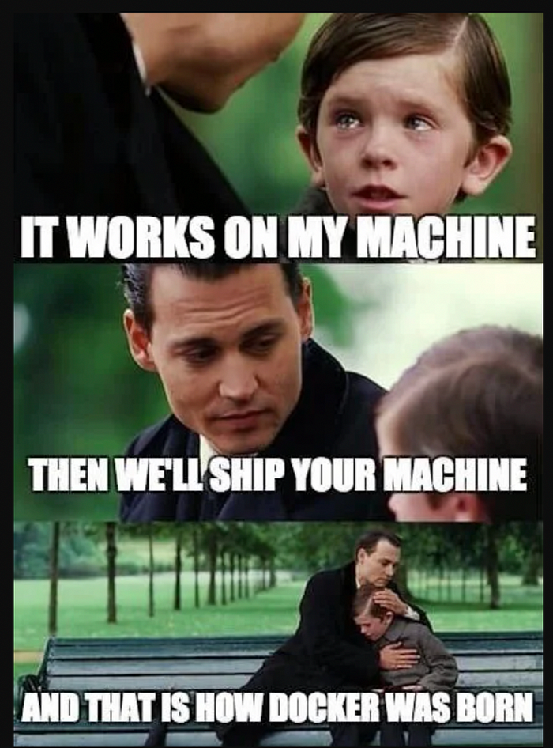

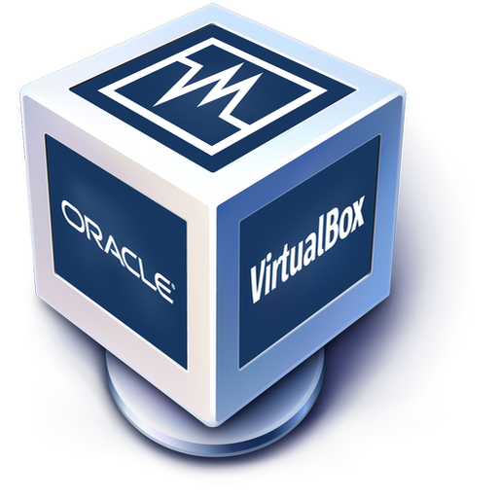
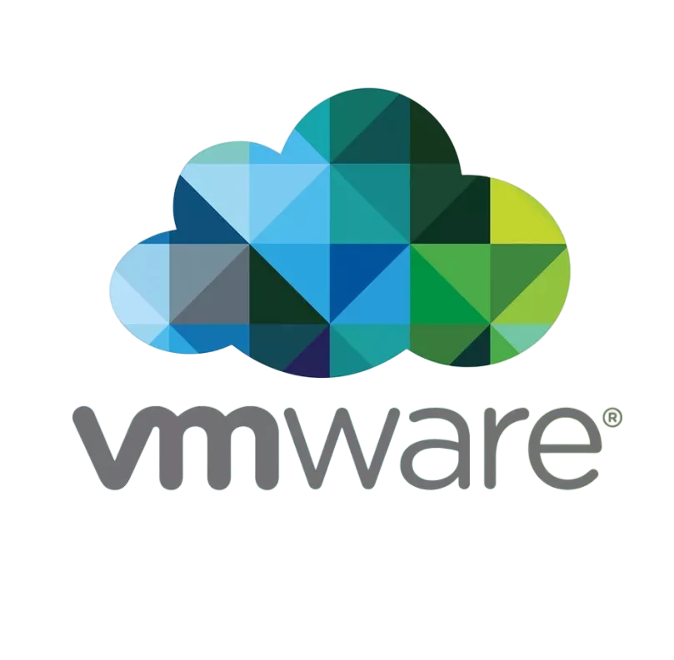

Virtual Machines: Oh, We have been here for the whole time …
Notes:
Resources:
https://www.vagrantup.com/
https://github.com/hashicorp/vagrant

Slide 13
Docker
There are other container technologies!
Notes:
Resources:
https://www.reddit.com/r/ProgrammerHumor/comments/cw58z7/it_works_on_my_machine/

Slide 14
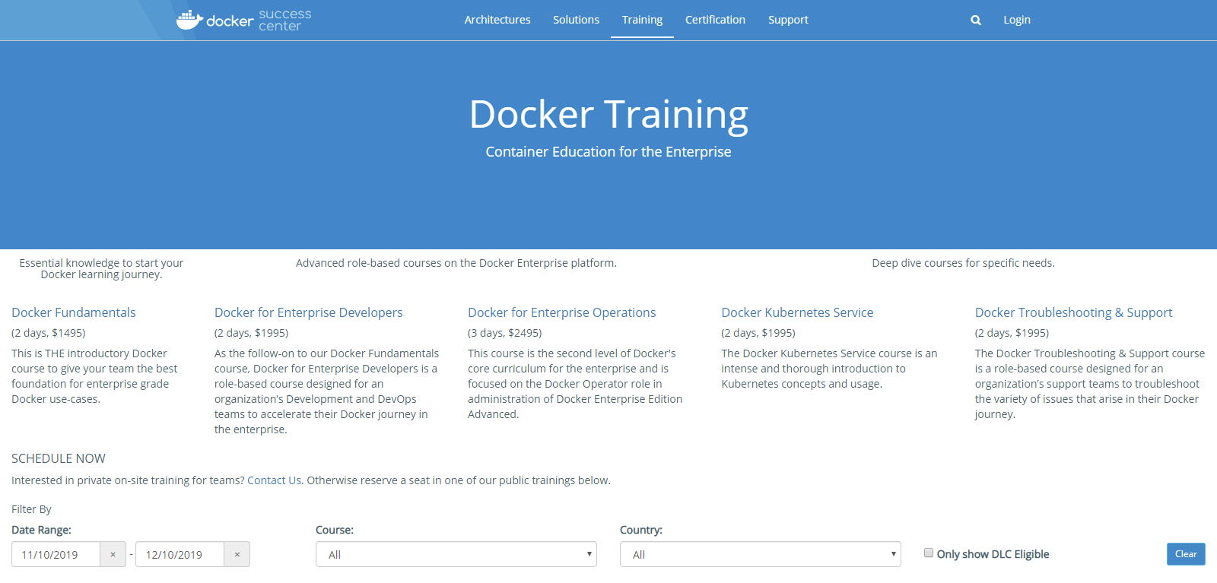
Warning
I want to learn Docker ...
print(“Hello, World!”)
C++ in 21 days
…
Notes:
Sources:
https://success.docker.com/training/ (2019)

Slide 15
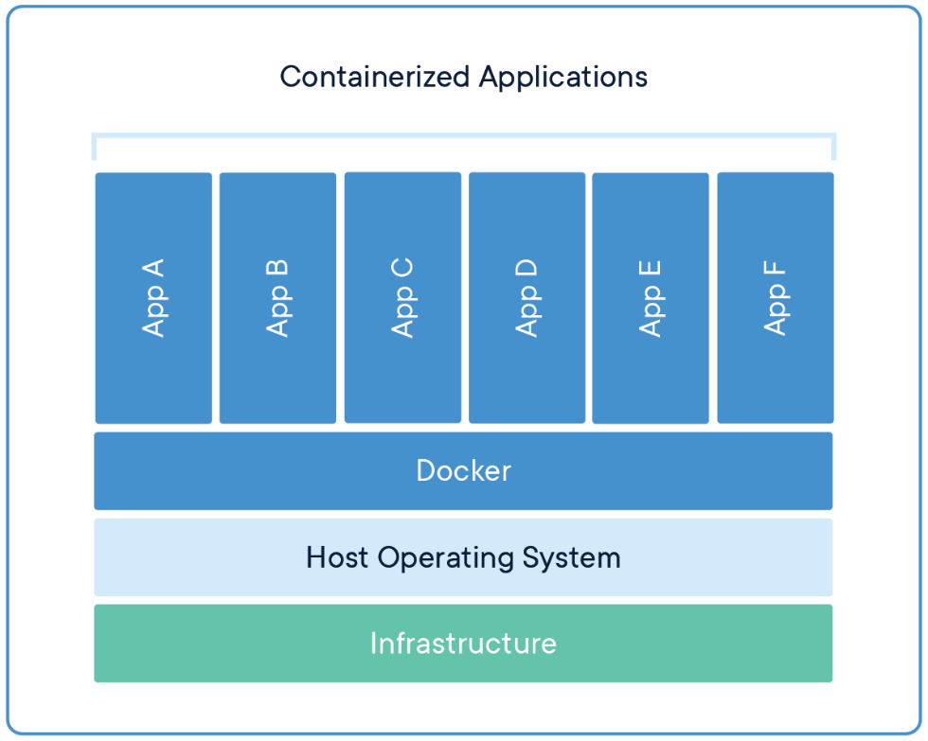
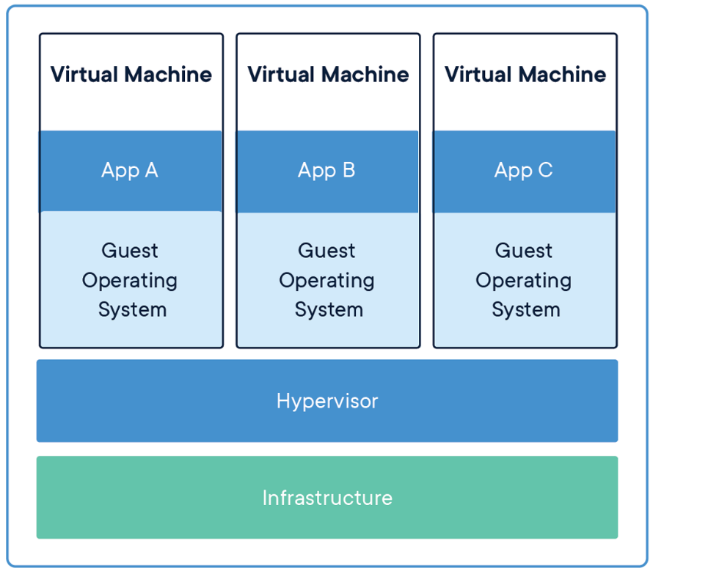
Docker internals 1 / 2
Linux namespaces provide isolated environments: pid, net, ip, mnt, uts
Control groups (cgroups) to limit resources.
Union file system (UnionFS) variants to manage file system.
…
Notes:
Resources:
https://docs.docker.com/engine/docker-overview/#docker-engine (2019)

Slide 16
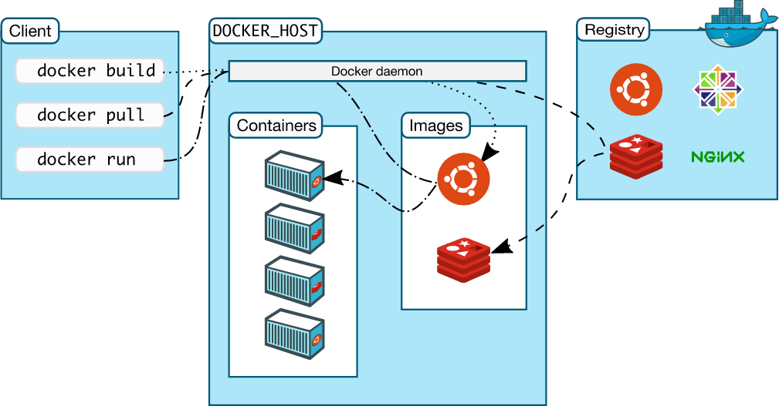
Docker internals 2 / 2
Notes:
Resources:
https://docs.docker.com/engine/docker-overview/#docker-engine (2019)

Slide 17
Dockerfile
FROM
ARG
ENV
WORKDIR
COPY
RUN
USER
EXPOSE
CMD
FROM node
ARG GOOGLE_ANALYTICS
ENV UID=5988
WORKDIR /usr/src/app
COPY package*.json ./
RUN npm install
COPY ./src ./src
USER ${UID}:${UID}
EXPOSE 8080
CMD [ "node", "./src/server.js" ]
DO NOT TRY THIS AT HOME
Notes:
Resources:
https://nodejs.org/en/docs/guides/nodejs-docker-webapp/

Slide 18




Ecosystem
#!/bin/bash
# Create a container
container=$(buildah from node:14)
# Copy
buildah config --workingdir /app $container
# Copy package files
buildah copy $container package*.json /app/
# Install dependencies buildah run $container npm install ... # Commit buildah commit $container my-node-app
Notes:
Resources:
https://openvz.org/
https://podman.io/
https://linuxcontainers.org/
https://containerd.io/
https://buildah.io/
https://docs.docker.com/develop/develop-images/build_enhancements/
https://github.com/GoogleContainerTools/kaniko
https://cri-o.io/
https://earthly.dev/blog/docker-vs-buildah-vs-kaniko/
https://opencontainers.org/

Slide 19

Resources
Docker Captains
Volumes / Networking / …
ADD / MAINTAINER / ENTRYPOINT / LABEL / …
Dockerfile Reference
Multi-stage builds
API (REST, /var/run/docker.sock)
cAdvisor
docker run \
--volume=/:/rootfs:ro \
--volume=/var/run:/var/run:ro \
--volume=/sys:/sys:ro \
--volume=/var/lib/docker/:/var/lib/docker:ro \
--volume=/dev/disk/:/dev/disk:ro \
--publish=8080:8080 \
--detach=true \
--name=cadvisor \
--privileged \
--device=/dev/kmsg \
gcr.io/cadvisor/cadvisor:$VERSION

Slide 20
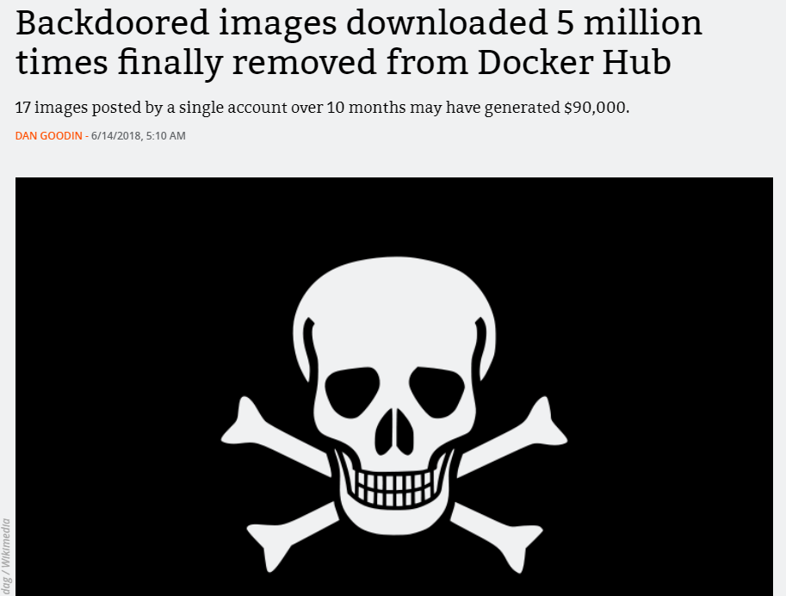
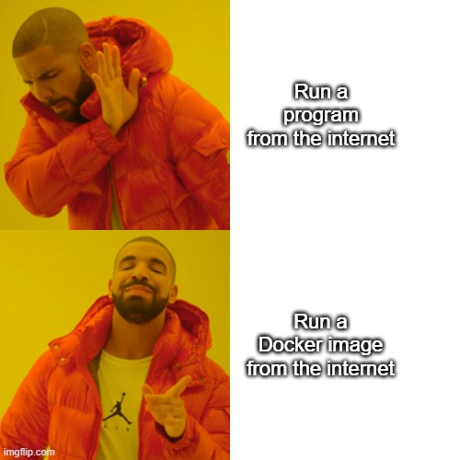
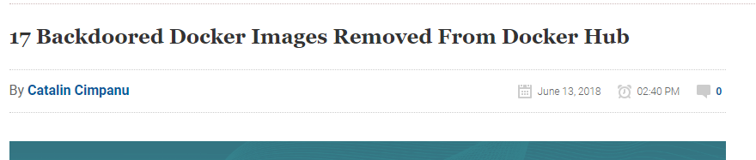
Docker goes wrong … security edition
Would you ..
Notes:
Resources:
https://www.bleepingcomputer.com/news/security/17-backdoored-docker-images-removed-from-docker-hub/
https://arstechnica.com/information-technology/2018/06/backdoored-images-downloaded-5-million-times-finally-removed-from-docker-hub/

Slide 21
Docker goes wrong …
FROM maven:3-jdk-10-slim
RUN apt-get update; apt-get upgrade -y
RUN apt-get install -y curl software-properties-common gnupg; \
curl -sL https://deb.nodesource.com/setup_10.x | bash -
RUN apt-get install -y nodejs
RUN node -v; npm -v
WORKDIR /etl
COPY . .
RUN mvn install -DskipTests
RUN chmod a+x start.sh
CMD ["/bin/bash", "/etl/start.sh"]
EXPOSE 8080
DO NOT TRY THIS AT HOME
exec ./executor.sh & exec ./executor-monitor.sh & exec ./storage.sh & exec ./frontend.sh
Notes:
Sources:
https://github.com/linkedpipes/etl/pull/627

Slide 22

Docker Compose
Declarative
Definition in docker-compose.yml Development vs Production docker files
Multiple isolated environments on a single host
Service discovery (domain name resolution)
docker-compose vs docker compose

Slide 23
docker-compose.yaml
version: "3.9"
services:
web:
build: .
ports:
- "8000:5000"
volumes:
- .:/code
environment:
FLASK_ENV: development
redis:
image: "redis:alpine"
Notes:
Source:
https://docs.docker.com/compose/gettingstarted/
https://docs.docker.com/compose/compose-file/

Slide 24
Demo
Docker compose PrankWeb / LinkedPipes ETL / NKOD

Slide 25
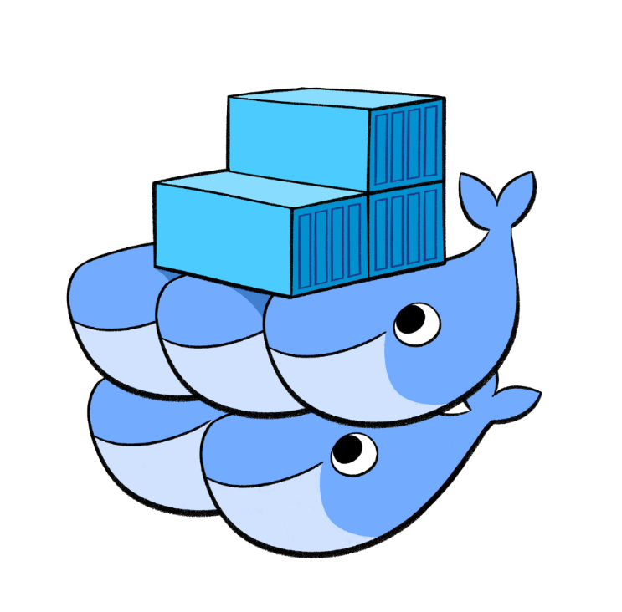
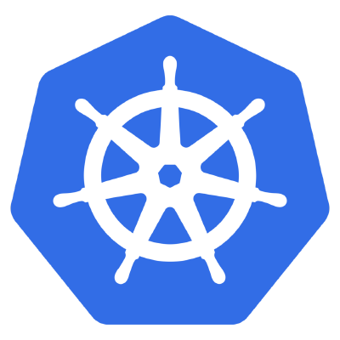

Out of scope
High availability
Infrastructure as a code
Notes:
Sources:
https://terraform.io/intro/index.html
https://www.ansible.com/

Slide 26
Composition
<<component>>
web browser
<<component>>
web server
<<component>>
application server
<<component>>
database

Slide 27
< placeholder >
Deployment with Docker
Github Actions

Slide 28
Deployment
NSWI150 Virtualization and Cloud Computing
NSWI152 Cloud Application Development (Azure)
Deployment options:
On-premise (internal)
Infrastructure as a Service (hardware)
Virtual machine
Platform as a Service
Software as a Service
Function as a Service (serverless / lambda)

