Slide 1
Server
NSWI153 - Advanced Programming of Web Applications
2025/2026
Petr Škoda
https://github.com/skodapetr
https://www.ksi.mff.cuni.cz

Slide 2
Starting point
PHP
$_GET, $_POST, $_REQUEST, $_SERVER
CGI / FastCGI / PHP-FPM / mod_php / mod_SuPHP / …
$app = AppFactory::create(); $app->setBasePath('/~skoda/lab-02'); $app->get('/name/{name}', function ($request, $response, $args) { $response->getBody()->write('Hello ' . $args['name']); return $response;
});
Notes:
Resources:
https://fastcgi-archives.github.io/FastCGI_Specification.html
https://www.nginx.com/resources/wiki/start/topics/examples/fastcgiexample/
https://flask.palletsprojects.com/en/2.1.x/deploying/fastcgi/
https://www.digitalocean.com/community/tutorials/understanding-and-implementing-fastcgi-proxying-in-nginx
https://www.php.net/manual/en/install.fpm.php
https://www.plesk.com/blog/various/why-do-you-need-php-fpm/
https://www.slimframework.com/

Slide 3
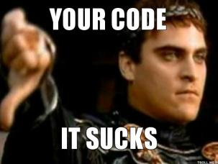
Demo
Python & Sockets
Notes:
Resources:
https://azatty.wordpress.com/wp-content/uploads/2014/02/your-code-it-sucks-thumb.jpg

Slide 4
Web server
"A web server is computer software and underlying hardware that accepts requests via HTTP" Wikipedia 2024
Features:
Debug Mode / Error Handling / Logging
Routing
Static Files
Template Rendering
Request Data (POST, …) / Response Data
Sessions
SSL
…
Language:
PHP
Python
NodeJS
Java
…
<<actor>>
user
<<component>>
web server
Notes:
Resources:
https://flask.palletsprojects.com/en/2.1.x/

Slide 5
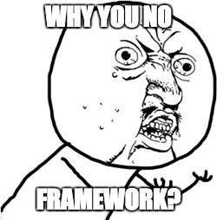
Demo
Python & "get good"
<<actor>>
user
<<component>>
???
<<component>>
our code

Slide 6
Python & Web framework
Flask is a Micro-Framework (no database, validator, … ).
Slim Framework
…
$app = AppFactory::create(); $app->get('/name/{name}', ….);
…
app = Flask(__name__)
@app.route("/")
def hello_world():
return "<p>Hello, World!</p>"
Notes:
Resources:
https://wiki.python.org/moin/WebFrameworks
https://flask.palletsprojects.com/en/2.1.x/

Slide 7
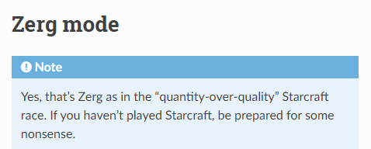
Are we there yet?
Deployment:
uWSGI (Apache, Nginx, …)
mod_wsgi (Apache)
CGI / FastCGI (Apache, Nginx, … ) Gunicorn / Waitress / Uvicorn / ...
Cloud
uwsgi --http :9090 --wsgi-file foobar.py --master --processes 4 --threads 2 --stats 127.0.0.1:9191
LoadModule wsgi_module modules/mod_wsgi.so
...
Notes:
Our application is not ready for deployment … or is it?
What are the hosting options we have?
uWSGI - alternative to FastCGI, external server. Supports Python, perl and ruby. It is quite a big project actually. The command: start an HTTP router at 9090, use given file as entry, one master monitoring 4 processes with 2 threads each. Monitoring is available at 9191, using IP make sure we can connect only from localhost.. We can replace the HTTP router with NginX or Apache. uWSGI is also a native protocol [https://uwsgi-docs.readthedocs.io/en/latest/Protocol.html] protocol for uWSGI server. There is a Zerg mode [https://uwsgi-docs.readthedocs.io/en/latest/Zerg.html]. Allow to add workers dynamically, good for variable site loads. With this option it is possible to attach additional workers at runtime. And there is an Emperor [https://uwsgi-docs.readthedocs.io/en/latest/Emperor.html], to deploy multiple applications from a single directory. It monitor the directory and perform reload. Something like hot redeployment, but for applications.
wsgi_module is similar to mod_php, just running "inside" the Apache server. We have another process (in Apache pool, or managed), the module translate the request to WSGI format and pass it to the Python interpreter.
[2] WSGI (Web Server Gateway Interface) servers – replace mod_python, it is not a standard specification. Server just invoke a callable object, WSGI 1.0 is in PEP 0333, WSGI 1.0.1 in PEP 3333. Gunicord and CherryPy are implementations. Uvicorn is implementation of ASGI (Asynchronous Server Gateway Interface)/ [3] We talk about Gunicorn at the following slide. There are other options see [4] : Waitress (Python only server),, CherryPy [5].
For cloud we can got with Flask, Django, FastAPI, ... we just need to have the project and upload to the cloud [6].
Resources:
https://uwsgi-docs.readthedocs.io/en/latest/index.html
https://modwsgi.readthedocs.io/en/master/
https://gunicorn.org/#quickstart
https://docs.pylonsproject.org/projects/waitress/
https://www.fullstackpython.com/wsgi-servers.html
https://github.com/cherrypy/cherrypy
https://github.com/Azure-Samples/msdocs-python-flask-webapp-quickstart
https://www.uvicorn.org/

Slide 8
Python Web server
Gunicorn is a Python WSGI and HTTP server for Unix.
Pre-Fork Model
Sync Workers
Async Workers (coroutines)
Shared state/memory
Monitoring
...
wsgi.py
def app(environ, start_response):
data = b'Hello, World!\n'
status = '200 OK'
response_headers = ...
start_response(status, response_headers)
return iter([data])
app = Flask(__name__)
…
gunicorn -w 4 -b :8020 wsgi:app
Notes:
Resources:
https://gunicorn.org/#quickstart
https://www.geeksforgeeks.org/coroutine-in-python/

Slide 9
JavaScript
NodeJS

Slide 10

Node.js
JavaScript runtime environment based on V8 engine.
Offers natively many code packages:
Net - socket API, supports both TCP and UDP
TLS – sockets with encryption
DNS, HTTP, HTTP/2
…
Accompanied by npm package management system.
Uses single-threaded main loop for async operations (like JS in browser).
In many cases offers both async and sync API calls.
Built-in N-API for C/C++ bindings (JS-C interoperability).
Notes:
Resources:
https://nodejs.org/en/

Slide 11

JavaScript & Web framework
Express
Fast, unopinionated, minimalist web framework for Node.js
Middleware (POST, XML, Metrics, ... )
Slim Framework
…
$app = AppFactory::create(); $app->get('/name/{name}', ….);
Flask
…
app = Flask(__name__)
@app.route("/")
def hello_world():
return "<p>Hello, World!</p>"
const app = express();
app.get("/home/:name", (req, res) => { … });
app.listen(8080, () => { … });
Notes:
Resources:
https://expressjs.com/en/resources/frameworks.html
https://expressjs.com/
https://github.com/expressjs/express/tree/master/examples

Slide 12
Demo
NodeJS & Express
Middleware
Helmet

Slide 13

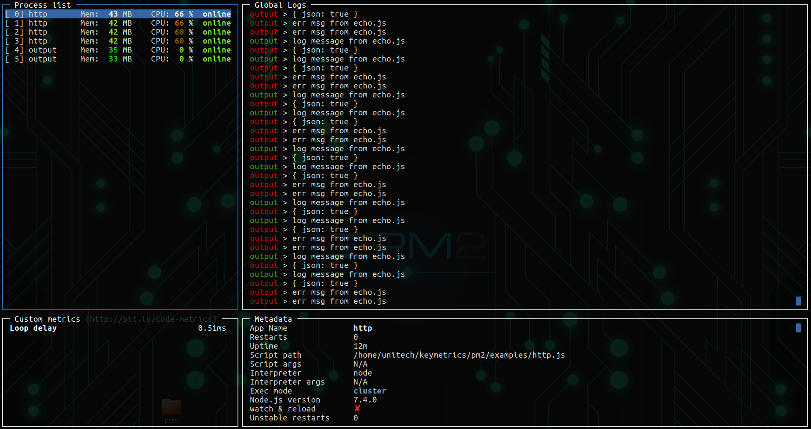


JavaScript Web server
Express
NODE_ENV="production“
node server.js
Process manager
Restart / OS Startup script
Clustering
Sticky sessions ?
Monitoring / Metrics
…
pm2 start application.js -i max
pm2 start "npm run start"
Alternatives:
Notes:
Resources:
https://nodejs.org/en/
http://strong-pm.io/compare/
https://pm2.keymetrics.io/
https://github.com/indutny/sticky-session

Slide 14

Java

Slide 15
Java & Web framework
JAX-RS is a specification. The implementation is provided by a server, as a result deployable applications can be small/thin.
Breaking change javax.ws.rs to jakarta.ws.rs as of May 2019.
<dependency>
<groupId>jakarta.platform</groupId>
<artifactId>jakarta.jakartaee-api</artifactId>
<version>10.0.0</version>
<scope>provided</scope>
</dependency>
@Path("/pipeline")
public class PipelineServlet {
@GET
@Path("/list")
public Response getPipelines( @Context HttpServletRequest request) { … }
}
Notes:
Resources:
https://www.baeldung.com/jax-rs-spec-and-implementations
https://github.com/eugenp/tutorials

Slide 16
Demo
Java & Jetty
(Semi-)Improvised stand up ….
Notes:
java-jetty

Slide 17
Application Server
“An application server is a software framework that provides both facilities to create web applications and a server environment to run them.
...An application server acts as a set of components accessible to the software developer through a standard API defined for the platform itself.
... they implement services like clustering, failover, and load-balancing, … developers can focus on implementing the business logic.” Wikipedia 2023

Slide 18
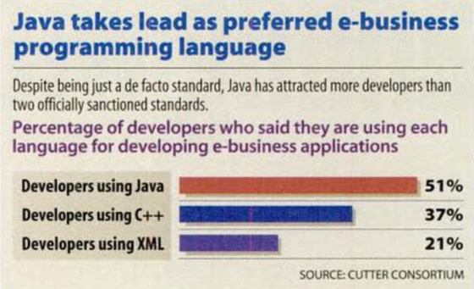
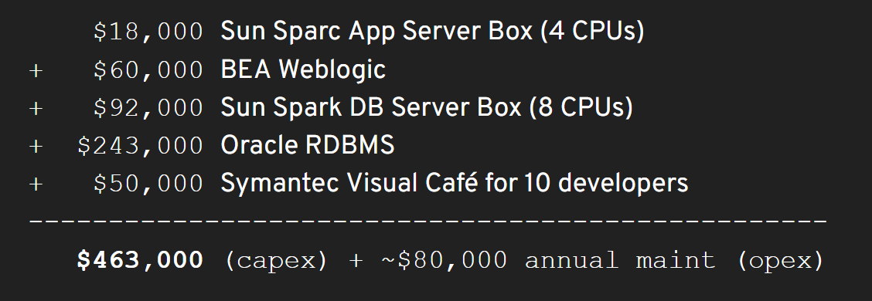
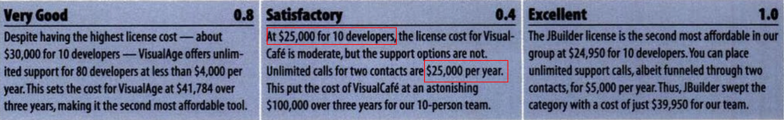
History
Infoworld December 13, 1999
Notes:
Resources:
https://www.youtube.com/watch?v=pwxAZWqt4I8
https://docs.google.com/presentation/d/1DFy4ZZdsK2ftREetv_f52E-caZXOGX6GvgzGQlfSLfE
https://adtmag.com/articles/1999/12/27/bea-systems-weblogic-application-server.aspx
https://books.google.cz/books?id=4U4EAAAAMBAJ&pg=PA37&lpg=PA37&dq=1999+most+popular+java+ide&source=bl&ots=z3IYxlq9Hc&sig=KOQXhuDlasyuQDySBwazRW0HSe4&hl=en&ei=WP18TLXrG8GAlAf6y6nrCw&sa=X&oi=book_result&ct=result&redir_esc=y#v=onepage&q&f=true

Slide 19
Java Server
It is Java ! ( Java Enterprise Edition )
Web Server vs Application Server
*.war
Servers:
Apache Tomcat / Apache TomEE
Jetty
WebLogic (Oracle)
WebSphere (IBM)
WildFly (Red Hat)
GlassFish
…
Web Server | Application Server
Servlets | Servlets
JSP | JSP
WebSockets | WebSockets
JTA | JTA
JASPIC | Bean Validation
 | EJB
 | JPA
 | JMS
 | JavaMail
 | JAX-RS
 | JAX-WS
 | …
JAVA SE DEVELOPMENT KIT (JDK), VERSION 6
…
Licensed Software is not designed or intended for use in the design, construction, operation or maintenance of any nuclear facility.
Notes:
Resources:
https://en.wikipedia.org/wiki/Jakarta_RESTful_Web_Services
https://www.baeldung.com/java-servers
https://blog.idrsolutions.com/2015/04/top-10-open-source-java-and-javaee-application-servers/
https://download.oracle.com/otndocs/jcp/servlet-4-final-spec/index.html
https://www.oracle.com/technetwork/java/javase/downloads/jdk-6u21-license-159167.txt
https://www.javatpoint.com/servlet-tutorial

Slide 20
Java Embedded Server
Run server inside your application!
You are not alone .. (Spring Framework, ...)

Slide 21
Demo
Embedded Java Jetty
(Semi-)Improvised stand up ….

