Slide 1
User Interface JavaScript
NSWI153 - Advanced Programming of Web Applications
2025/2026
Petr Škoda
https://github.com/skodapetr
https://www.ksi.mff.cuni.cz

Slide 2
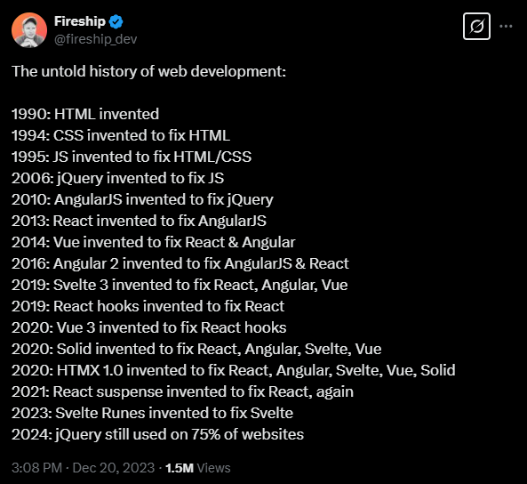



Disclaimer: I am biased …
Notes:
Resources:
https://x.com/fireship_dev/status/1737475143222317123
https://www.builder.io/blog/history-of-reactivity

Slide 3
Demo
Building web application

Slide 4

Objectives
Create user interface We need to render or create HTML page. Can be client or server side.
Listen to events We need to be able to listen for events and changes as user interaction with the page.
Update data model Once user perform action, we need to update our data model. This may be a complex change recomputing multiple values.
Update user interface Once our data model is ready, we need to synchronize changes with the HTML page (DOM).
Presenter
notifies
updates
notifies
updates
View
Model
Notes:
Resources:
https://fontmeme.com/fonts/nfs-font/

Slide 5

Episode I
Is there a better API ... ?
Notes:
Resources:
https://makeameme.org/meme/can-you-help-80jsdz

Slide 6

jQuery
Since January 2006
“It makes things like HTML document traversal and manipulation, event handling, animation, and Ajax much simpler with an easy-to-use API that works across a multitude of browsers. ”
We know how to do things; it was just about doing more.
DOM Traversal and Manipulation
Event Handling
Better DOM API
// Execute when page is ready.
$(document).ready( () => { … } );
// Register for an event.
$("p").on("click", (event) => { … });
// Set button content.
$("button.continue").html("Next Step...");
// Get a value from an input, pass a value to set it.
$("#myselect").val();
Notes:
Sources:
https://jquery.com/
https://github.com/jquery/jquery
https://api.jqueryui.com/

Slide 7
Objectives in the Age of jQuery
Create user interface Render HTML at server (static / PHP), wait for page to load to initialize jQuery.
Listen to events Using jQuery register for events.
Update data model Use jQuery.post or custom code.
Update user interface Using jQuery set value based on the change.

Slide 8


D3.js
Since February 2011
Visualization library, bring data to life
Selection
Computed properties / Transitions
Enter / Exit
Event handling
// We can use d3 like jQuery.
d3.selectAll("p").style("color", "blue");
// Create new paragraphs with given text.
const p = d3.select("body")
.selectAll("p")
.data([4, 8, 15, 16, 23, 42])
.text( value => value );
// New object enters data.
p.enter().append("p")
.text(value => value ) .attr("class", "bar");
// Object leaves data.
p.exit().remove();
Notes:
Sources:
https://d3js.org/
https://github.com/d3/d3
http://using-d3js.com/08_01_events.html
https://medium.com/@mbostock/a-better-way-to-code-2b1d2876a3a0

Slide 9
Demo
PrankWeb: Ligand Binding Site Prediction
GitHub
Demo

Slide 10

Episode II
Application is getting bigger ...
reactivity and MVVM
Notes:
Resources:
https://www.memecreator.org/meme/can-you-help-me/

Slide 11

AngularJS 1 / 3
Since 2010. “AngularJS support has officially ended as of January 2022.”
Custom HTML directives.
View, Controller separation.
Custom HTTP wrapper ($http.get(…), …).
angular.module("app", [])
// Register a controller.
// We can request injection of services like $html.
.controller("counter", function($scope, $http) {
// This is executed on binding.
$scope.value = "initial";
// All in $scope is usable from HTML.
$scope.onClick = () => $scope.count = "";
});
<!doctype html>
<html ng-app="app"> <body>
<div ng-controller="counter">
<input type="text" ng-model="value">
<button ng-click="onClick">
{{value}}
</button>
</div>
</body> </html>

Slide 12
AngularJS 2 / 3
Two-way data binding ~ synchronize two data sources.
<section ng-app="clickApp">
<div ng-controller="clickCtrl">
<button ng-click="addNum()">
<p>Add Num</p>
</button>
<p>{{count}} : {{value}}</p>
</div>
</section>
angular.module("clickApp", []) .controller("clickCtrl", function($scope){
$scope.count = 0;
$scope.value = 0;
$scope.addNum = () => $scope.count++;
// Derived value
$scope.$watch("count", (next) => $scope. value = next + 1 );
// Derived value
$scope.$watch("value", () => {
$scope.count += $scope.count % 2 === 0;
});
});

Slide 13

AngularJS 3 / 3
Two-way data binding ~ synchronize two data sources.
One-time data binding.
Change detection: dirty checking / digest cycle
Angular.js is a framework!
setInterval(() => { // NOT WORKING !
$scope.count += 1;
}, 1000);
setInterval(() => {
$scope.$apply(() => $scope.count += 1);
}, 1000);
// Internal method invoked to start the digesting, // i.e. calling all watchers.
$scope.$digest();
// $scope.$watch - view to model
// $scope.$apply - model to view
Notes:
Resources:
https://www.youtube.com/watch?v=UODIbKWGADo

Slide 14
AngularJS
Scope, digests , …
https://docs.angularjs.org/guide/scope
https://ponyfoo.com/articles/angle-brackets-rifle-scopes
https://www.newline.co/ng-book/p/The-Digest-Loop-and-apply/
https://stackoverflow.com/questions/24698620/how-does-angularjs-know-when-variables-change-how-does-angularjs-dirty-checking
https://ryanclark.me/how-angularjs-implements-dirty-checking/

Slide 15
Backbone.js
Since 2010 - …
Optional
Notes:
https://en.wikipedia.org/wiki/Backbone.js
https://github.com/jashkenas/backbone

Slide 16
Knockout
Since 2010 - 2019 (marked as feature complete)
Optional
Notes:
https://en.wikipedia.org/wiki/Knockout_(web_framework)
https://github.com/knockout/knockout
https://github.com/justlep/knockout-esnext

Slide 17
Ember.js
2011 -
Optional
Notes:
https://en.wikipedia.org/wiki/Ember.js
https://github.com/emberjs/ember.js

Slide 18
Objectives in the Age of AngularJS
Create user interface Client side rendered code with JavaScript. HTML template files with custom attributes and elements.
Listen to events Two-way data binding and event handling.
Update data model Two-way data binding. Custom code and watchers for propagations, notify about change using specialized methods.
Update user interface Two-way data binding.

Slide 19

Episode III
Notes:
You are not ready yet .. we need to talk about a few things.

Slide 20
Binding and change detection
User interface as a function of an application state.
Two-way data binding is not easy to manage for large projects as there are hidden dependencies. Watcher-Watcher
One-way data flow / one-way data binding / unidirectional data flow. Watcher-Event
Change detection (manual / automatic / publish-subscribe ).
Coarse-grain reactivity (AngularJS, React, ...)
Fine-grained reactivity
State
User Interface
Event
Change Request
Notes:
Sources:
https://stackoverflow.com/questions/34519889/can-anyone-explain-the-difference-between-reacts-one-way-data-binding-and-angular
https://reactjs.org/docs/two-way-binding-helpers.html
https://www.accelebrate.com/blog/two-way-data-binding-angular-2-and-react

Slide 21
Virtual DOM
Specification of a desired state
Browse’s DOM tree is updated to match to the Virtual DOM tree
Declarative approach
When should we re-render?
<p>Hello all!</p>
<p class="big">Hello World!</p>
const virtualDom = {
type: "p",
props: {},
children: [ "Hello all!" ],
};
const virtualDom = {
type: "p",
props: { "class" : "big" },
children: [ "Hello World!" ],
};
21
Notes:
Sources:
https://preactjs.com/tutorial/01-vdom
https://github.com/developit/htm
https://blog.angular.io/how-the-angular-compiler-works-42111f9d2549

Slide 22
Virtual DOM Example
Current state (source)
Desired state (target)
<div id=“content”>
<ul class=“list”>
<li>First</li>
</ul>
Loading items …
</div>
<div id=“content”>
<ul>
<li>Second</li>
<li>First</li>
<li>Third</li>
</ul>
<div>
Total items loaded 2.
<button>Load next</button>
</div>
Loading items …
</div>
Patch / Diffing / Reconciliation / …

Slide 23
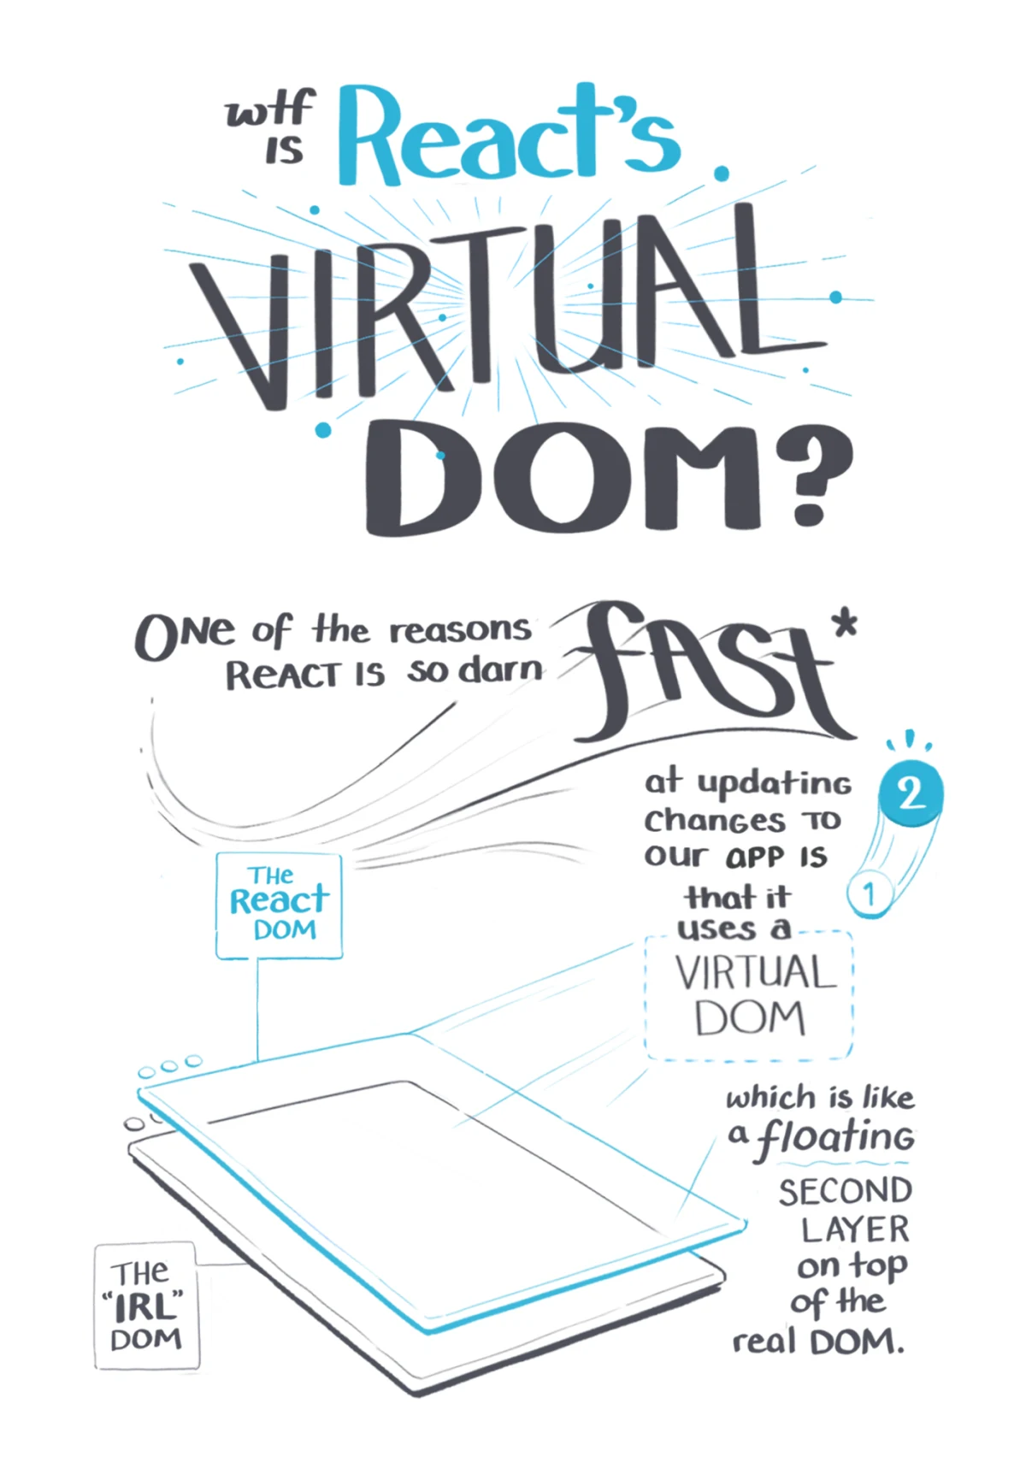

Episode III
Faster, faster ... !
"A Virtual DOM is an abstraction to simplify the act of modifying a UI."
Notes:
Resources:
https://www.memecreator.org/meme/can-you-help-me/
https://lazamar.github.io/virtual-dom/

Slide 24


React.js
Since 2010 ... "The library for web and native user interfaces"
Rendering library with a huge ecosystem.
Introduced JSX.
User interface as a function.
Virtual DOM.
Component state (unidirectional data flow)
props
state ( this.state, this.setState, useState, … )
…
React 2017 !== React 2021 !== React 2023 !== compiled React …
<?php
$post =
<div class="post">
<h2>{$post}</h2>
<p>Hey there.</p>
<a href={$like_link}>Like</a>
</div>;
Notes:
Sources:
https://beta.reactjs.org/learn Nice tutorial from JS to React
https://blog.risingstack.com/the-history-of-react-js-on-a-timeline/
https://github.com/phplang/xhp

Slide 25
React.js: JSX
React utilize JSX to let user define the desired state as a sequence of function calls. It is possible to utilize React without JSX!
<button onClick = { () => this.like() }>
Like {times} !
</button>
React.createElement("button", {
onClick: function onClick() {
return _this.like();
}
}, "Like ", times, "!");
function MediaPlayer(props) {
return ( <div> { props.playing ? ( <Button text="Stop" /> ) : ( <Button text="Play" /> ) } </div> );
}

Slide 26
React.js: Component API
class Example extends React.Component {
constructor(props) { super(props); this.state = { count: 0, name: props.name };
this.onClick = this.onClick.bind(this); }
onClick() { this.setState({count: this.state.count + 1}) }
render() { const {name, count} = this.state;
return
<div>
<p>{name} clicked {count} times</p>
<button onClick={this.onClick}>Click me</button>
</div> } }
Using ES2015 (ES6) classes. Simple inheritance, no mixins.
React.Component vs React.PureComponent.
Smart components vs. dump components.
Prefer Hooks to HOCs and Render Props.
Notes:
Resources:
https://stackoverflow.com/questions/42556083/what-does-bindthis-in-constructor-do-in-reactjs

Slide 27
React.js: Component lifecycle
Mounting
constructor
static getDerivedStateFromProps()
render()
componentDidMount()
Unmounting
componentWillUnmount()
Updating
static getDerivedStateFromProps()
shouldComponentUpdate()
render()
getSnapshotBeforeUpdate()
componentDidUpdate()
Notes:
Sources:
https://reactjs.org/docs/react-component.html
https://legacy.reactjs.org/docs/state-and-lifecycle.html

Slide 28
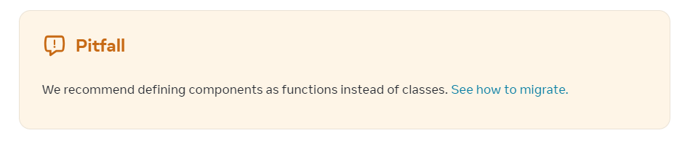
Demo
React application with Components
Notes:
Resources:
https://react.dev/reference/react/Component

Slide 29
Recompose
Recompose is a React utility belt for function components and higher-order components. 2015 - 2018, with announcement: “Hi! I created Recompose about three years ago. About a year after that, I joined the React team. Today, we announced a proposal for Hooks (Oct 25, 2018). Hooks solves all the problems I attempted to address with Recompose three years ago, and more on top of that. ….”
Hooks was just one more attempt to tackle issues of sharing common logic between components.
const enhance = withState('counter', 'setCounter', 0)
const Counter = enhance(({ counter, setCounter }) =>
<div>
Count: {counter}
<button onClick={() => setCounter(n => n + 1)}>Increment</button>
<button onClick={() => setCounter(n => n - 1)}>Decrement</button>
</div>
)
Optional
Notes:
Resources:
https://github.com/acdlite/recompose
https://reacttraining.com/blog/where-did-hooks-come-from

Slide 30
React.js: Functional components
Definition of Example component using Hooks. The component takes props (state from parent) and use useState (hook) for internal state.
React Conf 2018: React Today and Tomorrow and 90% Cleaner React With Hooks
import React, { useState } from "react";
function Example(props) {
const [count, setCount] = useState(0);
return (
<div>
<p>{props.name} clicked {count} times</p>
<button onClick={() => setCount(count + 1)}>
Click me
</button>
</div>
);
}
Notes:
Resources:
https://www.youtube.com/watch?v=dpw9EHDh2bM

Slide 31
React.js: Hooks NOT explained …
Pure rendering function.
Designed to share logic.
Selected hooks:
useState
useEffect
useMemo
useReducer
...
The main drawback is, besides code quality, the fact that we need memoize.
import React, { useState } from 'react';
function Example(props) {
const [count, setCount] = useState(0);
return (
<div>
<p>{props.name} clicked {count} times</p>
<button onClick={() => setCount(count + 1)}>
Click me
</button>
</div>
);
}
0
Notes:
Resources:
https://alexkondov.com/tao-of-react/
https://reactjs.org/docs/render-props.html
https://vuejs.org/guide/extras/composition-api-faq.html#comparison-with-react-hooks
https://reactjs.org/docs/hooks-intro.html

Slide 32
React.js
The Dark Side of useEffect in React
…
export function DarkSideOfUseEffect() {
const [count, setCount] = useState(0);
const [pressed, setPressed] = useState(false);
useEffect(() => {
console.log("Count is", count);
setPressed(!pressed);
});
return (
<div>
<p>Count: {count}</p>
<button onClick={() => setCount(count + 1)}>add</button>
</div>
);
}
Optional: 2024/2025

Slide 33
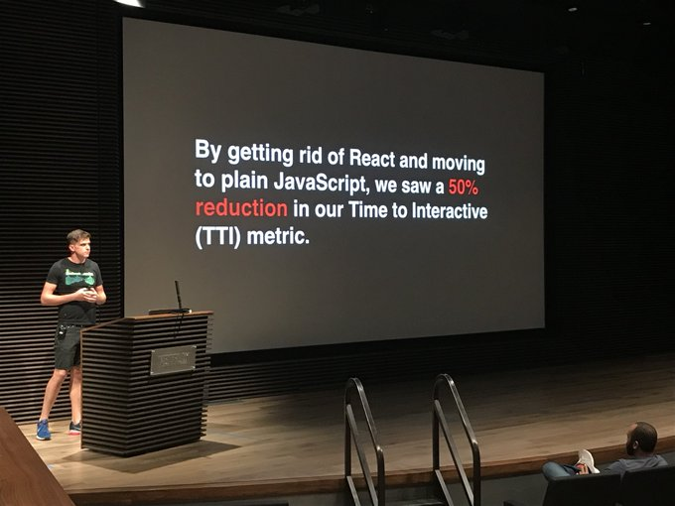
Demo
React application

Slide 34
React.js: Rendering NOT explained …
React internals (subject of change … )
Calls the root render function.
Serves hooks (useState, useEffect, … ).
Waits for something to happen (synthetic event).
Execute user code in reaction to an event.
Notification (hook called).
Calls the root render function.
Reconciliation.
Commit (write changes to DOM).
Notes:
Sources:
https://reactjs.org/docs/reconciliation.html
https://geekflare.com/react-rendering/
https://dev.to/spukas/react-work-phases-4eaj
https://indepth.dev/posts/1008/inside-fiber-in-depth-overview-of-the-new-reconciliation-algorithm-in-react
https://www.velotio.com/engineering-blog/react-fiber-algorithm
https://andela.com/insights/building-your-own-version-of-react-from-scratch-part-1/
https://beta.reactjs.org/learn/render-and-commit

Slide 35
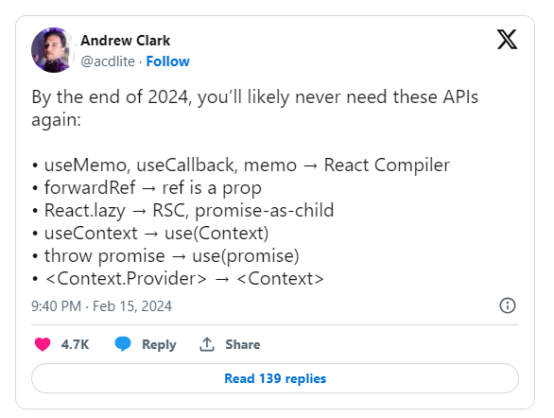
React.js: Compiler
Beta Release October 2024
React (19) is a library it does not change the code. There is a separate plugin: eslint-plugin-react-compiler
Automatic memoization (useMemo, useCallback, memo) The objective is fine-grained reactivity.
React 19, stable December 2024
Optional
Notes:
Resources:
https://x.com/acdlite/status/1758229889595977824
https://www.youtube.com/watch?v=qd5yk2gxbtg - React India 2024
https://react.dev/learn/react-compiler
https://dev.to/artiumws/react-compiler-when-react-becomes-svelte-5969
https://jherr2020.medium.com/react-compiler-with-react-18-1e39f60ae71a

Slide 36
React.js Honorable mentions
Concurrent React (React 18)
Transitions (React 18)
Actions (React 19)
Server components (React 19) Server Components renders ahead of time, before bundling, in an environment separate from your client app or SSR server.
Server Actions (React 19) Client Components can call async functions executed on the server. "use client", "use server"
Optional

Slide 37

Episode III
Faster, faster ... !
State Management

Slide 38
State management
Where do we store a state of our application? (useState /setState )
How do we share the state with other components? Props
Prop-drilling is bad!
React solution: Context: Provider, Consumer
Original idea: User interface as a function of a state. Distributed state (systems) are complicated …
Root
Header
Main
Footer
Article
Section
Button

Slide 39

Immutability
Question: How do we know what sub-tree re-render?
Answer: Immutability makes fact compare (===) possible!
"An immutable value is one whose content cannot be changed without creating an entirely new value, in comparison with mutable values."
Questions:
Developer experience:
function shouldRender<State>(previousState: State, nextState: State) : boolean {
// TODO .... ???
}
const nextState = produce(prevState, draft => {
draft[1].completed = true;
draft.push({title: "Task..."};
});
const nextState = [...prevState];
nextState[1] = { ...nextState[1], completed: true };
nextState.push({title: "Task..."};
Notes:
Resources:
https://developer.mozilla.org/en-US/docs/Glossary/Immutable
https://immutable-js.com/
https://redux.js.org/faq/immutable-data
https://media.makeameme.org/created/time-travel-f17ae03a96.jpg

Slide 40
(Single) source of truth
User interface as a function
Redux (React, ...)
Action
Action
View
View
State
Store
Reducers
Flux (React)
Vuex (Vue)
Action
Dispatch
Action
Commit
View
Dispatcher
View
Mutation
Store(s)
Render
State
Mutate
Notes:
Sources:
https://facebook.github.io/flux/docs/in-depth-overview
https://vuex.vuejs.org/
https://redux.js.org/
https://github.com/reduxjs/react-redux/tree/4.x/src/components
https://punits.dev/jargon-free-intros/why-do-we-need-a-state-management-library-in-react/

Slide 41

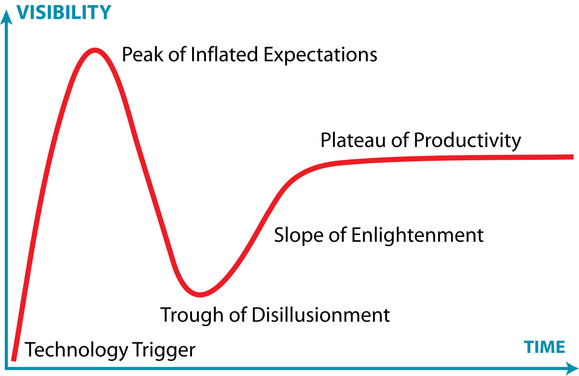
Choose your Flux implementation
Flux Comparison by Example
Facebook Flux
Fluxible by Yahoo
Reflux
Alt
Flummox
Marty.js
McFly
Lux
Material Flux
Redux
Redux + Flambeau
Nuclear.js
Fluxette
Fluxxor
Freezer
Fluxury
Notes:
Resources:
https://github.com/voronianski/flux-comparison/
https://y.yarn.co/a40784f6-b4d9-4690-bb6c-9c62e27c6a29_text.gif
https://en.wikipedia.org/wiki/Gartner_hype_cycle

Slide 42

Redux
State management library with a React binding.
const store = configureStore ({
reducer: reducer
});
const reducer = (state = new State(), action) => {
switch(action.type) {
case ActionAdd.Type:
// Immutability ! return { … state, value: state.value + 1 };
default:
return state;
}
};
// Invoke an action.
store.dispatch({ type: ActionAdd.Type });
// Register change listener.
store.subsribe(() => { … } );
// React hooks binding.
useSelector((state) => state.value ) ;
useDispatch( … );
// React HOC binding.
connect( mapStateToProps, mapDispatchToProps)(Component);
Notes:
Resource:
https://github.com/reduxjs/redux
https://react-re
dux.js.org/api/connect
https://media.makeameme.org/created/time-travel-f17ae03a96.jpg

Slide 43

The React alternative ?
Vue was created by Evan You after working for Google using AngularJS in several projects.
“I figured, what if I could just extract the part that I really liked about Angular and build something really lightweight.”
“In February 2014, that was how I first released it as an actual project. I put it out on Github and sent a link to Hacker News, and it actually got voted to the front page."
https://news.ycombinator.com/news
Notes:
Resource:
https://en.wikipedia.org/wiki/Vue.js

Slide 44

Vue.js
Since 2014.
Declarative Rendering using HTML templates
Reactivity
Single-File Component (*.vue)
Options API, Composition API (Hooks)
Custom renderer interface
Recommended (Official) libraries
Vue 2 vs Vue 3 💔
Angular.js successor (we have Angular)
<input
:value="text"
@input="event => text = event.target.value">
<div @click="doSomething">
<p v-if="seen"> {{message}}</p>
<p v-else> … </p>
</div>
<input v-model="text">
Notes:
Sources:
https://sfc.vuejs.org/
https://vuejs.org/api/custom-renderer.html

Slide 45
Vue.js: Options API / Composition API
Options API example
Composition API example
export default {
data: () => ({ count: 0 }),
methods: {
increment() {
this.count++;
}
},
mounted() {
console.log(`The initial count is ${this.count}.`);
},
}
import { ref, onMounted } from 'vue'
const count = ref(0);
function increment() { count.value++; }
onMounted(() => {
console.log(`The initial count is ${count.value}.`);
});
watch(count, async (next, prev) => { … } );
Some users moving from Options API found their Composition API code less organized and concluded that Composition API is "worse" in terms of code organization. We recommend users with such opinions to look at that problem from a different perspective.
Notes:
Sources:
https://vuejs.org/
https://vuejs.org/guide/extras/composition-api-faq.html#trade-offs

Slide 46
Demo
Vue

Slide 47
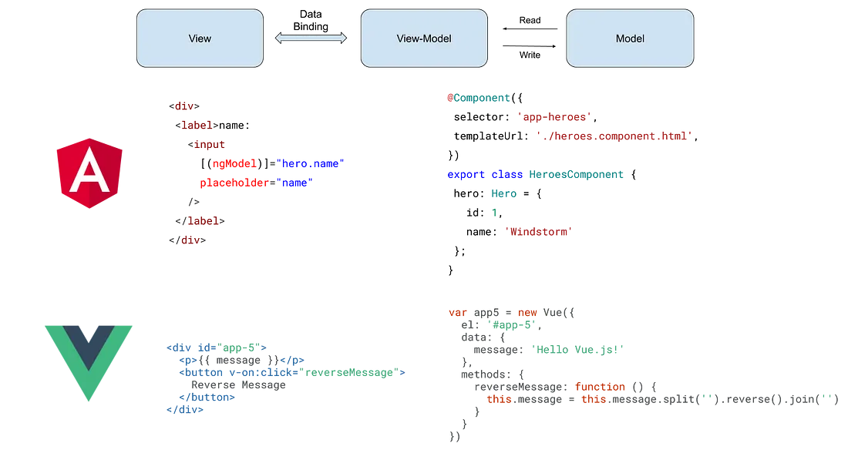
Angular, Vue.js with MVVM pattern
Notes:
Resources:
https://blog.cloudboost.io/the-state-of-web-applications-3f789a18b810

Slide 48
Reactivity
There is no need to explicitly announce change in the data by manually calling a function! Vue.js utilize runtime dependency-tracking based reactivity system.
Example with Composition API.
import { ref, computed, watch } from 'vue';
// Define reactive state.
const A0 = ref(0);
const A1 = ref(1);
// Define computed value.
const A2 = computed(() => A0.value + A1.value);
// Watch for a change, there are limitations …
watch(A2, (next, previous) => { .. });
// Set value to update all dependencies.
A0.value = 2;
ref(0)
ref(1)
computed(…)
Notes:
Sources:
https://vuejs.org/guide/extras/reactivity-in-depth.html
https://vuejs.org/guide/essentials/reactivity-fundamentals
https://vuejs.org/api/reactivity-core.html

Slide 49
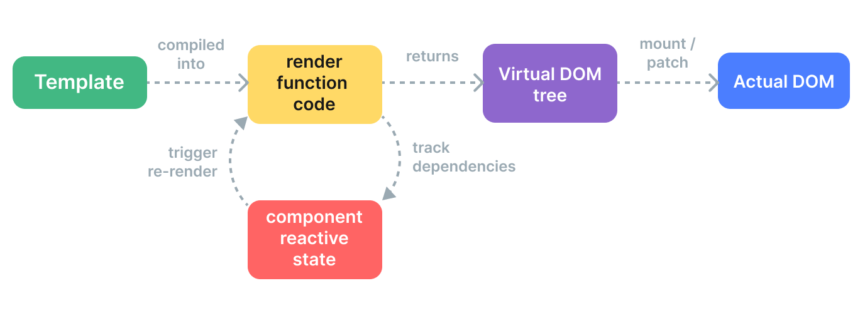
Vue.js: Virtual DOM
Compiler-Informed Virtual DOM (see Template Explorer)
<div>
<div v-if="ok">yes</div>
<span v-else>no</span>
</div>
<div> {ok.value ? <div>yes</div> : <span>no</span>} </div>
h('div', [ok.value ? h('div', 'yes') : h('span', 'no’)]);
Notes:
Sources:
https://vuejs.org/guide/extras/rendering-mechanism.html#render-pipeline
https://vuejs.org/guide/extras/render-function.html
https://vuejs.org/guide/extras/rendering-mechanism#compiler-informed-virtual-dom

Slide 50

Vue.js: Virtual DOM
The Compiler-Informed Virtual DOM is not good enough.
Vue Vapor
Vue without virtual DOM, inspired by Solid.js.
Opt-in, support only for Composition API.
Started in a separate repository, now branch in core.
<div :class="{ active }"></div>
<input :id="id" :value="value" :placeholder="placeholder">
<div>{{ dynamic }}</div>
Optional
Notes:
Resources:
https://www.vuemastery.com/blog/the-future-of-vue-vapor-mode/

Slide 51
Vue.js: Reactivity & State management
Similar time and place like React (Options API -> Composition API), state management libraries.
import { ref } from 'vue'
// ref is like reactive property in Vue 2, we use it
// to create a reference to a value we can
// directly update.
const globalCount = ref(1)
export function useCount() {
const localCount = ref(1)
return { globalCount, localCount }
}
// store.js
import { reactive } from 'vue'
// creates reactive object which can be observed
// for changes
export const store = reactive({ count: 0 });
<template>
<button @click="store.count++">
From A: {{ store.count }}
</button>
</template>
<script setup>
import { store } from './store.js'
</script>
Notes:
Resources:
https://enterprisevue.dev/blog/ref-vs-reactive-in-vue-3/

Slide 52
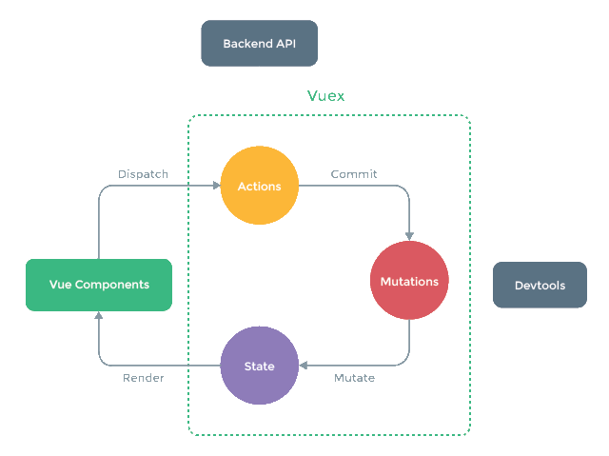
Vue.js: Vuex
"The official state management library for Vue has changed to Pinia. "
"Vuex helps us deal with shared state management with the cost of more concepts and boilerplate. It's a trade-off between short term and long term productivity."
Concept of one-way data flow.
Concepts:
State - single state tree. Connect to component using mapState helper.
Getter - way to compute derived state.
Mutation - the only way of changing a state.
Action - can be async, commit mutations.
Optional: 2023/2024
Notes:
Resources:
https://vuex.vuejs.org/#what-is-a-state-management-pattern

Slide 53

Vue.js: Pinia
We can share state using Reactivity, but distributed state is complicated.
Remember: "Not all applications need access to a global state."
Benefits of using a store:
Actions / Mutations and DevTools
Time travel
Hot module replacement
Server-Side Rendering support
…
import { defineStore } from 'pinia’
// There is also Composition API inspired syntax.
export const useCounterStore = defineStore('counter', {
state: () => ( { count: 0 } ),
actions: {
// We rely on this, so no arrow functions.
increment() { this.count++ },
},
getters: {
// Computed values
nextCount: (state) => state.count + 1
}
})
const counter = useCounterStore();
counter.increment();
Notes:
Resources:
https://pinia.vuejs.org/

Slide 54
Objectives with React.js / Vue.js < 2024
Create user interface React.js: Client side rendered, use JSX to create Virtual DOM. Vue.js: Client side rendered, use custom HTML-based syntax.
Listen to events Create custom function listening to (synthetic) events and changing state (state management). Vue.js: Use reactivity for simple values, register watchers to watch for a change.
Update data model React.js: Announce changes by calling setter from a hook or setState method, immutable data. Vue.js: Reactivity, optional immutability (for time traveling).
Update user interface React.js: Re-run rendering, React takes care of the update. Vue.js: Reactive updates.

Slide 55
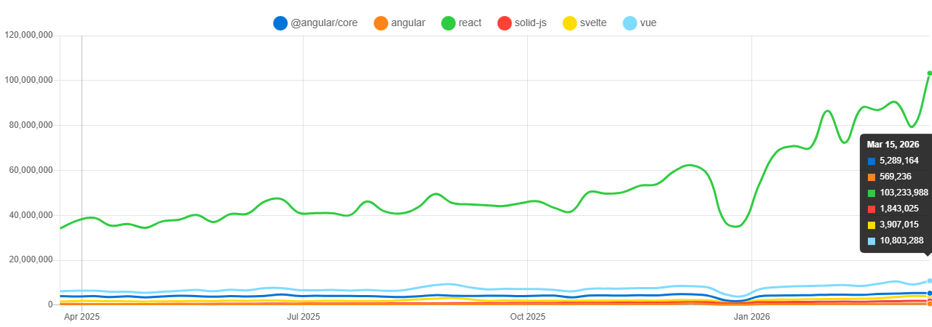
This is just the beginning ...
Notes:
Sources:
https://www.npmtrends.com/@angular/core-vs-react-vs-solid-js-vs-svelte-vs-vue-vs-angular

Slide 56
Episode IV
Notes:
Resources:
https://m.media-amazon.com/images/S/pv-target-images/af58cf4613f9e35d7701715030888ae8ee202fe82c7690903220ff440abb1dc2.jpg

Slide 57
Do we need virtual DOM?
function render() {
return (
<ul>
{items.map(item => (
<li key={item.id}>{item.name}</li>
)}
</ul>
);
}

Slide 58
Showcase
The State of JavaScript

Slide 59

Svelte
Since 2016, v3 (2019), v5 (2024), ... "Svelte converts your app into ideal JavaScript at build time, rather than interpreting your application code at run time" → "Svelte is a compiler" → Compile-time reactivity!
HTML, CSS, JavaScript ~ *.svelte
Specific use of features: labeled statement, export
HTML templates / directives: {#if loggedIn}, {#await promise}, … , on:click vs onClick, …
Lifecycle methods: onMount, onDestroy, beforeUpdate, afterUpdate , tick
Store: subscribe, writable, readable, derived, …
Svelte 3 != Svelte 5
Notes:
Sources:
https://svelte.dev/
https://svelte.dev/tutorial/basics
https://svelte.dev/examples/hello-world
https://github.com/DeMoorJasper/parcel-plugin-svelte
https://developer.mozilla.org/en-US/docs/Learn_web_development/Core/Frameworks_libraries/Svelte_getting_started

Slide 60

Svelte < 5
<script>
let count = 0;
</script>
<button on:click={++count}>
Clicked {count}
</button>
<script>
import {writable} from "svelte/store";
function createCounter() {
const {subscribe, update } = writable(0);
function increment() {
update(count => count + 2);
}
return {subscribe, increment};
}
const counter = createCounter();
</script>
<button on:click={counter. increment}>
{$counter}
</button>
Optional
Notes:
Resources:
https://media.makeameme.org/created/its-all-good-d5b72b9d28.jpg

Slide 61

Svelte and runes
Svelte < 5
Use JS syntax to add "native reactivity".
All variables in a component are reactive by default.
Derived state declared using labels.
Svelte 5 (release date October 19, 2024)
Runes internally use signals
Design similar to Vue3, explicit declaration.
Allow for easy reactivity outside the component files.
Rune $effect (like React's useEffect)
<script>
export let message = "Hi!"; // props, $$restProps
let count = 0;
let doubled = count * 2; // Initial value "optional"
$: doubled = count * 2; // Derived state, same logic!
</script>
<p>{message}</p>
<button on:click="{() => ++count}">{count}</button>
<script>
let { message = 'Hi!', ...props } = $props();
let count = $state(0);
let doubled = $derived(count * 2);
</script>
<p>{message}</p>
<button on:click="{() => ++count}">{count}</button>
runes
Notes:
Resources:
https://www.divotion.com/blog/signals-in-svelte-5-a-comprehensive-guide-to-runes
https://svelte.dev/docs/svelte/legacy-$$props-and-$$restProps
https://svelte.dev/blog/runes
https://www.youtube.com/watch?v=NR8L5m73dtE

Slide 62
Demo
Svelte 3.46.4 != Svelte 5
Notes:
Sources:
https://github.com/sveltejs/svelte/blob/master/src/runtime/internal/Component.ts
https://github.com/EmilTholin/svelte-routing

Slide 63
Signal
Popularized by SolidJS, used by Knockout (2010 - 2019)
In 2023 adopted by many frameworks (not by React as of 2025)
Allows fine-grained DOM updates!
ECMAScript proposal
 | Create | Derive state | Side effect | Access
Svelte | $state | $derived | $effect | count
Solid.js | createSignal | createMemo / createComputed | createEffect | count()
Vue 3 | ref / reactive | computed | watchEffect / watch | count.value
Angular 16 | signal | computed | effect | count()
Qwik | useSignal$ | useComputed$ | useVisibleTask$(trigger) | count.value
Notes:
Resources:
https://javascript.plainenglish.io/signals-in-svelte-solid-vue-angular-qwik-and-vanillajs-4a6138df8e52
https://github.com/tc39/proposal-signals

Slide 64
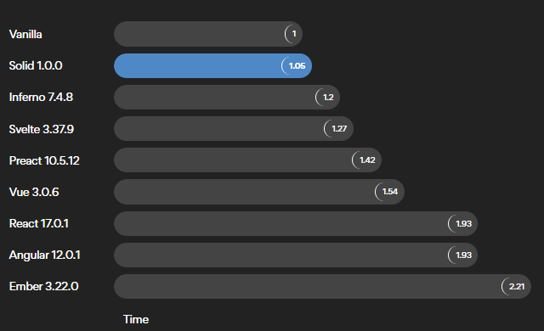
Performance
Values for 2022.
Notes:
Sources:
https://www.solidjs.com/
https://ryansolid.medium.com/javascript-ui-compilers-comparing-svelte-and-solid-cbcba2120cea

Slide 65

SolidJS
Since 2019 .. "React without Virtual DOM"
Build with signals at its core.
Use of JSX is optional, we can use html``
Reactivity (signals, memos, effects,...):
createSignal - track and react to changes
createMemo - cache calculation
createEffect - side effects
createComputes - derived state
State Management:
Store, Context
function Counter() {
const [count, setCount] = createSignal(0);
const doubleCount = () => count() * 2;
console.log("Render function runs once...");
return (
<>
<button onClick={() => setCount(c => c + 1)}>
{doubleCount()}
</button>
</>
);
}
function
function
Notes:
Source:
https://www.solidjs.com/
https://github.com/solidjs/solid
https://www.solidjs.com/tutorial/stores_context

Slide 66
Demo
SolidJS
Playground

Slide 67

Web components
Web standards:
Custom Elements
Shadow DOM
HTML templates : <template> , <slot>
class WordCount extends HTMLParagraphElement {
constructor() {
super();
const shadow = this.attachShadow( {mode: "open"} );
const value = this.getAttribute("data-value");
….
} }
customElements.define( "word-count", WordCount, { extends: "p" } );
Notes:
Sources:
https://developer.mozilla.org/en-US/docs/Web/Web_Components
https://developer.mozilla.org/en-US/docs/Web/Web_Components/Using_custom_elements#libraries
https://developers.google.com/web/fundamentals/web-components/customelements
https://reactjs.org/docs/web-components.html
https://custom-elements-everywhere.com/

Slide 68
Demo
Web Components
Lit Playground
Notes:
Sources:
https://lit.dev/
https://lit.dev/tutorial/
https://stenciljs.com/

Slide 69
Episode V

Slide 70

Alpine.js
Since 2019 ... "like jQuery for the modern web"
Small API:
15 attributes (x-data, x-on, x-text, x-model, x-for, x-init …)
6 properties
2 methods (Alpine.data, Apine.store, Alpine.bind )
Reactivity: Proxies, with
return new Function(
["__self", "scope"],
`with (scope) {
${expression}
}; `);
<script src="//unpkg.com/alpinejs" defer></script>
<div x-data="{ count: 0 }">
<button @click="count++">Increment</button>
<span x-text="count"></span>
</div>
Notes:
Sources:
https://alpinejs.dev/
https://daily.dev/blog/alpine-js-the-ultimate-guide
https://codewithhugo.com/alpine-tips/
https://codewithhugo.com/alpinejs-inspect-component-data-from-js/

Slide 71

htmx
Since 2022 ... "high power tools for HTML"
A book on how to build Hypermedia-Driven Applications using htmx.
Add HTML attributes.
API AJAX, CSS transitions, WebSockets, Server Sent events, Events, ...
Progressive enhancement
<form action="/search" method="POST">
<input class="form-control" type="search"
name="search"
placeholder="Begin typing to search users..."
hx-post="/search"
hx-trigger="keyup changed delay:500ms, search"
hx-target="#search-results"
hx-indicator=".htmx-indicator">
</form>
<script src="https://unpkg.com/htmx.org@2.0.4"></script>
<!-- Have a button POST a click via AJAX. -->
<button hx-post="/clicked" hx-trigger="click[ctrlKey]"
hx-swap="outerHTML">
Click Me!
<img class="htmx-indicator" src="/spinner.gif">
</button>
Notes:
Resources:
https://htmx.org/
https://www.youtube.com/watch?v=r-GSGH2RxJs

Slide 72

Too many choices ...
We can compare implementation in different libraries/frameworks -> component party
Stop Chasing New JavaScript Frameworks "React appears in over 57% of all job listings that mention a front-end framework, with Angular second at about 32%. Vue has a respectable share as well. "
Double down on fundamentals
Use frameworks as tools, not dogma
Build real projects (even small ones)
Keep an eye on trends, but bet on proven tech for serious work
Notes:
Resources:
https://miro.medium.com/v2/resize:fit:640/format:webp/0*AAfsfycxEBIkovqm.PNG

Slide 73




Notes:
Sources:
https://makeameme.org/meme/its-done-nowbut-12798w

