Slide 1
JavaScript eco-system II.
NSWI153 - Advanced Programming of Web Applications
2024/2025
Petr Škoda
https://github.com/skodapetr
https://www.ksi.mff.cuni.cz

Slide 2

JavaScript project in 2016
Hooks
Redux
Hooks
Material UI
Flux
Tailwind
stage-3
React
Babel
Typescript
JSX
React DOM
HTTP/2
Fetch
jQuery
Webpack
npm registry
On production you need to perform a series of pre-tasks to get your project ready that make the ritual to summon Satan look like a boiled eggs recipe.
Notes:
We need to get data from REST API and show them in a list. But we want to use JavaScript in 2016.
React DOM is for manipulating the DOM.
jQuery has wrap for AJAX.
We used to have CDN to include resources from.
With HTTP2 it make sense to split source code into multiple files, as it can handle multiple requests.
stage-3 is a reference to a Babel, which support JS features in Babel. It used to be that you need to use Typescript and then Babel to get back to ES5 compatibility.
And all of that is only 2016 …
Source:
https://hackernoon.com/how-it-feels-to-learn-javascript-in-2016-d3a717dd577f

Slide 3
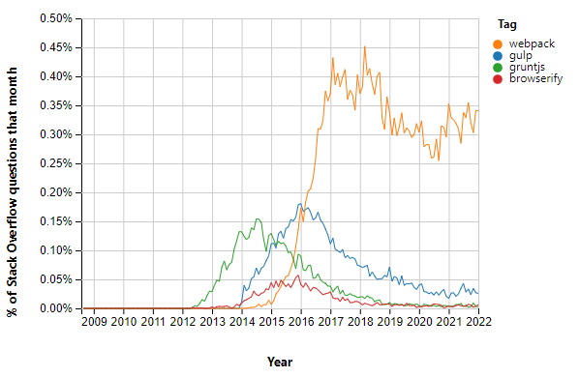
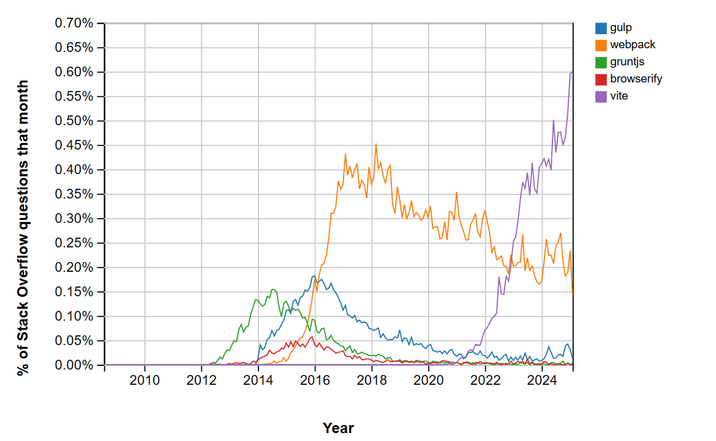
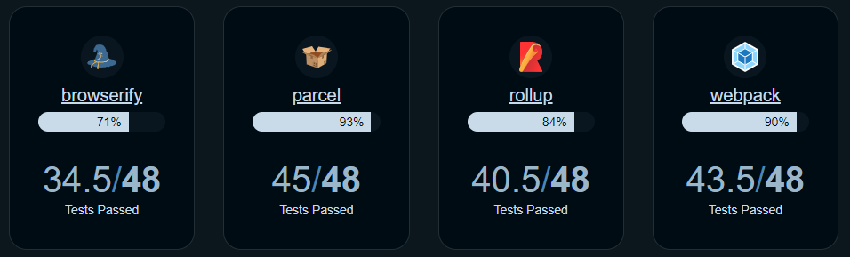
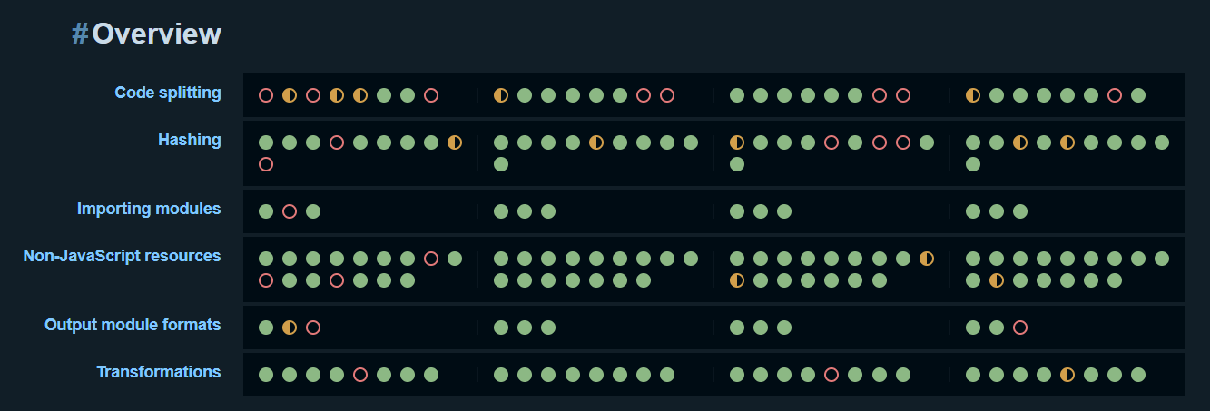
Can I speak to your manager?
CSS / HTML / JavaScript / media files
Task runner / Bundler / Bundler native ESM
Coding vs Configuration
Convention over configuration
2022/02/09
Notes:
We need to manage assets for a web page (HTML/ …). We can use bash to automate, but that is not good. Later task runners are getting less popular. A module bundler is a tool that bundle, initially, all JavaScript resources into a single file.
Left image is about supported features in predefined tests, right represents questions on stackoverflow.
Test are from several categories: code splitting, hashing, importing modules (common JS, ES, node_modules), non-JS resources, output module formats, transformations.
Bundlers focus on combining static assets.
Sources:
https://www.ionos.com/digitalguide/websites/web-development/gulp-vs-grunt-differentiating-between-the-task-runners/
https://blog.logrocket.com/node-js-task-runners-vs-module-bundlers/
https://insights.stackoverflow.com/trends?tags=gulp%2Cwebpack%2Cgruntjs%2Cbrowserify
https://bundlers.tooling.report/

Slide 4
Expectations
Copy files
Apply tools (tsc, sass, babel)
Run tests
Dev server
Hot reloading
HTTPS (self signed certificate)
API proxy
Code splitting
Dynamic imports
Tree shaking
Shared bundles
Minification
Compression
…

Slide 5
Browserify
Consider: 2023/2024
Notes:
https://browserify.org/ [2011] Bundler Pure bundler, as such it must be used with task runner like Gulp or Grunt. Focus on using Node.js packages in frontend ~ used to be a close competitor to webpack.

Slide 6
Grunt: The JavaScript Task Runner
Consider: 2023/2024
Notes:
https://gruntjs.com/ [2011-2012] Task Runner Employ temporary files. Focus on plugin configuration (tasks), there is a huge number of plugins ~6K. Configuration is huge nested object.

Slide 7
Gulp.js
Task runner, 2013
Programming over configuration.
Build pipelines using tasks Over 2.7K plugins
Task composition: series(), parallel()
Configuration file – JavaScript/…
Employ (memory) streams and pipelines
Watching files: watch()
Developer survey in May 2024.
Version 5 in March 2024.
const { src, dest } = require('gulp');
exports.default = function() {
return src('src/*.js') .pipe(dest('output/'));
}
exports.build = series(
clean,
parallel(
cssTranspile,
series(jsTranspile, jsBundle)
),
parallel(cssMinify, jsMinify),
publish
);
Notes:
Gulp is design to automate a build pipelines consisting of tasks. Pipelines are specified in JavaScript/Typescript/… file.
Example load all files and move them to other location. We can apply transformations along the way. Other example is a composition of tasks into a pipeline.
“watch” allow to execute task when a file change.
Compare to Grunt:
Use memory streams
Sources:
https://gulpjs.com/
https://medium.com/gulpjs/introducing-the-gulp-developer-survey-cc227fc2fb6d

Slide 8
Broccoli
Consider: 2023/2024
Notes:
https://github.com/broccolijs/broccoli [2013 - 2021] Task Runner Build resources using pipelines.

Slide 9
Turbopack
Consider: 2023/2024
Notes:
https://vercel.com/blog/turbopack
Rust-based successor to Webpack, use since Next.js 13

Slide 10
Webpack
Bundler, 2012
Complex configuration Zero-configuration with Webpack 4
Handles non-code assets (images, css, … ) with require ES6 module syntax
Loaders
Plugins
Notes:
Configuration similar to Grunt or Gulp. Primary focus is on combining JavaScript files with require statements. Before we may need Browserify + Gulp, Webpack can handle all.
Webpack can load JavaScript and JSON, for other formats it needs loaders. For example, reading raw text, css or TypeScript. Overall loader transform a single module.
On the other hand, Plugin can do much more like optimization, injection of environment variables.
Sources:
https://webpack.js.org/
https://webpack.js.org/concepts/hot-module-replacement/

Slide 11
Demo
Webpack & LinkedPipes: ETL
Notes:
Start with common.js next is production.js then develop.js. I hope this shows the complexity. Also, we are missing hot-reloading!
Do not try this at home, the code is old – initial commits 2018-07-30
https://github.com/linkedpipes/etl/commit/34ce8224d6f442b1fd4120b1716bed5d89926f8f

Slide 12
Rollup
Consider: 2023/2024
Notes:
https://rollupjs.org/ [2015] Task Runner Easier configuration compared to Webpack, easier plugin implementation.

Slide 13
Parcel.js
Zero-configuration bundler, 2017 (V2 2020), you can use: JavaScript, HTML, CSS, CSV, TypeScript, CoffeScript, Sass, Stylus, Less, SugarSS, Vue, Elm, JSON, TOML, GraphQL, YAML, GLSL, Prug, MDX, XML, …
Notes:
: Mention only briefly, use it as a steppingstone towards Vite.
Webpack is hard to configure, there is an alternative. Parcel can take a file (like HTML) and scan and prepare all what is needed. You need to use the right plugin, but Parcel.js can load it for you automatically.
Sources:
https://parceljs.org/

Slide 14
Demo
Parcel.js & datova-kancelaria
Notes:
The configuration is much smaller.
https://github.com/datova-kancelaria/nkod-software/tree/f7ac55b14013be3f5ccd218070120d6495106b57
Showcase: JavaScript, SCSS, …

Slide 15
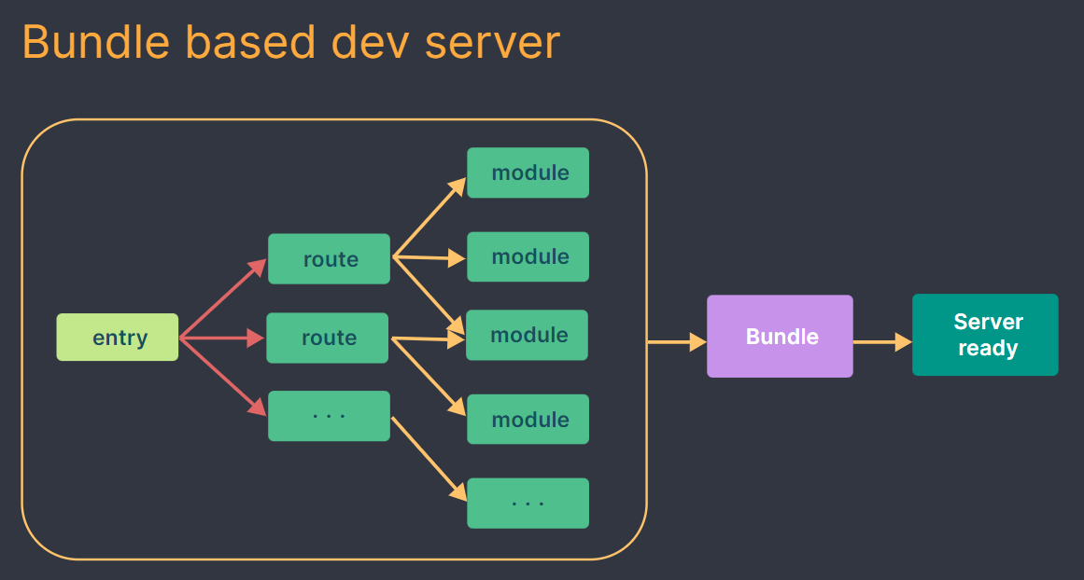
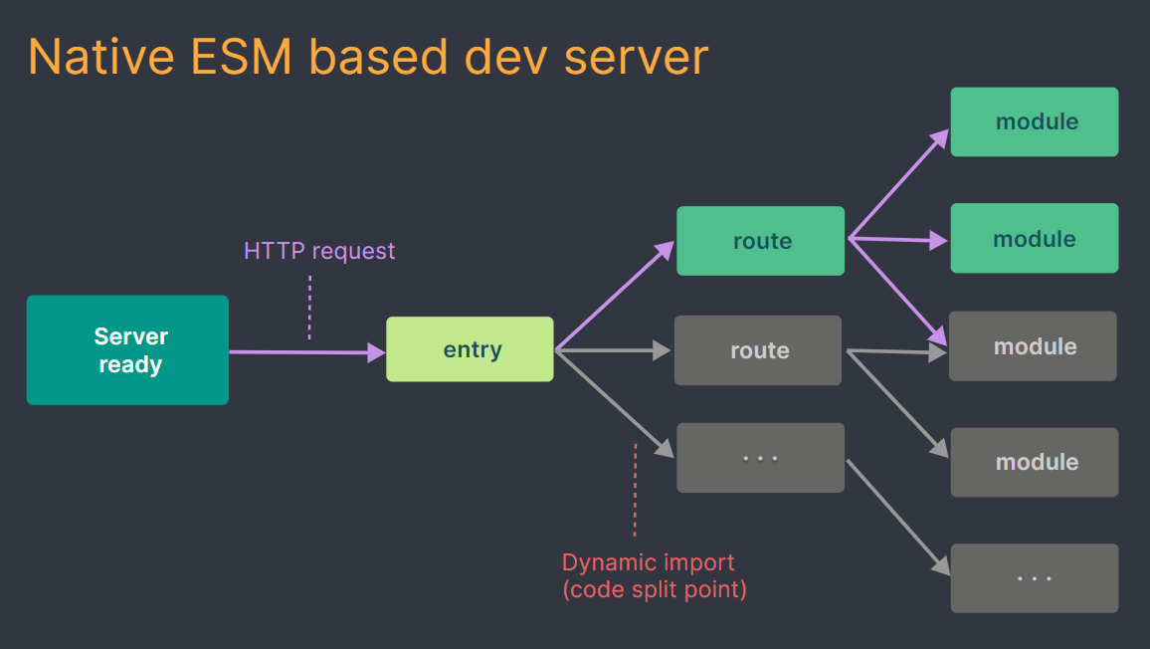
Vite
Bundler, 2020
Wrap esbuild, native ESM modules
Unbundled deployment TODO: Explain better
Notes:
The idea is to employ native Javascript modules (ESM).
Resource:
Images are from Vite documentation.
https://vitejs.dev/guide/why.html#how-is-vite-different-from-x
https://blog.konnor.site/misc/bundlers-and-beyond/

Slide 16
Vite
The basic idea is we write something and want something else to be produced.
import React from "react";
inject HRM, source maps (vite)
bundle.js
strip out types
(esbuild)
changes
index.html
develop
update module imports (vite, webpack)
index.html
compile jsx -> js
(tsc, babel, ...)
main.ts
production
bundle
(rollup)
bundle.js
type check
(tsc)
application.tsx
Add polyfills
Framework specific: vue, svelte, ..
Inject variables
...
Optimized and minified
Work in all browsers
HMR (dev-only)
Last update 2025-03-25
Notes:
Start with what we want and what we write.
) Optimized also mean unused code is removed.
) The esbuild is super fast bundler, basically a transpilation.
) for js to jsx : use babel especially when we need more transformation or polyfills
) A polyfill is a piece of code (usually JavaScript on the Web) used to provide modern functionality on older browsers that do not natively support it.
) We can not use import "react", for browser we need relative path with extension. We need to resolve modules and update the pats.
) When in production, we use rollup bundler, compare to eslint it is more mature with large ecosystem.
) HRM first time I've seen was webpack. We just add a lot of Javascript.
Resources:
https://www.youtube.com/watch?v=M_edImKoEt8

Slide 17
Demo
Vite & hot deployment

Slide 18
Create React Application
Set up a modern web app by running one command.
React specific libraries and functionality.
You can “eject” from the CRA to webpack, Babel, ESLint, ...
React's documentation, released on 2023-03-16, no longer recommends CRA as the go-to solution for creating React applications.
npx create-react-app my-app
cd my-app
npm start
Out of date
Notes:
This is sort of a library specific tools wrapping what we need to develop our application.
Issues with used tools, dependencies, warnings, … removed from official documentation in 2023.
For example, starting dev server may take up to 80s on CRA and under a second with Vite (depends on a project).
Resources:
https://create-react-app.dev/
https://dev.to/ag2byte/create-react-app-is-officially-dead-h7o
https://luketheweb.dev/blog/what-is-vite-and-why-should-you-use-it-instead-of-create-react-app

Slide 19
Testing
Units Tests / Integration Tests / Regression Tests
Test-Driven Development
UI Tests / End-to-End testing (e2e)
Asynchronous Testing
Browser Specific
Notes:
Asynchronous testing ~ imagine sending a HTTP request where you need to wait. Now consider JS is a single thread application with promises. As such the test function ends before it can be evaluated.

Slide 20
Testing
Test Framework
Assertions
Stubs / Mocks
Code Coverage
Browser
describe('GitHub', function () {
describe('LandingPage', function () {
it('should not contain kitten', function () {
driver.get('http://github.com');
chai.expect('#site-container h1.heading').dom.to.not.contain.text("I'm a kitty!");
} } }
Notes:
What we need:
Framework are about running tests, run them and show the result.
Assertions allow us to express the test.
Stubs / Mocks (Test Double Library) to answer what was called and how many times.
Code Coverage to know what was tested, important for introducing tests into legacy code.
Browser to run test in a specific environment.
Example: Mocha, Selenium, Chain.
References:
https://mochajs.org/ - [Test Framework] design to run and report test results. In the example. Without assertion library or stub library.
https://jasmine.github.io/ - [Test Framework] with assertions and test doubles (stubs / mocks)
https://karma-runner.github.io/latest/index.html – [Browser Testing] Using a web server executes test code in a spawned browser (Chrome, Firefox) instances. It can run in multiple browsers and devices. Mocha can do that as well, but the focus is different.
https://www.chaijs.com/ - [Assertion Library] (assert, expect, should).
https://istanbul.js.org/ - [Code coverage]
https://sinonjs.org/ [Stub Library] Can also mock whole HTTP server.
https://selenium.dev/ - [Browser] automation (browser specific drivers), not only for testing.
Specialized libraries may offer better functionality and allow for modular test design.

Slide 21

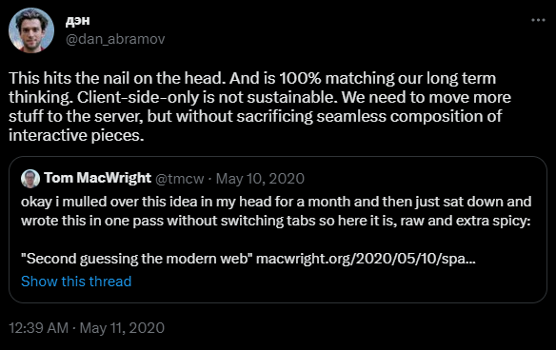
Meta-Frameworks
Did somebody say .. server-side rendering?
Next.js (React)
Nuxt.js (Vue)
Gatsby (React)
Remix (React)
Astro (React, Vue, Lit, Svelte, …)
…
Features:
Build-in Optimizations (Images, fonts, ..)
Data fetching / Server Actions
Route handlers
SSR
…
Notes:
The objective is to address the deployment and provide you with the environment.
- - - - - - - - - - - - - - - - - - - - - - - - - - - - - - - - - - - -
Dan Abramov - author of Redux,
https://twitter.com/dan_abramov/status/1259614150386425858
React was released 2013, ~2016 the Framework of choice
Resources:
https://nextjs.org/
https://astro.build/
https://www.gatsbyjs.com/
https://remix.run/
https://nuxt.com/

Slide 22
Server-side
Server-Side Rendering (SSR)
Why
Faster time-to-content
Unified mental model
Better SEO
Why NOT
Setup
Server load
Browser / Server specific code
Dehydration / Hydration
Static Site Generation (SSG)
User independent rendering
Easier deployment
<p><div>hi</div></p>
Notes:
We can not use client specific functionality on server and vice versa, for example no window or document. In addition, templates (for Vue) are compiled in a different way on server (string) and client (Virtual DOM). For example (Vue) onMounted or onUpdated methods are not called on the server side. Global state is shared among multiple client requests on the server side.
If you've already pre-rendered or server-side-rendered your application to HTML. But then we need JS to take back control ~ hydration.
There can be issues with hydration where browser parse the DOM producing mismatch. Frameworks can handle some of this, yet there is performance penalty.
We also need to manage routing, data fetching, and state management stores in a universal manner. A solution might be to go with higher level tools. Vue (Nuxt, Quasar, Vite SSR) or React (Next, ).
We may need both of them, depending on the page at hand.
Sources:
https://vuejs.org/guide/scaling-up/ssr.html#overview

Slide 23
Server-side
Features
Image optimization
Internationalization
Zero Configuration
Hybrid: SSG and SSR
Incremental Static Regeneration
Routing
API Routes
Built-in CSS Support
Production build
Building Blocks
User Interface
Routing
Data Fetching
Rendering
Integration
Infrastructure
Performance
Scalability
Developer Experience
Notes:
Features:
For example, Next.js pre-renders every page by default. React 18 propose only server-side components, which are not rendered on client side at all. We can choose rendering method on per-page basis.
Static Regeneration is for Static Site Generation (SSG).
Routing – Next.js will employ File-system routing, so there is no need for input index.html and index.js. Frameworks will mostly force a directory structure upon you.
Production – Compilation for given browsers, Minifying, Bundling, Code Splitting, Tree-Shaking.
For each block we can build it our-self or use existing solution.
UI – how user interacts with out application.
Rendering – when and where render the static and dynamic content.
Integration – auth, payments, …
Infrastructure – where to deploy and run code (Serverless, CDN, Edge, ..)
Origin – the server that store and run the original code.
Content Delivery Network – for static sites on multiple locations around the world.
Edge – is a concept, servers close to the user. CND can be part of the Edge, the difference is that Edge can run the code.
Scalability – also include developer team size
Developer Experience – a dev server for example.
Data Fetching – client / server side. We can have unified interface (Gatsby with GraphQL) over data sources like file system, API WordPress ... Remix for example join HTTP API declaration and use in fronted, so you do not need that separately – we can read files in client code from server inside a loader. This also help to reduce the data size making sites load faster.
For example, React only provide user interface, but dos not deal with the rest, not even where the rendering should take place.
Frameworks aim to fill in the missing building blocks. Some frameworks can be added additively into an existing application. For example, Next.js may will in more to a React application compared to Nuxt.js to a regular Vue application.
Some provide even ability to build cross-platform applications, like Quasar for Vue ,(more on write that later). To make this work Quasar provide custom set of components.
Sources:
https://nextjs.org/
https://nuxtjs.org/
https://www.gatsbyjs.com/
https://quasar.dev/
https://remix.run/

Slide 24
Demo
Server-side rendering (SSR)
Notes:
Resources:
https://github.com/bluwy/create-vite-extra/tree/master/template-ssr-vanilla

Slide 25
Small to medium React projects
You might not need a toolchain:
<script src=“…/react.production.min.js" crossorigin></script>
<script src=“…/react-dom.production.min.js" crossorigin></script>
<script src=“…/babel.min.js"></script>
<script type="text/babel“> …. </script>
You might need a toolchain:
npm create vite@latest my-application -- --template react
You might need a ….
npx create-next-app@latest
Notes:
Sources:
https://reactjs.org/docs/create-a-new-react-app.html

Slide 26

(Mono)repository
Git Submodules
A single repository for your code
NPM / YARN Workspaces
Lerna, Turborepo, Nx
Notes:
Dependency detection and code linking.
Build process can also be optimized.
While this increase coupling, it actually allows to better decouple UI and Service/Business layer into multiple projects.
Turborepo
CI/CD shared caches
Compatible with Lerna / NPM, YARN V1 workspaces
Nx – more powerful, can replace workspaces / Lerna, code Generators, extensible by plugins.
Source:
https://nx.dev/
https://turbo.build/
https://lerna.js.org/

Slide 27
Turborepo
Consider: 2023/2024
Notes:
Resource:
https://turbo.build/

Slide 28
Nx
Consider: 2023/2024
Notes:
Resource:
https://nx.dev/

Slide 29
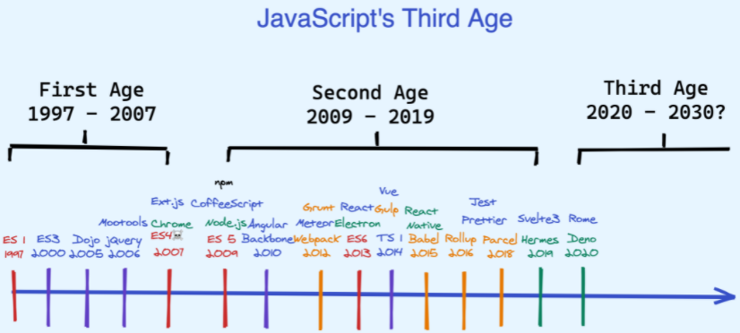
JavaScript age
Notes:
The First Age was about building out a language
The Second Age was about users exploring and expanding the language
The Third Age is about clearing away legacy assumptions and collapsing layers of tooling. Also, the tools may not be implemented in JavaScript.
Source:
https://www.swyx.io/js-third-age/

