Slide 1
JavaScript eco-system
NSWI153 - Advanced Programming of Web Applications
2025/2026
Petr Škoda
https://github.com/skodapetr
https://www.ksi.mff.cuni.cz

Slide 2
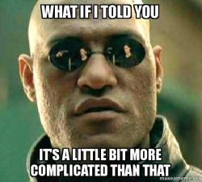
Demo
Starting point

Slide 3
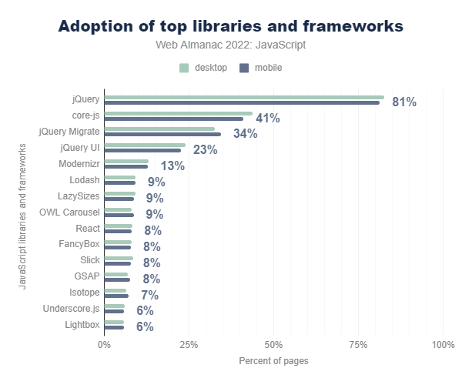
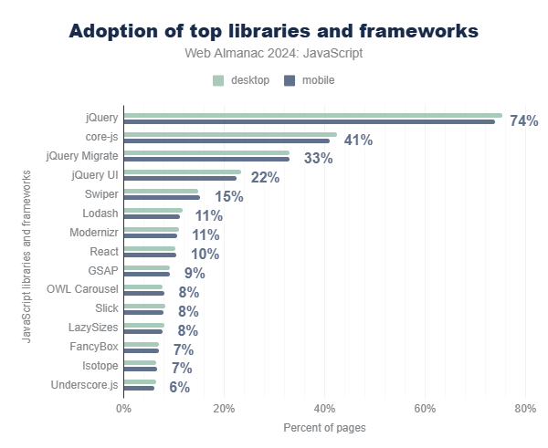
State of JavaScript
Notes:
Resources:
https://almanac.httparchive.org/en/2022/javascript
https://almanac.httparchive.org/en/2024/javascript

Slide 4
CSS Libraries and Frameworks 1 / 2
Bootstrap
Grid system, components, JavaScript plugins
Material Design
Design system, Web library of components,
Tailwind
Use CSS classes instead of CSS styles, style directly from HTML
Component libraries, CDN, optional build step, custom CLI
<div class=“modal”>
<div class=“modal-dialog”>
<div class=“modal-content”>
<div class=“modal-header”>
<h5 class=“modal-title”>Title</h5>
</div>
<div class=“modal-body”> … </div>
<div class=“modal-footer”>
<button type=“button”
class=“btn btn-primary”>
Save changes
</button>
</div> </div> </div> </div>
<md-dialog>
<div slot=“headline”>Title</div>
…
</md-dialog>
<div class="pt-6 md:p-8 text-center md:text-left space-y-4"> … </div>
Notes:
Resources:
https://getbootstrap.com/docs/5.3/getting-started/introduction/
https://m3.material.io/
https://tailwindcss.com/
https://code.gov.cz/gov-cz/gov-design-system/

Slide 5
CSS Libraries and Frameworks 2 / 2
shadcn/ui
"A set of beautifully-designed, accessible components and a code distribution platform. Works with your favorite frameworks. Open Source. Open Code."
Notes:
Resources:
https://ui.shadcn.com/

Slide 6
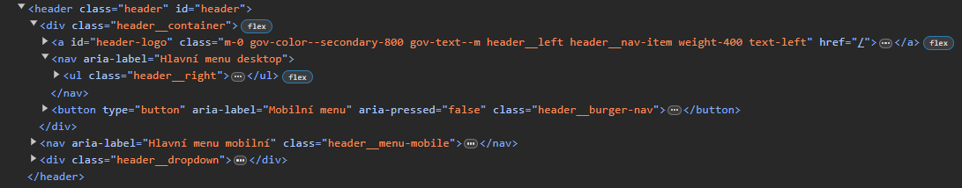
Quiz
.header__right
.header__right { display: none }
@media(min-width: 1024px) {
.header__right {display:flex; gap: .5rem }
}
Notes:
Source:
https://edoklady.gov.cz/

Slide 7
CSS preprocessors
Syntactically Awesome Stylesheets (SASS)
Leaner CSS (LESS)
.gov-container{
display:block;
width:100%;
max-width:calc(
var(--gov-container-width, 73.75rem) +
2*var(--gov-container-padding, 2.5rem));
margin-right:auto;
margin-left:auto;
padding-right:var(
--gov-container-padding-mobile, 1.25rem);
padding-left:var(
--gov-container-padding-mobile, 1.25rem)}
*.SASS
MAGIC BOX
*.CSS
@mixin container() {
display: block;
width: 100%;
max-width: calc($container-width + (2 * $container-padding));
margin-right: auto;
margin-left: auto;
padding-right: $container-padding-mobile;
padding-left: $container-padding-mobile;
…
}
$class: ".gov-container";
#{$class} {
@include container();
}
Notes:
Sources:
https://css-tricks.com/sass-vs-less/ from 2012
https://www.npmjs.com/package/sass-browser
https://lesscss.org/usage/

Slide 8




Package managers
The basics
npm NodeJS default.
yarn Introduced 2016 to address issues with npm.
pnpm Improve package sharing among projects.
Cool kids
Deno Package Manager
Bun
Monorepo / Workspace
Turborepo
Nx
Lerna
Component manager
bit
Notes:
Sources:
https://www.section.io/engineering-education/npm-vs-yarn-which-one-to-choose/
https://dev.to/arcanis/introducing-yarn-2-4eh1

Slide 9



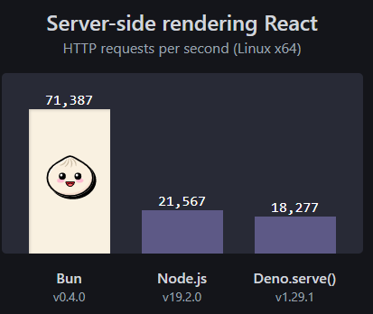


JavaScript runtime
Node.js 0.0.1 (2009), ...
Asynchronous event-driven JavaScript runtime
Deno 0.1.0 (2018), ...
Native TypeScript and WebAssembly support with build-in linter, prettier, test runner
Secure by default with no access to file system, network, environment variables, …
Custom dependencies management using deno.json
Bun 0.0.0-8 (2021), ...
Bun is a fast all-in-one toolkit
Experimental native build for Windows
Notes:
Resources:
https://blog.risingstack.com/history-of-node-js/
https://github.com/nodejs/node-v0.x-archive/tree/v0.0.1
https://techcrunch.com/2017/04/07/tracking-the-explosive-growth-of-open-source-software

Slide 10
Demo
SASS

Slide 11


Introducing HTML to JavaScript
JavaScript XML (JSX)
Transpilation
Hyperscript Tagged Markup (HTM)
Tagged templates html`x` ~ html(x, …variables)
function WelcomePage(name) {
return <p className=“high">Hi {name}!</p>;
}
function WelcomePage(name) {
return html`<p class=“high">Hi ${name}!</p>`
}
Babel
"use strict";
function WelcomePage(name) {
return /*#__PURE__*/ React.createElement( "p",
{ className: “high“ },
“Hi ", name, "!");
}
Notes:
Source:
https://reactjs.org/docs/introducing-jsx.html
https://babeljs.io/repl
https://github.com/developit/htm
https://developer.mozilla.org/en-US/docs/Web/JavaScript/Reference/Template_literals#tagged_templates

Slide 12
Demo
Babel & JSX
Notes:
Resources:
https://babeljs.io/repl

Slide 13
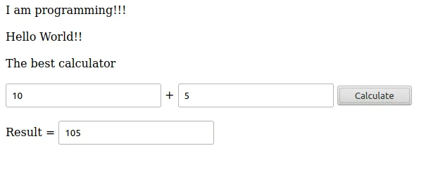
JavaScript
JavaScript suffers …
being too weakly typed …
Solutions:
Comments
JS proposal type annotations
Specialized solutions
JavaScript dialects
function equals(x: number, y: number): boolean {
return x === y;
}

Slide 14

Static type checker
Flow
Static type checker for JavaScript
Works with explicit types of variables, members, and function args
Inferred from assignments
Extended syntax for type annotations (like type hinting in PHP)
Checker scans the code for possible type violations
Plugins exist for various IDEs, also may enhance intellisense
// @flow
function square(n) { return n * n; }
function mulStr(str: string, times: number): string { … }

Slide 15
Typescript
Superset of JavaScript that introduces strict typing
Compiled (transpilled) to JavaScript whilst type constraints are checked.
Designed and maintained by Microsoft.
Probably the most widely-spread dialect of JavaScript.
Key Features
Type annotations (variables, members, arguments) and type inference
Both class annotations and standalone interfaces (for non-class objects)
Generics (re-usable parametrized type declarations)
…
"TypeScript is a popular choice for programmers accustomed to other languages with static typing, such as C# and Java."
Notes:
Sources:
https://www.typescriptlang.org/
https://www.typescriptlang.org/docs/handbook/typescript-in-5-minutes-oop.html

Slide 16
Typescript : Types
Basic: string, number, boolean, symbol, bigint, null, undefined
Arrays
Object types, Interfaces, Classes
Union types number | string | null
Enums enum State { Queued, Failed = "failed" }
Tuples [ string, number ]
Special: any, unknown
….
Notes:
Source:
https://www.typescriptlang.org/docs/handbook/2/everyday-types.html#differences-between-type-aliases-and-interfaces

Slide 17
Typescript : Basic syntax
type Pipeline = {
url: string,
name: string;
components: {
x: Number,
y: Number
} [],
};
interface PipelineService {
listPipelines(): string[];
pipeline(): Promise<Pipeline | null>;
}
class Local implements PipelineService {
private readonly directory: string;
constructor(directory: string) {
this.directory = directory;
}
…
}
const rootPath = '/data/storage';
const service = new Local(rootPath);

Slide 18
Demo
TypeScript

Slide 19
Typescript: Narrowing
Using type guards (if conditions) to handle specialized situations
Typescript understand important type-restricting operators: typeof, in, instanceof, equality, casting to bool, …
It is a shaped-based language. Two types of the same shape are same.

Slide 20
Demo
TypeScript : Narrowing
Notes:
Resources:
https://www.typescriptlang.org/play

Slide 21
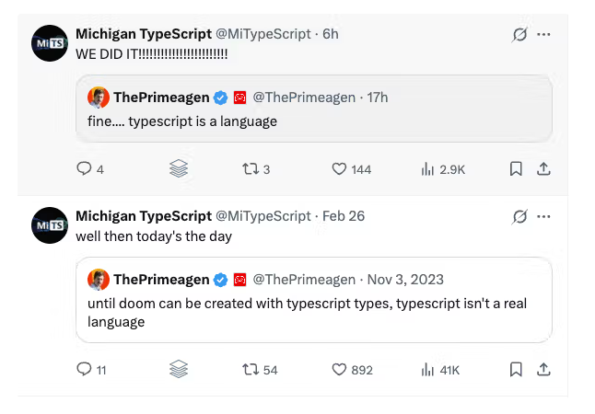

TypeScript
Michigan TypeScript Founder Successfully Runs Doom Inside TypeScript's Type System (2025-03).
Notes:
Resources:
https://socket.dev/blog/typescript-types-running-doom

Slide 22

ELM
It is a functional language that compiles to JavaScript.
Features:
Focuses more on form, not on implementation details
Shorter code (in many cases)
Static typing (less error prone)
Naturally immutable data structures
Specifically designed to declaratively create GUIs in web browsers
Simple interoperability with HTML and CSS using virtual DOM approach
Pure JavaScript interoperability via ports. Ports are abstractions that allow message exchange (similar to workers)
Notes:
Sources:
https://guide.elm-lang.org/

Slide 23
ELM : Example
import Browser
import Html exposing (Html, button, div, text)
import Html.Events exposing (onClick)
main = Browser.sandbox { init = 0, update = update, view = view }
type Msg = Increment | Decrement
update msg model = case msg of
Increment -> model + 1
Decrement -> model - 1
view model = div [] [
button [ onClick Decrement ] [ text "-" ]
, div [] [ text (String.fromInt model) ]
, button [ onClick Increment ] [ text "+" ] ]

Slide 24


Code style and beyond
ESLint
A tool that analyses source code Marks errors, suspicious constructs, stylistic errors, …
Logic error related rules: getter-return, no-unused-vars, no-unreachable, …
Essential for interpreted languages as there is no compilation
Customization
Prettier
An opinionated code formatter
Supports many languages
Notes:
Resources:
https://eslint.org/
https://eslint.org/docs/rules/
https://prettier.io/

Slide 25
Demo
ESLint & Prettier
Notes:
Resources:
https://eslint.org/play/
https://prettier.io/playground/

Slide 26

Takeaway
CSS preprocessors
CSS libraries and frameworks
Package managers
Working with HTML in JavaScript
There are alternatives to JavaScript
TypeScript overview (class, type, interface, generic, guards, … )
Linter & Prettier

