Slide 1
Sharing is caring
NSWI153 - Advanced Programming of Web Applications
2025/2026
Petr Škoda
https://github.com/skodapetr
https://www.ksi.mff.cuni.cz
Notes:
We employ PHP for context, yet many of the concepts are not limited to PHP.

Slide 2
This lecture in context
Original title "Higher Level Concepts"
Libraries banned for NSWI142
Resources:
Books
Libraries / Frameworks
Lectures / Seminars
…

Slide 3
Design Patterns
Technology tools come and go. Patterns stay.
Notes:
Source:
https://blog.cloudboost.io/the-state-of-web-applications-3f789a18b810

Slide 4
Gang of Four Design Patterns [1995]
.. a reusable and flexible design is difficult if not impossible to get "right" the first time ... Yet experienced object-oriented designers do make good designs. Meanwhile new designers are overwhelmed by the options … Each design pattern systematically names, explains, and evaluates an important and recurring design in object-oriented systems. … Design patterns make it easier to reuse successful designs and architectures. A pattern has: pattern name, problem, solution, consequences.
Categories:
Creational Patterns for the creation of objects : Builder, Singleton,…
Structural Patterns to provide relationship between objects : Adapter, Facade, Proxy, …
Behavioral Patterns to help define how objects interact : Command, Observer, Strategy, …
Notes:
Resource:
https://springframework.guru/gang-of-four-design-patterns/
Design Patterns Elements of Reusable Object-Oriented Software [1995]

Slide 5
Dependency Injection
Inversion of control
Component is not responsible for seeking its own dependencies
Dependencies are injected externally
Declaring dependencies In configuration, by annotations, using reflection, …
/**
* @component WelcomePage
*/
class WelcomePageController implements IController
{
/** @inject IDatabase */
public $database;
...
}

Slide 6
Example of Dependency Injection
Example implementation in PHP.
function processDocComment($comment) {
if (preg_match_all('/@[-a-zA-Z()_]+/', $comment, $matches)) ...
}
// ...
$refClass = new ReflectionClass('WelcomePageController');
processDocComment($refClass->getDocComment());
foreach ($refClass->getProperties() as $property) {
processDocComment($property-> getDocComment()); ...
}
foreach ($refClass->getMethods() as $method) {
processDocComment($method->getDocComment()); ...
}

Slide 7
Example of Dependency Injection
Example in Java using Spring.
@Service
public class Configuration { … }
@Service
class WebServer {
@Autowired
public WebServer( Configuration configuration { … }
@PostConstruct
public void onInit() { … }
}
<?xml version="1.0" encoding="UTF-8"?>
<beans:beans … >
<mvc:annotation-driven/>
<context:component-scan
base-package="com.linkedpipes…"/>
<beans:bean
id="jsonMessageConverter“
class="org.…"/>
</beans:beans>
Notes:
Resources:
https://github.com/linkedpipes/etl/blob/develop/executor-monitor/src/main/java/com/linkedpipes/etl/executor/monitor/web/WebServer.java
https://github.com/linkedpipes/etl/blob/develop/executor-monitor/src/main/resources/web/spring/context-web.xml

Slide 8
Demo
Design Patterns

Slide 9
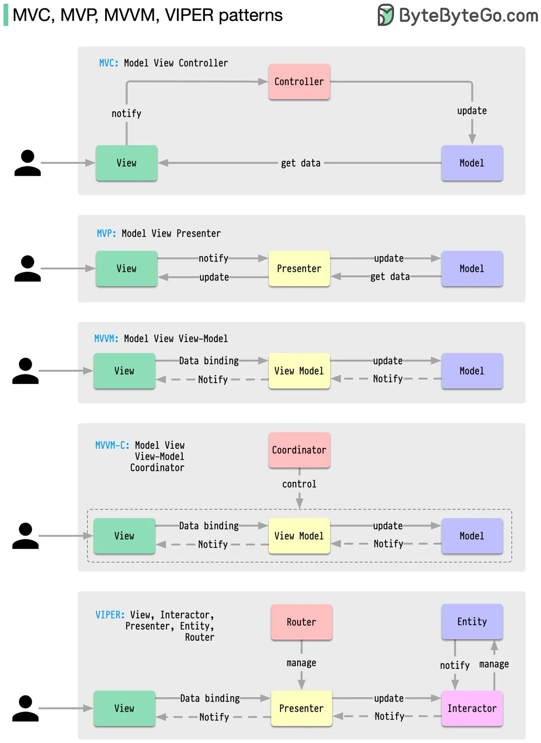
Model-View-*
Notes:
Resource:
https://blog.bytebytego.com/i/145954437/what-distinguishes-mvc-mvp-mvvm-mvvm-c-and-viper-architecture-patterns-from-each-other
https://www.youtube.com/watch?v=I5c7fBgvkNY

Slide 10
Model View Controller (MVC)
Controller
updates
notifies
View
reads
Model
User Interface Display information to the user
Data manipulation
Notes:
Resources:
https://medium.com/@duncandevs/origins-of-model-view-controller-d685528857ce
Applications programming in smalltalk-80: how to use model-view-controller (mvc) https://www.researchgate.net/publication/238719652_Applications_programming_in_smalltalk-80_how_to_use_model-view-controller_mvc
https://www.youtube.com/watch?v=I5c7fBgvkNY

Slide 11
Model View Presenter (MVP)
Presenter
updates
notifies
notifies
updates
View
Model
User Interface Display information to the user
Data manipulation

Slide 12
Model View View-Model (MVVM)
View-Model
updates
data & command binding
notifies
notifies
View
Model
User Interface Display information to the user
Data manipulation
Notes:
Resource:
https://learn.microsoft.com/en-us/dotnet/architecture/maui/mvvm
https://addyosmani.com/blog/understanding-mvvm-a-guide-for-javascript-developers/
https://www.oreilly.com/library/view/learning-javascript-design/9781449334840/ch10s06.html

Slide 13
Model View View-Model Coordinator (MVVMC)
Multi-screen user scenarios
Coordinator
control
View-Model
data binding
update
notify
notify
View
Model
Notes:
Resources:
https://www.youtube.com/watch?v=I5c7fBgvkNY

Slide 14
View Interactor Presenter Entity Router (VIPER)
Router
Entity
manage
control
notify
View
data binding
Presenter
update
Interactor
notify
notify
Optional
Notes:
Resources:
https://www.youtube.com/watch?v=I5c7fBgvkNY

Slide 15
Model-View-Template (MVT)
Which data you see, not how!
View
Controller
Template
Model
Data manipulation
How user see the data
Optional
Notes:
Resources:
https://docs.djangoproject.com/en/4.1/faq/general/

Slide 16
Showcase
Conferences
Notes:
Resources:
https://www.php.net/conferences/index.php
https://reactsummit.com/
https://pycon.org/
https://gotopia.tech/
https://vuejsnation.com/
https://frontendisti.cz/ (show archive)

Slide 17
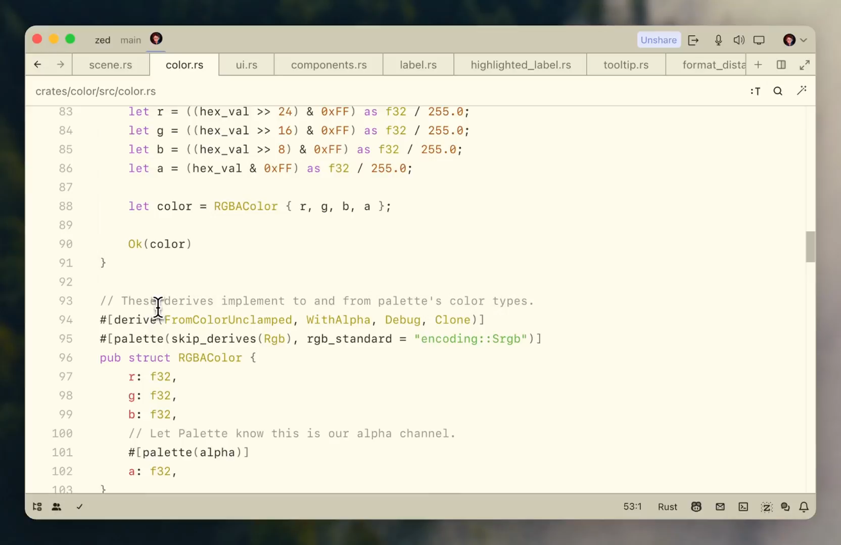
IDE / Generated Code
IDE code generation snippets
Browser based IDE
Copilot
AI integrated tools
GitHub Copilot falls inside the tech shortcut bucket. This platform is the next evolution of pre-packaged coding elements that started in the 1950’s with software libraries, which morphed into APIs (1970’s) and then became crowd sourced code snippets housed on StackOverflow (2000’s).
Medium, Brandeis Marshall, 14.3.2023
Notes:
Resources:
https://chat.openai.com/chat
https://github.com/features/copilot#pricing
https://zed.dev/
https://medium.com/@brandeismarshall/github-copilot-is-code-cloning-2-0-93726e40afbe
https://zed.dev/docs/getting-started 27.02.2024 (Video)

Slide 18
Database
Database transactions - maintaining data integrity
Database View
Stored Procedures/Functions
Triggers
Migration
Do you need one?

Slide 19
Database example
MySQLi (mysqli_) / (pg_) / …
Database Abstraction Layers
PHP Data Objects (PDO)
DiBi
$sql = 'SELECT name FROM fruit’;
foreach ($conn->query($sql) as $row)
echo($row['name’]);
}
$result = dibi::query(
'SELECT name FROM [users] WHERE [login] = %s’,
$login);
$username = $result->fetchSingle();
Notes:
Source:
https://www.php.net/manual/en/book.pdo.php
https://github.com/dg/dibi

Slide 20
Data model
Allows you express data entities naturally
Customer, Product, Order, …
Offers benefits like inheritance
Customer, Seller, Admin ~ User
Promotes encapsulation
Well defined interface
Hides the details of actual data representation/storage
Much more readable
Self documented code
Decorated with doc comments
Object persistence
Explicit way to flush objects to persistent storage
Object relations
Like database relations (1:1, 1:N, …)
Collections
Implicit
All customers
Defined by object relations (orders of a customer)
Explicit
Orders that are due today

Slide 21
Object-relational Mapping (ORM)
Technique which creates object-oriented API over (relational) database
Much simpler for the programmer (no need for SQL) and less error prone (no SQL).
Object-relational impedance mismatch
How to save objects into database?
Mapping IS-A hierarchy, private members, references, …
PHP Framework: Doctrine
Contains both DB abstraction layer and ORM
Provides transparent persistence of PHP objects
Requires mapping (XML, YAML, PHP annotations/attributes)
A DB schema is generated from the PHP classes
Migration management
Notes:
Resources:
- https://www.doctrine-project.org/

Slide 22
ORM example with Doctrine
/** @Entity @Table(name="subjects") **/
class Lecture
{
/** @Id @Column(type="integer") @GeneratedValue **/
protected $id;
/** @Column(type="string") **/
protected $fullname;
/** @ManyToOne(targetEntity="User", inversedBy="teach_lectures") **/
protected $teacher;
...
public function getDescriptionString() { ... }
public function getStudents() { ... }
}

Slide 23
Standup
ORM and Lazy Loading

Slide 24
Object-relational Mapping alternatives
NotORM
Between Doctrine and DIBi
SQL queries are not written in strings, but semi-automatically procedurally composed (similar to query builder)
Unlike ORM, the API does not have to know complete DB schema
Original API was proposed and implemented by Jakub Vrána
$db = new NotORM(...);
$subj = $db->lectures[42];
$subj->fullname = 'Web Applications';
$subj->update();
foreach ($db->lectures()->where('programme', 'I2')->order('teacher.name’) as $subj)
{
echo $subj->teacher['name'], ' ', $subj['fullname'];
}

Slide 25



Dependency monitoring
Monitoring security vulnerabilities.
Dependabot
Strong GitHub integration
Automatic PR for dependency updates
.github/dependabot.yml
Renovate
Self hosting / CI / Cloud
Snyk
Dashboard
Notifications
Notes:
Resources:
https://github.com/renovatebot/renovate
https://docs.renovatebot.com/bot-comparison/
https://docs.renovatebot.com/modules/manager/
https://docs.github.com/en/code-security/dependabot/dependabot-version-updates/about-dependabot-version-updates#supported-repositories-and-ecosystems
https://app.snyk.io/

Slide 26


Linter
Originally a software developed for static code analysis. Now family of tools performing “code analysis”.
Rules
IF code meets a certain expectations, THEN … ELSE …
IDE Integration SonarQube
Java, C++, JavaScript, Python, PHP, …
ESLint
JavaScript
Million lint Linting for performance (instrumentation and VSCode extension)
Notes:
Resources:
https://eslint.org/
https://www.sonarsource.com/products/sonarqube/ there is free community edition
https://old.million.dev/blog/lint

Slide 27


Prettier / code formatter
“Prettier is an opinionated code formatter. It enforces a consistent style by parsing your code and re-printing it with its own rules that take the maximum line length into account, wrapping code when necessary.”
Notes:
Resources:
https://prettier.io/
https://black.readthedocs.io/en/stable/

Slide 28
Maintenance
Co se týká HTTP/2 – tam je trošku problém, že by se musel web server Apache běžet na verzi 2.4 (nyní běží na verzi 2.2), současně HTTP/2 nepodporuje PHP ve formě modulu Apache, ale muselo by se přejít na řešení pomocí PHP-FPM.
A v neposlední řadě mám informaci od jednoho z autorů redakčního systému webu, že změna verze PHP, která by při tom všem nastala, by mohla způsobit nefunkčnost redakčního systému, protože novější verze PHP není vždy úplně zpětně kompatibilní se starší verzí PHP (starší funkce se mění nebo je i ruší).
Tedy tady zatím změny určitě nebudu J .
2020/2021

Slide 29
Takeaway
Design patterns
Dependency injection
ORM
MVC / MVP / MVVM / …
Dependency managers
Linters
Code formatters
NSWI154 - Software Development Tools

