Slide 1
PHP
NSWI153 - Advanced Programming of Web Applications
2025/2026
Petr Škoda
https://github.com/skodapetr
https://www.ksi.mff.cuni.cz

Slide 2


...
https://i1.memy.pl/obrazki/cc3e893449_seriously.jpg
Does this feature sound interesting?
Why is this feature part of the language?
https://learnenglishfunway.com/top-50-you-can-do-it-meme/
Notes:
I want to ask your self questions ...

Slide 3
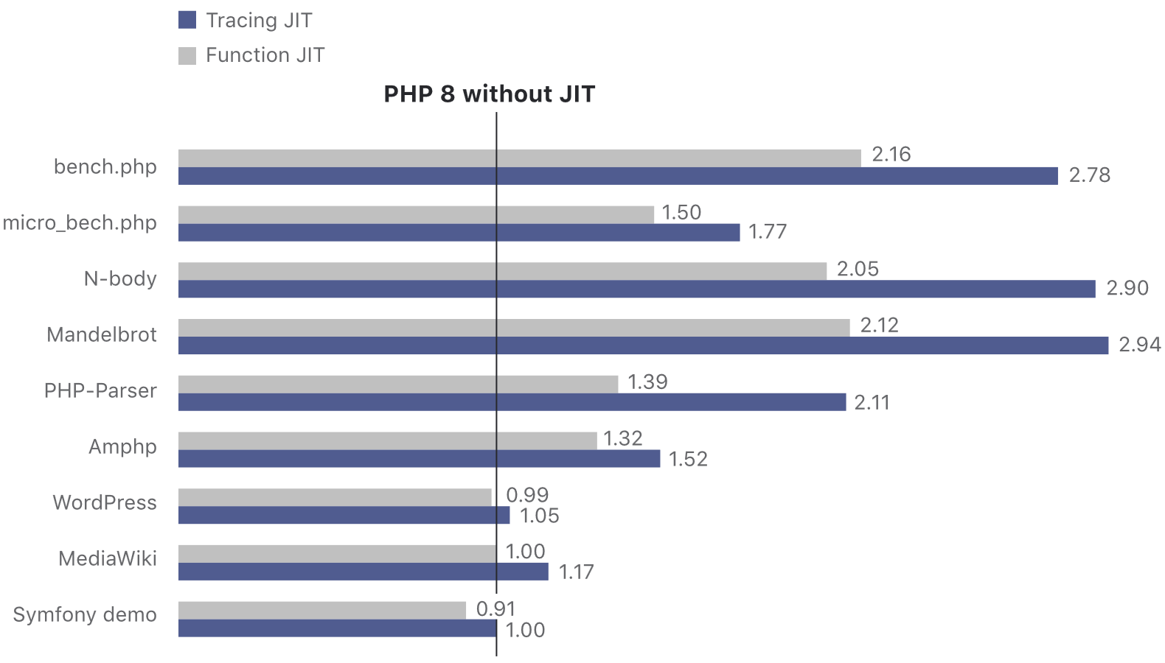
November 2020 : PHP 8.0
Just-In-Time compilation
since 2020
Notes:
Resource:
https://www.php.net/releases/8.0/en.php

Slide 4
Architecting the application

Slide 5

Inheritance
class Animal {
public function makeSound() {}
}
class Cat extends Animal {
public function makeSound() { print('Meow'); }
}
$animal = new Cat();
$animal->makeSound();

Slide 6
Traits
It is a class-like mechanism for code reuse, i.e. horizontal composition of behavior. A Trait is a special class that cannot be instantiated. It may contain both member variables and methods. It can be added to regular classes or a trait.
You may see parallels to mixins you may remember from SCSS.
trait OmniSaluter {
public function helloWorld() { echo 'Hello World'; }
}
class myClass {
use OmniSaluter;
...
}
since 2012
Notes:
Resources:
- https://www.php.net/manual/en/language.oop5.traits.php

Slide 7
Traits - Extended Edition
Precedence
Current class override Trait methods, which in turn override inherited methods.
Multiple Traits
Collisions must be explicitly resolved, else a datal error is produced. Use insteadof to select and as to alias. Traits Composed from Traits
Traits can compose from traits with the use syntax.
Abstract methods
Since 8.0.0 support for private, protected and public.
class Talker {
use A, B {
B::smallTalk insteadof A;
A::bigTalk insteadof B;
B::bigTalk as talks;
}
}
Notes:
If two Traits insert a method with the same name, a fatal error is produced, if the conflict is not explicitly resolved.
To resolve naming conflicts between Traits used in the same class, the insteadof operator needs to be used to choose exactly one of the conflicting methods.
Since this only allows one to exclude methods, the as operator can be used to add an alias to one of the methods.
Resources:
https://www.php.net/manual/en/language.oop5.traits.php

Slide 8
Annotations / Attributes
PHP attributes provide structured, machine-readable metadata for classes, methods, functions, parameters, properties, and constants. They can be inspected at runtime via the Reflection API.
#[Attribute]
class CustomAttribute
{
public string $message;
public function __construct($message)
{ $this->message = $message; }
}
/**
* @ClassAnnotation
*/
class Foo
{
/**
* @MyAnnotation(myProp="value")
*/
private $bar;
}
#[ClassAnnotation]
#[Another([ new MyClass() ])]
class Foo
{
#[MyAttribute(myProp: "value")]
private $bar;
}

Slide 9
Reflection
It is a mechanism implemented in (dynamic) languages to inspect types, objects, classes, etc. at runtime.
PHP holds a specific reflector class for each entity: - ReflectionType - ReflectionFunction - ReflectionClass - ReflectionObject - ReflectionProperty - ReflectionParameter

Slide 10
Constructor property promotion
For each promoted parameter, a property with the same name will be added, and a forwarding assignment to that property included in the body of the constructor, according to the detailed rules outlined in the following. This dramatically reduce the boilerplate.
class Point {
public float $x;
public float $y;
public float $z;
public function __construct(
float $x = 0.0,
float $y = 0.0,
float $z = 0.0,
) {
$this->x = $x;
$this->y = $y;
$this->z = $z;
}
}
class Point {
public function __construct(
public float $x = 0.0,
public float $y = 0.0,
public float $z = 0.0,
) {}
}
since 2020, 8.0.0
Notes:
Resources:
https://wiki.php.net/rfc/constructor_promotion
https://www.php.net/manual/en/language.oop5.decon.php#language.oop5.decon.constructor.promotion

Slide 11
Namespaces
It is another way how to encapsulate space of identifiers. It affect classes, traits, interfaces, functions, constants , but NOT global variables - one more reason to NOT use them. Corelates with directories and files.
namespace App\Presenters;
use App\Model\Entity\User;
use DateTime;
class UserDetailPresenter {
private function loginExpired(User $user, DateTime $ts): bool
...
}
since 2011
Notes:
Resources:
https://www.php.net/manual/en/language.namespaces.php
https://www.php.net/manual/en/language.namespaces.definitionmultiple.php

Slide 12
Working with the data

Slide 13

Enumerations
Use enum instead of a set of constants and get validation out of the box.
enum Status
{
case Draft;
case Published;
case Archived;
}
function acceptStatus(Status $status) {...}
since 2021, 8.1.0
Notes:
Resources:
https://wiki.php.net/rfc/enumerations
https://www.php.net/manual/en/language.enumerations.php

Slide 14
Readonly Properties
Readonly properties cannot be changed after initialization.
The readonly modifier can only be applied to typed properties. The reason is that untyped properties have an implicit null default value, which counts as an initializing assignment, and would likely cause confusion.
class BlogData
{
private Status $status;
public function __construct( Status $status)
{
$this->status = $status;
}
public function getStatus(
): Status
{
return $this->status;
}
}
class BlogData
{
public readonly Status $status;
public function __construct(Status $status)
{
$this->status = $status;
}
}
since 2021, 8.1.0
Notes:
Resources:
https://wiki.php.net/rfc/readonly_properties_v2
https://www.php.net/manual/en/language.oop5.properties.php#language.oop5.properties.readonly-properties

Slide 15
Property hooks
Developers use methods to wrap and guard access to object properties or execute pre- or post- processing. Generic version may include use of __get and __set.
Constructor property promotion allow use to easily write data-oriented classes. Yes, how can we add functionality?
Using property hooks, we can create computed properties which can natively be understood by IDEs and static analysis tools.
class User
{
public string $name {
set(string $next) { }
get() { }
}
}
since 2024
Notes:
Resources:
https://wiki.php.net/rfc/property-hooks
https://www.php.net/manual/en/migration84.new-features.php#migration84.new-features.core.property-hooks
https://wiki.php.net/rfc/asymmetric-visibility-v2
https://www.php.net/manual/en/language.oop5.visibility.php#language.oop5.visibility-members-aviz

Slide 16
Nullsafe operator
How to call something that may be null?
$country = null;
if ($session !== null) {
$user = $session->user;
if ($user !== null) {
$address = $user->getAddress();
if ($address !== null) {
$country = $address->country;
}
}
}
$country = $session?->user?->getAddress()?->country;
since 2020, 8.0.0
Notes:
Resources:
https://wiki.php.net/rfc/nullsafe_operator

Slide 17
Ready for the service

Slide 18
Error handling
We have different types of errors.
User errors
Temporary/Soft Errors
Hard Errors
Error can be of various severity.
E_ERROR, E_WARNING, E_NOTIVE, E_USER_xxx, E_STRICT
Controlled in php.ini or by error_reporting()
trigger_error()
Error Control (Silence) Operator
Exceptions
Uncaught exception causes Fatal Error
Destructors should not throw exceptions
Throwing-catching process is somewhat slow
try {
... throw new Exception('Error …');
} catch (MyException $ex) {
... My exception handler ...
} catch (Exception $ex) {
... Generic exception handler ...
}

Slide 19
Array unpacking support for string-keyed arrays
PHP supported unpacking inside arrays through the spread operator before, but only if the arrays had integer keys. Since 8.1.0 it is possible to unpack arrays with string keys too.
$arrayA = ['a' => 1];
$arrayB = ['b' => 2];
$result = array_merge( ['a' => 0], $arrayA, $arrayB);
// ['a' => 1, 'b' => 2]
$arrayA = ['a' => 1];
$arrayB = ['b' => 2];
$result = [ 'a' => 0, ...$arrayA, ...$arrayB];
// ['a' => 1, 'b' => 2]
since 2021, 8.1.0
Notes:
Resources:
https://wiki.php.net/rfc/array_unpacking_string_keys
https://www.php.net/manual/en/language.types.array.php#language.types.array.unpacking

Slide 20
Named Parameters
Pass arguments to a function based on the parameter name, rather than the position.
Self-documenting calls.
Skip default values. You could do that since 2015 with default keyword (*).
// Without named parameters.
htmlspecialchars($string, ENT_COMPAT | ENT_HTML401, 'UTF-8', false);
// With named parameters.
htmlspecialchars($string, double_encode: false);
since 2020, 8.0.0
Notes:
Resources:
https://wiki.php.net/rfc/named_params

Slide 21
Generators
Detached custom iterators.
The foreach construct is powerful, but it iterates over structures -- arrays and objects.
Custom iterator can be built, Iterator interface, both memory demanding and tedious.
Generator is a function that yields values.
It can be used in foreach construct.
function range($from, $to, $step) {
for ($i = $from; $i < $to; $i += $step) yield $i;
}
foreach ( range(1,10,2) as $value) ...
since 2013, PHP 5.5
Notes:
Resources:
https://www.php.net/manual/en/language.generators.overview.php

Slide 22
Match expression
The match is similar to switch and has the following features:
Match is an expression, meaning its result can be stored in a variable or returned.
Match branches only support single-line expressions and do not need a break statement.
Match does strict comparisons.
echo match (8.0) {
'8.0' => "Oh no!",
8.0 => "This is what I expected",
};
since 2020, 8.0.0
Notes:
Resources:
https://wiki.php.net/rfc/match_expression_v2
https://www.php.net/manual/en/control-structures.match.php

Slide 23




PHP
Frameworks and Libraries

Slide 24
Framework Interop Group
PSR-1, PSR-12 Coding style guidelines
PSR-3 Logger interface
PSR-4 Autoloading (classes)
PSR-6 Caching Interface
PSR-7 HTTP message interface
PSR-11 Container interface (DI)
…
PSR-5 PHPDoc Standard, 19 PHPDoc tags
use Monolog\Logger;
use Monolog\Handler\StreamHandler;
// create a log channel
$log = new Logger('name');
$log->pushHandler(
new StreamHandler(
'path/to/your.log’,
Logger::WARNING));
// Add records to the log
$log->warning('Foo');
$log->error('Bar');
Notes:
Source:
https://www.php-fig.org/
https://github.com/Seldaek/monolog

Slide 25






Dependency manager
Dependency manager / Package manager / …
Package ( code + metadata )
Lock file
CLI client
Repository
Sharing components
Notes:
Resources:
https://packagist.org/packages/monolog/monolog
https://www.npmjs.com/package/parcel
https://mvnrepository.com/artifact/com.github.jsonld-java/jsonld-java/0.13.6 [DEMO]
https://bit.dev/ - self promo [DEMO]

