Slide 1
Virtualization Infrastructure Administration
Cluster
Jakub Yaghob

Slide 2
VMware DRS
Distributed Resource Scheduler
  Automated resource management across multiple hosts
    Lowers operational costs

Slide 3
vSphere DRS cluster
DRS cluster
  Collection of hosts and associated VMs
  Managed by vCenter Server
  Resource management capabilities
    Initial placement
    Load distribution
    Power management

Slide 4
vSphere DRS cluster
Settings
  Automation level
  Power management
  Individual VM settings
  Rules
    Keep VMs together
      Affinity
      Heavy communication with one another
    Separate VMs
      Anti-affinity
      Multi-VM system with load balance or high availability
    VMs to hosts
      Affinity and anti-affinity rules
Adding host
  Resource pools

Slide 5
vSphere storage DRS
Storage DRS
  Automatically load balance across multiple datastores
  Datastores are grouped
  Performs automatic placement of VMs upon creation
  Storage DRS runs infrequently
    Long term load balancing
    I/O load history checked once every 8 hours
  Storage DRS requires Storage I/O control enabled on all datastores

Slide 6
vSphere DRS cluster – exercise
Create a cluster
  Do not enable High Availability
Add all hosts to the cluster
Create a distributed switch
Migrate hosts in the cluster to the distributed switch
  Add vmnic2 as a redundancy uplink to vSwitch0 (management switch created during installation)
  Ask your teacher to switch the virtual network card from “Virt vMotion” to “Kralicek Azurit”
  Migrate hosts to the distributed switch including vmk0 and all VMs
  Ask your teacher again to switch the virtual network card back to “Virt vMotion”
  Delete vSwitch0 on all hosts

Slide 7
vSphere vMotion
vSphere vMotion and vSphere Storage vMotion
  Higher service levels
  Improving overall HW utilization and balance

Slide 8
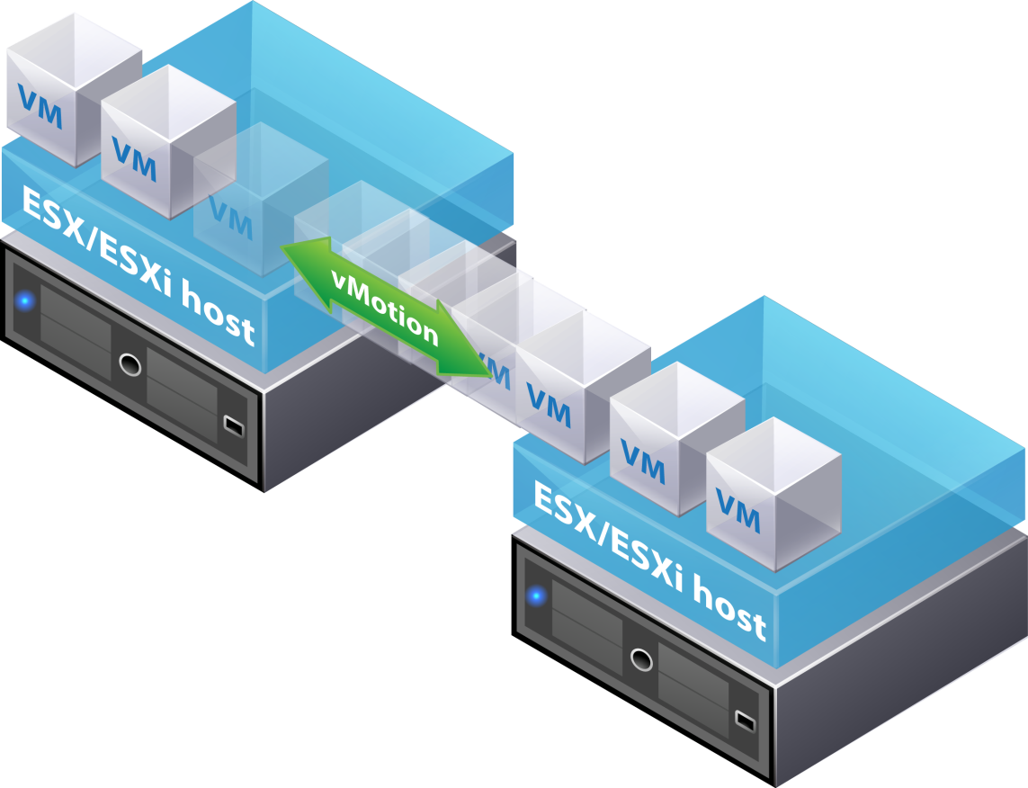
vSphere vMotion migration
Move a powered-on VM from one host to another
Using
  Improve overall HW utilization
  Allow continued VM operation during scheduled HW downtime
  Allow DRS to balance VMs across hosts

Slide 9


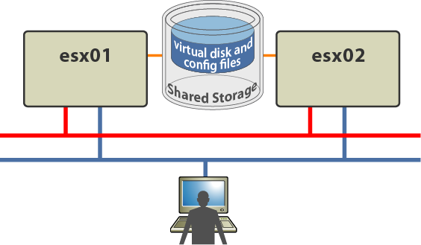
vSphere vMotion migration
Memory
bitmap
Memory
bitmap
Memory bitmap
Memory Bitmap
vMotion network
Production network

Slide 10
vSphere vMotion requirements
vMotion requirements
  VM must not have a connection to an internal vSwitch (no uplink)
  VM must not have a connection to a virtual device (CD-ROM) with a local image mounted
  VM must not have a virtual CPU affinity configured
  If VM’s swap file is not shared, vMotion must be able to create swap visible to the destination host
  If a VM uses an RDM, the RDM must be accessible on the destination host

Slide 11
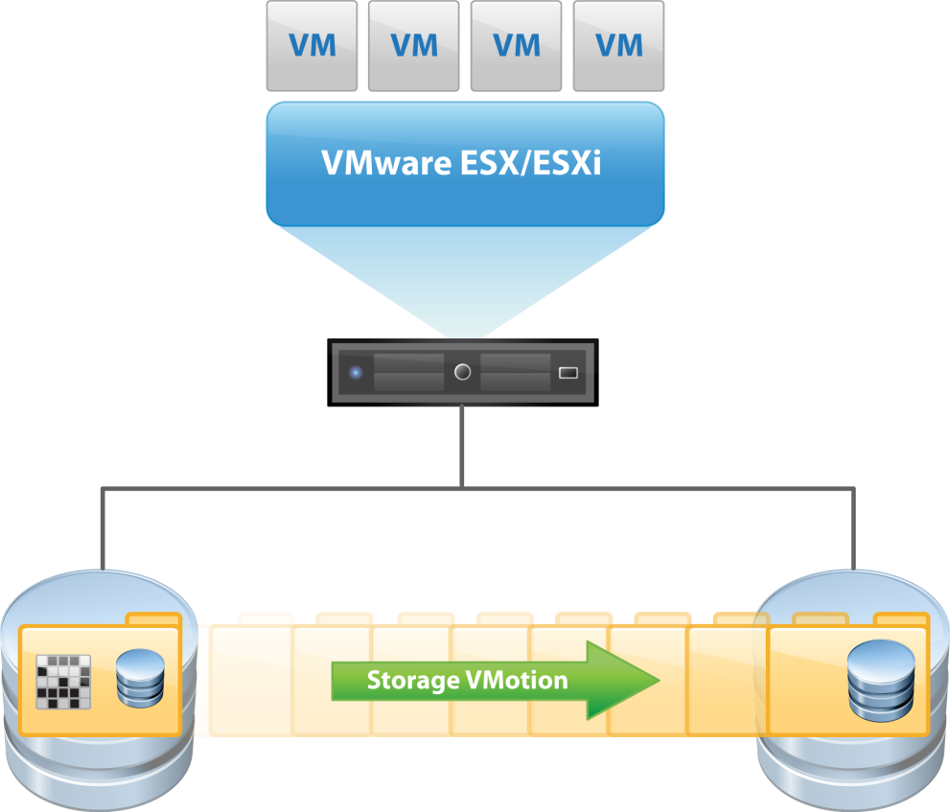
vSphere Storage vMotion
Storage vMotion
  Perform storage maintenance and reconfiguration
  Redistribute storage load
  Evacuate storage soon to be retired
  Storage tiering
  Storage type independent

Slide 12
vSphere Storage vMotion – limitations and guidelines
Guidelines
  Perform during off-peak hours
  Takes a long time
  The host must have access to both datastores
Limits
  VM disks must be in persistent mode or RDM
  VM storage migration combined with host migration only in powered off state

Slide 13
vSphere vMotion – exercise
Configure vMotion network on hosts
  Use “Virt vmotion” virtual network
  Hypervisor Y IP = 10.252.x.y
  Network mask 255.255.0.0
Move your VMs between hosts

Slide 14
vSphere HA – High Availability
vSphere HA
  Provides automatic restart of virtual machines in case of physical host failures
  Provides high availability while reducing the need for passive standby hardware and dedicated administrators
  Provides support for virtual machine failures with virtual machine monitoring and FT
  Integrates with vSphere Distributed Resource Scheduler (DRS)
  Is configured, managed, and monitored with VMware vCenter Server

Slide 15


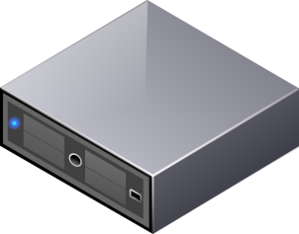
vSphere HA
datastore
datastore
datastore
VMware ESXi™ host (slave)
ESXi host (slave)
ESXi host (master)
FDM
FDM
FDM
vpxa
hostd
vpxa
hostd
vpxa
hostd
vpxd
vCenter Server
= Management network

Slide 16
vSphere FT – Fault Tolerance
vSphere FT
  FT provides zero-downtime and zero-data-loss protection to virtual machines in a vSphere HA cluster
  Some conditions required for running FT
    VM must have only one vCPU
    Primary and secondary hosts must have exactly same CPU model
    It is recommended to set up dedicated NIC for kernel with enabled FT
    Virtual disks must be set to thick provisioning eagerly zeroed

Slide 17
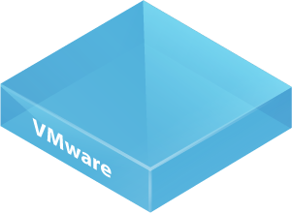
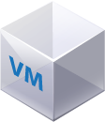
vSphere FT
vLockstep technology
vLockstep technology
new
primary
VM
new
secondary
VM
primary
VM
secondary
VM

