Slide 1
Virtualization Infrastructure Administration
Storage
Jakub Yaghob

Slide 2

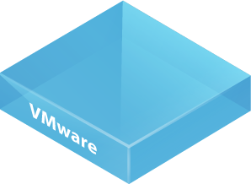
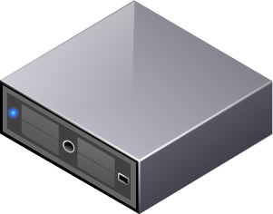

vSphere storage choices
ESXi hosts
datastore
types
VMware vSphere VMFS
NFS
File system
storage
technology
Direct Attached
Fibre Channel
FCoE
iSCSI
NAS

Slide 3

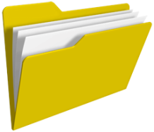


vSphere datastores
Datastore
Logical storage unit
Partition, physical disk
Spanning
Types
VMFS
NFS
VMs, templates, ISO images
ESXi host
VM content
datastore
volume
Notes:
y

Slide 4



Physical file system vs. virtual file system
physical architecture
virtual architecture
application
operating system
VMware vSphere
VMware vSphere
x86 architecture
x86 architecture
x86 architecture
NTFS, ext3, UFS
VMFS

Slide 5
vSphere storage adapters
Unified storage controller view
SATA
SCSI
HW iSCSI
SW iSCSI
FC
FCoE
USB

Slide 6
vSphere multipathing
Multipathing
Multiple paths to the device
Automatic detection of the same device
Path management
Path selection
Preferred path
Status

Slide 7
vSphere storage
Disk/LUN
Select available device
Hot increase
NFS
Server
Folder
Must have no_root_squash

Slide 8
vSphere storage vendor provider
Extends storage capability
SW plug-in
Storage API
Storage topology, capabilities, status
Vendor provider component on the array
Server, plug-in is a client
Defines system storage capabilities

Slide 9
vSphere storage profiles
List of required storage capabilities
VM storage must satisfy them
User defined storage capabilities
Must be enabled
Must have license
Check compliancy

Slide 10
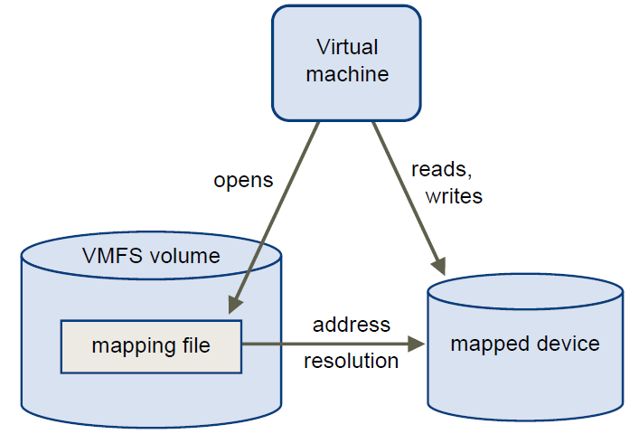
vSphere RDM
Raw Device Mapping
RDM is a mapping file
Proxy for a raw physical storage device
Contains metadata for managing and redirecting disk access to the physical device
Allows a VM to directly access and use the storage device
Compatibility modes
Virtual – RDM behaves exactly as a virtual disk, snapshots possible
Physical – direct access to the device, no snapshots

