Slide 1
Virtualization Infrastructure Administration
Resources
Jakub Yaghob

Slide 2
Resources
Main resources
CPU
Memory
I/O resources
Storage I/O
Network I/O

Slide 3
Resource management
Resource pool
Resource allocation
Provides resources for VMs and child pools
Hierarchical structure
Business requirements of organization
Expandable?
YES – VMs and subpools can draw from this pool’s parent
NO – VMs and subpools can draw only from this pool, even if its parent has free resources
Resource allocation for VM
Fine tuning of an application

Slide 4
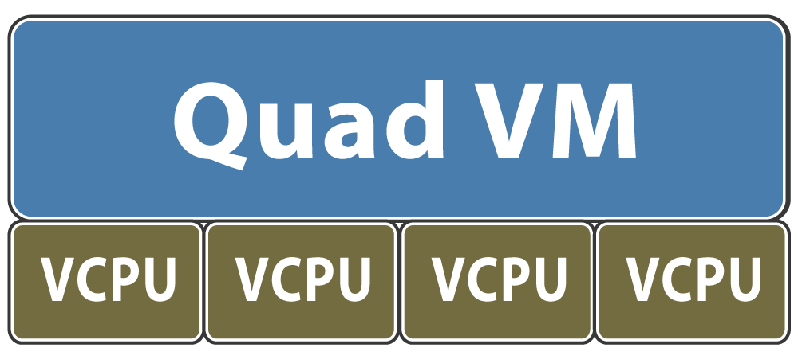
CPU management
vCPU mapping
Each vCPU from VM mapped to HEC (HW execution context)
HEC
Hypervisor scheduling entity
Core/HT thread
All vCPUs in the VM scheduled at the same time
HEC
HEC
HEC
HEC

Slide 5
CPU scheduling
Proportional-share scheduling
Simple virtual-time algorithm
Virtual time = usage / share
Schedule VM with smallest virtual time
Example: 3 VM A, B, C with 3:2:1 share ratio
A
2
4
4
6
8
8
8
10
10
B
3
3
6
6
6
9
9
9
12
C
6
6
6
6
6
6
12
12
12

Slide 6
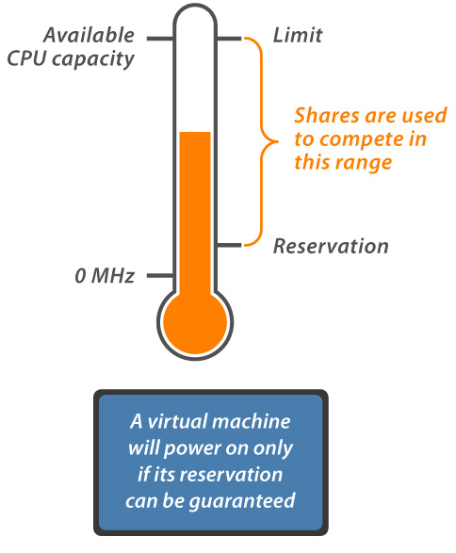
Limits, reservations, and shares
Limit
Upper bound of consumption, even if underutilized
Concrete absolute units
Reservation
Minimum guarantee, even when system overloaded
Concrete absolute units
Admission control: sum of reservations ≤ capacity
Shares
More shares – greater priority
Abstract relative units, only ratios matter

Slide 7
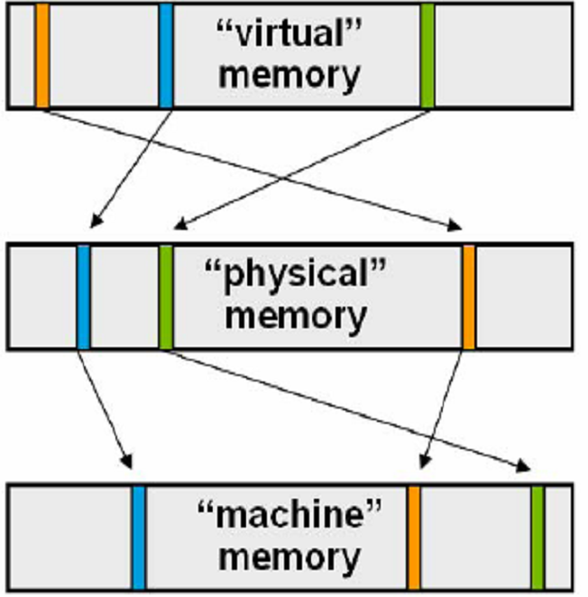
Virtual memory management
Virtual memory
Mapped by application inside the guest OS
Physical memory
Host presents physical pages to VMs
Machine memory
Actual pages allocated by host
application
guest OS
hypervisor

Slide 8
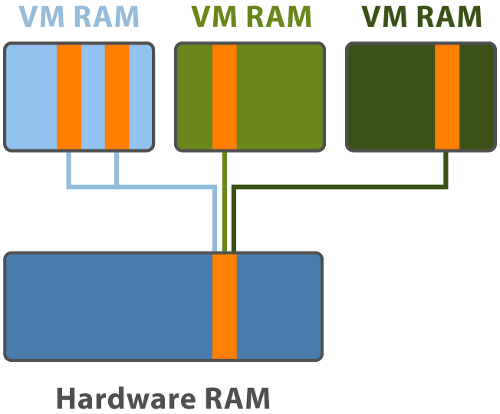
Using memory efficiently
Transparent page sharing
Hypervisor detects identical pages in VM memory and maps them to the same physical memory
No changes to guest OS
Shared pages as COW

Slide 9
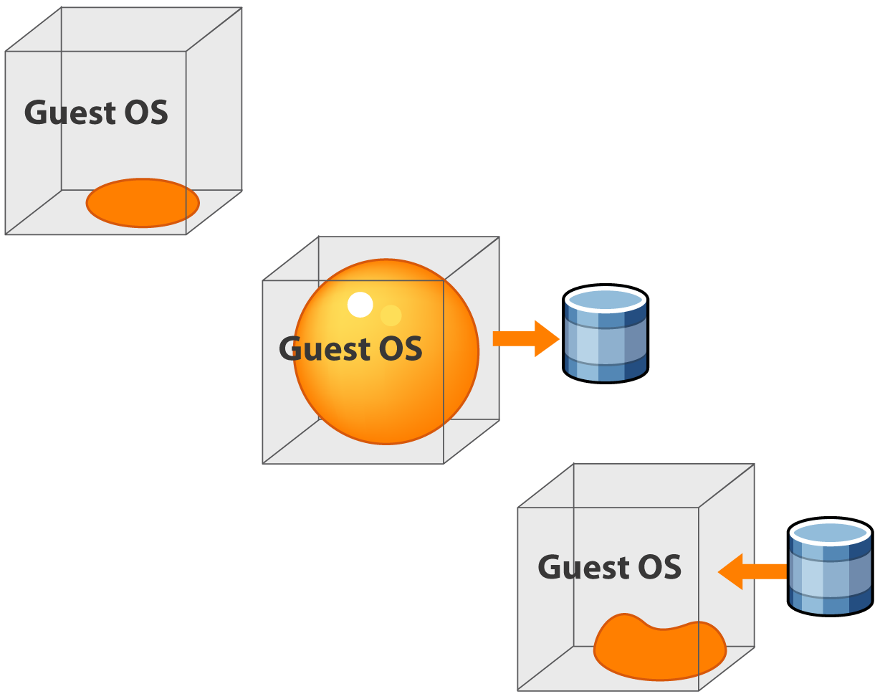
Guest OS ballooning
VMware Tools balloon driver
Deallocate memory from VM when memory is scarce
Ample memory. Balloon remains uninflated.
Inflate balloon. (Driver demands memory from guest operating system.)
Guest is forced to page out to its own paging area. The VMkernel reclaims memory.
Deflate balloon. (Driver relinquishes memory.)
Guest can page in. Host grants memory.

Slide 10
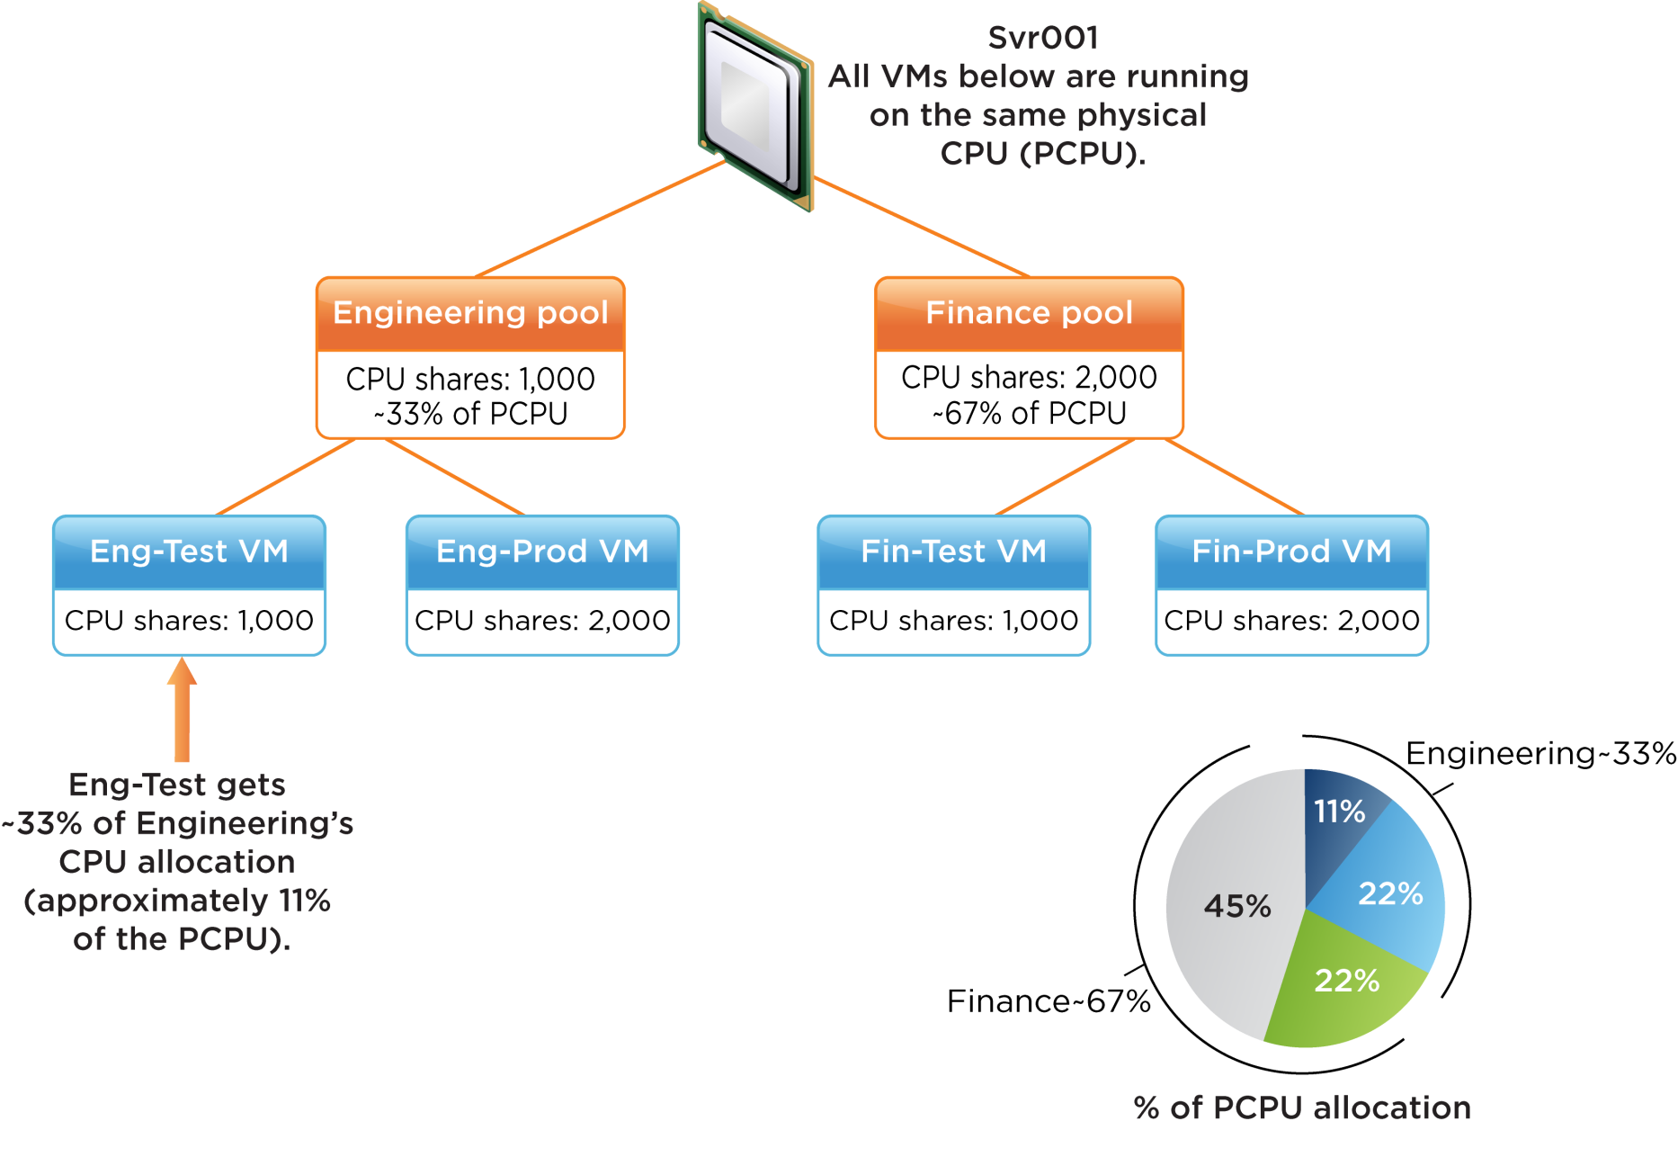
Resource pools example

