Slide 1
Virtualization Infrastructure Administration
Network
Jakub Yaghob

Slide 2
vSphere networking
Network services for hosts and VMs
Connecting virtual machines to the physical network and to each other
Connecting VMkernel services (such as NFS, iSCSI, or vMotion) to the physical network

Slide 3

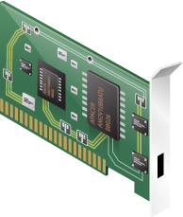
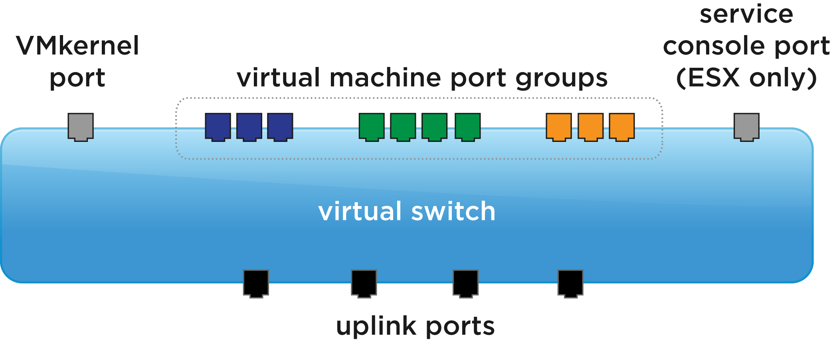
vSphere networking overview
application
application
application
operating system
operating system
operating system
Virtual NIC
Virtual NIC
Virtual NIC
Physical NIC
physical switch
ports
External World

Slide 4
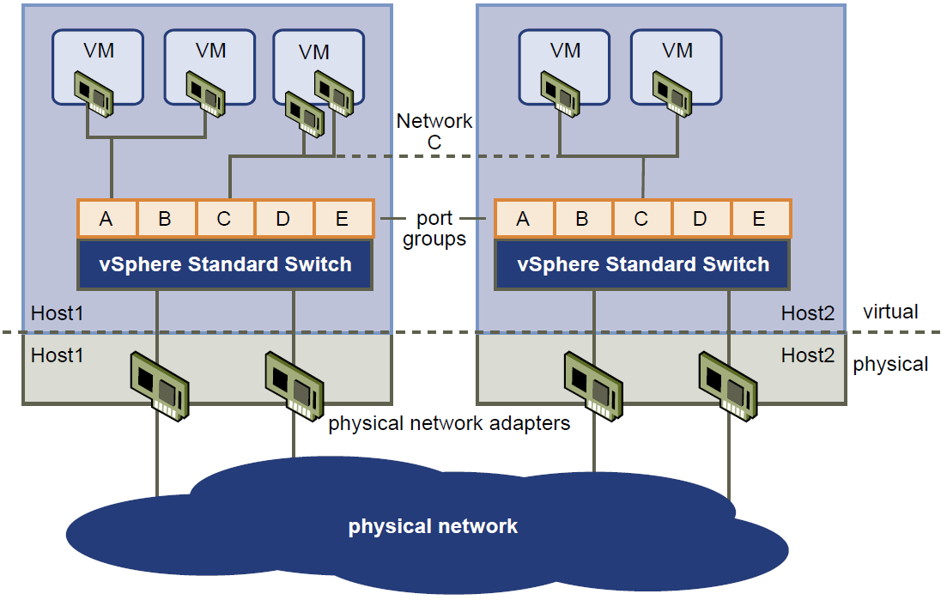
vSphere port group

Slide 5
vSphere port group
Port group
Aggregates multiple ports under a common configuration
Network label
Unique on a host
VLAN ID
802.1q, 802.1ad
Traffic shaping
Security

Slide 6
vSphere port group
VM port group
Connecting VMs to the switch
Common VLAN ID
VM can migrate only when on the same Layer 2 subnet
VMkernel port group
Connecting host to the switch
IP, VLAN ID
Using
Management
vMotion
Fault Tolerance
iSCSI, NFS

Slide 7
vSphere virtual switch
Networking for host and VMs
Directs network traffic between virtual machines and links to external networks
Combines the bandwidth of multiple network adapters and balances traffic among them. It can also handle physical network interface card (NIC) failover
Models a physical Ethernet switch
A virtual machine’s NIC can connect to a port
Each uplink adapter uses one port

Slide 8
vSphere virtual switch
Standard
Local for a single host
Distributed
Over all hosts in a datacenter
Only for Enterprise Plus license
Consistent network configuration for migrating VMs
Port mirroring, Netflow, Network I/O Control
Network statistics and policies migrate with VM

Slide 9








vSphere virtual switch
vSwitch
vSwitch
vSwitch
Distributed Virtual Switch
standard switches
distributed switches

Slide 10
vSphere virtual switch
Uplinks
Assign real host’s NIC
Teaming
Failover
Capacity
LACP, LAG
Network discovery protocol
CDP, LLCP
No uplink
Internal communication

Slide 11
VLAN
Segmenting physical LAN
Isolating groups
Using VLAN
EST – external switch tagging
Port groups with VLAN ID=0
VST – virtual switch tagging
Trunk port on physical switch
VGT – virtual guest tagging
Trunk port on physical switch
Tagging performed by the VM
Secondary VLAN IDs
VLAN ID
0 – no tagging
1-4094 – valid VLAN ID
4095 – private ID, used for VGT

