Slide 1
Virtualization Infrastructure Administration
Virtual machine
Jakub Yaghob

Slide 2
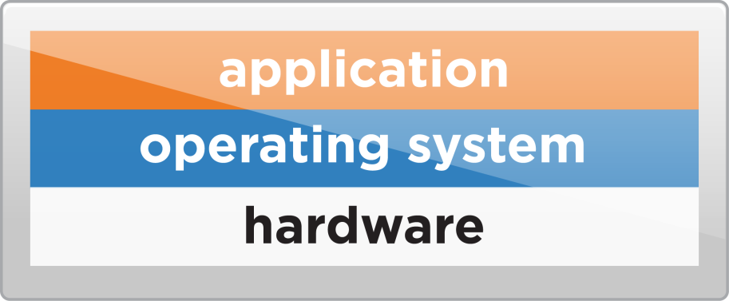
What is virtual machine?
VM is
Set of virtual HW on which a supported guest OS and its applications run
A set of discrete files
Virtual machine configuration
.vmx

Slide 3
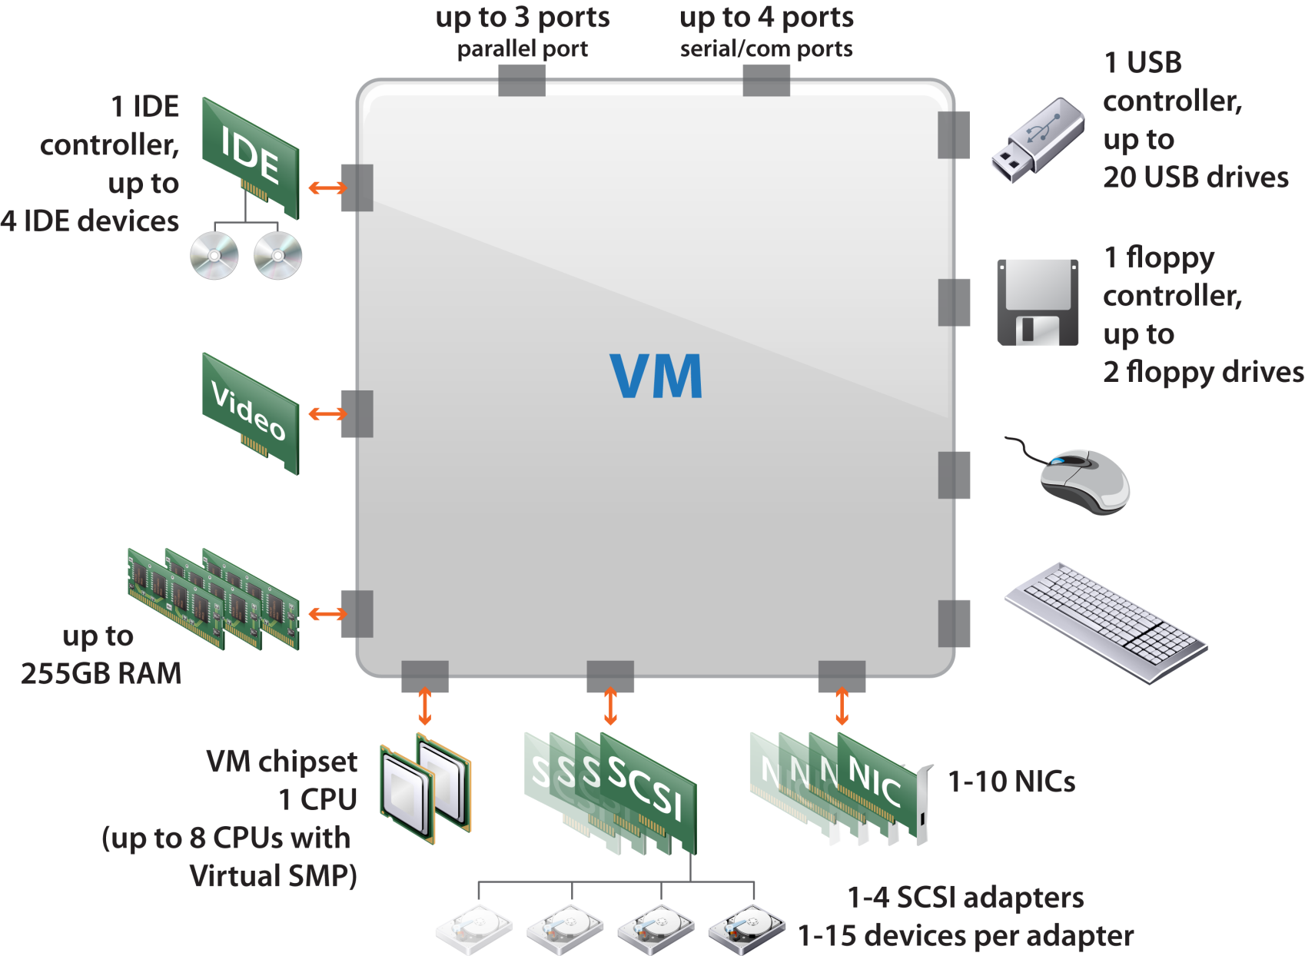
Virtual machine HW

Slide 4
VMware tools
Install them into guest OS
Set of supported OS/prepared Tools
Possibility to compile Tools on *nix machines
Paravirtualized virtual HW
VMXNET3
Better mouse movement in console
VM heartbeat
Graceful shutdown for guest OS

Slide 5
Templates
Create and provision VMs
Reduce VM creation time
Master image
Guest OS
Applications
Specific VM configuration
Creating a template
Clone the VM to a template
Convert the VM to a template
Clone a template
Deploying a template
Can be deployed across datacenters

Slide 6
Hot-adding devices
Certain devices can be added, while the VM is running
USB
Ethernet adapter
Hard disk
SCSI adapter
CPU
RAM
Guest OS must support hot-add

Slide 7
Prepare ESXi for VCSA installation
Connect to the VSPxx1 host client UI (port 11xx1)
Configure networking
Create new virtual switch
Enable forged transmits
Assign physical NIC connected to the “Virt SAN” network (use MAC for detection) as the uplink of the switch
Create VMkernel NIC (no services enabled)
Hypervisor Y IP = 10.251.x.y, network mask 255.255.0.0
Configure storage
Configure iSCSI
VIRTSAN IP = 10.251.0.1
iSCSI IQN = iqn.1991-05.com.microsoft:virtsan-virtxx-target
No CHAP, static discovery
Create datastores
Clear partition table
Use partedUtil mklabel <disk> gpt, when unable to erase partitions
<disk> is /vmfs/devices/disks/naa….

Slide 8
Install observer Windows machine
Create new VM
Connect VSPxx1 to the CD win10-demo.iso on datastore [IFT60-vmdata parlab-chiba]/VIRTISO
MS Win 10 64-bit
Select CD on host
Select VMXNET3 network adapter
2 CPU (1 socket), 4 GB RAM
Setup Win VM
Install VMware Tools
Set the network: 10.2.x.251, mask 255.255.0.0, GW 10.2.0.1, DNS 195.113.19.71 and 195.113.19.77
Enable remote access
Use Win VM
Connect to the observer VM using RDP (acheron port 11xx0)

Slide 9
Install VCSA
Deploy OVA
Connect VSPxx1 to the CD vcsa80.iso on datastore [IFT60-vmdata parlab-chiba]/VIRTISO
From observer Windows machine connect to the host 10.2.xx.1 UI and connect observer VM to the host CD
Start VCSA installation
Start installer from vcsa-ui-installer\win32
IP and system name (FQDN) 10.2.x.250, prefix 16, GW 10.2.0.1, DNS 195.113.19.71 and 195.113.19.77
Tiny size+PSC
Enable thin provisioning
Optionally, after the installation has finished, create snapshot
Connect to the VCSA admin web (acheron port 11xx9)
Continue with the 2nd phase

