Slide 1
Virtualization Infrastructure Administration
Introduction
Jakub Yaghob

Slide 2
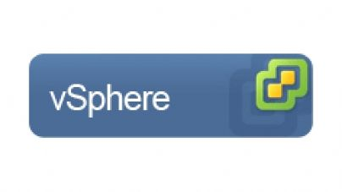

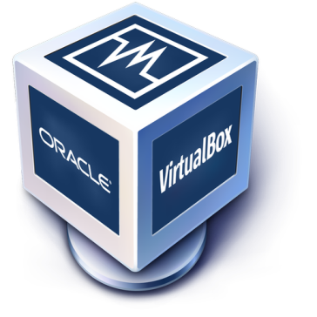
Course organization
VMware vSphere
Microsoft Hyper-V

Slide 3
Resources
VMware
VMware Learning – basic subscription (free)
Microsoft Hyper-V
https://docs.microsoft.com/en-us/windows-server/virtualization/hyper-v/get-started/get-started-with-hyper-v-on-windows

Slide 4
vSphere vs Hyper-V – limits
 | Hyper-V 2019 | Hyper-V 2025 | vSphere 8.0 | vSphere 9.0
Logical Processors per Host | 512 | 2048 | 896 | 960
Physical Memory per Host | 24TB | 4PB | 24TB | 24TB
Virtual CPUs per Host | 2048 | 2048 | 4096 | 4096
Virtual CPUs per VM | 240 | 2048 | 768 | 768
Memory per VM | 12TB | 240TB | 24TB | 24TB
Active VMs per Host | 1024 | 1024 | 1024 | 1024
Cluster Maximum Hosts | 64 | 64 | 96 | 64
Maximum VMs in cluster | 8000 | 8000 | 8000 | 8000
OS | Win, RHEL, SUSE, Debian, CentOS, Ubuntu, generic Linux, MAC OS X, FreeBSD, Solaris, VMware, Hyper-V, …

Slide 5
vSphere 7.0 vs Hyper-V 2019 – price
Microsoft Hyper-V 2019 |  | vSphere 7.0
Hyper-V server | $0 | vSphere ESXi | $0
System Center Management Suite Enterprise + 2-year SA | $3,607 | vCenter Server + 1-year SA | $8,487
 |  | 1 processor Enterprise Plus License + 1-year SA | $4,948
 |  | vCenter Server + 3-years SA | $10,903
 |  | 1 processor Enterprise Plus License + 3-year SA | $6,356
Total (2S, 2 years) | $3,607 | Total (2S, 3 years) | $23,615

Slide 6
Network and naming organization, virtual laboratory
Each student has the number XX
Part of login name to the virtual laboratory
Virtual machines naming convention
Part of private IP addresses
Number XX is firmly assigned, find it in Grupíček
Virtual laboratory
Shared laboratory with other courses
Shutdown/pause your virtual machines
Access point
bobr.ms.mff.cuni.cz
Web client
User: virt_XX, Password: find it in Grupíček

Slide 7


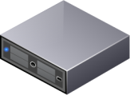


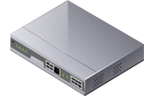
Physical infrastructure
applications operating system physical host
Fibre Channel
Ethernet
iSCSI storage
NFS storage
Network
Fibre Channel storage

Slide 8
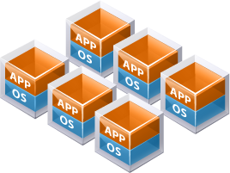

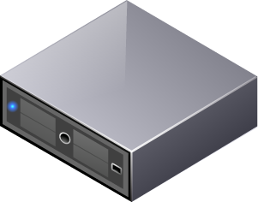
Virtual infrastructure
virtual machines
VMware vSphere
VMware vSphere
VMware vSphere
VMware vSphere
Fibre Channel
Ethernet
iSCSI storage
NFS storage
Network
Fibre Channel storage

Slide 9
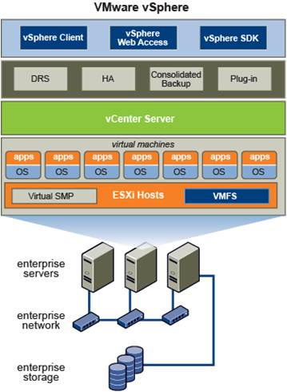
What is VMware vSphere?
Components
ESXi
vCenter Server
vSphere Client
vSphere VMFS
vSphere Virtual SMP
And many other…

Slide 10
vSphere objects
Datacenter
Standalone set of servers
Possible different locations
Cluster
Tightly coupled set of servers
HA, DRS, DPM
Host
Physical server running a hypervisor
Guest
OS running within VM
Resource pool
Provides abstract resources to VMs and child resource pools

Slide 11
Building our own (virtualized) infrastructure – vSphere
internet
GW: 10.2.0.1
Mask: 255.255.0.0 DNS1: 195.113.19.71 DNS2: 195.113.19.77
acheron
port: 11xx9
port: 11xx0
10.2.x.250
10.252.x.y
10.2.x.251
VCSA
WIN
port: 11xx1
port: 11xx2
port: 11xx3
10.2.x.1
10.2.x.2
10.2.x.3
VSPxx1
VSPxx2
VSPxx3
10.251.x.1
10.251.x.2
10.251.x.3
virtsan
10.251.0.1

Slide 12
Building our own (virtualized) infrastructure – Hyper-V
port: 11xx9
internet
GW: 10.2.0.1
Mask: 255.255.0.0 DNS1: 195.113.19.71 DNS2: 195.113.19.77
acheron
10.250.x.250
10.2.x.251
HVSCMxx
HVADxx
10.252.x.y
10.250.x.251
10.250.x.1
10.250.x.2
10.250.x.3
HVxx1
HVxx2
HVxx3
10.251.x.1
10.251.x.2
10.251.x.3
virtsan
10.251.0.1

Slide 13
Building simple (virtualized) infrastructure – vSphere
port: 11xx1
internet
GW: 10.2.0.1
Mask: 255.255.0.0 DNS1: 195.113.19.71 DNS2: 195.113.19.77
acheron
10.2.x.1
VSPxx1

Slide 14
VMware vSphere ESXi installation
Deploy template esxi80
Select correct folder (Virt/virt_xx) , resource (PARG/Teach/Virt/virt_xx), and storage (IFT60-vmdata SC5k-small)
VM name VSPxxy
Start VSPxxy
Install ESXi
Press F2 and login
Select “Configure management network”->”Network adapters”
Check any network adapter (use MAC) connected to the “Kralicek azurit” virtual network and confirm
Select “IP configuration”, choose “Set static IP…”
IP 10.2.x.y, Mask 255.255.0.0, GW 10.2.0.1, DNS1 195.113.19.71, DNS2 195.113.19.77
Select “IPv6 configuration” and disable IPv6

