Slide 1
NSWI150 - Virtualizace a Cloud Computing
David Bednárek, Jakub Yaghob, Filip Zavoral
+ Special Guest Star
https://www.ksi.mff.cuni.cz/teaching/nswi150-web/

Slide 2
Související předměty – see also www.ksi.mff.cuni.cz
Navazující předměty
Principy distribuovaných systémů
Zavoral ZS 2/0
Middleware
Tůma LS 2/1
Virtualizace a cloud computing
ZS 2/0
Administrace virtualizační infrastruktury
Yaghob LS 0/2
Vývoj cloudových aplikací
Zavoral + Special Guest Stars LS 0/2
Vývoj vysoce výkonného software
Bednárek LS 2/2
Pokročilé programování v paralelním p.
Kruliš ZS 2/2
Programování v paralelním prostředí
Kruliš LS 2/2

Slide 3
Program přednášky - 2025/26
5* Technické principy kontejnerů a virtualizace [Bednárek]
  Kontejnery vs. para-virtualizace vs. plná virtualizace
  Kontejnery, linux namespaces & cgroups
  Virtuální stroje, hardwarová podpora, vybrané technické detaily
3* Virtualizační infrastruktury [Yaghob]
  Co musí správce virtualizační infrastruktury vědět o virtualizaci
  Virtuální CPU, paměť, disky, sítě, migrace, load-balancing, správa
3* Cloud Computing [Zavoral]
  Cloudové technologie a služby, procesní modely
  Cloudové platformy, Cloud design patterns
1* Bezpečnost a identita [Grafnetter]

Slide 4
Cloud Computing - 'definice'
Cloud computing is a universal collection of data which extends over the internet in the form of resources and forms individual units within the
virtualization environment. Held together by infrastructure providers, service providers and the consumer, then it is semantically accessed by various users
  Dr. Biju John and Dr. Souheil Khaddaj, CLUSE 2012
Formal 'definition'
  Let F be a set of available functionalities {F_{i}} _{i=1..∞}
  Let CF be a set consisting of all pre-images of {φ⁻¹(φ(Fi))} ⊆ I, where F_{i} ∈ F
  We call CF a Cloud
  We say CF is a public Cloud if CF = {φ⁻¹(φ(F_{i}))}, where F_{i} ∈ P
  We say CF is a private Cloud if CF = {φ⁻¹(φ(F_{i}))}, where F_{i} ∈ F\P
  Zhu, 2009
The interesting thing about cloud computing is that we've redefined cloud computing to include everything that we already do
  Larry Ellison, Oracle, 2008

Slide 5
A distributed system is one in which the failure of a computer you didn’t even know existed can render your own computer unusable
  Leslie Lamport, 1987

Slide 6
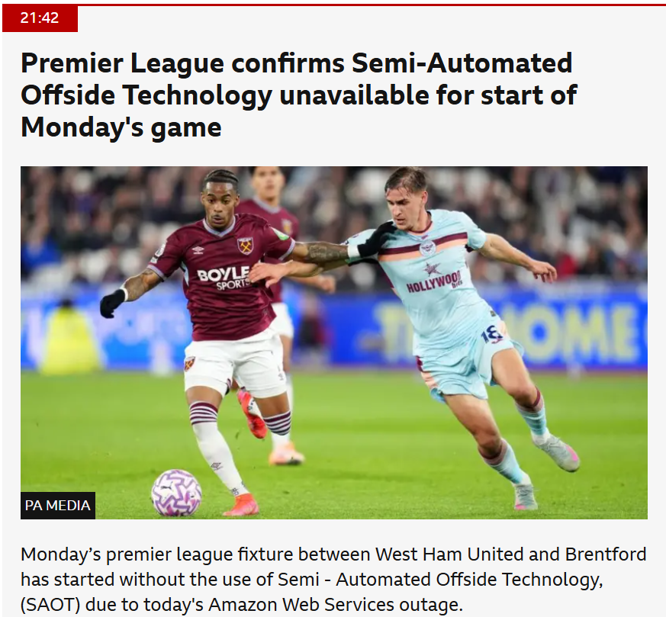
BBC, Oct 20, 2025

Slide 7
Date: Thu, 28 May 87 12:23:29 PDT
From: lamport (Leslie Lamport)
To: src-t
Subject: distribution
There has been considerable debate over the years about what
constitutes a distributed system. It would appear that the following
definition has been adopted at SRC:
A distributed system is one in which the failure of a computer
you didn't even know existed can render your own computer
unusable.
The current electrical problem in the machine room is not the
culprit--it just highlights a situation that has been getting
progressively worse. It seems that each new version of the nub makes
my FF more dependent upon programs that run elsewhere.
Having to wait a few seconds for a program to be swapped in is a lot
less annoying than having to wait an hour or two for someone to reboot
the servers. I therefore propose a development project to make our
system more robust. I am not proposing any particular approach
(enabling stand-alone operation is just one possibility).
I will begin the effort by volunteering to gather some data on the
problem. If you know of any instance of user's FF becoming inoperative
through no fault of its own, please send me a message indicating the
user, the time, and the cause (if known).
Leslie

