Slide 1
Cascading Style Sheets
Supporting Materials
NSWI142 - Web Applications Development
2026/2027
Petr Škoda
https://skodapetr.github.io/
https://www.ksi.mff.cuni.cz/
This work is licensed under a Creative Commons Attribution 4.0 International License.

Slide 2
Cascading Style Sheets
The fundamentals

Slide 3
Connecting CSS to the DOM
Inline CSS
We can use style attribute directly with HTML elements. Do not write this by hand. For this approach we do not need selectors, the style is directly connected with the element.
<h1 style="color: red;">Red Heading</h1>
Embedding CSS
With embedding the CSS is in the <style> element in <head>. This is useful for a small CSS that we want to load before HTML is rendered. As such we can use this for so called critical CSS.
<head> <style type="text/css"> ... </style> ... </head>
Linking CSS
We can also link am External Style Sheet file using <link> element from head. This separate the languages into separate files and allow for better style sheet reusability.
<head> <link rel="stylesheet" type="text/css" href="assets/styles.css"> ... </head>

Slide 4
CSS Selector
Unless we are using inline CSS we need to map the CSS to the HTML, i.e., select element using a selector to which given properties should be applied to. One property block can be used with multiple selectors separated by a comma. Selectors on a simple declarative language.
<selector>, [<selector>...] { <properties> }
There are various CSS selectors which can target a specific element by a type, an attribute, or a class. The selectors can be combined to select almost anything on the website.

Slide 5
Basic CSS Selectors Examples
*
Universal selectors, select all elements.
p
An element selectors selects all elements of given name. This example selects all paragraph (<p>) elements.
#section
Select an element with id="section". The id attribute should be unique in scope of a document.
.list
Class selector selects all element with assigned class. This example selects all element with "list" in the class attribute.
Selectors can be combined:
div.info
Selects all div elements with class info.
ul li
Selects all li elements in a subtree of a ul element.
ul>li
Select all direct li children of a ul element.
h1+p
Select all p elements that are immediately preceded by h1 element.
...

Slide 6
Selected CSS properties
font
font-size
text-align
display
color
background-color
border-style
border-width
border-color
There are shorthand's for properties like border, margin, ...
Notes:
Resources:
CSS properties
https://developer.mozilla.org/en-US/docs/Web/CSS/Reference/Properties

Slide 7
Display property
Elements have specific ways of rendering, e.g. inline vs block elements. The rendering mode is se by CSS display property. The browser provides default display property for most elements. Inline elements like <em> or <b> have display set to inline. Block elements like <div> have display set to block. Table below contains few selected values.
Value | Description
block | Standard block element.
inline | Element rendered inline with the text.
inline-block | Small block inserted in text flow.
none | Hide element, no effect on layout.
list-item | Default for <li> elements.
table, table-* | Table rows and cells have specialized formatting.
… | …

Slide 8
Populating the page
Warning: This is shorted and simplified version!
We start by quick recap what happen from the start:
Navigation - user enters the URL, click on a link, ...
DNS lookup, TCP, TLS, ...
Browser receives the data and parse the content into Document Object Model (DOM) using HTML parser.
When browser encounter non-blocking resource, e.g., image, CSS file or script, the browser requests the resources and continue parsing. The size of initial package is 14KB, the browsers starts rendering after first 14KB. Put your critical HTML and CSS in the first packet!
The CSS is built into CSSOM tree - the CSS object the browser can use.
The browser assemble DOM and CSSOM into a render tree.
Elements that should not render, e.g., display: none, are not part of the tree.
Notes:
Resources:
https://developer.mozilla.org/en-US/docs/Web/Performance/Guides/How_browsers_work

Slide 9
Rendering website
Warning: This is shorted and simplified version!
The next is to compute the layout (reflow), i.e., determine dimensions and locations.
The browser starts at the root and traverse the tree during the computation.
Each element is represented by a box. Block elements have default width 100% of their parent. Body has, by default, 100% width. Box display property decide how is the content formatted, e.g. block, inline, table, flex ...
The viewport size can be specified using <meta name="viewport" content="width=device-width"> head element.
The last step is painting the pixels to the screen. Form elements "used to be" rendered as components from the operation system on top of the website.

Slide 10
Selected notes on rendering
While the width is determined top-down (from the parent), the height is determined bottom-up (from the content). This is why width: 50% works while height: 50% does often not. The browser does not know the height.
Block (normal flow) and inline (text flow) roughly follows the direction of writing as they fit into the viewport.
The dimension and position computation is also influenced by other CSS properties, e.g., left, top, position, ...

Slide 11
Content positioning and size
Size properties, related to size (box model):
Use width, height to set exact size of the element contents.
Use min-*, max-* to set size limits.
Location properties, for positioned elements only:
Use left, right, top, bottom to set distance from the edge at the corresponding side
Value of position | Description
static | Default page rendering algorithm is used.
relative | Like static, but element is moved relative to its computed position after the layout is created.
absolute | Element is positioned inside closest positioning context.
fixed | Element is fixed within the browser viewport.
sticky | Sticks to ancestor viewport when scrolling.
… | …
Notes:
Resources:
position CSS property
https://developer.mozilla.org/en-US/docs/Web/CSS/Reference/Properties/position

Slide 12
position: relative
The Element is positioned by normal rendering algorithm.
Afterwards, it is shifted from its computed position relatively.
Can be combined with other position-related styles, e.g., inline-block, floating elements.
Often used in combination with absolute positioning.
Relatively positioned element creates positioning context for its children.
Top
Relative div
Left

Slide 13
position: absolute
The content is taken out of the page layout.
The position is computed with respect to nearest positioned element or whole document.
#positioned-div {
position: absolute;
left: 10px;
right: 20px;
top: 30px;
height: 50px;
}
Nearest positioned element or the whole document.
30px
10px
positioned-div
50px
20px
Determined by parent width.

Slide 14
position: ...
Fixed positioning
Like absolute positioning, but the frame of reference is the viewport.
Sticky Positioning
Hybrid between relative and fixed positioning.
Element is positioned regularly if it is entirely visible.
When not entirely visible, due to scrolling, it is positioned relatively to its nearest scrolling viewport. Keep in mind there can be more than on scrolling viewport.
top, right, bottom, or left specify the relative position and the threshold when the scrolling changes the behavior of the element.

Slide 15
Content positioning
Additional positioning-related properties
z-index – depth in the stack of positioned elements.
Higher number is closer to the top.
opacity – useful (not only) for overlapping elements.
0 for fully transparent, and 1 for opaque.
overflow – when contents does not fit its explicitly-sized element.
  visible – content overflows and may overlap.
  hidden – content is cropped to the element boundaries.
  scroll – scroll bars are added and the element has its own viewport in which the whole content is displayed.
  auto – like scroll but scroll bars are initially hidden.

Slide 16
Box Model
The Box Model is applied to all block, and inline block, elements. Each element consists of:
Content
Padding is a space between content and border.
Border is a visible bounding box around contents.
Border can be styled (width, color, line type), corners can be rounded or can be replaced by a custom image.
Margin is a minimal space to nearest border of another element.
There are exceptions to this rule, e.g. elements of same type.
Notes:
Resources:
Mastering margin collapsing
https://developer.mozilla.org/en-US/docs/Web/CSS/Guides/Box_model/Margin_collapsing

Slide 17
Box Model
Size related properties like width, height, max-* and min-* work with size defined by box-sizing property.
box-sizing: border-box
width
width
box-sizing: content-box
(default)
Content
right
padding
margin

Slide 18
Selected CSS units
Absolute length units, like cm, mm, pt (points), px (pixels) are more useful for print, rather than screen output.
Relative length units are relative to something, selected examples:
ch - a width of zero, Unicode U+003, in element's font.
em - calculated font-size of the element.
ex - equal to x-height of the element's font.
lh - equal to computed line-height property of the element on which it is used.
...
Relative length units based on the root element's font, selected examples:
rch - root's ch
rem - root's em
rlh - root's lh
Relative units based on the viewport size. There are different viewport sizes small, large, dynamic, default. Selected examples:
vh - a percentage of the viewport height
vw - a percentage of the viewport width
vmax, vmin - max/min of vw and vh
Notes:
Resources:
CSS values and units
https://developer.mozilla.org/en-US/docs/Learn_web_development/Core/Styling_basics/Values_and_units
length CSS type
https://developer.mozilla.org/en-US/docs/Web/CSS/Reference/Values/length

Slide 19
Calculating values
It is possible to perform dynamic computations in CSS.
We can declare a custom property (CSS variable) as --{variable name} . The same property can be defined multiple times, the value of the property changes.
To read a custom property, we use var(). To compute, with or without variable, we use calc(). The computation works only on numeric values and is limited to basic operators +, -, *, and /.
:root { --gap: 20px; }
body { padding: var(--gap); }
#somediv { width: calc(100vh – 2 * var(--gap)); }
Notes:
Resources:
var()
https://developer.mozilla.org/en-US/docs/Web/CSS/var
calc()
https://developer.mozilla.org/en-US/docs/Web/CSS/calc

Slide 20
Transitions
Transitions are limited way to describe property interpolations. It always interpolating between two exact states. The time function may be non-linear.
transition: width 2s, height 2s;

Slide 21
Animations
Animation is a mechanism of interpolation. It defines a set of states between which the values are interpolated. There are additional features like timing, pausing, repetition, alternation, … Animation restart is not a default.
The animation is applied using animation-* CSS properties. The animation is defined using @keyframes.
@keyframes colorize {
0% { color: black; }
30% { color: red; }
100% { color: blue; }
}
#something {
animation-name: colorize;
animation-duration: 5s;
animation-iteration-count: 3;
}

Slide 22
Media query
We need to restrict styles for a particular (visualization) medium, e.g., screen, print, speech, .. We can use media features / properties in addition to media types:
width, height
device-width, device-height
orientation, aspect-ratio
Attribute based
Inside CSS
<style media="print">
body {
color: black;
background-color: white;
}
</style>
@media screen and (max-width: 450px) {
body { font-size: 0.8em; }
}

Slide 23
Cascading ...
Cascading Origin Precedence in descending order
Transition declarations
Important user agent declarations
Important user declarations
Important author declarations
Animation declarations
Normal author declarations
Normal user declarations
Normal user agent declarations
Cascading Selector Specificity defines priority for selectors from the same origin.
For given selector 𝑆, let
𝐴 = number of ID sub-selectors of 𝑆
𝐵 = number of class, pseudo-class, and attribute sub-selectors of 𝑆
𝐶 = number of type sub-selectors in 𝑆
Concatenation 𝐴𝐵𝐶, in sufficiently high base, gives selector specificity. If two selectors have the same specificity, latter overrides former (in the document order).
Notes:
Resources:
CSS Cascading and Inheritance Level 3
https://www.w3.org/TR/css-cascade-3/

Slide 24
CSS Pseudo-Classes Selectors 1/3
:link
Unvisited hyperlink.
:active
Active, currently clicked on, hyperlink.
:visited
Visited hyperlink.
:first-line
First line of the text inside.
:first-letter
First letter of the text inside.
:disabled
Disabled, e.g., input with disabled attribute.
:checked
Checked input checkbox.
:focus
Element which has focus.
:hover
Element over which a mouse cursor hovers.
:target
Element that matches fragment part of current URL.
:root
Root element of the document.

Slide 25
CSS Pseudo-Classes Selectors 2/3
:first-child
Element which is the first child of its parent.
:last-child
Element which is the last child of its parent.
:only-child
Element which is the only child of its parent.
:first-of-type, :last-of-type, :only-of-type
Element which is the first/last/only sibling of its type (e.g., p:first-of-type selects the first p within its parent no matter other element types).
:nth-child(e), :nth-of-type(e), :nth-last-child(e), :nth-last-of-type(e)
The expression e in the parenthesis can be B, An, or An+B, where A and B are numeric literals. It selects elements that have exactly An+B-1 preceding children/type-siblings for any n ≥ 0. E.g., 2n selects even items, 2n+1 odd items, …
...

Slide 26
CSS Pseudo-Classes Selectors 3/3
:not(X)
Negation pseudo-class selects elements that does not match simple selector X.
:has(X)
Pass when an argument match at least one element when anchored against this element. E.g. h1:has(+ p) { … }
::selection
Part of the text selected by user.
::before, ::after
Inserts additional content before/after selected element. E.g. p.proof::after { content: "Q.E.D."; }

Slide 27
CSS Attribute Selectors
[attr]
Selects elements with attribute attr, value does not matter.
[attr=val]
Attribute attr with exact value val.
[attr^=val]
Attribute that starts with given val, e.g., a[href^="https"] selects links to secured pages
[attr$=val]
Attribute that ends with given val.
[attr*=val]
Attribute that contains a val as a substring.
[attr~=val]
Attribute with list of whitespace-separated values, here val matches one of the items on the list.
[attr|=val]
Atribute with value val or beginning with val immediately followed by ‘-’ (intended for lang).

Slide 28
Cascading Style Sheets
Flex & Grid

Slide 29
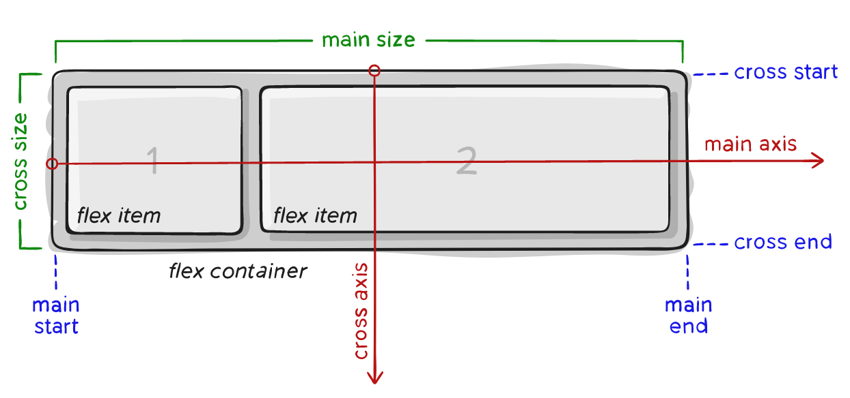
Flex
A way to create flexible smaller layouts (e.g., flow of UI controls) without too much customization.
There are many good and interactive Flex tutorials on the internet.
Notes:
Resources:
A Complete CSS Flexbox Layout Guide
https://css-tricks.com/snippets/css/a-guide-to-flexbox/

Slide 30
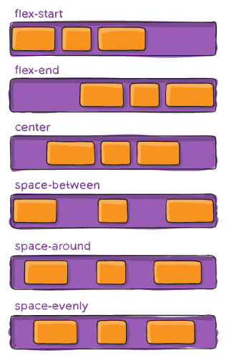
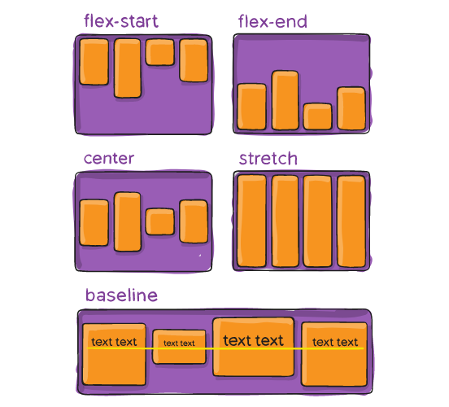
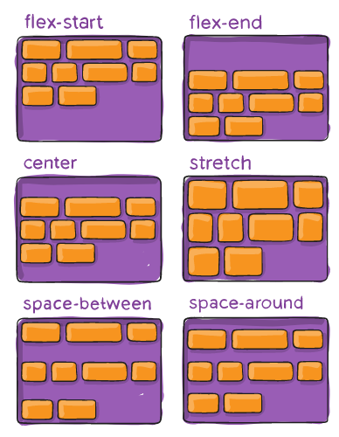
Selected flex properties
justify-content
align-items
align-content

Slide 31
Selected flex properties
Container properties:
display: flex
flex-direction
Direction of main axis.
flex-wrap
Whether wrapping is allowed.
justify-content
Alignment and spacing along the main axis.
align-items, align-content
Alignment, spacing, and padding along the cross axis.
Item properties:
order
Items are sorted by their order values. Items with the same order are sorted by HTML positions. Do NOT use!
flex-grow, flex-shrink
How much should the item grow/shrink if there is space left or not enough space.
flex-basis
Default size of the item, before growing or shrinking.

Slide 32
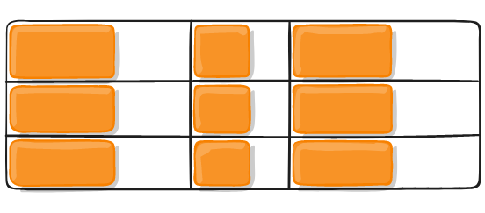
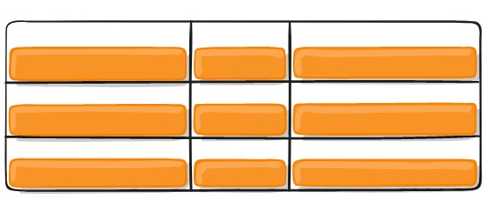
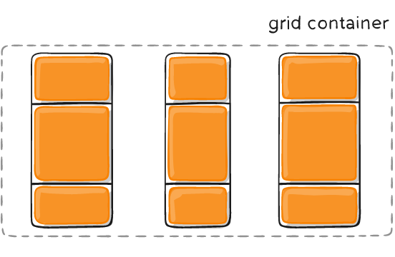
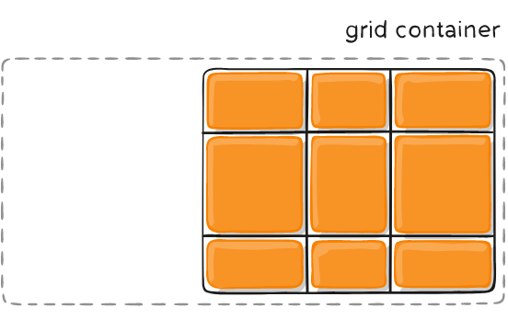
Grid
A container defines rectangular grid where items can be placed. The column and row sizes can be specified using various units, including fr unit - fraction unit introduced with grid.
The items are direct descendants, children, of the container. They are aligned within grid lines (i.e., inside a rectangle).
Items can be smaller than cells
Both horizontally and vertically
And the grid may be smaller than container
Notes:
Resources:
A Complete CSS Grid Layout Guide
https://css-tricks.com/snippets/css/complete-guide-grid/

Slide 33
Selected grid properties
Container properties:
display: grid
grid-template-rows, grid-template-columns, grid
grid-column-gap, grid-row-gap, grid-gap
align-items, justify-content
Align grid items inside a cell, using column and row axis.
grid-auto-columns, grid-auto-rows
Size of auto-generated columns and rows.
grid-auto-flow
Automatic placements direction or dense, to fill holes.
Item properties:
grid-column-start
grid-column-end
grid-row-start
grid-row-end
grid-column
grid-row
grid-area
justify-self, align-self
Align the item inside a cell.

Slide 34
Cascading Style Sheets
Layout

Slide 35
Cascading Style Sheets
Beauty is in the eye of the beholder

Slide 36
Cascading Style Sheets
"Functional" style

Slide 37
CSS Gaaming
Resources related to the topic:
CSS Diner https://flukeout.github.io/
A simple game with 32 levels to practice CSS selectors.
CSSBattle https://cssbattle.dev/
Challenges to improve your CSS skill.

