Slide 1
Introduction &
Fundamentals
NSWI142
2025/2026
Škoda Petr
https://www.ksi.mff.cuni.cz/
https://skodapetr.github.io/

Slide 2
Státní zkouška: Programování a vývoj software
Principy WWW, HTTP, URL. Statické webové stránky.
HTML struktura statické webové stránky
Interpretace HTML prohlížečem, DOM
Využití CSS ke stylování webové stránky
Využití HTTP a URL pro přístup k webové stránce
Programování na straně klienta.
Syntax JavaScriptu
Využití JavaScriptu pro modifikaci DOMu a obsloužení událostí
AJAX
API webových aplikací.
Správa stavu ve webové aplikaci
REST API
Základy bezpečnosti webových aplikací
SQL injection a cross-side scripting
HTTPS, digitální certifikáty
autentizace a autorizace

Slide 3
Státní zkouška: Databáze a web
Principy www, HTML, XHTML, HTML5 a CSS
Umět vytvořit statickou webovou stránku pomocí HTML, HTML5 v rozsahu osobního blogu, či e-shopu.
Na příkladu ukázat výhody HTML5 sémantických tagů.
Na příkladu ukázat využití HTML formulářů včetně validace vstupních polí.
Umět vysvětlit principy fungování CSS: syntaxe, specificita selektorů, vložení do stránky.
Umět vytvořit responzivní layout stránky v rozsahu: menu, hlavní obsah se sloupci, patička.
Architektury, základní principy, návrhové vzory a techniky webových aplikací
Umět vysvětlit použití návrhových vzorů: Front Controller, MVC/MVP, MVVC.
Programování na straně klienta, JavaScript, standardní API v prohlížeči.
Umět napsat JavaScript, který v reakci na událost provede dotaz na server, zpracuje odpověď a modifikuje DOM.
Umět uvést příklady standardní API v prohlížeči.
Vysvětlil přístupy k asynchronnímu programování v JavaScriptu: callbacks, promises, async/await, event loop.
API webových aplikací a webové služby.
Vysvětlil základní principy REST API.
Popsat úrovně REST API.
Umět popsat REST API pomocí OpenAPI.
Umět položit dotaz v GraphQL, popsat výhody a nevýhody GraphQL.

Slide 4
Státní zkouška: Databáze a web
Single-page aplikace, udržování stavu a uživatelské relace.
Vysvětlit princip fungování single-page aplikací.
Popsat možnosti udržování stavu pro webové aplikace v kontextu single-page aplikací.
Programování na straně serveru, CGI a CGi-like aplikace.
Vysvětlit fungování CGI a CGI-like aplikací.
Popsat možnosti udržování stavu pro webové aplikace a využití uživatelských relací.
Na příkladu demonstrovat PHP interleaving.
Umět vytvořit jednoduchou stránku v PHP, s využitím HTTP wraperu a připojením k SQL databázi.
Základy bezpečnosti webových aplikací.
Vysvětlil vztah HTTPS a HTTP, popsat výhody.
Na příkladu (JWT) vysvětlit použití autentizačních tokenů.
Identifikovat a popsat základní bezpečností rizika webových aplikací.

Slide 5
Practical / Seminar / Lab
Czech, English version
Attendance on the course seminar (labs) is not mandatory
There is "Cvičení pro repetenty"
Credit
Mandatory home assignments
Offline programming test
The credit is required before attending the final test

Slide 6
Points and Examination
Practicals
1 point for each active attendance
1 extra point as a bonus for solving some problems during / after the practical
Home assignments
Mandatory
Regular
Programming test
Specification
Modification during the test
Notes:
There may be one or two extra points.

Slide 7
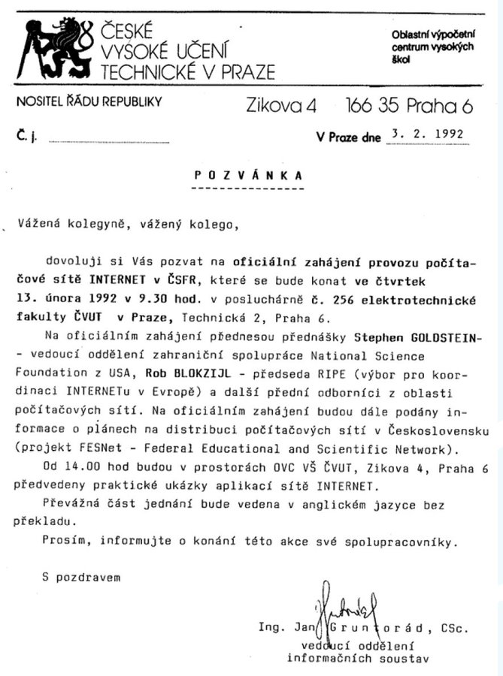




Scope
Notes:
Resources:
https://twitter.com/Vedact24/status/1492765483678015490?t=mibYlO7HNBC0NpMJR7ZX-Q&s=19

Slide 8


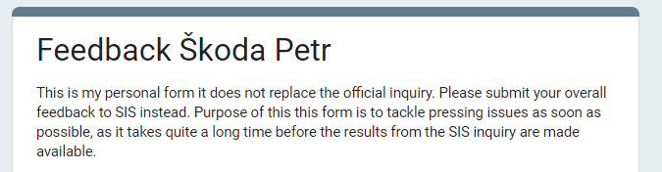
Feedback
zruste tento predmet a pokrocile weby ako povinny na sw specializaciu OKAMZITE
2024/2025
Notes:
Resources:
https://forms.gle/bXEzm1mVQvhxPdS79

Slide 9
Starting Point
What you should already know ...

Slide 10
Starting Point : NSWI141
Explain how a web page gets to your browser.
What is a URL? What parts does it consist of? What is their meaning?
Explain a communication between client and server. What protocol
do they use to communicate?
What is the difference between static and dynamic web page?
What are the two approaches to create a dynamic web page?
Which web technologies run in a client, and which are server-based?
What is the most important feature of applications using AJAX?
…

Slide 11
Starting Point : NSWI141
Jednoduchý statický web
Create a simple static web -- i.e., a set of (at least three) HTML documents interconnected with hyperlinks.
The web is supposed to be properly decorated with CSS styles (esthetic aspects will not be graded, but the utilization of styles has to be purposeful).
The actual contents is arbitrary; however, it has to reflect a feasible real-life situation (e.g., personal web presentation, short tutorial, ...).
….

Slide 12
Web application
URL, HTTP, ...

Slide 13

Resource Identification
Uniform Resource Identifier (URI) / Internationalized Resource Identifier (IRI)
Identification string with specific format.
Query and fragment parts are optional.
Uniform Resource Locator (URL)
An URI that describes a location of a resource.
<schema>:<hierarchical_part>?<query>#<fragment>
protocol://username:password@domain:port/path?p1=v1&p2=v2#fragment
https://data.gov.cz/datov%C3%A1-kvalita/
Notes:
Resources:
IRI in RFC 3987 from 2005

Slide 14
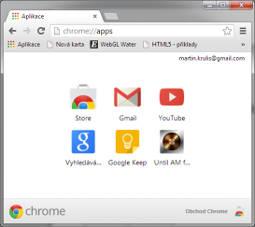


Accessing Web Pages
Address Bar
DNS
Server
http://www.ksi.mff.cuni.cz/cs/lide.php
Browser
Port 80
195.113.20.128
Creates TCP Connection
HTTP Protocol
Server
195.113.20.128
Client

Slide 15
HTTP Request
Request line (1st line)
Method Request-URI HTTP-version
Method
GET - Retrieve data from server, must be nullipotent.
POST - Use to send data to server or create a new resource.
HEAD - Retrieve response headers only.
PUT, DELETE, …
Request URI
A path, with optional query part, of absolute URI.
Specifying the requested content.
GET /index.html HTTP/1.1

Slide 16
HTTP Request Headers
Headers are optional. They follow the request line and are terminated by a blank line. They are the meta-information for the request or response. Hader consist of case-insensitive name followed by a colon ":", then by its value. Whitespaces before the value are ignored. Following are examples of request headers.
Host - The host domain name.
Accept - What is acceptable response data type.
If - Enable for conditional request, like modified since.
User-Agent - Information about the browser.
Authentication – User credentials.
…
Notes:
Resource:
https://developer.mozilla.org/en-US/docs/Web/HTTP/Headers

Slide 17
HTTP Response
Status line (1st line)
HTTP-version Status-code Reason-phrase
Status Codes
1xx - Informational
2xx - Success : 200 OK, 204 No Content, 206 Partial Content
3xx - Redirections : 301 Permanently Moved, 307 Temporary Redirect
4xx - Client-side errors
5xx - Server-side errors
HTTP/1.1 404 Not Found

Slide 18
HTTP Response Headers
Following are examples of response headers.
Content-Type - Type of the data in the body (MIME).
Content-Encoding - How is the content transferred.
Content-Length - Size of body in bytes.
Cache-Control - Rules for caching the content.
Expires - When does the content cease to be valid.
Location - New URL, in case of 3xx Redirects.
Connection - Rules for maintaining TCP connection.

Slide 19
HTTP Design Decisions / Issues
HTTP expected usage
Downloading contents from the server.
Uploading small amounts of data to the server.
The most problematic issues
Stateless communication
Each request is treated without a context.
Client-initiated protocol
Server cannot initiate dialog, e.g., send updates.
Non-persistent connections
A HTTP (TCP) connection is not maintained for long.

Slide 20
HTTP
HTTP/2
Advanced multiplexing over TCP.
Intensive compression, including headers.
Server may push content in advance.
Emphasis on encryption, most implementations support only HTTPS.
HTTP/3 QUIC
QUIC is a transport layer over UDP
…

Slide 21
Web Fundamentals
HTML

Slide 22
HTML Standard
HTML stands for Hypertext Markup Language and it is a markup language.
WhatWG : HTML Living Standard
https://html.spec.whatwg.org/multipage/
W3C : HTML5 Formal Standard
http://www.w3.org/TR/html5/
W3C : HTML 4.01 vs 5
http://www.w3.org/TR/html5-diff
Mozilla MDN HTML Reference
https://developer.mozilla.org/en-US/docs/Web/HTML
The W3C and WHATWG merge HTML specification in March 2019.

Slide 23
Twofold Nature of HTML
Presentation format for UI of web applications
Hyperlinks, forms - user controls.
URL as a holder of (partial) application state.
Web of Documents
HTML as a format for representing documents published on the Web.
URLs as unique global identifiers of documents.
Hyperlinks between documents to link related documents on the Web.

Slide 24
HTML and DOM
HTML is an infix serialization of the Document Object Model (DOM). Below you can see an HTML fragment.
Document
<!DOCTYPE html>
<html lang="en">
...
<body>
<h1>DOM Example</h1>
<p>
Document Object Model is an API …
</p>
<img src="url" alt="text">
...
</body>
</html>
html
body
h1
p
img
src
alt
DOM Example
Document Object Model …

Slide 25
Document Metadata Section
<!DOCTYPE html>
<html lang="en">
<head>
<title>Technologies for …</title>
<base href="http://www.ksi.mff.cuni.cz/index.html">
<link rel="stylesheet" href="default.css">
<style type="text/css">
body { font-size: 12pt; }
</style>
<meta name="keywords" content="html, example">
<meta http-equiv="content-type" content="text/html; charset=utf-8">
</head>
...
</html>
Notes:
Note that "http-equiv" is a special construct.
It should only hold information that cannot be transferred over HTTP.
This is useful when the HTML document is saved on a local disk.

Slide 26
Semantic HTML Elements
Element | Description
<em> | Marks text that has stress emphasis.
<strong> | Indicates that its contents have strong importance, seriousness, or urgency.
<small> | A side-comments and small print, like copyright and legal text, independent of its styled presentation.
<code> | Displays its contents styled in a fashion intended to indicate that the text is a short fragment of computer code.
<abbr> | An abbreviation or acronym.
<time> | A specific period in time
…
Element | Description
<section> | A generic standalone section of a document, which doesn't have a more specific semantic element to represent it. There should be a heading.
<article> | A self-contained composition in a document.
<header> | Introductory content.
<footer> | Footer for its nearest ancestor.
<aside> | A portion of a document whose content is only indirectly related to the document's main content.
<nav> | A section of a page whose purpose is to provide navigation links.
…
See specification or references at mdn.
Notes:
Resources:
https://developer.mozilla.org/en-US/docs/Web/HTML/Element

Slide 27
Hyperlink Element
Links to external resources, which are exposed to user of the current document as means to browse, change what user sees.
Attribute href specifies URL of linked resource.
Content is visible to user, text or any inline elements.
Identifying fragment of a web page.
Is then referenced by fragment part of an URL.
Consider attributes like rel, to add meaning to the relation, or target.
<a href="http://www.google.com">Google</a>
<p id="Para2"> ... </p>
<a href="http://www.page.com#Para2">...</a>

Slide 28
Form Element
Component of a web page composed of UI controls. User can interact with form controls to fill in information. The interaction can be adding text, selecting options, clicking on buttons, etc.. User provided data can be processed by a script, at the client or server side.
We can submit the form using GET or POST HTTP request. This can by "method" attribute. The form need to be submitted to given URL. The URL is set using "action" attribute.

Slide 29
Form Example
<form method="get" action="http://www.example.org/newcustomer.php">
Name: <input name="fullname" ... >
<label for="phone">Phone:</label>
<input name="phone" id="phone" ... >
<label> Preferred delivery time: <input name="time" ... > </label>
<label> Comments: <textarea name="comments"></textarea> </label>
<button type="submit">Submit Order</button>
</form>
BAD PRACTICE
Submit button works as a link to an assembled URL:
http://www.example.org/newcustomer.php?fullname=John+Smith
&phone=555-1234&time=5pm&comments=unleashed+dog+at+house
Notes:
Resources:
https://developer.mozilla.org/en-US/docs/Web/HTML/Element/label

Slide 30
Input Example
<form ... >
<input name="phone"
title="Hint (bubble with text)."
maxlength="9"
autocomplete="off"
autofocus="autofocus"
pattern="[0-9]{9}"
placeholder="Fill in your 9-digit phone number"
required="required">
<button>Submit</button>
</form>
Unsupported types are treated as text inputs.

Slide 31
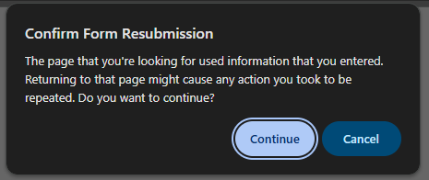
Submitting Forms
When form is submitted:
Data are encoded into HTTP request made for selected URL using given method (GET/POST).
In case of GET request, the data are encoded to URL.
For the POST requests, the "enctype" attribute of form element specifies the format of the encoded:
application/x-www-form-urlencoded
multipart/form-data
text/plain
Examples on following slide.
Browser can warn when reloading HTTP POST request,
to make sure user want to resubmit the form.
Notes:
application/x-www-form-urlencoded
- Default. Characters are encoded, so they can be safely sent as a query part of an URL (spaces are converted to "+" symbols, and special characters are converted to ASCII HEX values, …).
multipart/form-data
- No characters are encoded. This value is required when you are using forms that have a file upload control.
text/plain
- No special characters are encoded. Problem with newlines.

Slide 32
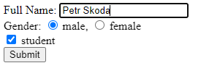
Submitting Forms Example
<form method="post" action="?" enctype="...">
Full Name: <input name="fullname" type="text"><br>
Gender:
<input name="gender" type="radio" value="M"> male,
<input name="gender" type="radio" value="F"> female <br>
<input name="student" type="checkbox" value="1"> student <br>
<input type="hidden" name="tag" value="#a&amp;Hx9%">
<button type="submit">Submit</button>
</form>
BAD PRACTICE

Slide 33
Submitting Forms Example
application/x-www-form-urlencoded
fullname=Petr+Skoda&gender=M&student=1&tag=%23a%26Hx9%25
multipart/form-data
text/plain
------WebKitFormBoundaryCPAwVnWB0tfHHRWI
Content-Disposition: form-data; name="fullname"
Petr Skoda
------WebKitFormBoundaryCPAwVnWB0tfHHRWI
Content-Disposition: form-data; name="gender"
M
------WebKitFormBoundaryCPAwVnWB0tfHHRWI
Content-Disposition: form-data; name="student"
1
------WebKitFormBoundaryCPAwVnWB0tfHHRWI
Content-Disposition: form-data; name="tag"
#a&Hx9%
------WebKitFormBoundaryCPAwVnWB0tfHHRWI--
fullname=Petr Skoda
gender=M
student=1
tag=#a&Hx9%
The content is send using an HTML request body and the content-type header is set.
For the "multipart/form-data" the header also contains the separator.

Slide 34
Web Fundamentals
CSS

Slide 35
Cascading Style Sheets (CSS)
Document
Sometimes, inheritance is involved
font: 12pt Arial;
background-color: #fff;
body
h1
p
…
font-size: 24pt;
margin: 10px 0;
Text
Some
b
and some plain text.
text-align: justify;
padding: 5px;
bold

Slide 36
CSS Inline / Embedding / Linking
Inline CSS
HTML attribute style with CSS properties.
Do not write by hand!
Embedding CSS
Element <style> in header.
Useful for single-file pages and for faster loading via HTTP.
Linking CSS
Linking External Style Sheet File.
Separate files for separate languages.
Better code (style sheet) reusability.
<h1 style="color: red;">Red Heading</h1>
<head>
<link rel="stylesheet" type="text/css"
href="styles.css">
...
<head>
<style type="text/css">
...
</style>
...
h1 { color: red; }
...

Slide 37
CSS Selectors
We need to select an element using a selector and then apply specified properties. One property block can be used with multiple selectors separated by a comma. Selectors on a simple declarative language.
<selector>[,<selector> { <properties> }
Basic selector types
p - element name selector (p)
#myId - single element of given ID
.myClass - elements with assigned class
* - universal selector selects all elements
Simple combinations
div.info - select all div elements with info class
…
Using relative positions in the document
E F - selects elements F which have ancestor E
E > F - selects elements F which have parent E
E + F - selects elements F which are immediately preceded by E
E ~ F - selects elements F which are preceded by E
We can use any other selectors instead
of E and F.

Slide 38
Demo
CSS Diner

Slide 39
CSS Pseudo-Classes Selectors
Selector | Description
:link | Unvisited hyperlink
:active | Active (currently clicked on) hyperlink
:visited | Visited hyperlink
:first-line | First line of the text inside
:first-letter | First letter of the text inside
:disabled | Disabled (e.g., input with disabled attribute)
:checked | Checked input checkbox
:focus | Element which has focus
:hover | Element over which a mouse cursor hovers
:target | Element that matches fragment part of current URL
:root | Root element of the document
… | …

Slide 40
CSS Pseudo-Classes Selectors
Selector | Description
:first-child | Element which is the first child of its parent
:last-child | Element which is the last child of its parent
:only-child | Element which is the only child of its parent
:first-of-type | Element which is the first/last/only sibling of its type (e.g., p:first-of-type selects the first p within its parent no matter other element types).
:last-of-type
:only-of-type
:nth-child(e) | The expression e in the parenthesis can be B, An, or An+B, where A and B are numeric literals. It selects elements that have exactly An+B-1 preceding children/type-siblings for any n ≥ 0. E.g., 2n selects even items, 2n+1 odd items, …
:nth-of-type(e)
:nth-last-child(e)
:nth-last-of-type(e)
… | …

Slide 41
CSS Pseudo-Classes Selectors
Selector | Description
:not(X) | Negation pseudo-class selects elements that does not match simple selector X.
:has(X) | Pass when an argument match at least one element when anchored against this element. E.g. h1:has(+ p) { … }
::selection | Part of the text selected by user.
::before ::after | Inserts additional content before/after selected element. E.g. p.proof::after { content: "Q.E.D."; }
… | …
Notes:
h1:has(+ p) – a h1 followed by a paragraph. This is a powerful selector.
::before and ::after are used to generate content. They add a new element as a first last child of the selected element. We can use this later with grid layout.

Slide 42
CSS Attribute Selectors
Select elements with given attribute(s).
[attr] - selects elements with attribute attr (its value does not matter)
[attr=val] - attribute attr with exact value val
[attr^=val] - attribute that starts with given val
e.g., a[href^="https"] selects links to secured pages
[attr$=val] - attribute that ends with given val
[attr*=val] - attribute that contains a val as a substring
[attr~=val] - attribute with list of whitespace-separated values
here val matches one of the items on the list
[attr|=val] - attribute with value val or beginning with val immediately
followed by ‘-’ (intended for lang)

Slide 43
Cascading Origin Precedence
Descending order
Transition declarations
Important user agent declarations
Important user declarations
Important author declarations
Animation declarations
Normal author declarations
Normal user declarations
Normal user agent declarations
!important suffix
Styles in HTML document
or in linked CSS file
Styles provided by browser
user (e.g., via configuration)
Browser (default) style sheets
Notes:
1 and 6 will be explained later.
Resources:
https://www.w3.org/TR/css-cascade-3/

Slide 44
Cascading Selector Specificity
Defines priority for selectors from the same origin.
For given selector 𝑆, let
  𝐴 = number of ID sub-selectors of 𝑆
  𝐵 = number of class, pseudo-class, and attribute sub-selectors of 𝑆
  𝐶 = number of type sub-selectors in 𝑆
Concatenation 𝐴𝐵𝐶 (in sufficiently high base) gives selector specificity.
For example: #d1 ul li.new span:hover
If two selectors have the same specificity, latter overrides former (in the document order).
Notes:
Resource:
https://www.w3.org/TR/selectors-4/#specificity

Slide 45
Selected CSS Properties
font
font-size
font-*
float
clear
text-align
text-ident
line-height
letter-spacing
whitespace
transform
transition
background-color
background-image
background-position
background-repeat
linear-gradient
box-shadow
text-shadow
color
border
border-style
border-collapse
…
Notes:
Selected:
whitespace - whether whitespace is pre-formated, no-breaking, …
transform - 2D (translate, rotate, scale, skew, matrix) , 3D (rotateX, rotateY, rotateZ)

Slide 46
Transitions / Animations
Transitions
Limited way to describe property interpolations.
Always interpolating between two exact states.
Time function may be non-linear.
Animations
It is a mechanism of interpolation.
Define a set of states between which the values are interpolated.
There are additional features like timing, pausing, repetition, alternation, …
Animation restart is not a default.
transition: width 2s, height 2s;

Slide 47
Animation Example
@keyframes colorize {
0% { color: black; }
30% { color: red; }
100% { color: blue; }
}
#something {
animation-name: colorize;
animation-duration: 5s;
animation-iteration-count: 3;
}
Named set of keyframes
Each keyframe holds a state of the element at a particular phase of the animation
Animation is then applied using CSS properties

Slide 48
Display
Element Display Modes.
Elements have specific ways of rendering.
Inline elements (<em>), block elements (<p>), table elements, lists, …
Display property can override default behavior.
Value | Description
block | Standard block element
inline | Element rendered inline with the text
inline-block | Small block inserted in text flow
none | Hide element, no effect on layout
list-item | Default for <li> elements
table, table-* | Table rows and cells have specialized formatting
… | …
Notes:
CSS3 introduced flex and inline-flex values along with flex* properties. We will get to that later…

Slide 49
Box Model
Applied to all block, and inline block, elements.
Border is a visible bounding box around contents.
  Have width, color, and style (solid, dotted, …).
  Can be replaced by custom image (like background).
  Corners may be rounded (border-radius).
Padding is a space between content and border.
Margin is a minimal space to nearest border of another element.
There are exceptions to this rule, e.g. elements of same type.
Properties can be set for each side separately with: *-left, *-right, *-top, *-bottom.

Slide 50
Box Model Example
padding
Content
border
margin
Margins (typically) collapse,
i.e., adjacent margins overlap
Another Content
Notes:
Resources:
https://developer.mozilla.org/cs/docs/Web/CSS/CSS_Box_Model/Mastering_margin_collapsing

Slide 51
Box Model
Box Model Related Properties:
width, height, max-*, min-*
box-sizing: content-box | border-box
When the contents does not fit width/height constraints, it will overflow (see overflow property)
box-sizing: border-box
width
padding
Content
border
width
margin
box-sizing: content-box
(default)

Slide 52
Media
We need to restrict styles for a particular (visualization) medium, e.g., screen, print, speech, ..
We can use media features / properties in addition to media types:
width, height
device-width, device-height
orientation, aspect-ratio
Attribute based:
Inside CSS:
<style media="print">
body {
color: black;
background-color: white;
}
</style>
@media screen and (max-width: 450px) {
body { font-size: 0.8em; }
}
Notes:
Dark mode is a good example; responsive layout is another one.

