Slide 1
Fundamentals
NSWI142 - Web Applications Development
2026/2027
Petr Škoda
https://skodapetr.github.io/
https://www.ksi.mff.cuni.cz/
This work is licensed under a Creative Commons Attribution 4.0 International License.

Slide 2

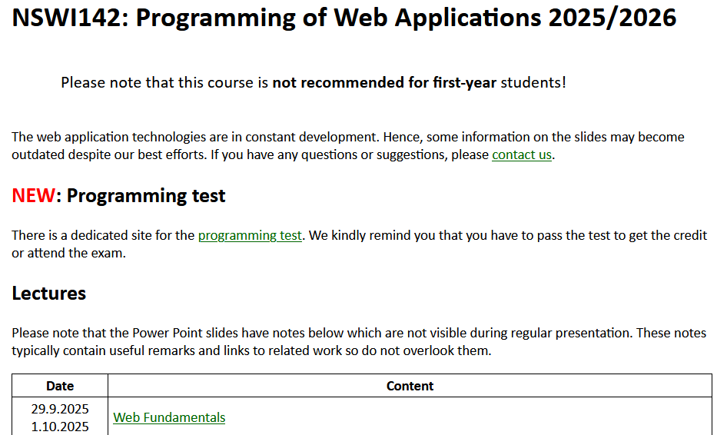
Organization
Website
https://teaching.mff.cuni.cz/nswi142-web/
Supporting materials

Slide 3
Státní zkouška
Bc. Programování a vývoj software
Bc. Databáze a web
NSWI142 is not enough!
Mgr. Softwarové a datové inženýrství
Only NSWI153.

Slide 4
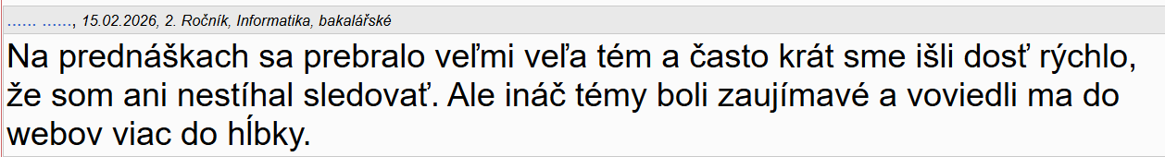
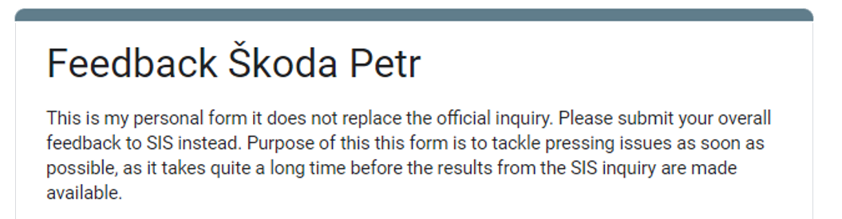
Feedback
zruste tento predmet a pokrocile weby ako povinny na sw specializaciu OKAMZITE
2024/2025
anonymous
Notes:
Resources:
https://forms.gle/bXEzm1mVQvhxPdS79

Slide 5
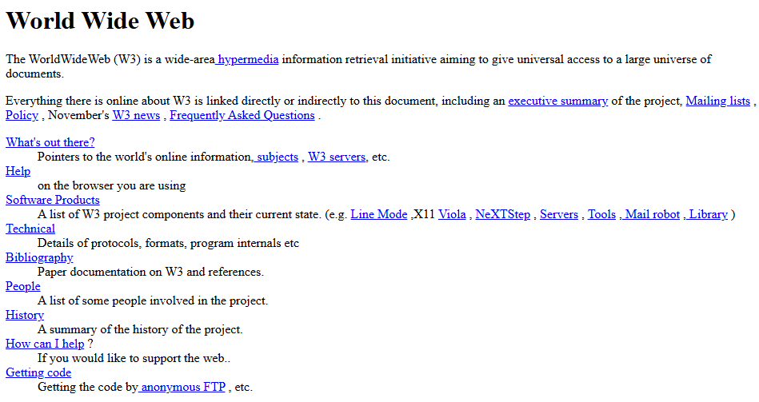
The First Website
Tim Berners-Lee, a British scientist, invented the World Wide Web (WWW) in 1989, while working at CERN. The Web was originally conceived and developed to meet the demand for automated information-sharing between scientists in universities and institutes around the world.
By the end of 1990, Tim Berners-Lee had the first Web server and browser up and running at CERN, demonstrating the ideas behind the proposal. ...
To prevent it being accidentally switched off, the computer had a hand-written label in red ink: "This machine is a server. DO NOT POWER IT DOWN!!"
Notes:
Resources:
A short history of the Web
https://home.cern/science/computing/the-birth-of-the-web/short-history-web/
World Wide Web
https://info.cern.ch/hypertext/WWW/TheProject.html

Slide 6
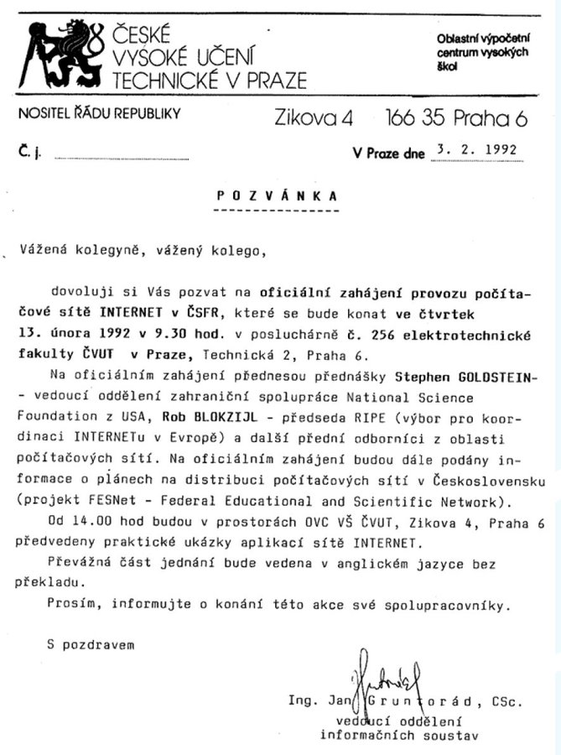




Scope
"Those who cannot remember the past are condemned to repeat it"
-- George Santayana, The Life of Reason, 1905
Notes:
Resources:
https://twitter.com/Vedact24/status/1492765483678015490?t=mibYlO7HNBC0NpMJR7ZX-Q

Slide 7
Prerequisites / Starting Point
User perspective
Open a website using a browser of choice.
(Power-)User perspective
Ability to use IDE of your choice.
Basic familiarity with scp, ssh, and git commands.
NSWI177
Basic familiarity with networking and TCP/IP protocols.
NSWI141
Web applications
Create a set of, at least three, HTML documents interconnected with hyperlink and decorate all of them with CSS styles.
NSWI141
Application development
Python
NPRG030, NPRG031
Fundamentals of relation databases and SQL
NDBI025

Slide 8
Credit and exam
Points
Up to 20 points from seminar active participation.
10 points for seminar assignments.
10 points for mandatory ReCodEx assignments.
15 points for seminar projects and a lab test.
To get the credit you need to:
Complete all ReCodEx assignments.
Finish the seminar project and pass the lab test.
Get 25 points or more.
Based on your performance you can also get a grade:
3 you need to be eligible for the credit and get 42 or more points.
2 you need to be eligible for 3 and score 47 points or more.
1 you need to be eligible for 2 and score 52 points or more, in addition, you need to show exceptional performance with your seminar project and a lab test.
There is an OPTIONAL written exam.

Slide 9
Demonstration
Open a website using a browser of choice.

Slide 10
The 3 pillars of a website
Website
Structure
Presentation
Behavior
Structure is the (Semantic) HTML, e.g., paragraphs, forms, lists, heading, ...-
Behavior is addressed by JavaScript for interaction, validation, animation, business logic, ...
Presentation is about CSS, colors, fonts, layout, ...
Notes:
Resource:
Do It With Style: Rethinking CSS - Dylan Beattie - NDC London 2026
https://www.youtube.com/watch?v=nhbYveaV0pk

Slide 11
HTML Standard
The W3C and WHATWG merge HTML specification in March 2019.
WhatWG : HTML Living Standard
https://html.spec.whatwg.org/multipage/
W3C : HTML5 Formal Standard
http://www.w3.org/TR/html5/
W3C : HTML 4.01 vs 5
http://www.w3.org/TR/html5-diff
Mozilla MDN HTML Reference
https://developer.mozilla.org/en-US/docs/Web/HTML

Slide 12
Twofold Nature of HTML
Presentation format for UI of web applications
User change the state by interaction with the user controls.
Hyperlinks and forms serve as user controls.
URL as a (partial) holder of an application state.
Web of Documents
HTML as a format for representing documents published on the Web.
URLs as unique global identifiers of documents.
Hyperlinks between documents to link related documents on the Web.

Slide 13
Sending data to the server

