Slide 1
Web applications with JavaScript
NSWI142
2025/2026
Škoda Petr
https://www.ksi.mff.cuni.cz/
https://skodapetr.github.io/

Slide 2

Revision
JavaScript
Document Object Model
Event Model
<script type="text/javascript" src="url"></script>

Slide 3
User interface State Synchronization

Slide 4
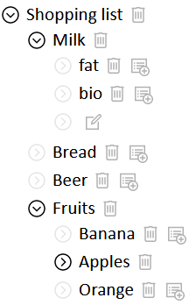
The state is kept only in DOM
Example of collapsible list.
Nested item list
Each item with sub-list is collapsible
Collapsed/Expanded state is defined by a presence of a CSS class
CSS class also hides the sub-list
On-click event toggles the class
Initial state can be encoded in HTML

Slide 5
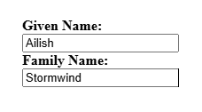
State Synchronization
State is expressed with HTML and CSS. We can even store part of application state using DOM.
At the same time, we would naturally store state using JavaScript. We need the state in JavaScript to execute business logic.
As a result, we have state at two places ~ state (data) synchronization issue.
const user = {
givenName: "Ailish",
familyName: "Stormwind",
};
State in memory,
can be modified by code.
State in DOM, (can be modified by user events.

Slide 6
Bi-directional synchronization 1/3
Data are kept both in JavaScript memory and in DOM.
The bi-directional synchronization is preferably automated.
Connections are often defined in declarative manner.
const user = {
givenName: "Ailish",
familyName: "Stormwind",
};

Slide 7
Bi-directional synchronization 2/3
From DOM to JavaScript, we just need to register listeners and update the state.
document.getElementById("givenName").addEventListener("change", event => {
user.givenName = event.target.value;
});
We can be more creative with attributes!
const user = {
givenName: "Ailish",
familyName: "Stormwind",
};

Slide 8
Bi-directional synchronization 3/3
We need to be able to detect change in JavaScript. There are multiple options ...
// Use a class.
class User {
setGivenName(name) {
...
// JavaScript language.
let user {
set givenName(name){
...
// Special method.
user.givenName = "";
synchronize();
// ...
...
const user = {
givenName: "Ailish",
familyName: "Stormwind",
};

Slide 9
Demo
Bi-directional synchronization

Slide 10
User Interface Design
Premature optimization is the root of all evil, yet ...
Efficient event handlers Otherwise, the browser may start to lag.
Disjoint DOM nodes assembly.
When creating DOM subtree, assemble it separately and then insert it to visible DOM all at once.
Use cloning when possible. You can put templates in your HTML.
Prefer hiding/showing of existing nodes using CSS instead.
Use CSS classes instead of style attributes. Especially when operating on multiple nodes.

Slide 11
Single page application
Almost everything is handled by JavaScript and asynchronous HTTP requests.
The traditional form or browsing is not used.
…
Advanced Programming of Web Applications - NSWI153

Slide 12
User interface & asynchronous operations

Slide 13
Example
Let us have a data table, where each item has a delete button that triggers POST request. User can click buttons and delete items.
How can we implement this functionality?

Slide 14
Example
Using native HTML forms functionality This is not really about JavaScript.
Trivial solution We utilize full page reload. After successful request, JavaScript triggers reload of the page. URL may be in the response body.
Slightly more optimized solution After successful request, JavaScript triggers reload of affected components, table, via separate GET request. The table is replaced by DOM manipulation.
Optimized solution The POST response sends a HTML fragment or, better yet, component data for re-rendering the table.
...

Slide 15
Example
Regardless of the implementation, we send the request, we wait, we get the response. What is user doing all that time? When should we remove the element from DOM?
Optimistic update
Item is removed (from DOM) when request is started.
Problematic if the operation fails. Item must be returned, user may not notice.
Pessimistic update
Item is removed after request is completed.
May take long time Progress animation, other operations must be blocked.

Slide 16
JavaScript and forms
There is a wrapper for form data.
Can be used as body for HTTP requests
Represents a collection of data (as key-value pairs)
Analogical to data sent by regular form submit
Assembled manually or loaded from <form>
// Create binding.
new FormData([ formElement ])
// Read operations
keys(), values(), entries()
has(), get(), getAll()
// Write operations
set(), append(), delete()

Slide 17
JSON
JSON is a lightweight interchange format for structured data. It is based on subset of JavaScript language. As a format it is language independent. There are parsers and serializers for many languages. JSON was intended for replacing XML in simple scenarios - now most of the web applications.
Basic syntax:
Two basic structures: collections and lists
Supports strings, numbers, bools, and null type
Unicode safe
[
{
"StudentId": 42,
"Name": "John Smith"
}, {
"StudentId": 54,
"Name": "Jane Johnson",
"Graduated": true
}
]
// Create object from JSON.
const res = JSON.parse(jsonString);
// Save object to JSON sring.
const jsonString = JSON.stringify(jsObject);

Slide 18
Fetch API
API for asynchronous HTTP request:
Arguments:
input - URL or Request object
init - object with initialization parameters
method - HTTP method to be used
headers - request headers
body - request body
…
The function returns a promise.
CORS (Cross-Origin Resource Sharing) A mechanism build to allow a server to indicate any origins (schema, domain, or port) other than its own from which a browser should permit loading resources. The mechanism is implemented using "prefligh" request and HTTP headers.
fetch( input [, init] )
Notes:
Resources:
https://developer.mozilla.org/en-US/docs/Web/API/Fetch_API/Using_Fetch
https://developer.mozilla.org/en-US/docs/Web/HTTP/Guides/CORS

Slide 19
HTML5 API & ...
Advanced Programming of Web Applications - NSWI153

Slide 20
History API
Captures hidden script-managed state.
Allows backward/forward navigation over the states/
history.state
history.pushState(stateObject, unused, url)
history.replaceState(stateObject, unused, url)
history.back()
Notes:
Resources:
https://developer.mozilla.org/en-US/docs/Web/API/History_API

Slide 21
Non-visible data attributes
Data for scripts but associated with DOM elements.
Special data-* attributes
Appear in element.dataset collection
<li class="tab-heading" data-section="first" > …

Slide 22
Data storage
Persistence key-value data storage accessible from JavaScript.
Similar isolation like cookies
sessionStorage - for each window/tab
localStorage - persistent, per web application
window.localStorage.setItem("key-utf-16", "state-as-string");

Slide 23
Demo
API

Slide 24
Compatibility issues
Browser’s developers implement the web standards when they want and how they want.
Especially problematic with their older versions.
Test the functionality, not the browser type/version
We can check for API presence:
Use libraries
Babel - JavaScript transpilling and polyfill
Webpack - bundling the code (JavaScript and CSS)
if ("fetch" in window) { code using fetch } else { ... }
Advanced Programming of Web Applications - NSWI153
Notes:
Resources:
http://html5test.com/
http://www.webbrowsercompatibility.com/dom/desktop/

Slide 25
WARNING: Following slides are NOT an overview of current trends and frameworks.

Slide 26
jQuery
Modern & Lightweight & … JavaScript library for basic operations.
Selected features:
Simplified DOM traversal and manipulation.
Event handling.
CSS based animations and effects.
Unified API with support for data (de)serialization.
Extendable with plugins and UI libraries.
jQuery function object in global name jQuery and $. It acts as a function that returns set of nodes and as a container object for library functions
"Select and Do" Philosophy
Select a set of DOM nodes
Apply (a sequence of) operation(s) on the whole set of selected nodes
Most methods support invocation chaining
$(selector).doIt().doAnother().doSometingElse();
jQuery Selectors are inspired by CSS3 selectors
Subsequent operations work on the whole set
$(".secret").hide();
Notes:
Resources:
https://releases.jquery.com/jquery/

Slide 27
jQuery
write less, do more.
Since 2006 ...
Vanilla JS is a fast, lightweight, cross-platform framework for building incredible, powerful JavaScript applications.
WT ...

Slide 28
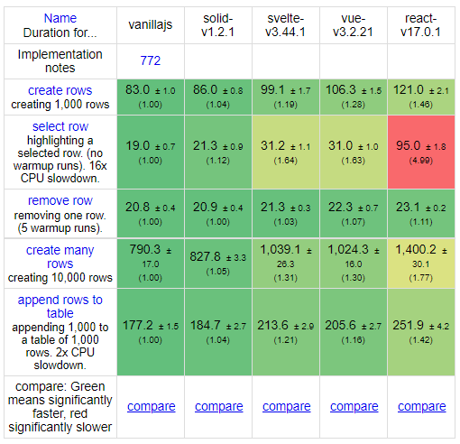

Frameworks
Advanced Programming of Web Applications - NSWI153
Notes:
Resource:
https://github.com/krausest/js-framework-benchmark
https://github.com/gothinkster/realworld

Slide 29

Angular.JS
<h1>Hello {{yourName}}!</h1>
<div>
<label>Name:
<input
type="text"
ng-model="yourName">
</label>
</div>
<div>Len: {{nameLen}}</div>
angular.module('app', []) .controller('controller', function() {
this.yourName = "petr";
this.nameLen = function() {
return yourName.size;
};
});
Advanced Programming of Web Applications - NSWI153
Notes:
Resources:
https://angularjs.org/
https://www.dotsquares.com/press-and-events/what-is-digest-cycle-in-angular-js-and-how-does-it-make-two-way-data-binding-possible

Slide 30

React
Introduced JSX
It is just a library
React DOM compares the element … and only applies the DOM updates necessary to bring the DOM to the desired state ~ Virtual DOM.
React 16.8.0 is the first release to support Hooks.
React 19 ... adds compiler.
Virtual DOM
const element = <div>Hello, {name}</div>;
var element = React.createElement(
“div", null, "Hello, ", name);
Advanced Programming of Web Applications - NSWI153
Notes:
Resources:
https://geekflare.com/react-rendering/
https://dev.to/spukas/react-work-phases-4eaj
https://indepth.dev/posts/1008/inside-fiber-in-depth-overview-of-the-new-reconciliation-algorithm-in-react
https://www.velotio.com/engineering-blog/react-fiber-algorithm
https://andela.com/insights/building-your-own-version-of-react-from-scratch-part-1/

Slide 31

Vue.js
export default {
data: {
message: 'Hello Vue!’
},
render(createElement) {
return createElement(
'div',
{attrs:{"id":"msg"}},
[this.data.message]
);
}}
<div id=“msg”>
{{ message }}
</div>
export default({
data: {
message: "Hello Vue!",
},
}
Virtual DOM
Advanced Programming of Web Applications - NSWI153
Notes:
Resources:
https://v3.vuejs.org/guide/optimizations.html#virtual-dom
https://blog.logrocket.com/how-the-virtual-dom-works-in-vue-js/

Slide 32


Svelte
<div on:click={onClick}>
{ msg }
</div>
<script>
let msg = "Message";
function onClick() {
msg += " . ";
}
</script>
Virtual DOM
Advanced Programming of Web Applications - NSWI153
Notes:
Resources:
https://lihautan.com/compile-svelte-in-your-head-part-1/
https://www.indiewire.com/wp-content/uploads/2017/10/matrix-code.jpg

Slide 33

React framework for production
Advanced Programming of Web Applications - NSWI153

Slide 34
2023/2024 Bonus content

