Slide 1
API & Design patterns
NSWI142
2025/2026
Škoda Petr
https://www.ksi.mff.cuni.cz/
https://skodapetr.github.io/

Slide 2
Software Engineering
Analysis
Gathering/anticipating user requirements.
Pay extra attention to scaling problems.
Development
Use appropriate scope.
Trivial custom PHP for trivial applications, robust frameworks and design patterns for complex applications.
Testing
User/Application Testing, e.g., Selenium.
Unit testing, e.g., PHPUnit.
Continuous Integration, e.g., Travis CI, GitHub Actions.

Slide 3
Software Engineering
Introduction to Software Engineering (NSWI041)
Software Engineering in Practice (NSWI149)
Software System Architectures (NSWI130)
Advanced aspects of software engineering (NSWI026)
Software Testing (NTIN070)
Design Patterns (NPRG024)
Software Development Tools (NSWI154)
Advanced Tools for Software Development and Monitoring (NSWI126)
Recommended Programming Practices (NPRG043)
…

Slide 4

Design patterns
Impact of design patterns on software quality: a systematic literature review Published: 01 February 2020
Design patterns represent solutions to frequently occurring software problems for designing good quality software.
…
23 design patterns called gang of four (GoF) patterns. GoF design patterns are classified into three categories: structural, creational, and behavioral patterns.
Design patterns are typical solutions to common problems in software design. Each pattern is like a blueprint that you can customize to solve a particular design problem in your code.
Notes:
Resource:
https://memegenerator.net/instance/51707203/dog-scientist-science-in-progress-do-not-disturb
https://martinfowler.com/eaaCatalog/
https://sourcemaking.com/design_patterns
https://www.geeksforgeeks.org/software-design-patterns/
https://refactoring.guru/design-patterns

Slide 5
Model-View-Controller
Notes:
Resources:
https://dev.to/dmitry-kabanov/model-view-controller-mvc-origins-of-design-pattern-1677

Slide 6
Model-View-Controller (MVC) Presenter (MVP)
A guideline how to divide code and responsibility, it was introduced in 1970s and 1980s. MVC is a basis for many frameworks. There term MVC is, unfortunately, little ambiguous.
Alternatives
Model-View-Presenter - separate Model and View
Model-View-ViewModel
...
Advanced Programming of Web Applications - NSWI153

Slide 7
Model-View-Presenter
Request processing
Presentation Tier
Business Logic
Data Tier
Presenter
Prepares
Manipulates
View
Load data from
Model
This is not part of MVP; but may be part of MVC.
User interface
Uniform data API

Slide 8
MVP: View
View is about user interface and data presentation. For server-side web-application view is typically responsible for generating HTML. It provides automatic sanitization of presented data (<,> chars). It can also deal with translations for multilingual applications.
Can use templates:
Mechanisms that separate HTML coding from application programming
Allow implementing View features (mentioned above) in declarative (instead of imperative) manner

Slide 9
MVP: Presenter
Presenter is non-ui class that integrates business/application logic. It issues commands to view and model. It do so based on the user requests:
Requests for displaying content (typically GET request)
Requests for modifying app. status (typically POST req.)
We can view similarities and potential integration in other patterns such as:
Front controller pattern
Command pattern
…
Notes:
Comment more at Model-View-Presenter.

Slide 10
Presenter example
class EditPresenter extends BasePresenter
{
// Handler function.
public function actionShowEditForm(string $id)
{
// Get data from model.
$object = $this->model->getItem($id);
// Prepare view, no direct communication between view and model.
if ($object !== null) {
$this->view->setArg('id', $id);
$this->view->setArg('editedObject', $object);
}
// Render view.
$this->view->render();
}
}

Slide 11
MVP: Model
Model is responsible for reflecting the application domain and the data we are working with.
Direct SQL writing is "inconvenient". Better to use some data abstraction layer. This can be a tiny helper to write SQL or all the way up to the Object-Relational Mapping (ORM) solutions.
But where do we store data and what data do we store?

Slide 12
Database

Slide 13
Data model
Allows you express data entities naturally.
Customer, Product, Order, …
Offers benefits like inheritance
Customer, Seller, Admin ~ User
Promotes encapsulation
Well defined interface
Hides the details of actual data representation/storage
Improves readability
Self documented code
Decorated with doc comments
Object persistence
Explicit way to flush objects to persistent storage
Object relations
Like database relations (1:1, 1:N, …)

Slide 14
Database
MySQLi
Database Abstraction Layers ….
Advanced Programming of Web Applications - NSWI153
Notes:
Resources:
https://www.php.net/manual/en/book.pdo.php
https://github.com/dg/dibi

Slide 15
Object-Relational Mapping (ORM)
Technique which creates object-oriented API over (relational) database. Much simpler for the programmer (no need for SQL) and less error prone (no SQL).
Object-relational impedance mismatch:
How to save objects into database?
Mapping IS-A hierarchy, private members, references, …
Advanced Programming of Web Applications - NSWI153

Slide 16
Example
/**
* @Entity
* @Table(name="subjects")
**/
class Lecture {
/**
* @Id
* @Column(type="integer")
* @GeneratedValue **/
protected $id;
/**
* @Column(type="string") **/
protected $fullname;
...
Advanced Programming of Web Applications - NSWI153

Slide 17
Example
$entityManager = EntityManager::create($conn, $config);
// Get record with given identifier.
$subj = $entityManager->find('Lecture', (int)$id);
// Modify record, just like any other object in our application.
$subj->setName('Web Applications');
// Save changes to database.
$entityManager->flush();
// PHP Magic incoming ..
$subjs = $entityManager->getRepository('Lecture')->findBy(
[ 'programme' => 'I2' ]);
foreach ($subjs as $subj) {
print($subj->getFullname());
...
}
Advanced Programming of Web Applications - NSWI153

Slide 18
Components

Slide 19
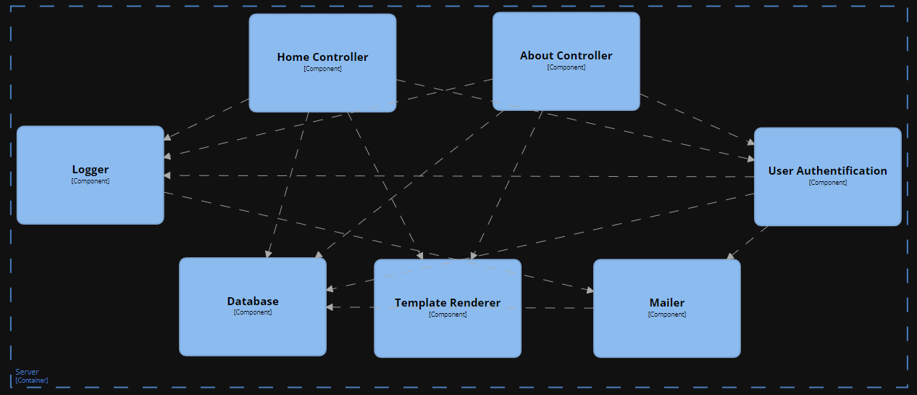
Example

Slide 20
Component-Based Development
Modern applications use components to promote encapsulation and separation of concerns.
Component
A software module that provides some functionality through a well-defined interface.
Typically, a class that implements an interface (in the code terminology).
Possibly a facade for a small set of classes.
Component may depend on other components:
Typically declares a list of (code) interfaces
Dependencies must be satisfied by providing components that implement given interfaces (allows some level of modularity)

Slide 21
Component Management
Creation and interlinking may be tedious. Just a few things we need to take care of:
Who creates components?
When are the components created?
Where is the component configuration?
How do one component find other components it needs to use?
What about different implementations of the same component “types”?
…

Slide 22
Example
Our controller component requires a log component. How can we solve this?
class Presenter {
public function action() { $log = …? }
}
Create on demand.
Multiple instances of log are created!
$log = new Log();
Use singleton design pattern.
Implementation bound
$log = Log::getInstance();
Log is looked up/created by a registry.
$log = Registry::get('Log');
Better, but tedious ..

Slide 23
Dependency Injection
Design pattern that implements inversion of control.
Component is not responsible for seeking its own dependencies.
Dependencies are injected externally (by the component manager).
Declaring required dependencies:
In configuration, by annotations, using reflection, …
The problem of cyclic dependencies: DB component requires Log component to log errors; Log component requires DB component to save messages.
Central Component Manager
Responsible for creating and initializing components

Slide 24
Dependency Injection Example
/**
* @component WelcomePage
*/
class WelcomePagePresenter implements Presenter {
/**
* @inject Database
*/
public $database;
/**
* @inject name="NewsService"
*/
public $news;
function __construct(Log $log) { ... }
...
Component naming convention.
Annotations, inject by interface.
Annotations, inject by name.
Constructor injection, by type hinting.
Advanced Programming of Web Applications - NSWI153

Slide 25
Representational State Transfer (REST)

Slide 26
REST API
Server API which offers retrieval and manipulation with application resources in a HTTP-compliant way. Resources are identified by URIs, and operations are performed by HTTP requests.
REST formal constraints are
Client-server model
Stateless interface (no client context is cached at server)
Cacheable (response defines whether it can be cached)
Uniform interface
Layered system (proxies, servers may be replicated)
Roy T. Fielding , Dissertation, Doctor of Philosophy 2000 : Architectural Styles and the Design of Network-based Software Architectures

Slide 27
Operations
HTTP request methods reflect desired operations:
GET - retrieve the resource (nullipotent)
POST - append new sub-entity in the resource
PUT - insert/replace the resource (idempotent)
DELETE - remove the resource (idempotent)
...

Slide 28
Example
 | /gallery (collection of galleries) | /gallery/kittens (photos in gallery) | /gallery/kittens/kitten01 (single photo)
GET | Get the list of all galleries (JSON) | Get the list of photos in the gallery (JSON) | Get the image (jpeg)
POST | Create a new gallery | Create a new photo in a gallery | Atypical. Add image metadata…
PUT | Atypical. Replace list of galleries. | Replace entire list of photos in gallery | Replace/insert an image (of given ID)
DELETE | Empty the whole application | Remove all photos of a gallery | Remove the given image

Slide 29
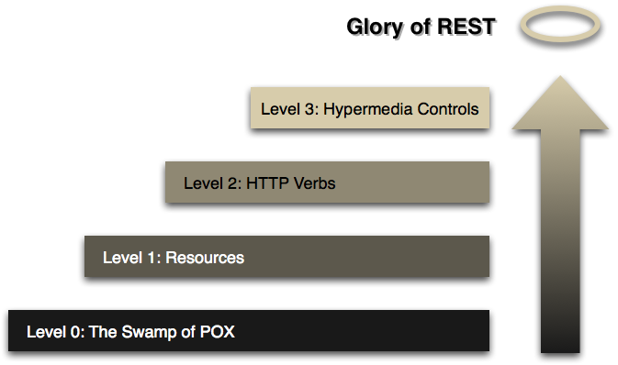
REST API
Advanced Programming of Web Applications - NSWI153
Notes:
Resource:
https://martinfowler.com/articles/richardsonMaturityModel.html

Slide 30
Trends
Advanced Programming of Web Applications - NSWI153

Slide 31
Single-Page-Application (SPA)
The application logic runs in the browser. The aim is to provide more desktop-like user experience. HTTP requests are handled asynchronously and covertly. As traditional browsing is typically discouraged, state changes are handled internally by changing DOM dynamically. Thin server architecture
Data storage, security verifications, HTTP/REST API
Disadvantages
Application boot - loading and initialization time
Less stable execution environment (many browser types)
SEO, scraping, size, ..
Advanced Programming of Web Applications - NSWI153

Slide 32
Micro Frontends
Website or web applications as a composition of features.
Independent teams.
Distinct area of business.
A team is cross functional and develops its features end-to-end.
Advanced Programming of Web Applications - NSWI153
Notes:
Resources:
https://micro-frontends.org/

Slide 33
Advanced Programming of Web Applications - NSWI153

