Slide 1
Web Applications Fundamentals & PHP II.
NSWI142
2024/2025
Škoda Petr
https://www.ksi.mff.cuni.cz/
https://skodapetr.github.io/

Slide 2
References
References are like Unix hard-links in FS, multiple variables attached to the same data. A reference is taken by the & operator. References are independent on object references. A reference to an object can be created.
It is common to employ references for function arguments. It prevent copy operation and provide ability to modify the argument.
$a = 1;
$b = &$a;
$b++;
echo $a; // prints 2
// Change given argument
function increase(&$x) {
$x++;
}
$a
int (...)
$b

Slide 3
References Pitfalls
References can be useful but there are pitfalls.
$array = [ 42, 54, 19 ];
foreach ($array as &$value) {
++$value;
}
...
foreach ($array as $value) {
echo $value;
}
Now, the $array holds [ 43, 55, 55 ]
Notes:
Do not reuse variables. Especially, if they are references.
Explanation: The first foreach increase values in array, yet in $value we are kept with reference to the last array member.
In the second for each we iterate the array again, we assign 43 to $value. Now $value is 43, but this is reference to last array member.
As a result, the array is now [43,55,43]. Next iteration change array to [43, 55, 55]. In the last iteration 55, the last array elements, is assigned to $value.

Slide 4
Including Files
There is a simple way to include files, both scripts and HTML.
The require keyword will produce fatal error if the file is missing while include only produce a warning.
Included file is subjected to same parsing rules. As a result, any code must be in <?php … ?>, otherwise it is treated as output.
Relative paths are resolved using include path configuration parameter and using the base directory of the calling script, not the current file! That might be confusing in transitive includes. It is recommended to use absolute paths prefixed with __DIR__ .
include file; include_once file;
require file; require_once file;
The _once variants make sure the file is not included multiple times (useful for libraries)

Slide 5
Object Oriented PHP
Design is inspired by languages like Java or C# with adaptations for interpreted loosely-typed language. For example:
There are explicitly virtual methods. All methods act as if they are virtual.
There are public, protected, private methods. Modifier public is used by default.
Current object instance, in a method, is available through $this. It must be used to access member variables, to distinguish members from local variables.
PHP classes are very powerful, especially in combination with PHP-specific features.
class Foo {
// A member variable.
public $var = 0;
// A method.
public function bar() {
print($this->var);
}
}
// Create new instance.
$instance = new Foo();
$instance->var = 42;
$instance->bar();
// No explicit destruction.
$instance = null;

Slide 6
Inheritance and Interfaces
Standard Inheritance model, like Java or C#. Each class may have only one parent class. Multi-inheritance is achieved by interfaces and traits.
An interface is a list of public methods a class must implement. Interfaces may be extended like classes. Using the extends operator. Class can implement multiple interfaces.
Overriding methods:
parent::method() – calling overridden version.
AncestorClass::method() – calling explicit version.
class MyFoo extends Foo {
public function Bar() {
parent::Bar();
}
}
interface Animal {
public function bar($goo);
}
class Cat implements Animal {
public function bar($goo) {
...
}
}

Slide 7
Constructor & Destructor
Special method __construct() used to initialize the object. It is called automatically, by the new operator. Like a normal function constructor may have arguments and there is no overloading.
If a constructor is not defined, then parent’s constructor or implicit constructor is used.
Parent’s constructor is not called implicitly!
Constructor should be public. Except for some special cases like Singleton or Factory Method design patterns.
Special Method __destruct() called when the object is garbage-collected. This can be when reference count reaches 0 or at the end of the script.
It a destructor is not defined, then parent’s destructor or implicit destructor is used.
Parent’s destructor is not called implicitly.
Destructor should not throw exceptions as they may not be handled properly. Is should be public, there are no reasonable exceptions!
Notes:
Fact that “Parent’s constructor is not called implicitly” is not typical for OO languages (e.g., C++ or C# calls parent constructors implicitly when possible or enforce explicit call).

Slide 8
Objects References
Class instances are passed by a reference by default. As a result, there is no need to create a reference for them. Yet, it is still possible to create a class reference.
class Foo {
public $bar = 0;
public function __construct($b) { $this->bar = $b;
}
}
$foo1 = new Foo(10);
$foo2 = $foo1;
$foo3 = &$foo1;
$foo2 = new Foo(20);
$foo3 = new Foo(30);
$foo2
objref#1
Foo(20)
objref#2
$foo1
objref#1
Foo(10)
objref#3
$foo3
Foo(30)
Notes:
Objects are reference types, like in Java or C#.

Slide 9
Comparing objects
Reference comparison behavior.
$object1 == $object2
True if both object are of the same class and all member variables are equal
That can take some time (in case of larger objects)
$object1 === $object2 ← JUST USE THIS!
True if both variables hold a reference to the same object
Behavior of != and !== operators can be easily extrapolated

Slide 10
Namespace
Namespaces are another way how to encapsulate space of identifiers:
Affect classes, traits, interfaces, functions, constants.
Similar to directories and files.
Declaration: namespace identifier;
First statement in the file
Identifier may be hierarchical (separator is backslash)
Dereferencing
Aliasing
myClass -> currentNS\myClass
name\space\myClass -> currentNS\name\space\myClass
\name\space\myClass – absolute path, no modifications
use identifier [as identifier];

Slide 11
PHP Standardization
The standardization goes beyond language specifications. It aims to improve cooperation, library designs, … There are accepted, drafted, abandoned and deprecated proposals.
Accepted:
PSR-1: Basic Coding Standard
PSR-2: Coding Style Guide
PSR-3 Logger interface
PSR-4 Autoloading (classes)
PSR-7 HTTP message interface
PSR-12 Coding style guidelines
...
Draft:
PSR-5: PHPDoc Standard
...
Notes:
Resources:
https://www.php-fig.org/psr/

Slide 12
Application State
Back to our web application ...

Slide 13

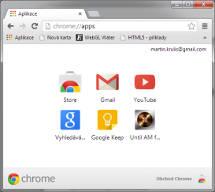
Application State
We have two interconnected applications - client and server.
What state do we have and where is the state stored?
Who is responsible for state management?
Should the state be persistent? If so for how long?
file
input
main memory (HTML, DOM)
input
main memory
Internet
processing
processing
output
output
Database Module
Browser

Slide 14
Application State 1/3
Logical and UI State
Focus, mouse cursor location
Component Micro-States Open-selection of a control box, …
Scroll location
Values filled in form controls
Which application screen is visible
Work in progress in an open transaction
Handled in HTML/CSS (i.e., by browser) or with little help from JavaScript.

Slide 15
Application State 2/2
User Interface State
Selected screen
User transaction progress
User login
…
Handled using URL, Cookies, Sessions, IndexeDB, LocalStorage, …

Slide 16
Application State 3/3
Business Logic State, Complex UI States
Modifications in an opened data file
Content of a shopping card
…
Handled per-user using application files or database.

Slide 17


Application State Implementation
Traditional (CGI-like) Web Applications
Database, Files,
Session storage
URL
Cookies
(POST Data)
Application
State
Browser
Application
State
Check integrity
Event
Batch-like processing
Browsing, submitting form
Processing Script
Memory
New
State

Slide 18
Web application

Slide 19


Web Applications in General
Two interconnected applications - client (GUI) and server (batch CLI).
event loop
Client
Browser
Potential source of many errors
Server App
Web Server
file
input
main memory (HTML, DOM)
input
main memory
Internet
processing
processing
output
output
cookies, local storage
Each request is separate batch process
Database Module

Slide 20
Single Page Web Applications
Single Page Web Applications.
event loop
JS implementing most of business logic
Client
Browser
Fetching/updating data
Server App (REST API)
Web Server
file
input
main memory (HTML, DOM)
Fetch API requests
input
main memory
Internet
processing
processing
output
output
cookies, local storage
Data requested by client (e.g. in JSON)
Slightly smarter database interface
Database Module
Advanced Programming of Web Applications - NSWI153

Slide 21
Web Applications
Hybrid Web Applications
Many shades of gray in between MPA (traditional) and SPA web applications. E.g., traditional web application may perform asynchronous HTTP requests for selected simple operations. This is often the case of legacy applications maintained for a long time.
Overlapping with other application types:
Mobile Applications
Cloud services may replace some server functions
Databases, file storages, computing complex tasks asynchronously
Native applications (Electron, ..)
Advanced Programming of Web Applications - NSWI153

Slide 22


Serving with Integrated Web Server
Dedicated Web Server for an Application.
HTTP Request
GET /myweb/index
...
`
Web Server Module
Proxy Server
Client
HTTP Response
HTTP/1.1 200 OK
Content-Length: 1984
Content-Type: text/html;
...
<contents generated by app>
Database Module
Handles static pages, proxies requests for web app(s)
Advanced Programming of Web Applications - NSWI153

Slide 23
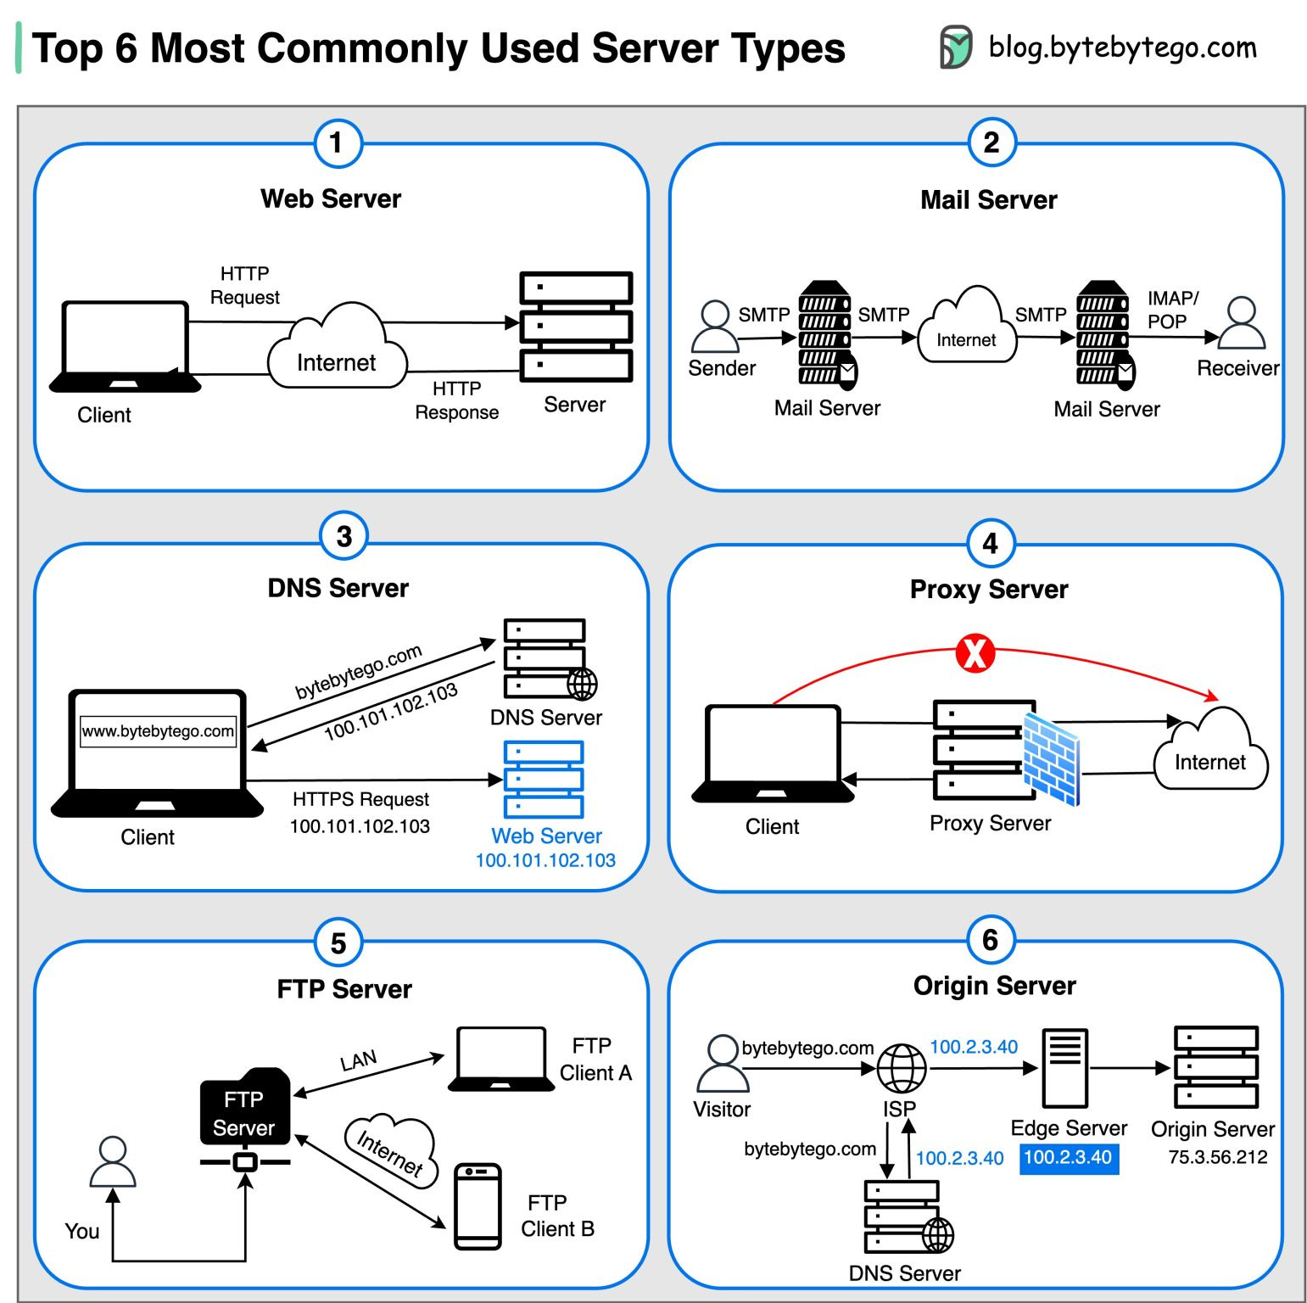
What is a Server?
Mail Server
Handles sending, receiving, and routing of emails across networks.
DNS Server
Translates domain names into IP addresses.
Web Server
Hosts websites and deliver web content over a network.
Examples: Apache, Nginx, …
From 2023-07-24
Advanced Programming of Web Applications - NSWI153

Slide 24
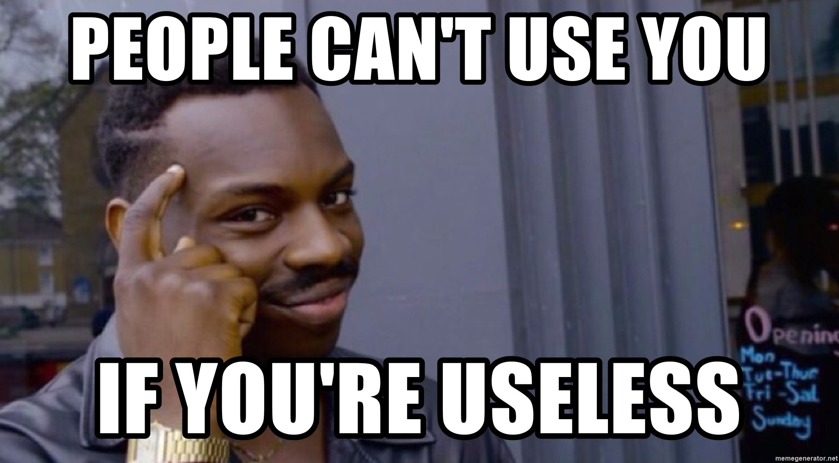
Can I use My language?

Slide 25
Python : WSGI
Web Server Gateway Interface
Universal interface between web servers and web applications designed for the Python language.
Interface is called WSGI middleware, and it is implemented by both sides (server and application).
Other languages have they're with similar API: Rack (Ruby), PSGI (Perl), JSGI (JavaScript), SAPI (PHP).
Selected features:
Routing requests to application objects by URL.
Multiple applications may run in one process.
Load balancing (remote processing, forwarding, …).

Slide 26
Python (Micro) Frameworks
Flask
WSGI micro framework
Web server included (for development)
Suitable for small REST APIs
Django
Complex web framework
MTV (Model-Template-View) pattern
Can be deployed via WSGI or using integrated server
…

Slide 27
ASP.NET
Microsoft solution built on .NET platform Supports all .NET languages (C#, VB, …)
Successor to Microsoft’s Active Server Pages
Now with .NET Core available on multiple platforms
Keywords:
ASP.NET WebForms
ASP.NET MVC
ASP.NET Web Pages (Razor Pages)
ASP.NET Single Page Applications
Razor syntax for interleaving HTML with executive code
Block starts with @ and does not require explicit closing

Slide 28
ASP.NET
ASP.NET WebForms
Event-based model, events may be processed at server
The forms automatically serializes the whole state
The idea is to design web pages in the same manner as desktop applications
Visual designer with set of server components
ASP.NET MVC
Default view engine is either Razor (.cshtml, .vbhtml), or Web Forms (.aspx). More control over HTML.
Controllers are .NET classes, methods are actions
Routers select controller class and invoke an action

Slide 29
Java Server Pages (JSP)
Java-based solution for dynamic web pages
Requires web server with servlet container
Apache Tomcat, Jetty, …
Supports both "simple" HTML interleaving approach and MVC
Uses <%, %> marks for scriptlets inside HTML
MVC usually uses JavaBeans as the model and Java servlets as the controller
Java compilation
Compiler is integrated in the web server and compiles the page when first needed, or when changed.
JSP is (almost) dead…

Slide 30
Java
Spring MVC
Spring boot
JSF
Vaadin
Play 1, Play 2
Struts 1, Struts 2
GWT
Grails
Wicket
…
From 2022/2023
Notes:
Resources:
http://zeroturnaround.com/rebellabs/java-tools-and-technologies-landscape-2016/
http://zeroturnaround.com/rebellabs/the-curious-coders-java-web-frameworks-comparison-spring-mvc-grails-vaadin-gwt-wicket-play-struts-and-jsf/

Slide 31
Ruby on Rails
Ruby scripting language + Rails web framework
Basic philosophy
DRY (Don’t Repeat Yourself) – avoid code duplication
Convention Over Configuration – our way is the “best”
Very strict style of application development Improves efficiency, but ties your hands
Specific structure of the application reflecting the MVC pattern.
2025/2026 Remove

Slide 32
JavaScript
Node.js is JavaScript server-side platform.
Basically, a Google V8 JavaScript engine compiled as CLI script interpreter. V8 is used in Chrome, and it is the fastest JS interpreter.
Contains many pre-built packages for server-side application development (sockets, HTTP, …) HTTP server is embedded in the application, so the programmer may tune it for specific needs.
Aims for fast developed single-language solutions. Using JavaScript on client and server allows some level of code sharing.
Advanced Programming of Web Applications - NSWI153

Slide 33
PHP Frameworks
Listed in a semi-random order!
Laravel since 2011
Symfony since 2005
Laminas (based on Zend Framework) since 2006
Nette (developed in Czechia with a large Czech community)
Yii since 2008, Yii 2 since 2014, designed to fix PRADO since 2004
Slim (NSWI153)
CodeIgniter
Phalcon
CakePHP
...
Advanced Programming of Web Applications - NSWI153

Slide 34
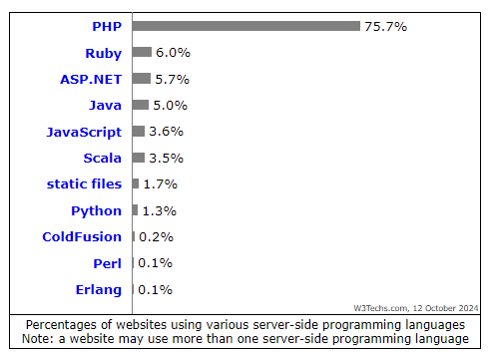
Statistics of server-side programming languages
2025/2026 Remove
Notes:
Resources:
https://w3techs.com/technologies/overview/programming_language

