Slide 1
Web Applications Fundamentals & PHP I
NSWI142
2024/2025
Škoda Petr
https://www.ksi.mff.cuni.cz/
https://skodapetr.github.io/

Slide 2
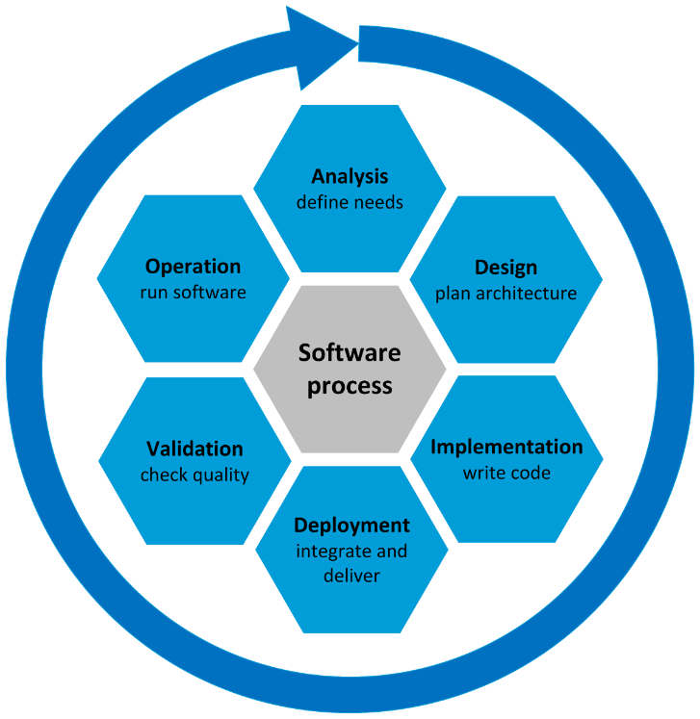
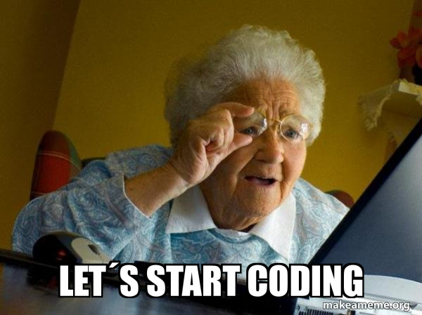
Running example: HTML document validator
User requirement
I need an application that checks and validates an HTML website.
For more on software process see NSWI041.
Notes:
Resources:
https://media.makeameme.org/created/lets-start-coding.jpg

Slide 3


Batch Processing with Command Line Interface
One way data flow with all data available.
Application reads inputs, perform computation, and prints output.
input (HTML)
processing (validation)
output
(errors)
file
main memory
file
?
Notes:
Since HTTP is text-based protocol we could employ batch application to run our websites..

Slide 4
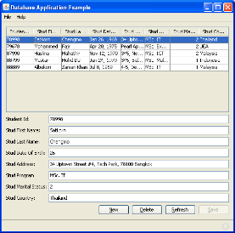
Graphical User Interface Desktop Applications
Probably multi-thread application with UI and working thread. Build using a UI component library.
Application must be ready to react to user inputs, i.e. events.
continuous interaction
event loop
Input data are kept in memory. Additional features may be implemented editing, revalidation better visualization, …
main memory
file
input (HTML)
processing (validation)
output
(errors)
file
GTP-5 mini: Take the existing application and rewrite it to use graphical user interface. The objective of the application is to validate given HTML file. Use the validate_html method as is, do not change it!

Slide 5

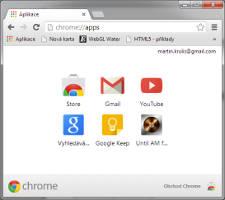

Web Applications
Traditional Common Gateway Interface (CGI)-like / Multi-Page Web Applications.
HTML visualization, handling standard controls (e.g., forms)
event loop
Clicking on a hyperlink, submitting a form
Client
Browser
Web Server
file
input
main memory (HTML, DOM)
input
main memory
Internet
processing
processing
output
output
Generated HTML document representing a new state
Database Module

Slide 6



Serving Static Pages
HTTP Request
GET /myweb/index.html
...
Configuration
/var/www/myweb/
Internet
Client
Web Server
HTTP Response
HTTP/1.1 200 OK
Content-Length: 1019
Content-Type: text/html;
...
<contents of index.html>
index.html

Slide 7
Common Gateway Interface (CGI)
NSCA specification from 1993 how to invoke command line applications. It is one of the first standards for generating dynamic web content. The CGI version 1.1 (RFC 3875) is from 2004.
The CGI specifies only the interface.
Application may be written in any language as long as it can be executed.
Important information and headers are set as environment variables.
Request body is directed to standard input.
Whole HTTP response is taken from the standard output.

Slide 8

Serving with CGI
HTTP Request
GET /myweb/index.html
...
Configuration
/var/www/myweb/
Internet
stdin
Client
Web Server
stdout
app.cgi
HTTP Response
HTTP/1.1 200 OK
Content-Length: 1019
Content-Type: text/html;
...
<contents of index.html>
index.html

Slide 9
FastCGI
CGI Issues
Starting a process takes some system time.
Each process handles exactly one request.
Unable to keep session/shared data in memory.
Fast CGI Improvements
Fast CGI server runs independently from web server. Keeps the process pool, resources, …
Communicates with web server via socket or TCP.
Multi-request processing may be achieved by multiplexing, multiple connections, or both.
Notes:
Resources:
https://fastcgi-archives.github.io/FastCGI_A_High-Performance_Web_Server_Interface_FastCGI.html

Slide 10
Scripting Languages for Web Applications
Benefits
No compilation required, thus, much faster and easier deployment.
We need scripting language at client-side in the browser anyway.
It was a fashion trend in the 90’.
Drawbacks
Main concern of web applications was the speed of the network; as a result, application performance was not an issue. This is no longer true.
Due to the slow data storage, the bottle neck used to be the database, not the web application.
PHP, Python, JavaScript, Ruby, Perl, …
Notes:
How do we code the dynamic websites?

Slide 11
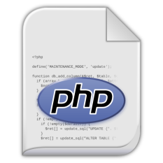
Serving with Integrated Scripting Modules
HTTP Request
GET /myweb/index.html
...
Configuration
/var/www/myweb/
Internet
mod_php
Client
Web Server
HTTP Response
HTTP/1.1 200 OK
Content-Length: 1019
Content-Type: text/html;
...
<contents of index.html>
index.php
index.html

Slide 12


Serving with FastCGI
Configuration
fastcgi_pass unix:/var/run/php/php7.4-fpm.sock;
HTTP Request
GET /myweb/index.html
...
Internet
Client
Web Server
FastCGI Server
HTTP Response
HTTP/1.1 200 OK
Content-Length: 1019
Content-Type: text/html;
...
<contents of index.html>
index.html
Notes:
Resources:
https://httpd.apache.org/mod_fcgid/
https://www.nginx.com/resources/wiki/start/topics/examples/phpfcgi/
https://www.php.net/manual/en/install.fpm.php
https://www.digitalocean.com/community/tutorials/understanding-and-implementing-fastcgi-proxying-in-nginx

Slide 13
Scripting language
PHP

Slide 14
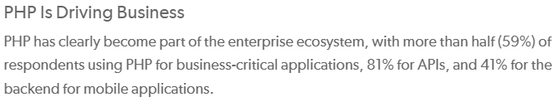
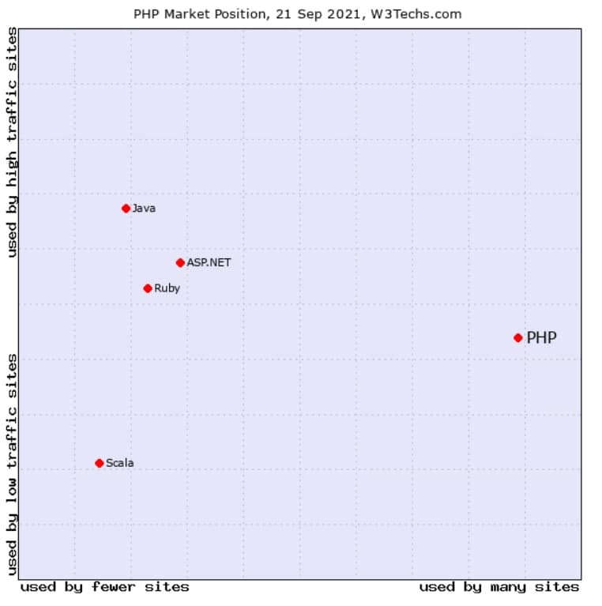
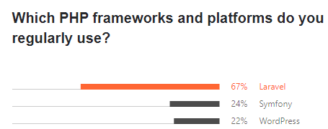
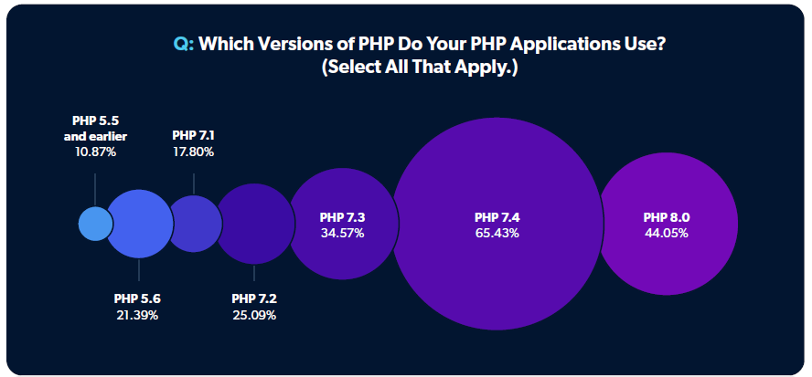
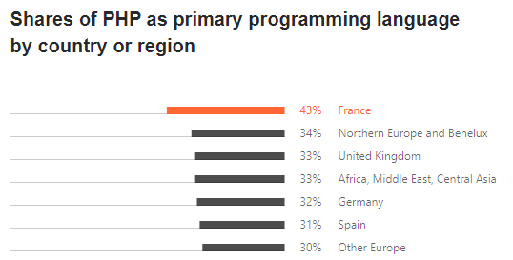
PHP
Remove 2025/2026
Notes:
Resources:
https://www.zend.com/blog/state-php-2022
https://www.jetbrains.com/lp/devecosystem-2021/php/
https://www.altamira.ai/blog/build-websites-with-php/

Slide 15
History 1/2
1994 Rasmus Lerdorf created "Personal Home Page" Perl scripts to maintain CGI-like pages, later re-written to C++. Mostly for template processing
1995 Public release, community formed
1997 PHP/FI 2.0 released Zeev Suraski and Andi Gutmans Rebranded to "PHP: Hypertext Preprocessor" ZeEnd, takes care of PHP
1999 PHP core rewritten to Zend Engine
2000 PHP 4 released (based on Zend Engine 1.0) OOP first introduced to PHP (in a bad way, slow implementation)
…

Slide 16

History 2/2
2004 PHP 5 released (Zend Engine II) OOP completely redesigned, concepts from C# and Java
2015 PHP 7 released (Zend Engine III, AST-based) There was no version 6, as features get implemented into version 5.
2020 PHP 8 released Introducing JIT, Named arguments, Match expression, Internal function errors …
…
Ele
ant
Notes:
Resources:
* https://www.php.net/ChangeLog-8.php
* https://www.php.net/releases/8.0/en.php

Slide 17
Weakly Typed Dynamic Language
Weak Dynamic Typing
PHP, Javascript, Python …
Type is held at values (variables are type-less)
Resolved at runtime
Variable is just a registered name
Strong Static Typing
C, C++, C#, Java, …
Type is held at variables and values (mismatch -> type cast or error)
Resolved at compile time
Variable allocates memory
Compile time error
$x = 42;
$x = "hippo";
int x = 42;
x = "hippo";
Runtime check
Inferred by compiler
function foo(int $count)
auto y = 54;

Slide 18
PHP Script
Pure PHP Scripts
Must start with <?php, but no ending mark is required, nor recommended.
The opening mark is not required in the interactive mode.
Basic Syntax:
C-like syntax with relics from Perl.
Statement separated by ';', blocks enclosed in ' {', '} ' .
Line comments //…\n, block comments /* … */
There is a great documentation at https://www.php.net/manual/ , check it out!

Slide 19
Demo
PHP

Slide 20
Control Syntax
Standard control structures
if (cond) stmt; elseif (cond2) stmt2; else ...
while (cond) stmt;
do stmt; while (cond);
for (init; cond; inc) stmt;
foreach (array as [ $key => ] $value) stmt;

Slide 21
Values and Data Types
Values in PHP have explicit type.
Scalar: boolean, integer, float, or string
Compound: array, or object
Special: resource, or NULL
Type can be tested by built-in functions:
is_int(), is_string(), is_numeric(), is_scalar(), …
gettype() returns human-readable representation
Type casting, explicit re-typing, is using C-like syntax (type-name)expression.
Type juggling – automatic type casting.

Slide 22
Variables
All variables are prefixed with '$' symbol. There are no declarations and statically defined types. A variable is created on the first assignment. Using non-existing variable generates notice and the value is treated as null. Variable has the type of the value assigned to it.
$name = 'Petr';
$lectures = '2';
$practicals = 3;
$teaching = $lectures + $practicals; // Type juggling
echo $name . ' is teaching ' . $teaching . ' hours.';

Slide 23
Expressions
Almost every statement is an expression.
PHP has all standard C-like operators
Arithmetic, bitwise, logical, …
Identity operator (equality & type equality) '===', '!=='
String concatenation is performed by dot '.'
String Literals
Single quoted strings ('text') – no special treatment
Double quoted strings ("text") – interpreted, i.e. variables are replaced by their contents with double quotes. It also supports special escaped characters \n, \r, \t, ...
Regular comparison allows type juggling, identity comparison not. I.e., 42 == '42' but 42 !== '42'
$a = 'foo';
$b = "Say $a\n";
$b value is ‘Say foo’ (ended with newline)

Slide 24
Arrays
Array in PHP is an ordered map of key-value pairs. It can be used as array, list, hash table, dictionary, stack/queue, multi-dimensional array, or tree.
Defining arrays – array language construct.
Accessing elements
Each element may have different type.
$a1 = [1, 2, 3];
$a2 = ['foo' => 42, 'bar' => 54];
Prints ’44’
print($a1[1] + $a2['foo’]);
$a2['spam'] = 19;
$a1[] = 4;
unset($a1[2]);
The following key is assigned
$a1 ~ [0=>1, 1=>2, 3=>4]

Slide 25
Arrays
Each key can be either an integer or a string.
Strings containing valid numbers are casted to integers.
Floats are truncated and casted to integers.
Booleans are casted to either 0 (false) or 1 (true).
null is casted to an empty string.
Arrays and objects cannot be used as keys!
Built-in functions for array manipulation
array_key_exists(), in_array()
array_push(), array_pop(), array_shift()
array_merge()
...
Notes:
Arrays maintain order independent on keys and they provide quick access to value given the key.

Slide 26
Functions
Declaration : keyword function followed by the identifier.
The function body can be pretty much anything. Even nested function/class declaration, evaluated when function is first called. You probably do not need to use this.
A value can be yielded back by the return construct.
Invocation
Functions are 2nd level citizens and identifier space is flat, and function can not be re-declared. There are namespaces.
Pass by value vs pass by reference (C++ style).
function foo([args, …]) { … body … }
foo(argument-expressions);

Slide 27
HTTP Wrapper
Reading HTTP request and writing HTTP response.

Slide 28
Demo
HTTP Wrapper

Slide 29
HTTP Wrapper
There are predefined variables, set as a part of initialization process, i.e. before running the script. Request data, headers and server settings are automatically parsed into superglobal arrays
$_GET – parameters from request URL
$_POST – parameters posted in HTTP body (form data)
$_FILES – records about uploaded files
$_SERVER – server settings and request headers
$_ENV – environment variables
Examples:
index.php?name=Petr : ['name' => 'Petr']
index.php?foo=bar&arr[]=one&arr[]=two : ['foo' => 'bar', 'arr' => ['one', 'two']]

Slide 30
$_SERVER
Selected keys for the $_SERVER array:
REQUEST_METHOD – used method (“GET” or “POST”)
SERVER_PROTOCOL – protocol version (“HTTP/1.1”)
REQUEST_URI – request part of URL (“/index.php”)
REMOTE_ADDR – clients IP address
HTTP_ACCEPT – MIME types that the client accepts
HTTP_ACCEPT_LANGUAGE – desired translation
HTTP_ACCEPT_ENCODING – desired encodings
HTTP_ACCEPT_CHARSET – desired charsets
more info about the server and the client’s browser

Slide 31
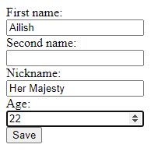
Example
<form action="?op=update&amp;id=42" method="POST">
<input name="name" type="text">
<input name="surname" type="text">
<input name="nickname" type="text">
<input name="age" type="number">
<input type="submit" value="Save">
</form>
$_GET
$_POST
$_SERVER
'op' => 'update'
'id' => '42'
'name' => 'Ailish'
'surname' => ''
'nickname' => 'Her Majesty'
'age' => '22'
'REQUEST_METHOD' => 'POST' 'HTTP_HOST' => 'localhost:8080'
'CONTENT_TYPE' => '…'
'HTTP_ACCEPT' => ''
…
Notes:
Note the &amp; entity used in URL, since it is being included in HTML attribute. Furthermore, note that all values are strings, despite the fact that some of them contain numbers.

Slide 32
Response
Any output from the script is considered a response:
Text outside <?php ?> script marks
Data written by echo or print()
Headers may be modified by a function:
header('header-line');
The modifications are parsed and moderated by the web server.
Headers must be sent, function called, before any output is sent. Unless you do output buffering.
Beware the BOM signatures of unicode files.
By default, the status code is 200, it can be changed together with the headers.
http_response_code()
Notes:
We can control output buffering using ob_start() and ob_end_flush().

Slide 33
HTML Interleaving
Ability to interleave content to output, e.g. HTML, and PHP code.
PHP script file is treated as text (HTML) document.
Contents between <?php and ?> is treated as script.
When the file is processed, the interpret removes script parts executes them and replaces them by their output.
Script output is generated by echo or print().
Script controls prevail the HTML code
Shorthand mark <? is equivalent of <?php and shorthand mark <?= is the same as <?php echo. Availability of the shorthands is determined by server configuration.

Slide 34
HTML Interleaving Example
… <html>
<head>
<title>PHP Example</title>
</head>
<body>
<?php if (has_headline()) { ?>
<h1>Conditional H1</h1>
<?php } ?>
<?php for($i=1; $i<4; ++$i) { ?>
<div><?= $i; ?></div>
<?php } ?>
</body>
</html>
<html>
<head>
<title>PHP Example</title>
</head>
<body>
<h1>Conditional H1</h1>
<div>1</div>
<div>2</div>
<div>3</div>
</body>
</html>
Notes:
Do not use this if you find it confusing.

