Slide 1
Cascading Style Sheets
NSWI142
2025/2026
Škoda Petr
https://www.ksi.mff.cuni.cz/
https://skodapetr.github.io/

Slide 2
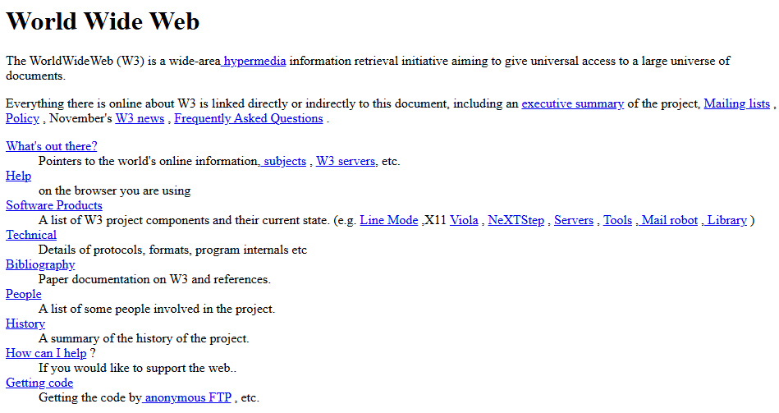
The First Website
Notes:
Resources:
https://info.cern.ch/hypertext/WWW/TheProject.html

Slide 3
Levels
CSS 1 (1996)
"The CSS Working Group considers the CSS1 specification to be obsolete."
CSS 2 (1998)
CSS 2.1
"Once CSS2.1 became Candidate Recommendation - effectively though not officially the same level of stability as CSS2 - obsoleted the CSS2 Recommendation."
CSS 3 (1999-present)
"CSS Level 3 builds on CSS Level 2 module by module, using the CSS2.1 specification as its core. Each module adds functionality and/or replaces part of the CSS2.1 specification."
CSS4
"There is no CSS Level 4. Independent modules can reach level 4 or beyond, but CSS the language no longer has levels."
Notes:
There is no single CSS.
CSS1: Font, text/background colors, alignment, margin, border padding for most elements.
CSS2: Add absolute, relative, fixed positioning. Concept of media types.
CSS2.1 (2004-2011): Fix bugs, remove poorly supported features and add those implemented by browsers.
CSS3: Wider support to CSS2. New selectors, pseudo-elements, style properties and combinators. As a result of modules, the specification is split into multiple documents.
Resources:
https://www.w3.org/TR/css/#css-levels
https://www.w3.org/Style/CSS/current-work

Slide 4
Display Property
Specify an element display mode.
Elements have specific ways of rendering.
Inline elements (<em>, ...), block elements (<p>, ...), table elements, lists, …
Be warned, the display property can override default behavior.
Value | Description
block | Standard block element
inline | Element rendered inline with the text
inline-block | Small block inserted in text flow
none | Hide element, no effect on layout
list-item | Default for <li> elements
table, table-* | Table rows and cells have specialized formatting
… | …
Notes:
CSS3 introduced flex and inline-flex values along with flex* properties. We will get to that later…

Slide 5
Box Model
Applied to all block, and inline block, elements.
Border is a visible bounding box around contents.
  Have width, color, and style (solid, dotted, …).
  Can be replaced by custom image (like background).
  Corners may be rounded (border-radius).
Padding is a space between content and border.
Margin is a minimal space to nearest border of another element.
There are exceptions to this rule, e.g. elements of same type.
Properties can be set for each side separately with: *-left, *-right, *-top, *-bottom.

Slide 6
Position Property
Page Rendering Algorithm
The elements and their content are processed from the beginning to the end.
Each element is positioned according to its size, margins, and display properties (block, inline, …).
Except for the floating elements!
This behavior can be modified by position property.
Value | Description
static | Default page rendering algorithm is used.
relative | Like static, but element is moved relative to its computed position after the layout is created.
absolute | Element is positioned inside closest positioning context.
fixed | Element is fixed within the browser viewport.
sticky | Sticks to ancestor viewport when scrolling.
… | …
Notes:
We talk more in-depth for each of position value on the following slides.

Slide 7
Content Positioning
Size properties, related to box model:
Use width, height to set exact size of the element contents.
Use min-*, max-* to set size limits.
Location properties, for positioned elements only:
Use : left, right, top, bottom to set distance from the edge at the corresponding side
When the contents does not fit width/height constraints, it will overflow,
see overflow property.
box-sizing: border-box
width
It does not make sense to set left, width, and right simultaneously.
width
Content
right
padding
margin
box-sizing: content-box
(default)
Margins (typically) collapse,
i.e., adjacent margins overlap
Notes:
Remember the width sets either the width of content or width of border depending on property box-sizing: content-box | border-box.
Resources:
https://developer.mozilla.org/cs/docs/Web/CSS/CSS_Box_Model/Mastering_margin_collapsing

Slide 8
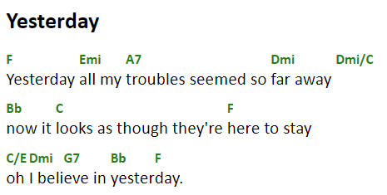
Demo
Positioning

Slide 9
Content Positioning
Relative positioning
Element is positioned by normal rendering algorithm.
Afterwards, it is shifted from its computed position relatively.
Can be combined with other position-related styles inline-block, floating elements.
Often used in combination with absolute positioning.
Relatively positioned element creates positioning context for its children.
Top
Relative div
Left

Slide 10
Content Positioning
Absolute positioning
The content is taken out of the page layout.
Fixed positioning
Like absolute positioning, but the frame of reference is the viewport.
Nearest positioned element or the whole document.
#positioned-div {
position: absolute;
left: 10px;
right: 20px;
top: 30px;
height: 50px;
}
30px
10px
positioned-div
50px
20px
Determined by parent width.

Slide 11
Content Positioning
Sticky Positioning
Hybrid between relative and fixed positioning.
Element is positioned regularly if it is entirely visible.
When not entirely visible, due to scrolling, it is positioned relatively to its nearest scrolling viewport. Keep in mind there can be more than on scrolling viewport.
top, right, bottom, or left specify the relative position and the threshold when the scrolling changes the behavior of the element.

Slide 12
Content Positioning
Additional positioning-related properties
z-index – depth in the stack of positioned elements.
Higher number is closer to the top.
opacity – useful (not only) for overlapping elements.
0 for fully transparent, and 1 for opaque.
overflow – when contents does not fit its explicitly-sized element.
  visible – content overflows and may overlap.
  hidden – content is cropped to the element boundaries.
  scroll – scroll bars are added and the element has its own viewport in which the whole content is displayed.
  auto – like scroll but scroll bars are initially hidden.

Slide 13
Page Layout
Visual structure of the content blocks of the whole page or its logical part.
Placement of menu-bar, additional sidebar, page header and footer, …
Placement of items in navigation, offered goods in e-shop, …
There are different approaches.
Whether the page scrolls as whole or not.
How each container handle content overflows.
…
header
content
menu bar
side bar
footer

Slide 14
Page Layout
We have multiple ways to create a simple layout with sidebars.
Tables
Floating Sidebars
  Quite easy to design, but …
  The sidebars must precede main content
  It is a little bit tricky to ensure correct sidebar height
Absolute / Fixed Sidebars
  Cover the contents underneath
  Sidebars can be almost anywhere in the document
  More modern approach, which can be used for more complex situations than floating sidebars
  Slightly more difficult to design and code
Grid / Flex
Notes:
Anyway, we want you to try and use this at the practical and the seminar.

Slide 15
Grid
Container
Defines rectangular grid where items can be placed.
Column/row sizes can be specified using various units, including new fr unit (fraction).
Items
Direct descendants, children, of the container.
Aligned within grid lines (i.e., inside a rectangle).
Notes:
Resource:
https://css-tricks.com/snippets/css/complete-guide-grid/

Slide 16
Grid
.container {
display: grid;
grid-template-columns: 50px auto 30vw;
grid-template-rows: 40px 80px;
}
.item1 {
grid-column: 1 / 2;
grid-row: 1 / 3; }
.item2 {
grid-column: 2 / 3;
grid-row: 2 / 3; }
.item3 {
grid-column: 3 / -1;
grid-row: 2 / 3; }
.item4 {
grid-column: 2 / 4;
grid-row: 1 / 2; }
<div class="container">
<div class="item1">…</div>
<div class="item2">…</div>
<div class="item3">…</div>
<div class="item4">…</div>
</div>
item1
item4
item2
item3

Slide 17
Grid
.container {
display: grid;
grid-template-columns: ...
grid-template-rows: ...
grid-template-areas:
"header header header"
"main . sidebar"
"footer footer footer";
}
.item1 {
grid-area: header; }
.item2 {
grid-area: main; }
.item3 {
grid-area: sidebar; }
.item4 {
grid-area: footer; }
<div class="container">
<div class="item1">…</div>
<div class="item2">…</div>
<div class="item3">…</div>
<div class="item4">…</div>
</div>
item1
item2
item3
item4

Slide 18
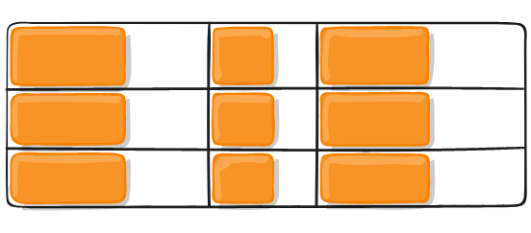
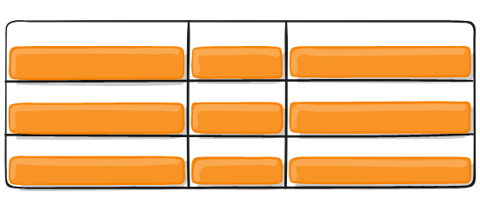
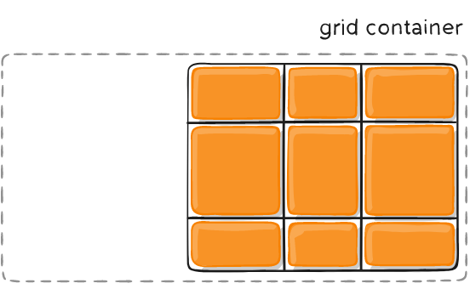
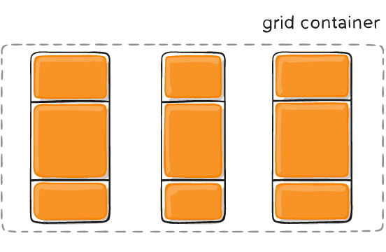
Grid
Gaps and Alignment
Spacing and alignment can be set for items within the cells as well as for cells themselves.
Both horizontally and vertically
Items can be smaller than cells
And the grid may be smaller than container

Slide 19
Demo
Grid

Slide 20
Selected properties
Container properties:
display: grid
grid-template-rows, grid-template-columns, grid
grid-column-gap, grid-row-gap, grid-gap
align-items, justify-content
Align grid items inside a cell, using column and row axis.
grid-auto-columns, grid-auto-rows
Size of auto-generated columns and rows.
grid-auto-flow
Automatic placements direction or dense, to fill holes.
Item properties:
grid-column-start
grid-column-end
grid-row-start
grid-row-end
grid-column
grid-row
grid-area
justify-self, align-self
Align the item inside a cell.

Slide 21
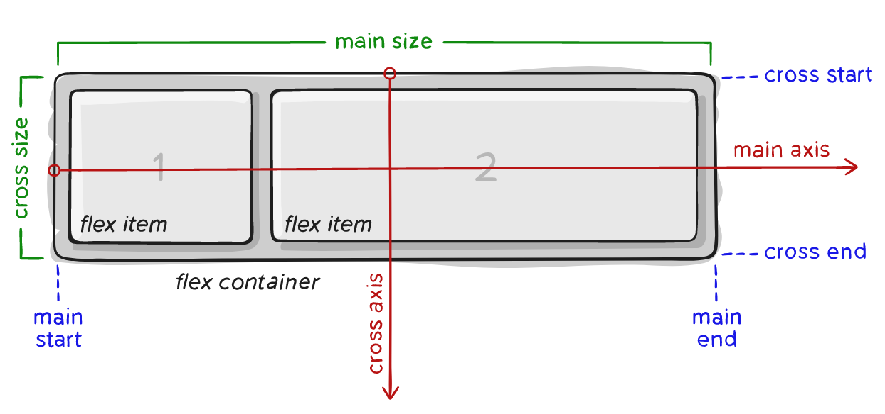
Flex
A way to create flexible smaller layouts (e.g., flow of UI controls) without too much customization.
There are many good and interactive Flex tutorials on the internet.
Notes:
Resources:
https://css-tricks.com/snippets/css/a-guide-to-flexbox/

Slide 22
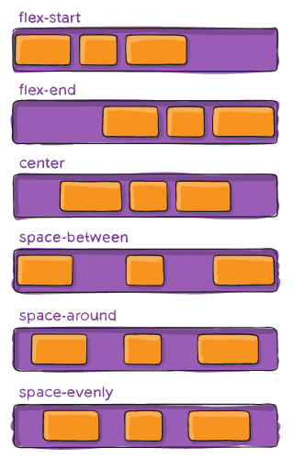
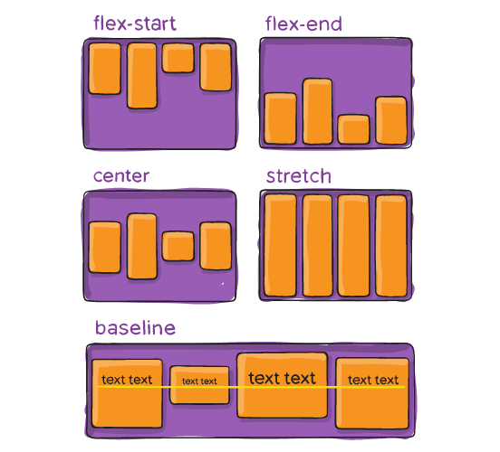
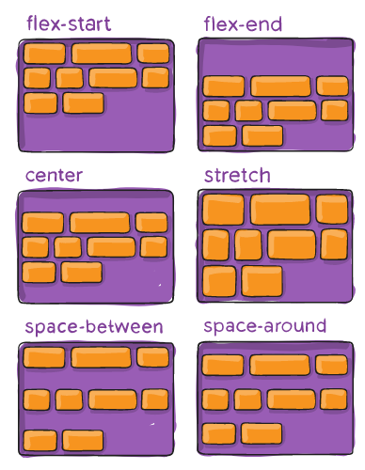
Selected properties
justify-content
align-items
align-content
Notes:
Resources:
https://css-tricks.com/snippets/css/a-guide-to-flexbox/

Slide 23
Demo
Flex

Slide 24
Selected properties
Container properties:
display: flex
flex-direction
Direction of main axis.
flex-wrap
Whether wrapping is allowed.
justify-content
Alignment and spacing along the main axis.
align-items, align-content
Alignment, spacing, and padding along the cross axis.
Item properties:
order
Items are sorted by their order values. Items with the same order are sorted by HTML positions. Do NOT use!
flex-grow, flex-shrink
How much should the item grow/shrink if there is space left or not enough space.
flex-basis
Default size of the item, before growing or shrinking.

Slide 25
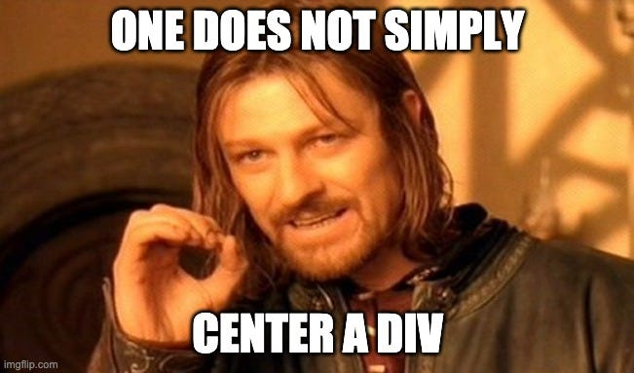
Center content
Question: How do I center a div?
Center floating or absolutely positioned elements with fixed width.
margin-left: auto; margin-right: auto;
Flex
display: flex;
align-items: center;
justify-content: center;
Grid
display: grid;
justify-content: center;
align-content: center;
Notes:
There is no tax in making display flex just to align content.

Slide 26
Responsive Page Layout with Flex
This slide is inspired by Bootstrap. There was a need to create a layout before flex and grid. To tackle this issue, Bootstrap utilize so called "Grid system". The system consists of rows and columns forming a grid. As of 2025, the Grid system, is implemented using Flex.
Column
Column
Column
There are 12 template columns available per row. Thus, each column can be of size 1 to 12. If the column does not fit, it is moved to the next row.
Bootstrap defined 6 responsive breakpoints. They represent a screen sizes you may want to consider when designing a layout. You can defined column size for a given breakpoint.
Column
Column
Column
<div class="row container">
<div class="col-xs-6 col-md-3">Column</div>
<div class="col-xs-6 col-md-3">Column</div>
<div class="col-xs-6 col-md-3">Column</div>
</div>
In addition, there is a max-width defined for the container for each breakpoint.
Notes:
Resources:
https://getbootstrap.com/docs/5.1/layout/grid/

Slide 27
Calculating values
It is possible to perform dynamic computations in CSS.
--{variable name}
  Define a new custom property. The property can be defined multiple times.
var()
  Reads value of a custom property (CSS variable).
calc()
  A function which can be used to compute CSS values
  Works for numeric values only
  Limited to basic operators +, -, *, and /
:root { --gap: 20px; }
body { padding: var(--gap); }
#somediv { width: calc(100vh – 2 * var(--gap)); }
Notes:
The var() can be used inside calc() and calc() can be used to initialize a variable value.
var() do also take second argument the default value (fallback).
Declarative – there is no notion of time, cycles are not allowed, value can be changed in the style attribute.
Resources:
https://developer.mozilla.org/en-US/docs/Web/CSS/var
https://developer.mozilla.org/en-US/docs/Web/CSS/calc

Slide 28
Frameworks
Predefined styles (and possibly scripts) which automatically handle various screen sizes.
Many frameworks currently available
Twitter Bootstrap
W3.CSS
Skeleton
Foundation
HTML5 Boilerplate
HTML KickStart
…
Responsive design
<meta name="viewport" content="width=device-width,initial-scale=1.0">
Notes:
Before mobile devices, pages have fixed size. Browsers on smaller devices scale down the entire web page to fit the screen. This was quick fix, yet nothing we want today.
The viewport is the user's visible area of a web page e.g. phone display size, browser window size.
Resources:
https://jecas.cz/meta-viewport

Slide 29
CSS Preprocessing
CSS Issues
Selectors are quite powerful but possibly tedious.
Limited possibilities of using variables / calculations.
Not particularly DRY-friendly.
...
Overall good for a single website but tedious for a general framework.
CSS Preprocessing
Styles are written in preprocessing language and generated into CSS files.
Several languages/tools available (LESS, SASS).
Notes:
Some of the issues are being addressed by new CSS modules.

Slide 30
SASS
Syntactically Awesome Stylesheets (SASS) is a
style sheet language that extends CSS. It is interpreted into CSS files. Selected features are:
Variables allow single definition of a value.
Mixins provide CSS templates that can be reused.
Selector inheritance simplifies selector construction.
Scripting with loops, conditions, expressions, …
Selector is updated to .message, .error
.message { border: 3px solid yellow; }
.error {
@extend .message;
border-color: red;
}
nav {
ul {
margin: 0;
li { display: inline-block; }
}
}
$size: 300px;
@mixin mybox($width){ width: $width; }
#div1 { @include mybox($size); }
Notes:
SASS is recommended over LESS by multiple individual sources on the Internet, so we have selected this preprocessor as a representative. Some of the following examples are inspired by SASS basic guide.
Original SASS was based on Haml language (https://haml.info/) is now considered obsolete and is replaced by syntax similar CSS.
Haml was similar to YAML.
Resources:
http://sass-lang.com/guide
https://caniuse.com/css-nesting

Slide 31
Demo
Container Query, ::has, …
Notes:
Resources:
https://www.youtube.com/watch?v=OGJvhpoE8b4

Slide 32
Design Perspective Beyond CSS
Text
We can use the "ch" to set a text width. The unit roughly corresponds to a character width.
It is recommended to put a cap on the text width.
Use whitespace to your advantage.
Use at least 16px, the default, or more.
Limit the number of typefaces to 2 or 3.
Material Design state Roboto as the default for Android.
There is Serif or Mono version as well.
Colors
Light mode, dark mode, high-contrast mode, color blindness ...
Use contrast checkers, it is not about design but also accessibility.
Color selectors (1, ..) can help to choose a sensible color palet.

Slide 33

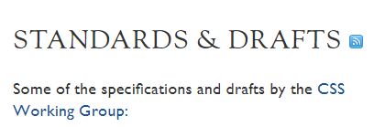
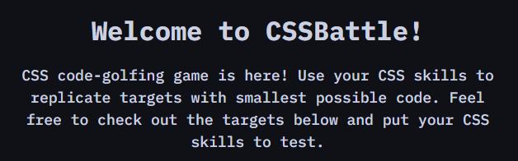
There is more …
YouTube
Twitter
…
Learn CSS
CSS current work
CSSBattle
Material Design
...

