Slide 1
Compiler principles
Syntax analysis
David Bednárek

Slide 2
Syntax analysis
The main task
  Produce a derivation or build the derivation tree
  Produce syntax-related error messages and recover from errors
The parser is often the main loop of the front-end
  Both lexical analysis (the previous phase) and semantic analysis (the following phase) invoked from syntax analysis
Automaton type
  Languages described using context-free grammars
    We need a pushdown automaton
Get next
token
Derivation
tree
Source
code
Lexical
analysis
Syntax
analysis
The rest of
front-end
Token
Intermediate
code
Symbol
tables

Slide 3
Example CF grammar
Terminals
  +, *, (, ), id
Non-terminals
  E, T, F
Root/start non-terminal
  E
Rules/productions
  E → E + T
  E → T
  T → T * F
  T → F
  F → ( E )
  F → id

Slide 4
Derivation
A sequence of rule applications
  Applied to words mixed from terminals and non-terminals
  Starts with the root non-terminal
  Ends with a purely terminal word
Each step applies a rule to a non-terminal at some position
  Special cases
    Left/left-most derivation always expands the left-most non-terminal
    Right/right-most derivation ... right-most non-terminal
  In the special cases, the sequence of rule numbers determines the derivation
Example
  A left-most derivation:
  E ⇒① E+T ⇒② T+T ⇒④ F+T ⇒⑥ id+T ⇒③ id+T*F ⇒④ id+F*F ⇒⑥ id+id*F ⇒⑥ id+id*id
  A right-most derivation:
  E ⇒① E+T ⇒③ E+T*F ⇒⑥ E+T*id ⇒④ E+F*id ⇒⑥ E+id*id ⇒② T+id*id ⇒④ F+id*id ⇒⑥ id+id*id

Slide 5
Derivation/parse/syntax tree
Graphical representation of derivations using trees
  Vertices labelled with:
    non-terminals (any vertex, including some leaves)
      may additionally be labelled with rule numbers
    terminals (leaves only)
  Parent-child relationship represents application of grammar rules (productions)
E
E
+
T
T
T
*
F
F
F
id
id
id

Slide 6
Derivation
E ⇒① E+T ⇒② T+T ⇒④ F+T ⇒⑥ id+T ⇒③ id+T*F ⇒④ id+F*F ⇒⑥ id+id*F ⇒⑥ id+id*id
E
⇒①
E
⇒②
E
⇒④
E
⇒⑥
E
⇒③
E
+
T
E
+
T
E
+
T
E
+
T
T
T
T
F
F
id
E
⇒④
E
⇒⑥
E
⇒⑥
E
E
+
T
E
+
T
E
+
T
E
+
T
T
T
*
F
T
T
*
F
T
T
*
F
T
T
*
F
F
F
F
F
F
F
F
id
id
id
id
id
id
id

Slide 7
Ambiguous grammar
We can construct distinct derivation trees for the same input word
Real-life example (dangling else):
  stmt → if expr then stmt
  | if expr then stmt else stmt
  | while expr do stmt
  | goto num
  Input word: if E₁ then if E₂ then S₁ else S₂
stmt
stmt
if
E1
then
stmt
if
E1
then
stmt
else
S2
if
E2
then
S1
else
S2
if
E2
then
S1

Slide 8
Disambiguation
Clarify, which tree is wanted (for its semantics)
In our case: else pairs with nearest “unpaired” if (without else)
Implies that anything between if and else must be "paired"
  stmt → m_stmt
  | u_stmt
  m_stmt → if expr then m_stmt else m_stmt
  | while expr do m_stmt
  | goto num
  u_stmt → if expr then stmt
  | if expr then m_stmt else u_stmt
  | while expr do u_stmt

Slide 9
Parsing methods
Denoted PXY(k)
  P – prefix
    Denotes variations, usually simplifications - weaker than the full XY(k)
  X – the manner/direction in which the input is consumed
    For programming languages, only L is relevant, i.e. Left-to-right
  Y – the kind of derivation produced
    L – left derivation
    R – right derivation (in reverse order)
  k – look-ahead
    An integer, usually 1, can be 0 or more generally k
The most frequently used methods
  top-down methods
    LL(1), LL(k)
  bottom-up methods (in the order of increasing power)
    LR(0), SLR(1) - "simple", LALR(1) - "look-ahead", LR(1)
    GLR(1) - "generalized" (not a push-down automaton)

Slide 10
Top-down parsing
An attempt to construct a parse tree for the input starting from the root and creating the nodes of the tree in preorder
  It will produce the leftmost derivation for an input string
Implementation
  Non-recursive predictive parsing
    An automaton with an explicit stack
    Actions correspond to rewriting along the leftmost derivation
  Recursive-descent parsing
    Recursive descent using procedures
    Each call corresponds to descend from a node to its children
LL(k) class of grammars
  Many real-life languages/grammars do not fit here
  In particular, it cannot handle left recursion in the grammar
ANTLR, CocoR – LL conflict resolution using dynamic look-ahead (like automatically extending k)

Slide 11
Top-down parsing
initial
configuration
pop action
a∈T
expand action
X→w ∈ P
Stack
(top on the left)
S$
au$
Xu$
w$
av$
v$
final
configuration
The rest
of the input
$
u$
wu$
$
v$
v$
There may be more than one rule for a given nonterminal X.
Top-down parsing methods (LL(k)) etc. differ in the way how
the rule is chosen, usually based on FIRST_{k}(v)

Slide 12
LL(1) automaton behavior
Xu$
Initial configuration
  Input pointer points to the first terminal in the input string
  The stack contains the start symbol of the grammar on top of $
In each step, the automaton decides, what to do, using a symbol X on top of the stack and a terminal a, pointed by input pointer
  If X=a=$, the parser halts, parsing finished successfully
  If X=a≠$, the parser pops X from the stack and advances the input pointer to the next input symbol
  If X≠a and X∈T, the parser reports error
  If X is a nonterminal, the parser uses entry M[X, a]. If this entry is a production, the parser replaces X on top of the stack by the right side (leftmost symbol on top of the stack). At the same time, the parser generates an output about using the production. If the entry is error, the parser informs about a syntax error.
av$

Slide 13
LL(1) grammar
Context-free grammar G=(T,N,S,P) is a LL(1) grammar, if and only if
  for every u,v∈T*, A∈N, γ,δ∈(T∪N)* such that
  S →* uAγ, S →* vAδ [aka left sentential forms]
  if A→α, A→β ∈ P are two distinct productions
  then there are no x∈T, φ,ψ∈(T∪N)* such that
  αγ →* xφ, βδ →* xψ
    also denoted as FIRST(αγ) ∩ FIRST(βδ) = ∅
Aγ$
αγ$
Aδ$
βδ$
xφ$
xφ$
xψ$
xψ$

Slide 14
Operators FIRST and FOLLOW – definitions
If α is any string of grammar symbols, let FIRST(α) be the set of terminals that begin the strings derived from α. If α can be derived to Λ, then Λ is also in FIRST(α)
Define FOLLOW(A), for nonterminal A, to be the set of terminals that can appear immediately to the right of A in some string, where exists a derivation of the form S ⇒* αAaβ for some α and β. If A can be the rightmost symbol in some sentential form, then $ is in FOLLOW(A).

Slide 15
Construction of the FIRST operator
Construction for a grammar symbol X
  If X is terminal, then FIRST(X)={X}
  If X→Λ is a production, then add Λ to FIRST(X)
  If X is nonterminal and X→Y₁Y₂…Y_{k} is a production, then place a in FIRST(X), if for some i, a is in FIRST(Y_{i}) and Λ∈FIRST(Y_{j}) ∀ j<i. If Λ∈FIRST(Y_{j}) ∀ j, then add Λ to FIRST(X)
Construction for any string
  The construction of the FIRST operator for a string X₁X₂…X_{n} is similar as for nonterminal.

Slide 16
Construction of the FOLLOW operator
Construction for a nonterminal A
  Place $ in FOLLOW(S), where S is the start symbol of a grammar and $ is EOS
  If there is a production A→αBβ, then everything in FIRST(β) except for Λ is placed in FOLLOW(B)
  If there is a production A→αB or A→αBβ where Λ∈FIRST(β), then everything in FOLLOW(A) is in FOLLOW(B)

Slide 17
Nonrecursive predictive parsing
input
c
a
b
$
stack
X
Automaton
output
d
Y
$
Parsing
table M
Parsing table M[X, a], where X is a nonterminal and a is terminal
The stack contains grammar symbols

Slide 18
Construction of predictive parsing tables
For each production X→β do the following steps:
  For each terminal a∈FIRST(β) add X→β to M[X,a]
  If Λ∈FIRST(β), then
    for each terminal c∈FOLLOW(X), add X→β to M[X,c]
    if $∈FOLLOW(X), add X→β to M[X,$]
If any entry of M contains more than one production, the grammar is not LL(1)
Mark each empty entry in M as error

Slide 19
Conflicting table - not a LL(1) grammar
E → E + T
E → T
T → T * F
T → F
F → ( E )
F → id
FIRST(E)={ (, id }
FIRST(T)={ (, id }
FIRST(F)={ (, id }
 | id | + | * | ( | ) | $
E | E→E+T E→T |  |  | E→E+T E→T
T | T→T*F T→F |  |  | T→T*F T→F
F | F→id |  |  | F→(E)

Slide 20
Left recursion elimination
A grammar is a left-recursive grammar, when there is a non-terminal A for which it is true that A ⇒⁺ Aα for a string α
Top-down parser can never handle left recursion
Solution: Rewrite the grammar using right recursion
  The general algorithm is complex
  A simple solution for simple cases:
    The language generated is {βα^{m}}
  A → Aα
  A → β
  A → βA’
  A’ → αA’
  A’ → Λ
Beware: The grammar transformation suggests a change in semantics which is not actually there
  Semantic analysis must recover the original left-recursive meaning
  Not a problem for simple lists of something

Slide 21
Removing left recursion from our grammar
E → E + T
E → T
T → T * F
T → F
F → ( E )
F → id
E → TE’
E’ → + TE’
E’ → Λ
T → FT’
T’ → * FT’
T’ → Λ
F → ( E )
F → id

Slide 22
Left factoring
LL Conflict solved by creating intermediate non-terminals
  Works only if there is no left recursion
  A → αβ₁
  A → αβ₂
  A→ αA’
  A’→ β₁
  A’→ β₂

Slide 23
FIRST and FOLLOW – an example for the tranformed grammar
E → TE’
E’ → + TE’
E’ → Λ
T → FT’
T’ → * FT’
T’ → Λ
F → ( E )
F → id
FIRST(E)={ (, id }
FIRST(T)={ (, id }
FIRST(F)={ (, id }
FIRST(E’)={ +, Λ }
FIRST(T’)={ *, Λ }
FOLLOW(E)={ ), $ }
FOLLOW(E’)={ ), $ }
FOLLOW(T)={ +,), $ }
FOLLOW(T’)={ +,), $ }
FOLLOW(F)={ +, *, ), $ }

Slide 24
Table construction for the transformed grammar
E → TE’
E’ → + TE’
E’ → Λ
T → FT’
T’ → * FT’
T’ → Λ
F → ( E )
F → id
 | id | + | * | ( | ) | $
E | E→TE’ |  |  | E→TE’
E’ |  | E’→+TE’ |  |  | E’→Λ | E’→Λ
T | T→FT’ |  |  | T→FT’
T’ |  | T’→Λ | T’→*FT’ |  | T’→Λ | T’→Λ
F | F→id |  |  | F→(E)
FIRST(E)={ (, id }
FIRST(T)={ (, id }
FIRST(F)={ (, id }
FIRST(E’)={ +, Λ }
FIRST(T’)={ *, Λ }
FOLLOW(E)={ ), $ }
FOLLOW(E’)={ ), $ }
FOLLOW(T)={ +,), $ }
FOLLOW(T’)={ +,), $ }
FOLLOW(F)={ +, *, ), $ }

Slide 25
Example of parser behavior for our grammar
Stack | Input | Output
E $ | id+id*id$ | E→TE’
T E’ $ | id+id*id$ | T→FT’
F T’ E’ $ | id+id*id$ | F→id
id T’ E’ $ | id+id*id$
T’ E’ $ | +id*id$ | T’→Λ
E’ $ | +id*id$ | E’→+TE’
+ T E’ $ | +id*id$
T E’ $ | id*id$ | T→FT’
F T’ E’ $ | id*id$ | F→id
Stack | Input | Output
id T’ E’ $ | id*id$
T’ E’ $ | *id$ | T’→*FT’
* F T’ E’ $ | *id$
F T’ E’ $ | id$ | F→id
id T’ E’ $ | id$
T’ E’ $ | $ | T’→Λ
E’ $ | $ | E’→Λ
$ | $

Slide 26
Expanding definition of FIRST and FOLLOW on k
If α is a string from grammar symbols, then FIRST_{k}(α) is a set of terminal words with maximal length k, which are on the beginning of at least one string derived from α. If α can be derived on Λ, then Λ is in FIRST_{k}(α).
FOLLOW_{k}(A) for nonterminal A is a set of terminal words with maximal length k, which can be on the right side of A in any string derived from the start nonterminal (S ⇒* αAuβ for some α and β). If A is the right-most symbol in any sentential form, then $ is in FOLLOW_{k}(A).

Slide 27
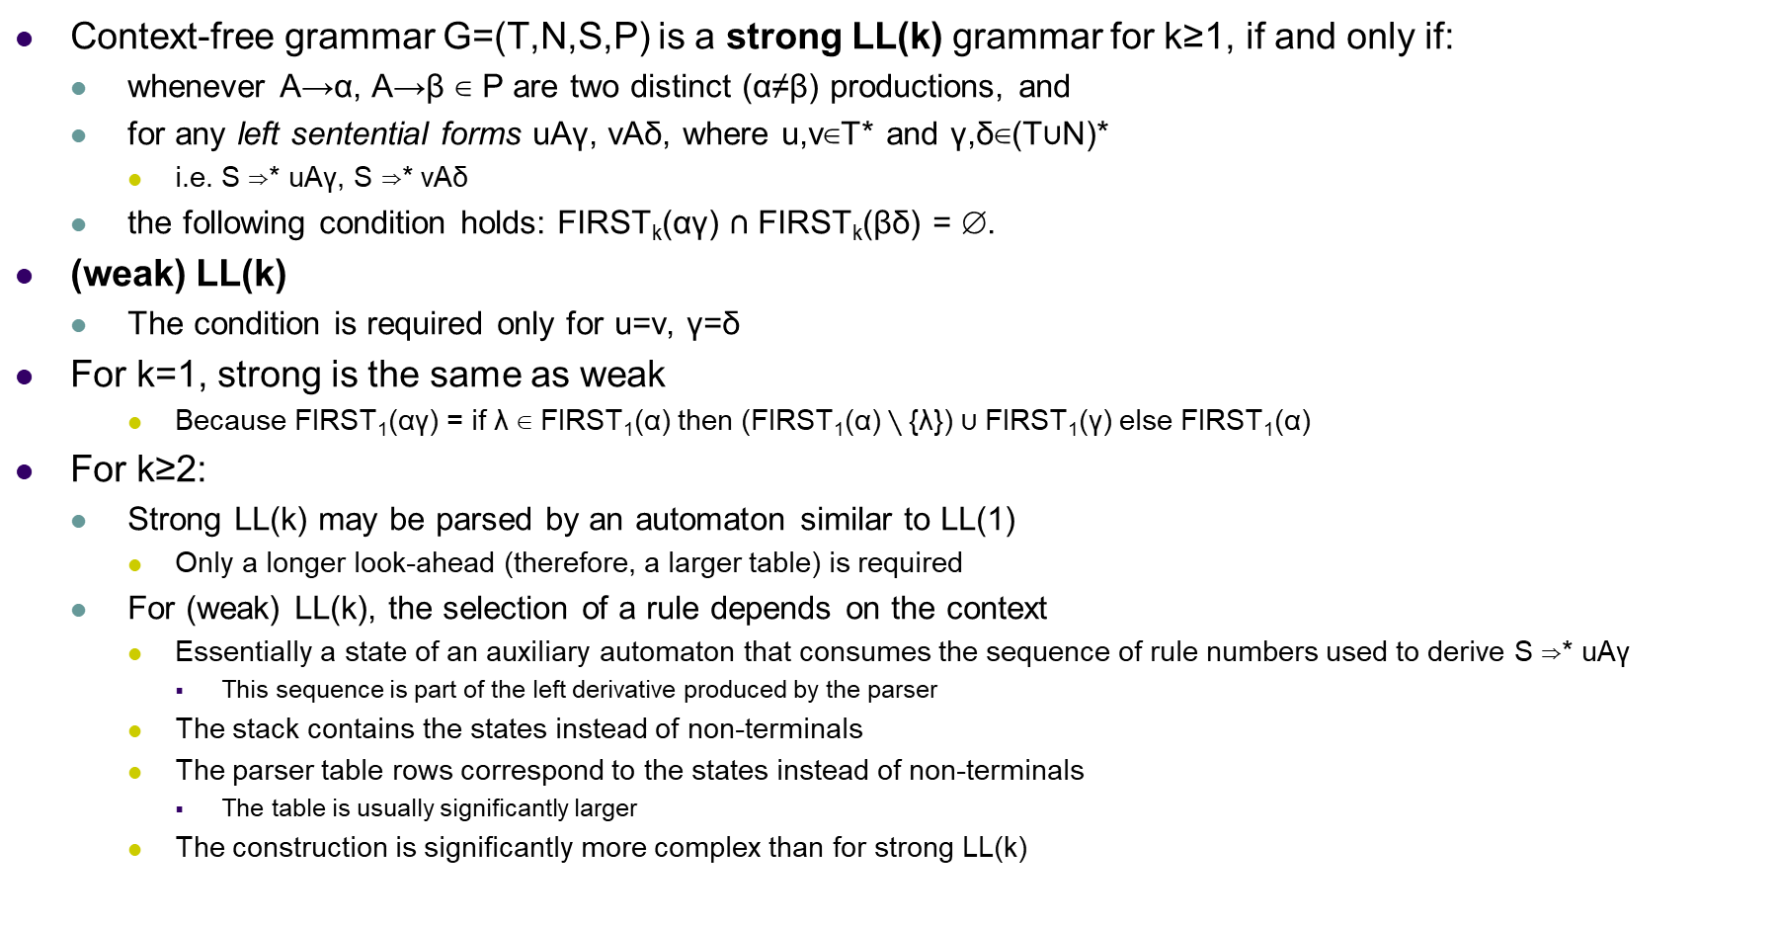
LL(k) grammar
Context-free grammar G=(T,N,S,P) is a strong LL(k) grammar for k≥1, if and only if:
  whenever A→α, A→β ∈ P are two distinct (α≠β) productions, and
  for any left sentential forms uAγ, vAδ, where u,v∈T* and γ,δ∈(T∪N)*
    i.e. S ⇒* uAγ, S ⇒* vAδ
  the following condition holds: FIRST_{k}(αγ) ∩ FIRST_{k}(βδ) = ∅.
(weak) LL(k)
  The condition is required only for u=v, γ=δ
For k=1, strong is the same as weak
    Because FIRST₁(αγ) = if λ ∈ FIRST₁(α) then ($\text{FIRST}\text{1}\text{(}\text{α}\text{)}∖\text{\{}\text{λ}\text{\}) }\text{∪} \text{FIRST}\text{1}\text{(}\text{γ}\text{)}$else FIRST₁(α)
For k≥2:
  Strong LL(k) may be parsed by an automaton similar to LL(1)
    Only a longer look-ahead (therefore, a larger table) is required
  For (weak) LL(k), the selection of a rule depends on the context
    Essentially a state of an auxiliary automaton that consumes the sequence of rule numbers used to derive S ⇒* uAγ
      This sequence is part of the left derivative produced by the parser
    The stack contains the states instead of non-terminals
    The parser table rows correspond to the states instead of non-terminals
      The table is usually significantly larger
    The construction is significantly more complex than for strong LL(k)

Slide 28
Recursive-descent parsing
One procedure/function for each nonterminal of a grammar
Each procedure does two things
  It decides, which grammar production with given nonterminal on the left side will be used using look-ahead. A production with right side α will be used, when the look-ahead is in FIRST(α). If there is a conflict for the look-ahead among some production right sides, the grammar is not suitable for recursive-descent parsing. A production with Λ on the right side will be used, if the look-ahead is not in FIRST of any right side.
  Procedure code copies the right side of a production. Nonterminal means calling a procedure for this nonterminal. Terminal is compared with the look-ahead. If they are equal, a next terminal is read. If they are not equal, it is an error.

Slide 29
Recursive-descent parsing – example for our grammar
void match(token t) {
if(lookahead==t)
lookahead = nexttoken();
else error();
}
void E(void) {
T(); Eap();
}
void Eap(void) {
if(lookahead=='+') {
match('+'); T(); Eap();
}
}
void T(void) {
F(); Tap();
}
void Tap(void) {
if(lookahead=='*') {
match('*'); F(); Tap(); }
}
void F(void) {
switch(lookahead) {
case '(': match('('); E();
match(')');break;
case 'id': match('id'); break;
default:
error();
}
}

Slide 30
Regular-right-part (RRP) grammars
E → E + T
E → T
T → T * F
T → F
F → ( E )
F → id
E → E ( + T )*
T → F ( * F )*
F → ( E ) | id
Regular expressions on the right
  Only one rule for a nonterminal
This example RRPG produces the same language as the plain G on the left
  But not the same derivation/tree

Slide 31
LL(k) parsing for RRP grammars
Regular expressions converted to deterministic automata
Stack contains states of these automata
  Instead of terminals and non-terminals
E → T ( + T )*
T → F ( * F )*
F → ( E ) | id
Decisions needed in almost any state of each automaton
  For classic grammar, decisions are between rules = at the RP start

Slide 32
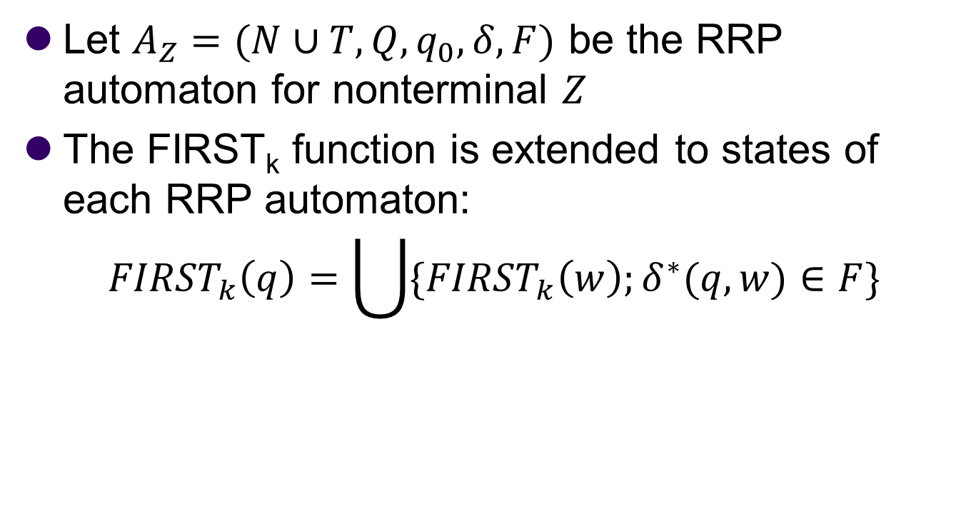
LL(k) parsing for RRP grammars
Let $A_{Z}=(N∪T,Q,q_{0},δ,F)$ be the RRP automaton for nonterminal $Z$
The FIRST_{k} function is extended to states of each RRP automaton:
$${FIRST}_{k}\left(q\right)=\bigcup{\{{FIRST}_{k}\left(w\right);δ^{∗}(q,w)∈F\}}$$

Slide 33
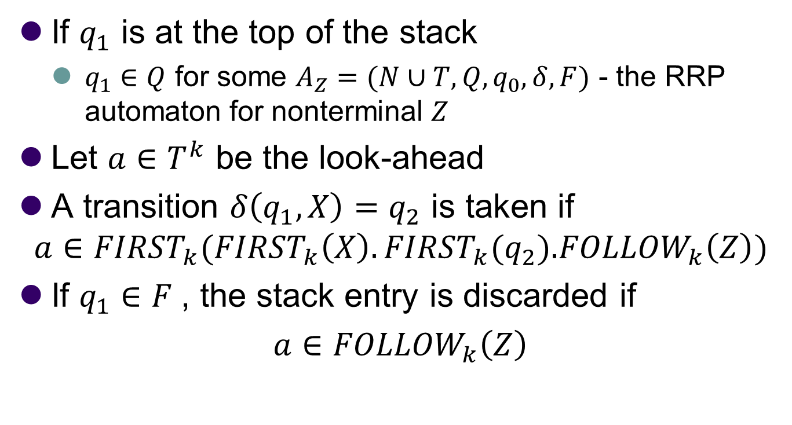
LL(k) parsing for RRP grammars
If $q_{1}$ is at the top of the stack
  $q_{1}∈Q$ for some $A_{Z}=(N∪T,Q,q_{0},δ,F)$ - the RRP automaton for nonterminal $Z$
Let $a∈T^{k}$ be the look-ahead
A transition $δ\left(q_{1},X\right)=q_{2}$ is taken if
$$a∈{FIRST}_{k}({FIRST}_{k}\left(X\right).{FIRST}_{k}\text{(}q_{2}\text{).}{FOLLOW}_{k}\left(Z\right))$$
If $q_{1}∈F$, the stack entry is discarded if
$a$ $∈{FOLLOW}_{k}\left(Z\right)$

Slide 34
Recursive-descent parsing – example for RRP grammar
void match(token t) {
if(lookahead==t)
lookahead = nexttoken();
else error();
}
void E(void) {
T();
while(lookahead=='+') {
match('+'); T();
}
}
void T(void) {
F();
while(lookahead=='*') {
match('*'); F(); Tap();
}
}
void F(void) {
switch(lookahead) {
case '(': match('('); E();
match(')');break;
case 'id': match('id'); break;
default:
error();
}
}
E → T ( + T )*
T → F ( * F )*
F → ( E ) | id

Slide 35
Bottom-up Analysis

Slide 36
Bottom-up analysis
Attempts to construct a parse tree for an input string beginning at the leaves and working up towards the root
  Replace a substring corresponding to a right side of a production by a nonterminal from the left side of the production in each reduce step
  The sequence of reduce steps correspond to the rightmost derivation in reversed order
Variants:
  Traditional methods generate push-down automatons
    LR(k) – the ultimate method
      For every deterministic language (i.e. parsable by a deterministic push-down automaton),
      there exists a LR(k) grammar for some k
    LALR(k) – more complex construction, smaller automaton, slightly less general than than LR(k)
    SLR(k) – simple construction
  GLR – simulates non-deterministic push-down automaton – general, large run-time costs
Parser generators
  Bison – LALR(1), GLR
Advantages wrt. LL parsers
  It can be implemented with the same efficiency as top-down parsing
  LL(1) is a proper subset of LR(1)
    Many real-life grammars belong to the set difference
    Bottom-up methods can handle left recursion

Slide 37
Bottom-up parsing (theory)
initial
configuration
shift action
a∈T
reduce action
X→w ∈ P
Stack
(top on the right)
u
uw
w$
av$
v$
final
configuration
The rest
of the input
S
ua
uX
$
v$
v$
There may be more than one rule whose right part matches a suffix of the stack.
Bottom-up parsing methods (LR(k),LALR(k),SLR(k)) differ in the way how the rule
is chosen, based on FIRST_{k}(v) plus some information extracted from the stack

Slide 38
Bottom-up parsing
Item-automaton
  Auxiliary finite-state automaton
    Input = the parser stack (bottom-up)
    Final state decides the parser actions
  Different methods produce different item automatons
Real implementation of the parser
  The item-automaton is not restarted when the stack changes
  The stack contains item-automaton states encountered when processing the stack
  Only the top layers need to be changed
  The word on the stack is no longer required
    Sometimes shown as states interleaved with nonterminals and terminals

Slide 39
Bottom-up parsing (reality)
initial
configuration
shift action
a∈T
reduce action
X→w ∈ P, |w|=n
Stack
(top on the right)
q₀
q₀...q_{m}
q₀...q_{m}
w$
av$
v$
final
configuration
The rest
of the input
q₀q_{F}
q₀...q_{m}r
q₀...q_{m-n}r
$
v$
v$
r = δ(q_{m},a)
r = δ(q_{m-n},X)
The stack contains states of the item-automaton, always corresponding to
a path in the item-automaton starting at the initial state q₀. The choice between
shift and reduce and among rules for reduce is based on q_{m} and FIRST_{k}(v).

Slide 40
LR/LALR/SLR parser as a push-down automaton
input
a₁
…
a_{i}
…
a_{n}
$
stack
q_{m}
Automaton
Y_{m}
output
q_{m-1}
Y_{m-1}
action
goto
…
q₀
The stack here is shown interleaved
  Y_{j} are terminals/non-terminals (not actually needed for parsing)
  q_{j} are states of the item-automaton
    q_{j} = δ(q_{j-1},Y_{j})
    The state on the top of the stack is the current state of the automaton

Slide 41
LR/LALR/SLR(1) parser behavior
Initial configuration
  Input pointer points to the first terminal in the input string
  The initial state q₀ is on the stack
Controlled by two tables (generated by the particular method)
  action: Q×T → commands
  goto: Q×N → Q
In each step, action[q_{m}, a_{i}] may be one of the following commands:
  <Shift r>, where r is a state
    discard a_{i} from the input
    add a_{i} and r to the top of the stack
  <Reduce X→w>, where X→w is a rule of the grammar
    remove n=|w| pairs from the top of the stack
      q_{m-n} is now the state on the top of the stack
    add X and r to the top of the stack, where r = goto[q_{m-n}, X]
    write X→w to the output
  <Accept>
    The input string is accepted, stop
  <Error>
    The input string is not in the input language, stop

Slide 42
LR(1) automaton tables for the example grammar
s = Shift
r = Reduce:
r1: E → E + T
r2: E → T
r3: T → T * F
r4: T → F
r5: F → ( E )
r6: F → id
acc = Accept
empty = Error
state | action |  |  |  |  |  | goto
 | id | + | * | ( | ) | $ | E | T | F
0 | s5 |  |  | s4 |  |  | 1 | 2 | 3
1 |  | s6 |  |  |  | acc
2 |  | r2 | s7 |  | r2 | r2
3 |  | r4 | r4 |  | r4 | r4
4 | s5 |  |  | s4 |  |  | 8 | 2 | 3
5 |  | r6 | r6 |  | r6 | r6
6 | s5 |  |  | s4 |  |  |  | 9 | 3
7 | s5 |  |  | s4 |  |  |  |  | 10
8 |  | s6 |  |  | s11
9 |  | r1 | s7 |  | r1 | r1
10 |  | r3 | r3 |  | r3 | r3
11 |  | r5 | r5 |  | r5 | r5

Slide 43
Example of LR parser behavior
Stack | Input | Action
0 | id+id*id$ | s5
0 id 5 | +id*id$ | r6: F→id
0 F 3 | +id*id$ | r4: T→F
0 T 2 | +id*id$ | r2: E→T
0 E 1 | +id*id$ | s6
0 E 1 + 6 | id*id$ | s5
0 E 1 + 6 id 5 | *id$ | r6: F→id
0 E 1 + 6 F 3 | *id$ | r4: T→F
0 E 1 + 6 T 9 | *id$ | s7
0 E 1 + 6 T 9 * 7 | id$ | s5
0 E 1 + 6 T 9 * 7 id 5 | $ | r6: F→id
0 E 1 + 6 T 9 * 7 F 10 | $ | r3: T→T * F
0 E 1 + 6 T 9 | $ | r1: E→E + T
0 E 1 | $ | acc

Slide 44
Grammar augmentation
Augmentation of a grammar G=(T,N,S,P):
  The grammar G’=(T,N’,S’,P’), where N’=N∪{S’} and P’=P∪{S’→S}
  Augmentation is not strictly necessary if
    there is only one production with S at the left side
    S is not present inside the right side of any production
  For our grammar, the rule S’→E is added
The purpose of augmentation:
  Reduction by the rule S’→S means that a complete derivation tree is constructed
    Because S' can only be at the root
  The parser will stop just before actually doing the reduction
    The <reduce S'> action would require a goto transition for S' but we have none
      Because there is no right side containing S'
      There is no column for S' in the goto table
    Reporting the reduction to S' would confuse the semantic analysis
    Instead, a special <acc> action is performed to stop the parser
      It may leave semantic data associated with S on the stack

Slide 45
LR(0) items
LR(0) item of a grammar G
  a production with a marked position on its right side
    n+1 possible positions for a right side of size n
    usually marked with a dot (♦) on the right side
  Example: the production E → E + T generates four LR(0) items:
  E → ♦E + T E → E +♦T
  E → E♦+ T E → E + T♦
  Each LR(0) item represents a state of a non-deterministic automaton
    With some transitions, the automaton will be able to accept the contents of the parser stack
    The stack corresponds to a descent from the root to the current position in the derivation tree
      Transitioning right (GOTO) or down (CLOSURE)

Slide 46
The closure operation
If I is a set of LR(0) items for a grammar G, then
CLOSURE(I) is a set of LR(0) items constructed from I by the following rules:
  Set CLOSURE(I) = I
  For each item A→α♦Bβ ∈ CLOSURE(I) such that B∈N
    for each rule B→γ∈P
    add the item B→♦γ to CLOSURE(I), if it is not already there
  Repeat this rule until no more new LR(0) items can be added to CLOSURE(I)
The purpose of the CLOSURE
  The item-automaton, as used in the parser, is a deterministic finite automaton
  It is constructed by determinization of a non-deterministic automaton
    LR(0) items are the states of the non-deterministic version
    Sets of LR(0) items are the states of the deterministic version
    The CLOSURE corresponds to a combination of two processes:
      Generating lambda-edges that connect non-deterministic automaton states:
      A→α♦Bβ to B→♦γ
      Creating an item set corresponding to deterministic automaton states
A
α₁
α₂
α_{j}
B
β₁
β₂
β_{k}
γ₁
γ₂
γ_{j}

Slide 47
Closure – an example
CLOSURE({S’→♦E}) =
  S’→ ♦E
  E → ♦E + T
  E → ♦T
  T → ♦T * F
  T → ♦F
  F → ♦( E )
  F → ♦id
  This will become the initial state of the deterministic automaton
    The initial state is the only state where all dots reside at the beginning
CLOSURE({E→E+♦T}) =
  E → E +♦T
  T → ♦T * F
  T → ♦F
  F → ♦( E )
  F → ♦id
  In all states except the initial, the closure is applied to a set not containing any item with a dot at the beginning
    It is easy to distinguish the items added by the closure from the original items
r1: E → E + T
r2: E → T
r3: T → T * F
r4: T → F
r5: F → ( E )
r6: F → id

Slide 48
GOTO transitions
GOTO transition
  for a set I of LR(0) items and a grammar symbol X
  GOTO(I, X) = CLOSURE({ A→αX♦β such that A→α♦Xβ ∈ I })
The goto table corresponds to GOTO transitions for non-terminals X
The <shift s> commands in the action table correspond to GOTO transitions for terminals X
A
α₁
α₂
α_{j}
X
β₁
β₂
β_{k}

Slide 49
Construction of canonical collection of sets of LR(0) items
We have an augmented grammar G’=(T,N’,S’,P’)
Canonical collection C
  A set of sets of LR(0) items
  Essentially, a set of all item sets that are reachable from an initial set by GOTO transitions
Construction:
  Start with C = { I₀ } where I₀ = CLOSURE({S’→♦S})
  For each I∈C and for each X∈T∪N’ such that GOTO(I, X)≠∅
    add GOTO(I, X) to C, if not already there
  Repeat this step until no more item sets can be added to C.
The canonical collection, together with the GOTO transitions, is also called LR(0)-automaton
  It is the item-automaton used for SLR(1) and LALR(1) parsing
    The LR(0) automaton defines the shift actions and the goto table
    The methods differ in the construction of the reduce actions
  Note: There is also LR(0) parsing - but too weak to have meaningful applications

Slide 50
LR(0) canonical collection for the example grammar
r0: S' → E
r1: E → E + T
r2: E → T
r3: T → T * F
r4: T → F
r5: F → ( E )
r6: F → id
I₀
I₄
I₇
S’→ ♦E
E → ♦E + T
E → ♦T
T → ♦T * F
T → ♦F
F → ♦( E )
F → ♦id
F → ( ♦E )
E → ♦E + T
E → ♦T
T → ♦T * F
T → ♦F
F → ♦( E )
F → ♦id
(
T → T *♦F
F → ♦( E )
F → ♦id
(
(
id
F
id
I₈
*
F
F → ( E♦)
E → E♦+ T
T
E
T
F
id
+
E
I₉
E → E + T♦
T → T♦* F
I₅
I₁
F → id♦
S’→ E♦
E → E♦+ T
(
id
T
)
I₁₀
I₆
T → T * F♦
*
E → E +♦T
T → ♦T * F
T → ♦F
F → ♦( E )
F → ♦id
I₂
+
E → T♦
T → T♦* F
I₁₁
F → ( E )♦
I₃
T → F♦
F

Slide 51
SLR(1) automaton construction
We have an augmented grammar G’. Tables of SLR(1) automaton are constructed by following algorithm
  Construct a canonical collection C of sets of LR(0) items
  State i is constructed from I_{i}. The parsing actions for state i are determined as follows
    For each A→α♦aβ ∈ I_{i} such that a∈T
      Define action[i,a] = <shift j> where I_{j} = GOTO(I_{i},a),
    For each A→α♦ ∈ I_{i} and for each a∈FOLLOW(A)
      Define action[i,a] = <reduce A→α>
    If S’→S♦ ∈ I_{i}
      Define action[i,$] = <accept>
  If there is a conflict in the previous step, the grammar is not a SLR(1) grammar
    shift-reduce conflicts
    reduce-reduce conflicts
  Table goto is indexed by state i and A∈N’
    whenever GOTO(I_{i},A)=I_{j}, then goto [i,A]=j
  All empty cells are filled by the <error> instruction
  The initial state of the parser is the state which contains the LR(0) item S’→♦S

Slide 52
Valid items
LR(0) item A→β₁♦β₂ is a valid item for a viable prefix αβ₁, if:
  there is a rightmost derivation S’ ⇒⁺ αAw ⇒ αβ₁β₂w
This is a mathematical background behind the GOTO transitions and parser actions
Basic LR parsing theorem:
  The set of valid items for a viable prefix γ is exactly the set of items reached from the initial state through the word γ by the deterministic finite automaton constructed from the canonical collection and the GOTO transitions

Slide 53
Full LR(1) automata
action[i,a] is set to reduction A→α, when A→α♦∈I_{i}, ∀a∈FOLLOW(A) for a state i during SLR(1) construction
In some situation, when i is on top of the stack, the viable prefix βα is in form, where βA cannot be followed by a terminal a in any right sentential form. Therefore reduction A→α is for lookahead a invalid.
Solution: add more information to states, so we can avoid invalid reductions.

Slide 54
LR(1) items
The added information is stored as an additional terminal for each LR(0) item. Such item has a form [A→α♦β,a], where A→αβ∈P, a∈T, and we call it LR(1) item. The terminal a is called lookahead.
  The lookahead has no meaning for A→α♦β, where β≠Λ
  Reduction A→α is set only when [A→α♦,a]∈I_{i} for current state i and a terminal a on the input
  A set of terminals created from lokaheads of LR(1) items ⊆FOLLOW(A)
LR(1) item [A→α♦β,a] is valid for viable prefix γ, whenever ∃ right derivation S⇒⁺δAw⇒δαβw, where
  γ=δα
  Either a is the first symbol of w or w=Λ and a is $

Slide 55
Closure for LR(1) items
We have a set of LR(1) items I for a grammar G. We define CLOSURE1(I) as a set of LR(1) items constructed from I by following procedure:
  Add set I to CLOSURE1(I)
  ∀ [A→α♦Bβ,a]∈CLOSURE1(I), where B∈N, add LR(1) item [B→♦γ,b] ∀ B→γ∈P and ∀b∈FIRST(βa) to CLOSURE1(I), if it isn’t there already. Repeat this step, until something is added to CLOSURE1(I).

Slide 56
GOTO operation for LR(1) items
We define GOTO1(I, X) operation for a set I of LR(1) items and a grammar symbol X as a CLOSURE1 of a set of all items [A→αX♦β,a] where [A→α♦Xβ,a]∈I

Slide 57
Construction of canonical collection of sets of LR(1) items
We have an augmented grammar G’=(T,N’,S’,P’)
Construction of canonical collection C of LR(1) items:
  We start with C={ CLOSURE1({[S’→♦S,$]}) }
  Add GOTO1(I, X) to C ∀ I∈C and ∀ X∈T∪N’, where GOTO1(I, X)∉C ∧ GOTO1(I, X)≠∅. Repeat this step, until something new is added to C.

Slide 58
LR(1) parsing example
S’→S
S→CC
C→cC
C→d

Slide 59
Example of closure construction for LR(1) items
I={[S’→♦S,$]}
CLOSURE1(I)=
  S’→ ♦S, $ β=Λ,FIRST(β$)=FIRST($)={$}
  S→ ♦CC, $ β=C,FIRST(C$)={c,d}
  C→ ♦cC, c/d
  C→ ♦d, c/d

Slide 60
Example of construction of canonical collection of LR(1) items
I₀
S’→ ♦S, $
S→ ♦CC, $
C→ ♦cC, c/d
C→ ♦d, c/d
I₄
C→ d♦, c/d
d
c
I₅
S→ CC♦, $
c
S
I₆
C→ c♦C, $
C→ ♦cC, $
C→ ♦d, $
I₁
S’→ S♦, $
C
C
c
C
I₂
S→ C♦C, $
C→ ♦cC, $
C→ ♦d, $
d
d
I₇
C→ d♦, $
d
I₈
C→ cC♦, c/d
I₃
C→ c♦C, c/d
C→ ♦cC, c/d
C→ ♦d, c/d
C
I₉
C→ cC♦, $
c

Slide 61
LR(1) parser construction
We have an augmented grammar G’. LR(1) automaton tables are constructed by following algorithm
  Construct a canonical collection C of sets of LR(1) items
  State i is constructed from I_{i}. The parsing actions for state i are determined as follows
    [A→α♦aβ,b]∈I_{i},a∈T ∧ GOTO1(I_{i},a)=I_{j}, then action[i,a]=shift j
    [A→α♦,a]∈I_{i} ∧ A≠S’, then action[i,a]=reduce A→α
    [S’→S♦,$]∈I_{i}, then action[i,$]=accept
  If there is a conflict in the previous step, the grammar is not a LR(1) grammar and the automaton cannot be constructed
  Table goto is indexed by state i and A∈N’: whenever GOTO1(I_{i},A)=I_{j}, then goto [i,A]=j
  All empty cells are filled by error instruction
  The initial state of the parser is the state, which contains LR(1) item [S’→♦S,$]

Slide 62
LALR
LALR=Look-Ahead-LR
LR(0), SLR(k) and LALR(k) parsers have the same number of states
  LALR(k) can handle more languages
    Implemented by yacc, bison
    Nobody really uses LR(0) or SLR(k)
LR(k) produces larger parser tables
  It is unlikely that a real-life grammar is LR(k) but not LALR(k)

Slide 63
How to make smaller tables?
Idea: merge sets with the same core into one set including GOTO1 merge
  Core: a set of LR(0) items (no lookahead)
  Merge cannot produce shift/reduce conflict
    Suppose in the union there is a conflict on lookahead a for LR(1) items [A→α♦,a] and [B→β♦aγ,b]
    Cores are same, therefore in the set with [A→α♦,a] must be [B→β♦aγ,c] as well for some c. There was already a shift/reduce conflict before merge
  Merge can produce reduce/reduce conflict

Slide 64
Easy LALR(1) table construction
Naive algorithm
  We have an augmented grammar G’
  Construct a canonical collection C of sets of LR(1) items for G'
  For each core in collection C, find all sets having that core, and replace these sets by their union
  Let C’={ J₀, J₁, …, J_{m} } be the resulting collection of LR(1) items
  Table action is constructed for C’ in the same manner as for full LR(1) parser
  If there is a conflict, the grammar is not LALR(1) grammar
  If J∈C’ is the union of sets of LR(1) items I_{i} (J=I₁∪I₂∪…I_{k}), then cores GOTO1(I₁,X), …, GOTO1(I_{k},X) are the same, since I₁, …, I_{k} all have the same core. Let K be the union of all sets of items having the same core as goto(I₁,X). Then GOTO1(J,X)=K
Sophisticated algorithm
  instead of constructing LR(1) and then compressing it back to LR(0)
  construct the canonical collection for LR(0), then compute the LALR(1) look-aheads
    graph-traversal algorithm (over the LR(0) items inside the LR(0) states)
      effectively computes the union of all LR(1) look-ahead terminals for every LR(0) item
    equivalent to starting with the non-deterministic LR(1) automaton but applying a lossy method of its determinization
      ignoring differences in look-aheads when comparing the sets of items

Slide 65
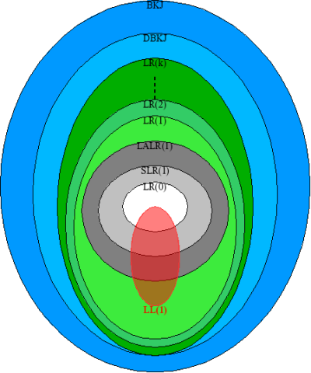
Grammars (languages) strength
Union of all LR(k) are deterministic context-free languages (DBKJ) and it is a proper subset of all context-free languages (BKJ)

Slide 66
LR(k) grammar - theoretical definition
Context-free grammar G=(T,N,S,P) is LR(k) for k≥1, if and only if
  whenever A→α, B→β ∈ P are two distinct (α≠β) productions of G, and
  for any two right sentential forms γAu, δBv, where u,v∈T* and γ,δ∈(T∪N)*
    i.e. S ⇒* γAu, S ⇒* δBv
  if there is a w∈T* such that γα ⇒* w and δβ ⇒* w
    i.e. S ⇒* γAu ⇒ γαu ⇒* wu, S ⇒* δBv ⇒ δβv ⇒* wv
  then the following condition holds: FIRST_{k}(u) ∩ FIRST_{k}(v) = ∅
The LALR(k) and SLR(k) criteria reference the LR(0) item automaton
  The automaton is constructed by a complex algorithm
  Any direct mathematical formulation would be overly complex

Slide 67
LR(1) but not SLR(1)
S’→S
S→L=R
S→R
L→*R
L→i
R→L

Slide 68
LR(1) but not LALR(1)
S’→S
S→aAd
S→aBe
S→bAe
S→bBd
A→c
B→c
Combined in LALR(1)
S → a♦Ad, $
S → a♦Be, $
A → ♦c, d
B → ♦c, e
S’→ ♦S, $
S → ♦aAd, $
S → ♦aBe, $
S → ♦bAe, $
S → ♦bBd, $
A → c♦, d
B → c♦, e
a
c
S → b♦Ae, $
S → b♦Bd, $
A → ♦c, e
B → ♦c, d
b
A → c♦, e
B → c♦, d
c

