Slide 1
CPU – principles of operation

Slide 2
Transistor level
CPU and similar chips mostly use CMOS technology (1963)
  C=Complementary – both polarities of transistors available
    A mix of n-type and p-type transistors on the same chip
    The mix allows control of both incoming and outgoing current at a gate
  MOS=Metal-Oxide-Semiconductor – a particular transistor technology (1959)
    A kind of FET=Field-Effect-Transistor – a transistor controlled by voltage on "Gate"
      Behaviorally similar to a triode vacuum tube (1908) but much smaller voltage, size, price
    Also called Unipolar – only one kind of current-carriers used (in one transistor)
      n-type transistors use electrons, p-type use holes
      The first transistors (1947) were Bipolar (both electrons and holes used to transport current) and controlled by current – no longer used in computing after ~1980
  DRAM (1968) and Flash (1980) chips use slightly different technologies
    the memory effect is provided by a specially constructed transistor
    usually not mixable with CPU in the same chip
      only low-density devices like embedded CPUs can mix CMOS logic and Flash

Slide 3
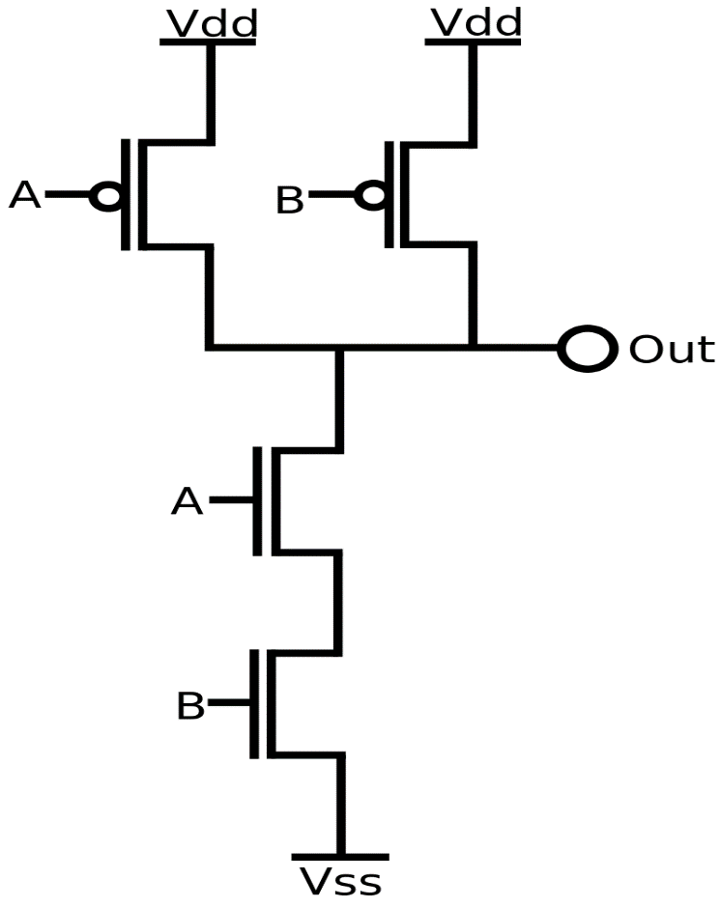
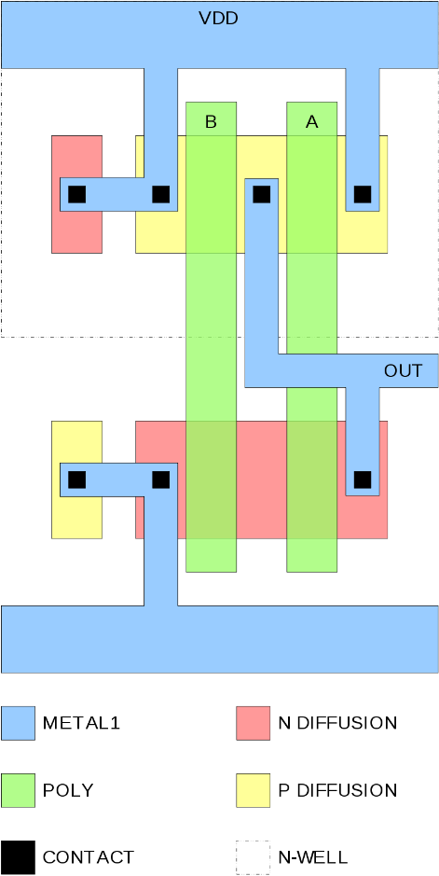
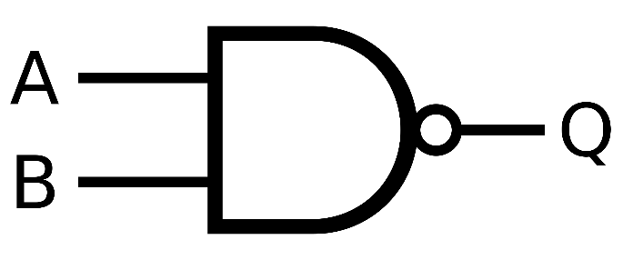
Logic (gate) level
Four transistors constitute a NAND gate
  Two inputs: A, B
  Output = !(A&&B)
  High voltage on both inputs closes the p-type transistors (current sources, top) and opens the n-type transistors (current sink, bottom)

Slide 4
Logic level
Power consumption
  Gates and wires connected to Out form a capacitor which must be charged and discharged in each cycle – proportional to frequency, reduced by Dennard scaling
  Short-circuit current (all transistors are open during state changes)
  Leakage through closed transistors – increased by geometry scaling down

Slide 5
Full 1-bit adder
A
S
B
Ci
Co
Full adder = 1-bit addition with carry in and carry out
  The sum of three 0/1 inputs may be 0/1/2/3 – representable by 2-bit output
        (Co<<1)|S = A+B+Ci
  The circuit is made smaller with three-input NAND and NOR gates

Slide 6
N-bit adder
+
+
+
+
A
B
A
B
A
B
A
B
Ci
Co
Ci
Co
Ci
Co
Ci
Co
S
S
S
S
N-bit addition with carry in and carry out
  O(N) delay - too slow for large N
  Recursive “dynamic-programming” construction used for large N
    O(log N) delay, but significantly more gates needed

Slide 7
Combinational vs. sequential circuits
Set~
Q
Q~
Reset~
Combinational circuit = directed acyclic graph = state-less circuit
  The signal is only delayed, proportionally to the longest path length
Sequential circuit = cyclic graph
  Cycles cause state-full behavior (usually through positive feed-back)
  Various kinds of registers
    “Register” is originally a digital-design term – any state-full circuit used to store information
    The simplest case of register is the 1-bit Set/Reset Latch depicted above
    A CPU register (as referenced in machine code) is, in digital-design terminology, a part of small Static RAM
    Static RAM is an addressable array of n-bit registers – one of them is activated by a binary decoder (a combinational circuit)
  More sophisticated cases (e.g. clock dividers)

Slide 8
Digital-circuit design
Process (lithography) – the technology of the chip-producing foundry (fab)
  Often simply denoted by geometric resolution in nanometers
  Decides the geometrical, electrical, and timing properties of transistors
Physical design – produces masks for manufacturing
Transistor Level – network of transistors (and other elements)
  Often skipped as each gate type has its optimized physical design
Logic (Gate) Level – network of gates, latches, etc.
RTL (Register-Transfer Level) design
  Circuits limited to Combinational circuits + Registers
    Registers controlled by a common clock
  Originally a principle of systematic (but not optimal) gate-level design
  Later an intermediate level of design, specified as program-like text (not schematically)
  Now usually generated from system-level design
System Level design
  Done in System-C, Verilog (1986), or VHDL (1981)
    Effectively parallel-programming languages
      Verilog and VHDL also allow direct RTL/Logic/Transistor-level design, analog and simulation models
      There is probably more work done than in gcc/clang/msvc/javac together
    Restrictions (w.r.t. general programming) allow transformation to RTL designs
      The transformation shares some algorithms with parallelizing compilers
Electronic Design Automation (EDA) software is a 10-billion USD/year industry
  The largest player is Synopsys, Inc. (market cap USD 35B, cf. Microsoft 1700B)

Slide 9
Combinational vs. sequential N-bit adder
+
D-type register
+
+
+
+
A
B
RES
CLK
A
B
A
B
A
B
A
B
Ci
Co
Ci
Co
Ci
Co
Ci
Co
Ci
Co
I
O
S
S
S
S
S
Sequential N-bit adder
  Input bits serialized on 2 wires, synchronized, in LSB-to-MSB order
  Requires clock to sample inputs and to control the (D-type) register
    Due to delay, outputs (Co, S) must be sampled later, at the end of clock cycle
  Slower even than naïve combinational but O(1) gates

Slide 10
Sequential N*N-to-2N-bit multiplier
LSB
MSB
N-bit register
LSB
MSB
N-bit shift register
CLK
+
+
+
+
A
B
A
B
A
B
A
B
Ci
Co
Ci
Co
Ci
Co
Ci
Co
S
S
S
S
2N-bit D-type register
CLK
I1
I2N
RES
O1
O2N
LSB
MSB
The school multiplication algorithm in binary digits
  Shown mirrored wrt. school convention, i.e. with LSB on the left and MSB on the right
  One operand fixed, one being shifted by a shift register
  1*N-bit multiplication implemented by N AND gates
  Addition of N N-bit results implemented by 2N full adders with shifting loopback
  Total delay O(N*N); may be improved to O(N*log N) with optimized 2N-bit adder

Slide 11
Combinational N*N-to-2N-bit multiplier
LSB
LSB
operand B
MSB
+
+
A
B
+
A
B
Ci
Co
Ci
A
B
Co
Ci
Co
S
S
S
operand A
+
+
A
B
+
A
B
Ci
A
B
Co
Ci
Co
Ci
Co
S
S
S
MSB
+
+
A
B
+
A
B
Ci
A
B
Co
Ci
Co
Ci
Co
S
S
S
final adder
The school multiplication algorithm in binary digits
  Shown mirrored wrt. school convention, i.e. with LSB on the left and MSB on the right
  1*N-bit multiplication implemented by N*N AND gates
  Addition of N N-bit results implemented by N*N full adders, then by a final N+N-bit adder
  Total delay O(N)
    In real designs (1992), reduced to half by radix-4 Booth encoding of operands

Slide 12
Wallace-tree multiplier (invented 1964, used after 2000)
64*AND
16*full adder
10*full adder
LSB
MSB
…
MSB
LSB
64 bits
15 columns
48 bits
38 bits
MSB
LSB
16 bits final result
1-bit multiplier = AND gate
N-bit multiplier must add N*N 1-bit results, properly shifted
  Wallace-tree: Instead of adding bits in the columns, recursively reduce number of operands by full adders
    A full adder converts three bits (in the same column) into two bits (in two adjacent columns)
    Each layer reduces the number of bits in a column from M to (M/3)+(M%3) but sends (M/3) bits to the left
    After O(log_{3/2} N*N) = O(log N) layers, the remaining small columns are summed by optimized 2N-bit adder
    This algorithm is done in the circuit generator – the generated circuit is combinational with O(log N) delay

Slide 13
Wallace-tree multiplier staged
time
Bit-by-bit AND |  | I1 | I2 | I3
Wallace layer 1
Wallace layer 2
 |  |  | I1 | I2 | I3
 |  |  |  | I1 | I2 | I3
Wallace layer M
Final 2N-bit adder |  |  |  |  | I1 | I2 | I3
delay < 1 clock
delay < 1 clock
delay < 1 clock
The Wallace-tree consists of tens of layers (log_{1.22} 64 = 21)
    Each layer is a set of independent full adders
  The total delay may be longer than the desired system clock period
  Registers inserted after each K layers, delay between registers less than a clock
  A new multiplication may be started in each clock period = pipelining

Slide 14
Arithmetic units in general
Sequential implementation
    Hardware equivalent of loop in a program
  The same hardware used repeatedly during the same operation
  Minimum number of transistors, large latency
    The registers incur additional delay
Purely combinational implementation
    Hardware equivalent of mathematical formula
  Each piece of hardware used only once during the same operation
    Idle for most of the time
  Large number of transistors, minimum latency
  Advanced (non-iterative) algorithms possible (e.g. Wallace multiplier)
Staged combinational implementation
    Hardware equivalent of unrolled loop (but iterations may differ)
  Each piece of hardware used once during a clock period
    May be used for another operation in the next period
  Even larger number of transistors, latency similar to sequential implementation
    Latency may be lower if a stage corresponds to more iterations of the algorithm
  Large throughput due to pipelining

Slide 15
Arithmetic units in general
When increasing transistor speed is no longer possible (2005)...
... there are two ways to improve throughput:
  Replace sequential by staged combinational implementation
    Allows pipelining
  Implement more than one arithmetic unit
    Multiple units in the same pipeline (SIMD instructions)
      A SIMD instruction may also use two pipelines in parallel
    Multiple pipelines (processing instructions of the same thread)
      Hyperthreading: More than one thread shares the same set of pipelines
    Multiple cores/sockets (processing instructions of different threads)
The price:
  Increased number of transistors
  Increased complexity of synchronization (additional energy consumption)
Throughput (number of operations per time) is improved
Latency (time required to finish an operation) is NOT improved
  Latency may be improved by advanced circuit designs

Slide 16
Arithmetic units in general
The reality in Intel/AMD CPUs (2010 to 2020):
  Integer addition/subtraction is single-clock (unstaged combinational)
    FP addition/subtraction usually 3 clocks due to shifting/normalization, pipelined
  Multiplication is staged combinational
    Latency usually 3 to 5 clocks
    Pipelined: Throughput 1 instruction per clock per pipeline
  Division is always iterative (sequential)
    Latency 20 to 80 clocks (FP often faster than integer)
      Latency may depend on actual values
      The pipeline is blocked – very small throughput
  Bit operations (AND/OR/XOR) are single-clock
    Shifts/rotations may cost more than one clock
      In terms of chip layout, ALUs are rather wide (across bits) than deep (across stages)
      Any information travelling across (many) bits is problematic
  SIMD operations: usually the same latency as their scalar counterpart
    Only few iterative operations (FDIV) available in the SIMD instruction set
    Some wide-vector instructions implemented as two half-width operations pipelined
      This fact heavily influenced the SIMD instruction set

