Slide 1
CPU microarchitectures (2000-2018)

Slide 2
CPU Microarchitecture
Branch prediction
conditions, indirect branches, call/return pairs
speculative execution
Instruction decoder
loop cache (simple loops up to ~20 instructions)
conversion to micro-ops (1:1, 1:N, 2:1)
stack-pointer simulator
Renamer
16 architectural integer registers mapped to ~160 physical
similarly for FP/vector registers
Out-of-order execution
~40 micro-ops in simultaneous execution (RS) from a window of ~300 (ROB)
retirement: memory/register stores in-order in background
store forwarding: loads retrieve values from waiting stores
speculative loads: no waiting for waiting stores (to unknown addresses)

Slide 3
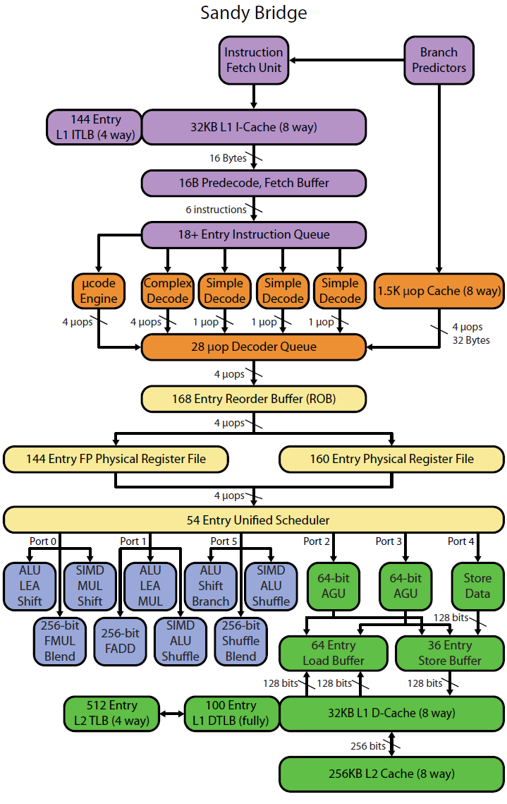
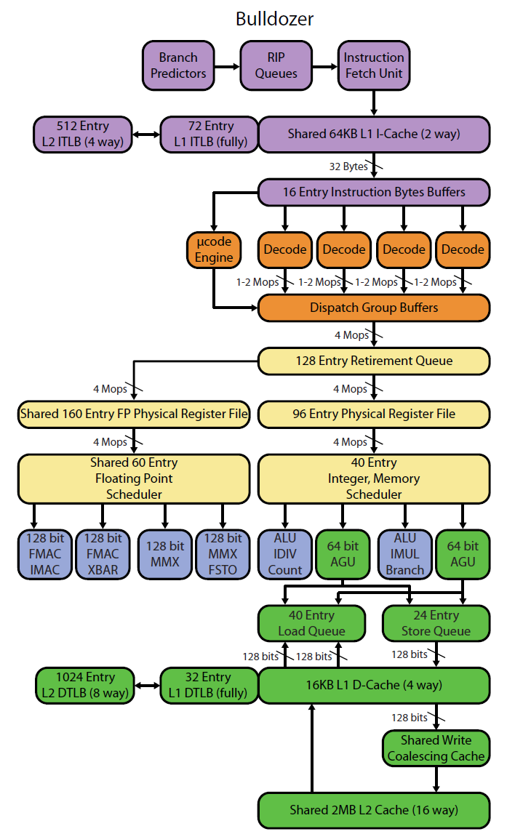
Intel vs. AMD architectures (realworldtech.com)

Slide 4
AMD Zen+ (2018) [wikichip.org]

Slide 5
AMD Zen+ (2018) [wikichip.org]

Slide 6
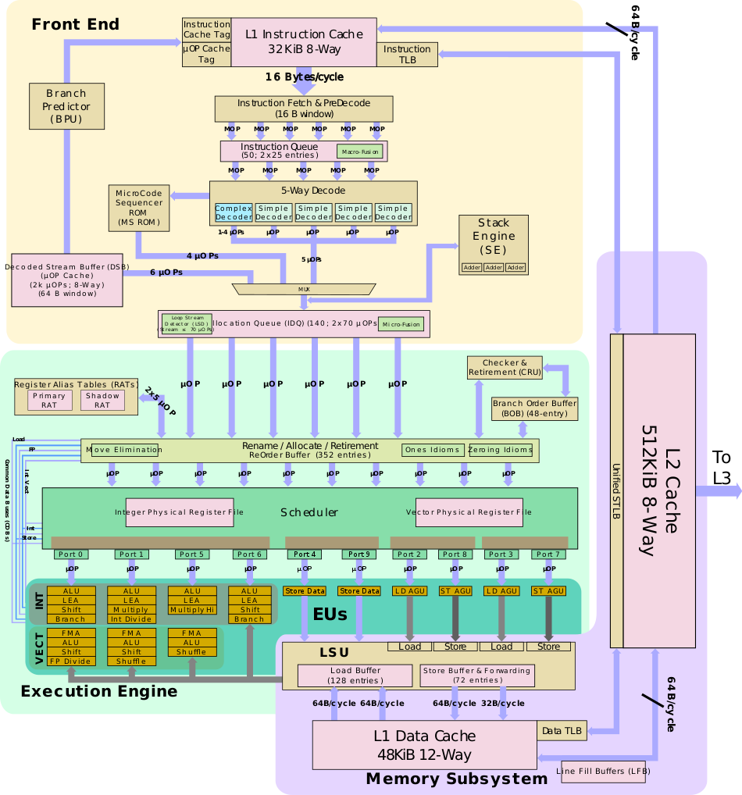
Intel Ice Lake (2019) [wikichip.org]

Slide 7
Intel Ice Lake (2019) [wikichip.org]

Slide 8
CPU Microarchitecture (Intel x86/64, 2015..2023)
In a cycle, CPU can (in theory) simultaneously perform:
Fetch: 16 B (avg. 4 instructions) from L1 instruction cache
Decode: 5..6 instructions
ALU: 3..5 simple operations (add/mul)
Memory load: 2..3 reads (up to 256..512 bits total) from L1 data cache
Memory store: 1..2 writes (up to 256..512 bits total) to L1 data cache
Latency
the time between consuming operands and producing results
integer add: 1, mul: 4
FP add: 2..4, FP mul/FMA: 4
FP div: 11/14, integer div: ~18, data dependent
integer load: 5, FP load: 6 (L1 cache)
store address: 3
store data: 1..2 (retirement, in-order)

