Slide 1
Simple mathematical model of cache behavior

Slide 2
Mathematical model of cache behavior
Simple mathematical model
  Input:
    A run of a (single-threaded) procedure with particular data
      Often, a generalization to any run with similarly-sized data is valid
    C = Cache size
  Output: The total number of cache misses during the run
    Estimation of the required main-memory throughput
      Does not estimate latency effects
    A statistic over the total run time – cannot identify bottlenecks
    Start/stop effects: Assume the procedure runs in an infinite loop
      The initial set of addresses present in the cache equals to the final set
  Assumptions
    All memory accesses of the same size
    Cache line size is equal to the access size (i.e., spatial locality has no effect)
    Fully associative cache
    Perfect LRU replacement strategy
  Many statistical details are ignored, the results are only approximate

Slide 3
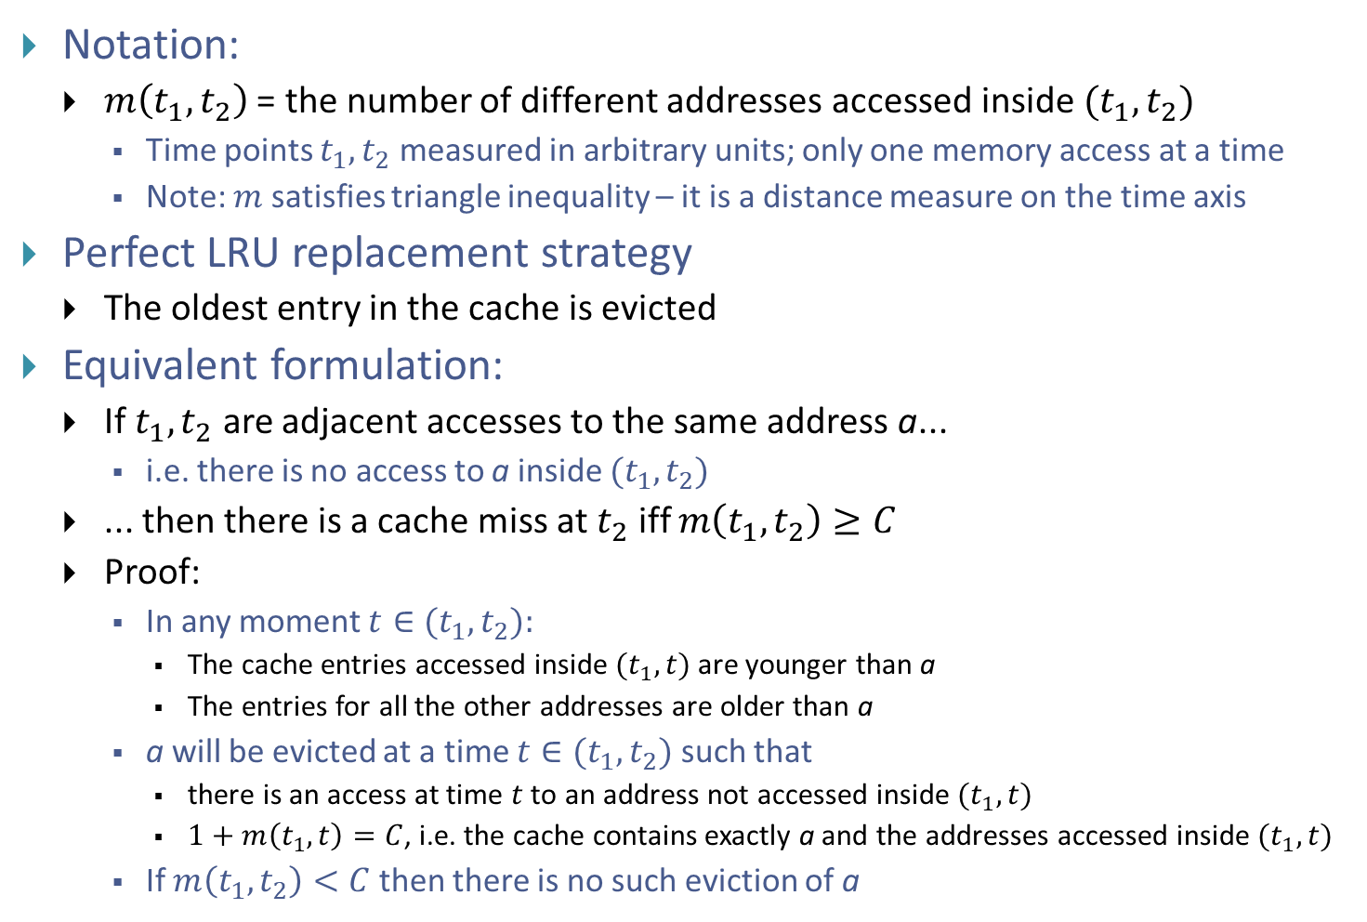
Mathematical model of cache behavior
Notation:
  $m\left(t_{1},t_{2}\right)$ = the number of different addresses accessed inside ${(t}_{1},t_{2})$
    Time points $t_{1},t_{2}$ measured in arbitrary units; only one memory access at a time
    Note: $m$ satisfies triangle inequality – it is a distance measure on the time axis
Perfect LRU replacement strategy
  The oldest entry in the cache is evicted
Equivalent formulation:
  If $t_{1},t_{2}$ are adjacent accesses to the same address a...
    i.e. there is no access to a inside ${(t}_{1},t_{2})$
  ... then there is a cache miss at $t_{2}$ iff $m\left(t_{1},t_{2}\right)≥C$
  Proof:
    In any moment $t∈{(t}_{1},t_{2}):$
      The cache entries accessed inside ${(t}_{1},t)$ are younger than a
      The entries for all the other addresses are older than a
    a will be evicted at a time $t∈{(t}_{1},t_{2})$ such that
      there is an access at time $t$ to an address not accessed inside ${(t}_{1},t)$
      $1+m\left(t_{1}, t\right)=C$, i.e. the cache contains exactly a and the addresses accessed inside ${(t}_{1},t)$
    If $m\left(t_{1},t_{2}\right)<C$ then there is no such eviction of a

Slide 4
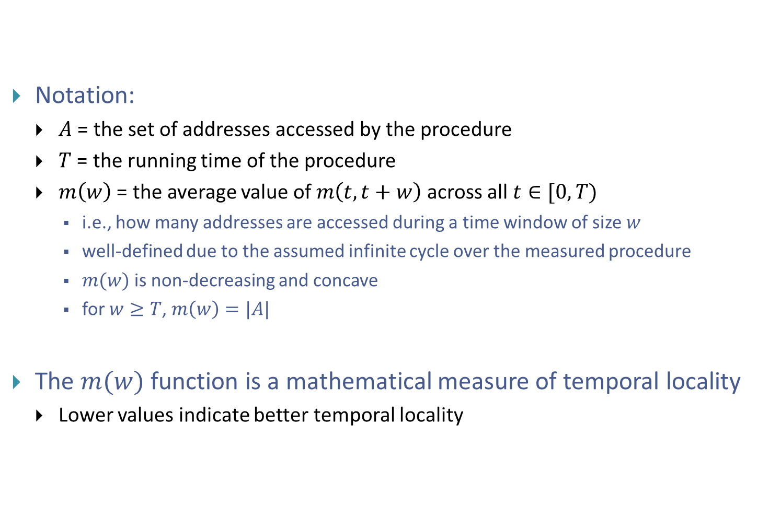
Mathematical model of cache behavior
Notation:
  $A$ = the set of addresses accessed by the procedure
  $T$ = the running time of the procedure
  $m\left(w\right)$ = the average value of $m\left(t,t+w\right)$ across all $t∈[0,T)$
    i.e., how many addresses are accessed during a time window of size $w$
    well-defined due to the assumed infinite cycle over the measured procedure
    $m(w)$is non-decreasing and concave
    for $w≥T$, $m\left(w\right)=|A|$
The $m(w)$ function is a mathematical measure of temporal locality
  Lower values indicate better temporal locality

Slide 5
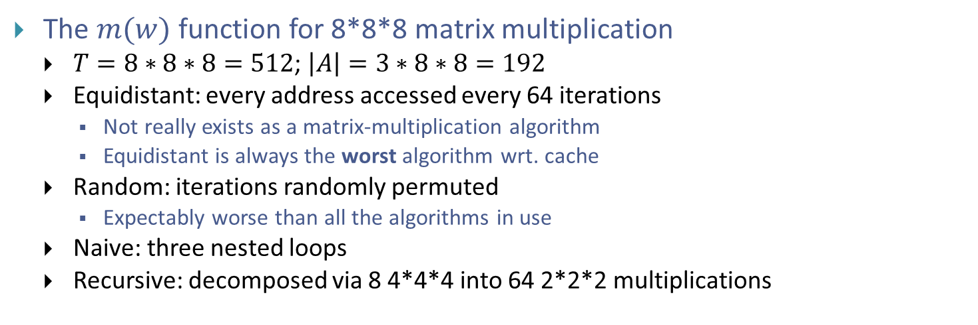
Example
The $m(w)$ function for 8*8*8 matrix multiplication
  $T=8∗8∗8=512$; $\left|A\right|=3∗8∗8=192$
  Equidistant: every address accessed every 64 iterations
    Not really exists as a matrix-multiplication algorithm
    Equidistant is always the worst algorithm wrt. cache
  Random: iterations randomly permuted
    Expectably worse than all the algorithms in use
  Naive: three nested loops
  Recursive: decomposed via 8 4*4*4 into 64 2*2*2 multiplications

Slide 6
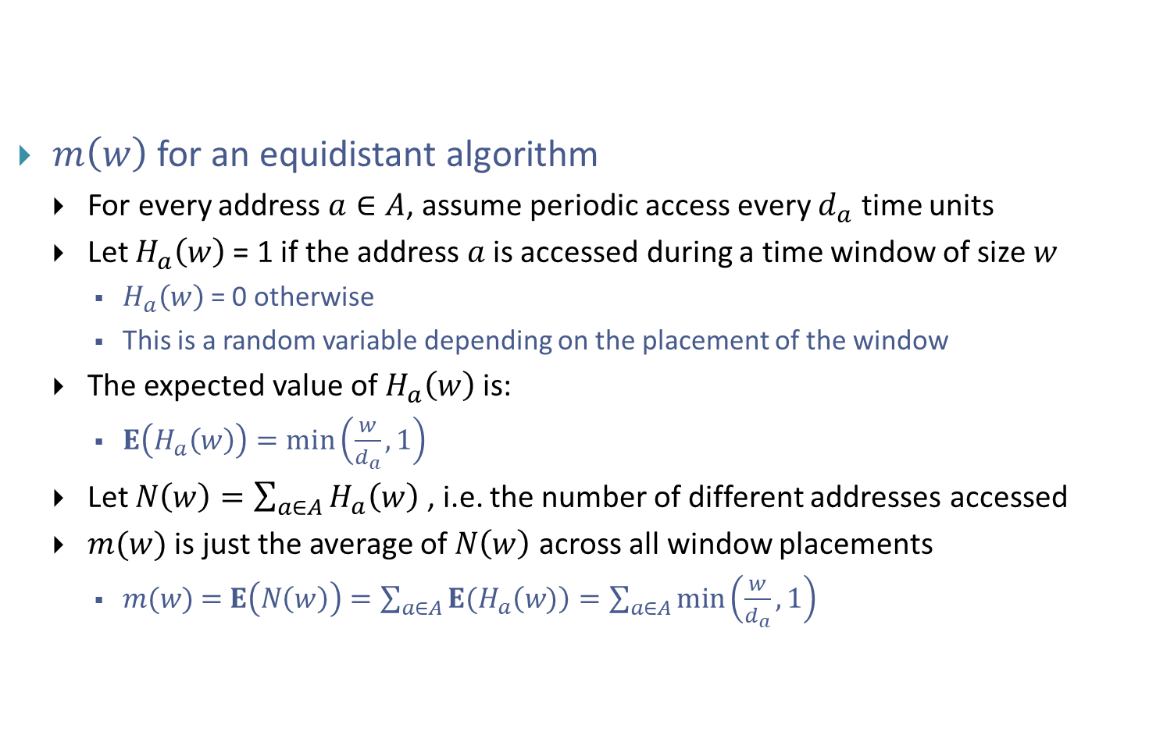
Estimating m(w)
$m\left(w\right)$ for an equidistant algorithm
  For every address $a∈A$, assume periodic access every $d_{a}$ time units
  Let $H_{a}\left(w\right)$= 1 if the address $a$is accessed during a time window of size $w$
    $H_{a}\left(w\right)$= 0 otherwise
    This is a random variable depending on the placement of the window
  The expected value of $H_{a}\left(w\right)$is:
    $E\left(H_{a}\left(w\right)\right)=min\left(\frac{w}{d_{a}},1\right)$
  Let $N\left(w\right)=\sum_{a∈A}{H_{a}\left(w\right)}$ , i.e. the number of different addresses accessed
  $m(w)$ is just the average of $N\left(w\right)$ across all window placements
    $m(w) \text{=} E\left(N\left(w\right)\right)=\sum_{a∈A}{E(H_{a}\left(w)\right)}=\sum_{a∈A}{\min\left(\frac{w}{d_{a}},1\right)}$

Slide 7
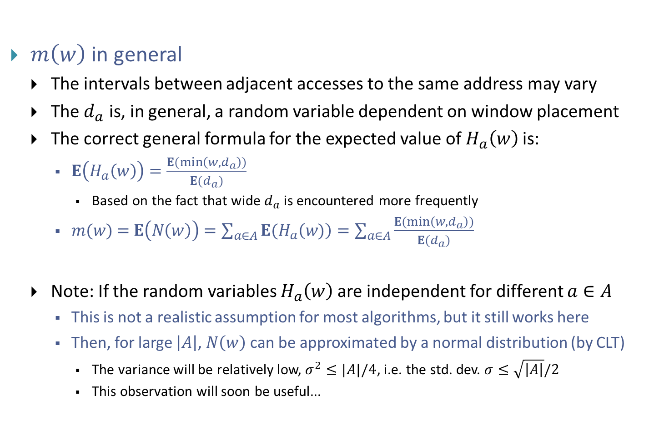
Estimating m(w)
$m\left(w\right)$ in general
  The intervals between adjacent accesses to the same address may vary
  The $d_{a}$ is, in general, a random variable dependent on window placement
  The correct general formula for the expected value of $H_{a}\left(w\right)$is:
    $E\left(H_{a}\left(w\right)\right)=\frac{E(min\left(w,d_{a}\right))}{E(d_{a})}$
      Based on the fact that wide $d_{a}$ is encountered more frequently
    $m(w) \text{=} E\left(N\left(w\right)\right)=\sum_{a∈A}{E(H_{a}\left(w)\right)}=\sum_{a∈A}{\frac{E(min\left(w,d_{a}\right))}{E(d_{a})}}$
  Note: If the random variables $H_{a}\left(w\right)$are independent for different $a∈A$
    This is not a realistic assumption for most algorithms, but it still works here
    Then, for large $\left|A\right|$, $N\left(w\right)$ can be approximated by a normal distribution (by CLT)
      The variance will be relatively low, $σ^{2}≤|A|/4$, i.e. the std. dev. $σ≤\sqrt{\left|A\right|}/2$
      This observation will soon be useful...

Slide 8
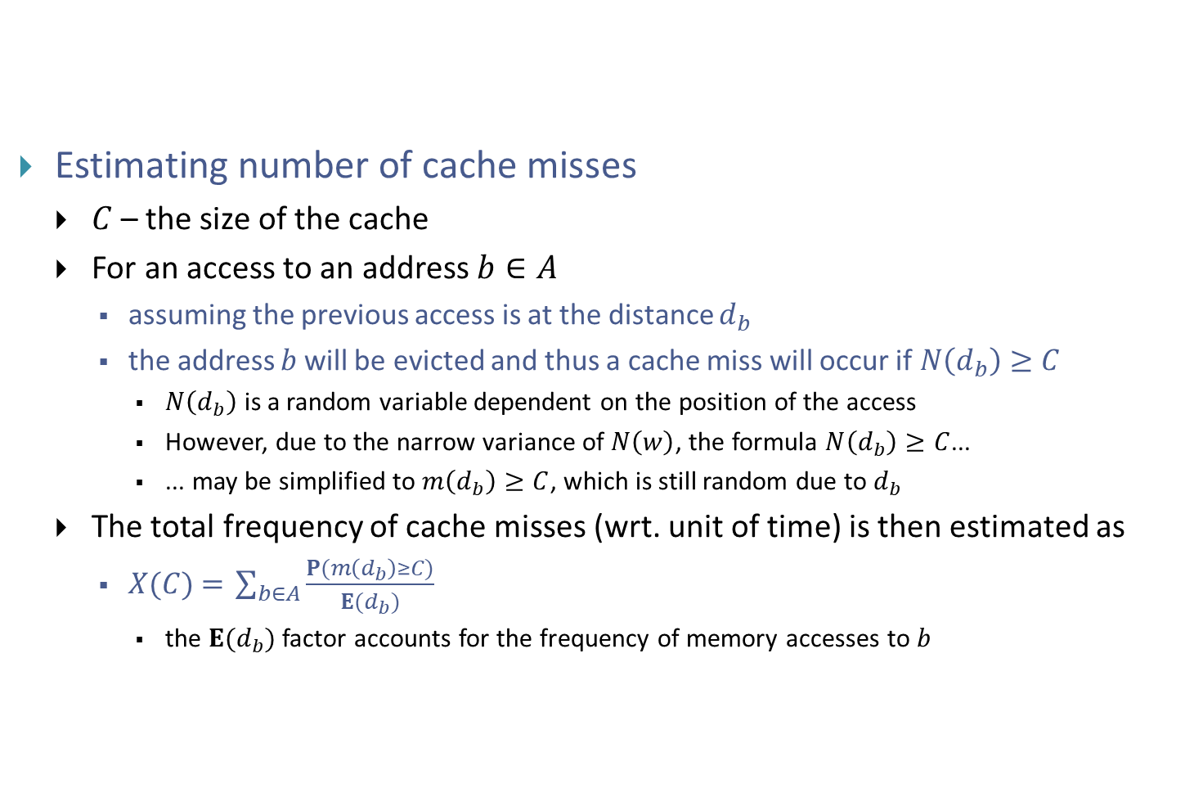
Estimating the frequency of cache misses
Estimating number of cache misses
  $C$– the size of the cache
  For an access to an address $b∈A$
    assuming the previous access is at the distance $d_{b}$
    the address $b$will be evicted and thus a cache miss will occur if$N\left(d_{b}\right)≥C$
      $N\left(d_{b}\right)$ is a random variable dependent on the position of the access
      However, due to the narrow variance of $N\left(w\right)$, the formula $N\left(d_{b}\right)≥C$...
      ... may be simplified to $m\left(d_{b}\right)≥C$, which is still random due to $d_{b}$
  The total frequency of cache misses (wrt. unit of time) is then estimated as
    $X(C) \text{=} \sum_{b∈A}{\frac{P(m\left(d_{b}\right)≥C)}{E(d_{b})}}$
      the $E(d_{b})$ factor accounts for the frequency of memory accesses to $b$

Slide 9
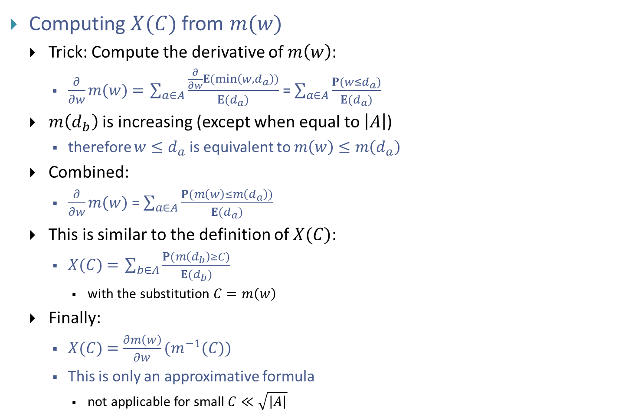
Estimating the frequency of cache misses
Computing $X(C)$from $m(w)$
  Trick: Compute the derivative of $m\left(w\right)$:
    $\frac{∂}{∂w}m(w)\text{ =} \sum_{a∈A}{\frac{\frac{∂}{∂w}E(min\left(w,d_{a}\right))}{E(d_{a})}}$ = $\sum_{a∈A}{\frac{P(w≤d_{a})}{E(d_{a})}}$
  $m\left(d_{b}\right)$ is increasing (except when equal to $\left|A\right|$)
    therefore $w≤d_{a}$ is equivalent to $m\left(w\right)≤m\left(d_{a}\right)$
  Combined:
    $\frac{∂}{∂w}m(w)$= $\sum_{a∈A}{\frac{P(m\left(w\right)≤m\left(d_{a}\right))}{E(d_{a})}}$
  This is similar to the definition of $X(C)$:
    $X(C) \text{=} \sum_{b∈A}{\frac{P(m\left(d_{b}\right)≥C)}{E(d_{b})}}$
      with the substitution $C=m\left(w\right)$
  Finally:
    $X(C) \text{=}$ $\frac{∂m\left(w\right)}{∂w}(m^{−1}(C))$
    This is only an approximative formula
      not applicable for small $C≪\sqrt{\left|A\right|}$

Slide 10
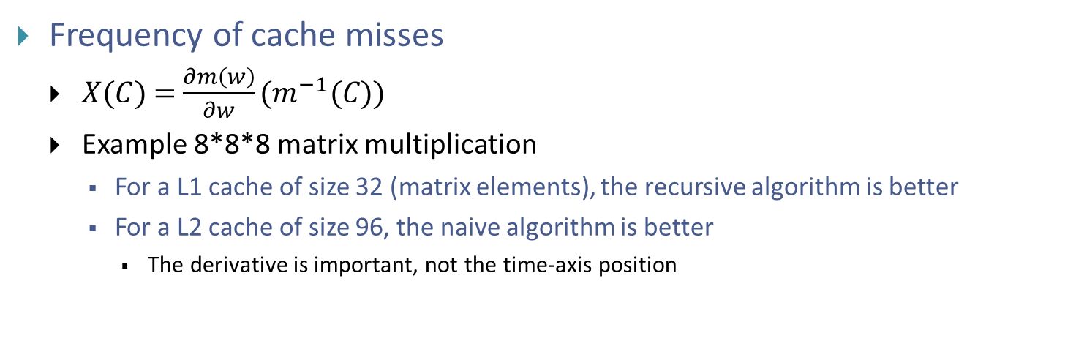
Frequency of cache misses
Frequency of cache misses
  $X(C) \text{=}$ $\frac{∂m\left(w\right)}{∂w}(m^{−1}(C))$
  Example 8*8*8 matrix multiplication
    For a L1 cache of size 32 (matrix elements), the recursive algorithm is better
    For a L2 cache of size 96, the naive algorithm is better
      The derivative is important, not the time-axis position

Slide 11
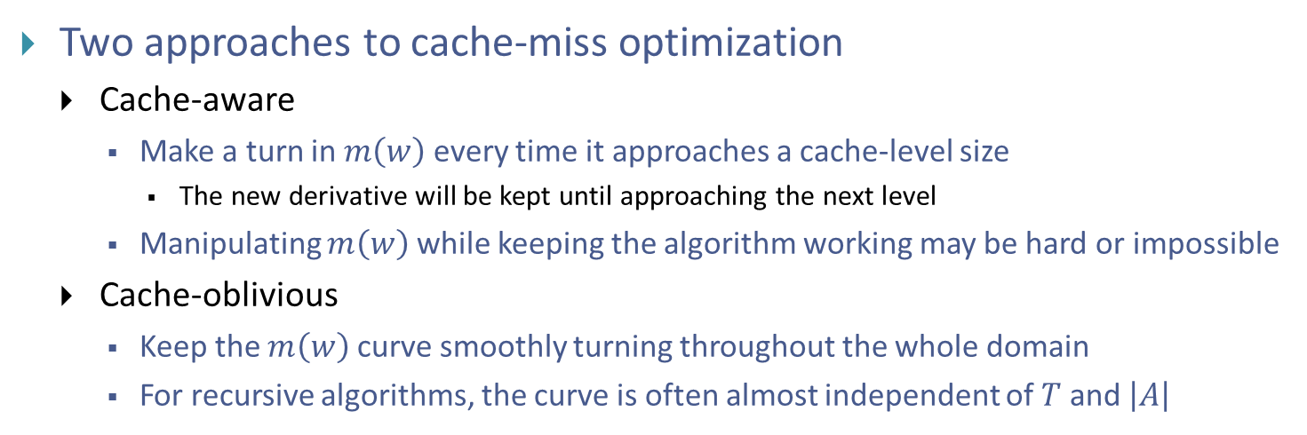
Frequency of cache misses
Two approaches to cache-miss optimization
  Cache-aware
    Make a turn in $m\left(w\right)$ every time it approaches a cache-level size
      The new derivative will be kept until approaching the next level
    Manipulating $m\left(w\right)$ while keeping the algorithm working may be hard or impossible
  Cache-oblivious
    Keep the $m\left(w\right)$ curve smoothly turning throughout the whole domain
    For recursive algorithms, the curve is often almost independent of $T$ and $\left|A\right|$

Slide 12
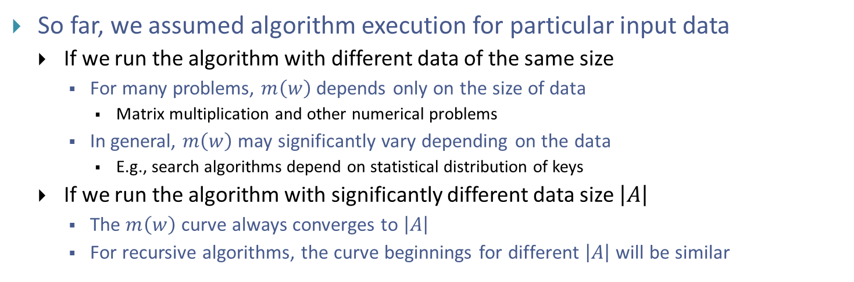
Frequency of cache misses
So far, we assumed algorithm execution for particular input data
  If we run the algorithm with different data of the same size
    For many problems, $m\left(w\right)$ depends only on the size of data
      Matrix multiplication and other numerical problems
    In general, $m\left(w\right)$ may significantly vary depending on the data
      E.g., search algorithms depend on statistical distribution of keys
  If we run the algorithm with significantly different data size $\left|A\right|$
    The $m\left(w\right)$ curve always converges to $\left|A\right|$
    For recursive algorithms, the curve beginnings for different $\left|A\right|$ will be similar

