Slide 1
C++ - parallelization and synchronization
Coroutines
Tomáš Faltín

Slide 2
References
https://www.scs.stanford.edu/~dm/blog/c++-coroutines.html
https://youtu.be/txffplpsSzg?si=HtVoibjwtu_vqAOE

Slide 3
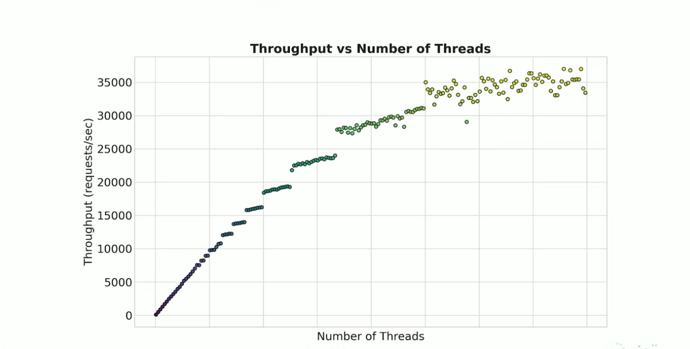
Motivation
Source: https://youtu.be/txffplpsSzg?si=HtVoibjwtu_vqAOE

Slide 4
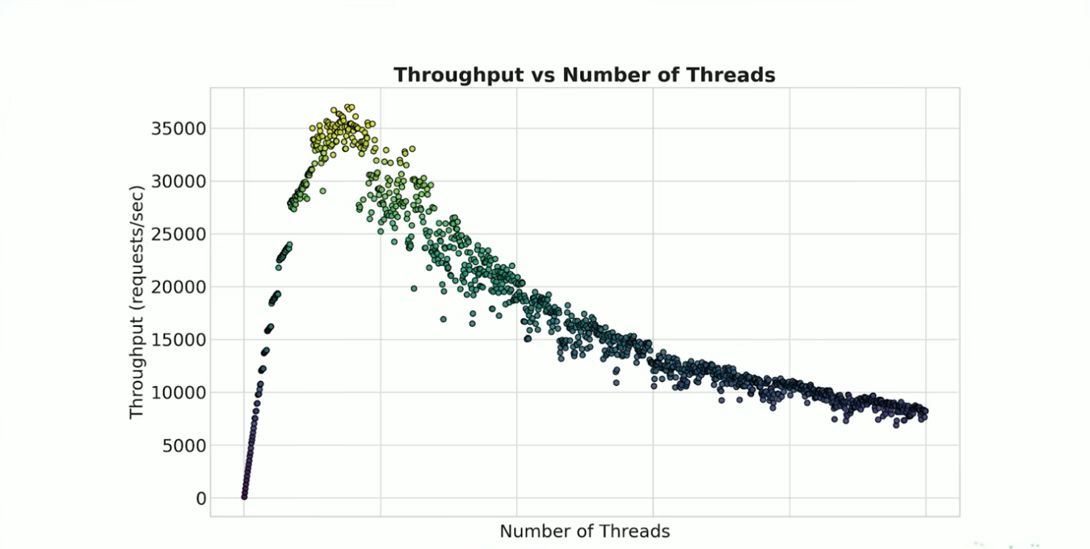
Motivation
Source: https://youtu.be/txffplpsSzg?si=HtVoibjwtu_vqAOE

Slide 5
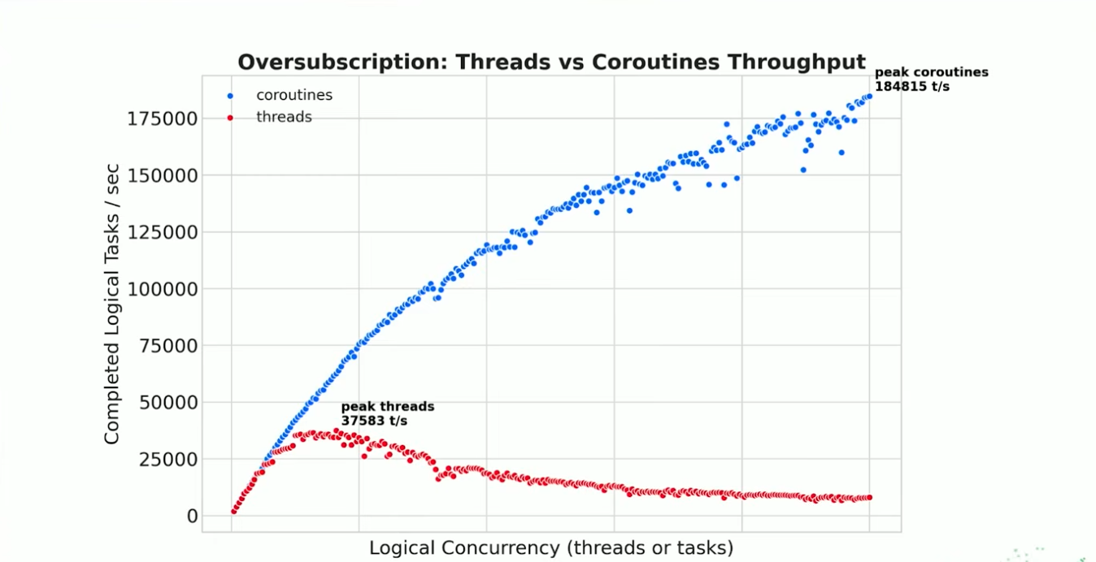
Coroutines
Source: https://youtu.be/txffplpsSzg?si=HtVoibjwtu_vqAOE

Slide 6
What are coroutines?
Like a subroutines
  Can be called
  Can return when completed
But with some differences
  Can suspend themselves
  Can be resumed (by someone else)

Slide 7
Why do we want coroutines?
Cooperative multitasking
  Cheaper context-switch compared with threads
Event driven architectures
  Asynchronous I/O
  User interfaces
  Simulations
Generators
Lazy evaluation

Slide 8
Stackful Coroutines
Stackful
  Fibers, green threads, etc.
  They have their own call stack
  Their lifetime is independent to the caller code
  Can be attached and detached to/from threads
  Cooperative scheduling
  Can be implemented as a library, no need for language support

Slide 9
Stackful coroutines
Thread stack
Fiber stack
create
AF
AF
call
AF
AF
suspend
AF
AF
resume
return
AF
AF
Notes:
AF = activation frame

Slide 10
Stackless coroutines
Stackless
  Use caller’s stack
  Can be suspended only from the top level function
    All function calls made by coroutine must return before suspend
  Coroutine state saved on the heap
  Require language level support
  Usually lighter
  C++ 20

Slide 11
Stackless coroutines
Thread stack
Heap
create
AF
call
AF
suspend
AF
call
resume
return
return
AF
call
return
AF

Slide 12
C++ Coroutines
How to detect a coroutine?
  Any use of coroutine keyword transforms a function to the coroutine
    Expressions co_await, co_yield
    Statement co_return
Restrictions
  No functions with: variadic args, returns, auto
    consteval, contexpr, ctors, dtors, …

Slide 13
co_wait – Example
task<> tcp_echo_server(){
char data[1024];
while (true){
std::size_t n =
co_await socket.async_read_some(buffer(data));
co_await async_write(socket, buffer(data, n));
}
}
Suspend execution
until resumed

Slide 14
co_yield – Example
generator<unsigned int> iota(unsigned int n = 0){
while (true)
co_yield n++;
}
Suspend execution
returning a value

Slide 15
co_return – Example
lazy<int> f(){
co_return 7;
}
Complete execution
returning a value

Slide 16
What does co_await do?
All local variables in the current function are saved to a heap allocated object
Creates a callable object that, when invoked, will resume execution of the coroutine at the point immediately following evaluation of the co_await expression
Calls (jumps to) a method of co_await’s target object a, passing that method the callable object from 2nd step

Slide 17
Coroutine Handles
Like a C pointer
Type std::coroutine_handle<>
Call coroutine_handle::destroy to avoid leaking memory, it destroys the state
Once destroyed, invoking coroutine handle has undefined behavior
Coroutine handle is valid for the entire execution of a coroutine, even as control flows in and out of the coroutine

Slide 18
co_await again
co_await a;
The compiler creates a coroutine handle and passes it to the method a.await_suspend(coroutine_handle)
The type of a must support certain methods
    Awaitable object or awaiter

Slide 19
co_await – Awaiter
(1) Is it ready already?
struct Awaiter {
std::coroutine_handle<> *hp_;
constexpr bool await_ready() const noexcept { return false; }
void await_suspend(std::coroutine_handle<> h) { *hp_ = h; }
constexpr void await_resume() const noexcept {}
};
task counter(std::coroutine_handle<> *cont_out){
Awaiter a{cont_out};
for (unsigned i = 0;; ++i) {
co_await a;
std::cout << i << std::endl;
}
};
int main(){
std::coroutine_handle<> h;
counter(&h);
for(unsingned i = 0; i < 3; ++i) { h(); }
h.destroy();
}
(2) Called right after suspend
(3) co_await expr

Slide 20
co_await internals
auto res = co_await expr;
auto &&a = expr;
if(!a.await_ready()) {
a.await_suspend(coroutine_handle);
// suspension point
}
auto res = a.await_resume();

Slide 21
Predefined awaiters
Include <coroutine>
  std::suspend_always
    await_ready returns false
  std::suspend_never
    await_ready returns true

Slide 22
Coroutine return object
Coroutine return type R must be an object with nested type R::promise_type
  Missing member function causes undefined behavior
struct task {
struct promise_type {
ReturnObject get_return_object() { return {}; }
std::suspend_never initial_suspend() { return {}; }
std::suspend_never final_suspend() { return {}; }
void unhandled_exception() {}
};
};

Slide 23
What does co_yield do?
We need to get values from coroutines somehow
co_yield e; is equivalent to
co_await p.yield_value(e); where p is a promise

Slide 24
co_yield example – 1st part
struct task {
struct promise_type {
unsigned value_;
task get_return_object() {
return {
.h_ = std::coroutine_handle<promise_type>::from_promise(*this)
};
}
std::suspend_never initial_suspend() { return {}; }
std::suspend_never final_suspend() { return {}; }
void unhandled_exception() {}
std::suspend_always yield_value(unsigned value) {
value_ = value;
return {};
}
};
std::coroutine_handle<promise_type> h_;
};

Slide 25
co_yield example – 2nd part
task counter() {
for (unsigned i = 0;; ++i)
// co yield i => co_await promise.yield_value(i)
co_yield i;
}
int main(){
auto h = counter().h_;
auto &promise = h.promise();
for (int i = 0; i < 3; ++i) {
std::cout << "counter: " << promise.value_ << std::endl;
h();
}
h.destroy();
}

Slide 26
What does co_return do?
How to signal that the coroutine is complete?
  Useful for finite streams
  Coroutine can call co_return e; for returning a final value e
    Compiler inserts p.return_value(e);
  Coroutine can call co_return; without value to end the coroutine without a final value
    Compiler inserts p.return_void();
  Coroutine execution falls off the end of the function
    Equivalent to the previous case
Check if coroutine is completed
  You can call h.done()

Slide 27
co_return example – 1st part
struct task {
struct promise_type {
unsigned value_;
~promise_type() { /* do something */ }
task get_return_object() {
return {
.h_ = std::coroutine_handle<promise_type>::from_promise(*this)
};
}
std::suspend_never initial_suspend() { return {}; }
std::suspend_always final_suspend() { return {}; }
void unhandled_exception() {}
std::suspend_always yield_value(unsigned value) {
value_ = value;
return {};
}
void return_void() {}
};
std::coroutine_handle<promise_type> h_;
};

Slide 28
co_return example – 2nd part
task counter() {
for (unsigned i = 0; i < 3; ++i)
co_yield i;
// falling off end of function or co_return;
}
int main() {
auto h = counter().h_;
auto &promise = h.promise();
// Do NOT use while(h) (which checks h non-NULL)
while (!h.done()) {
std::cout << "counter: " << promise.value_ << std::endl;
h();
}
h.destroy();
}

Slide 29
What about remaining member functions from promise?
Compiler wraps coroutine function body
{
promise-type promise promise-constructor-arguments ;
try {
co_await promise.initial_suspend() ;
function-body
} catch ( ... ) {
if (!initial-await-resume-called)
throw ;
promise.unhandled_exception() ;
}
final-suspend :
co_await promise.final_suspend() ;
}

Slide 30
Automatic clean up
Trick with p.final_suspend()
  If final_suspend suspends the coroutine, the state remains valid and code outside of the routine is responsible for freeing the object by calling destroy()
  If final_suspend does not suspend the coroutine, then the coroutine state will be automatically destroyed

Slide 31
Coroutines – Examples
struct promise;
struct coroutine : std::coroutine_handle<promise> {
using promise_type = ::promise;
};
struct promise {
coroutine get_return_object() {
return {coroutine::from_promise(*this)};
}
std::suspend_always initial_suspend() noexcept { return {}; }
std::suspend_always final_suspend() noexcept { return {}; }
void return_void() {}
void unhandled_exception() {}
};

Slide 32
Coroutines – Problems
struct S {
int i;
coroutine f(){
std::cout << i;
co_return;
}
};
void bad(){
coroutine h = S{0}.f();
h.resume();
h.destroy();
}
S{0} destroyed
Invokes std::cout << i after free
Notes:
S{} descructed

Slide 33
Coroutines – Problems
struct S {
int i;
coroutine f(){
std::cout << i;
co_return;
}
};
void bad(){
coroutine h = [i = 0]() -> coroutine {
std::cout << i;
co_return;
}();
h.resume();
h.destroy();
}
lambda destroyed
Notes:
S{} descructed

