Slide 1
C++ - parallelization and synchronization
Memory models, atomics, lock-free structures
Tomáš Faltín

Slide 2
Content
Memory models
  Memory ordering
  Fence
Atomics
Lock-free structures
  Problems

Slide 3
Memory models
What is it?
  What types of memory ordering you may expect for a given CPU or toolchain
Weak
  Really weak
    Any load and store operations can be reordered with any other load and store, as long as it would never modify the behavior of a single thread
    DEC Alpha, C++11
  Weak with data dependency ordering
    If you write A to B, then loading B is as new as A
    ARM, PowerPC, SPARC (older models), IA-64 (Itanium)
Strong
  Every instruction comes with acquire and release semantics
  When one CPU performs a sequence of writes, every other CPU sees those value change in the same order
  Usually
    In certain cases the strong ordering is lost
    x86/64, SPARC in TSO
  Sequential consistency
    No memory ordering
    No HW these days, only SW memory model (Java, C++)

Slide 4
Memory model
Demo memory model for AMD64
  Single processor
    Out-of-order R are allowed
    Speculative R are allowed
    R can be reordered ahead of W
    R cannot be reordered ahead of W if the R is from the same location as the prior W
      Stall the instruction until W completed
    Instruction fetch is parallel, asynchronous stream of R that is independent and unordered with loads from instructions
    Out-of-order W are not allowed
    Speculative W are not allowed
    Write buffering is allowed
    Write combining is allowed
Notes:
Fetch parallel ~ speculative fetch of unreachable code, self-modifying code needs fences
x86 is TSO — Total Store Order
core → store buffer → cache → memory
r1 = x;
r2 = y;
---
if (flag) {
r = x;
}
---
x = 1; // W
r = y; // R
----
x = 1;
r = x;
----
x = 1;
if (cond) {
y = 2;
}
----
x = 1;
y = 2;
---
if (flag) {
x = 1;
}
----
// Thread 0
x = 1;
r1 = y;
// Thread 1
y = 1;
r2 = x;
----
buf[0] = 1;
buf[1] = 2;
buf[2] = 3;
buf[3] = 4;

Slide 5
Memory model
Demo memory model for AMD64
  Multiprocessor
    All L, S from a single CPU appear in program order
    Successive S from a single CPU are committed to memory and visible to other CPUs in program order
    S from a CPU cannot be reordered prior L
    S can be delayed by buffering, therefore S from s CPU may not appear to be sequentially consistent
    Non-overlapping L may pass S
    Dependent S between different CPUs appear to occur in program order
    Local visibility may differ from the global visibility (data bypass)

Slide 6
Memory model - Examples
R1: All L, S from a single CPU appear in program order
  L A cannot R 0 when L B reads 1
R3: S from a CPU cannot be reordered prior L
  L A and L B cannot both read 1
R4: S can be delayed by buffering, therefore S from s CPU may not appear to be sequentially consistent
  Both L A and L B may read 1
CPU0 | CPU1
S A=1 | L B
S B=1 | L A
CPU0 | CPU 1
L A | L B
S B=1 | S A=1
CPU0 | CPU1
S A=1 | S B=1
… | …
S A=2 | S B=2
L B | L A

Slide 7
Memory model – Examples
R5: Non-overlapping L may pass S
  All combinations (00, 01, 10, 11) may be observed by both CPUs
R6: Dependent S between different CPUs appear to occur in program order
  If CPU1 reads a value from A before carrying out S B, and if CPU2 reads updated value from B, a subsequent R A must also be updated value
R7: Local visibility may differ from the global visibility (data bypass)
  L A in CPU0 can read 1 using data bypass, while L A in CPU1 can read 0, similarly for B
CPU0 | CPU1
S A=1 | S B=1
L B | L A
CPU0 | CPU1 | CPU2
S A=1
 | L A (1)
 | S B=1
 |  | L B (1)
 |  | L A (1)
CPU0 | CPU1
S A=1 | S B=1
L A | L B
L B | L A

Slide 8
Memory models
Barriers
  Acquire barrier
    All loads read after acquire will perform after it (loads do not overtake acquire)
  Release barrier
    All stores written before release are committed before the release (writes do not delay)

Slide 9
Memory model – totally weak ordering demo
RD B
L reordering
LD A
RD A
LD B
JCOND L1
RD C
Speculative R
ST X
Don’t make speculative W
LD C
L1:
ST Y
S reordering
WR Y
WR X
Delayed W

Slide 10

Memory model – barrier demo
CPU0
CPU1
RD A
ST A
BARRIER
BARRIER
LD A
WR A
WR A
ST.REL A
BARRIER
BARRIER
LD.ACQ A
RD A

Slide 11
Atomic operations
Atomic operations
  Header <atomics>
  Allows creating portable lock-free algorithms and data structures
  Memory ordering
  Fences
  Lock-free operations, algorithms, data-structures

Slide 12
Atomic operations
Memory ordering - enum memory_order;
  memory_order_seq_cst
    Sequentially consistent, most restrictive memory model
  memory_order_relaxed
    Totally relaxed memory model, allows best freedom for CPU and compiler optimizations
  memory_order_acquire, memory_order_release, memory_order_acq_rel
    Additional barriers, weaker then sequentially consistent, stronger then relaxed

Slide 13
Atomic operations
Easy way to make the demo safe
#include <atomic>
struct Counter {
std::atomic<int> value;
void increment(){ ++value; }
void decrement(){ --value; }
int get(){ return value.load(); }
};

Slide 14
Atomic operations
Template atomic
  Defined for any type
    Load, store, compare_exchange
  Specialized for bool, all integral types, and pointers
    Load, store, compare_exchange
    Arithmetic and bitwise operations
      fetch_add
  Wait, notify
    Wait on atomic value change
    Unblock waiting thread(s)

Slide 15
Atomic operations
Atomic flag
  atomic_flag allows one-bit test and set
Atomic operations for shared_ptr

Slide 16
Atomic operations
Fences
  Explicit memory barrier
  void atomic_thread_fence(memory_order order) noexcept;
    memory_order_relaxed
      No effect
    memory_order_acquire
      An acquire fence
    memory_order_release
      A release fence
    memory_order_acq_rel
      Both an acquire and a release fence
    memory_order_seq_cst
      Sequentially consistent

Slide 17
Busy Loop - Example
// Thread 1 (consumer)
while (!ready) {
// busy loop
}
std::cout << data << "\n";
// shared variables
bool ready = false;
int data = 0;
// Thread 0 (producer)
data = 42;
ready = true;
No ordering
guarantee

Slide 18
Busy Loop - Example
// Thread 1 (consumer)
while (!ready.test(
std::memory_order_relaxed)) {
// busy loop
}
std::cout << data << "\n";
// shared variables
std::atomic_flag ready = ATOMIC_FLAG_INIT;
int data = 0;
// Thread 0 (producer)
data = 42;
ready.test_and_set(
std::memory_order_relaxed);
No ordering
guarantee
Guarantees
atomicity

Slide 19
Busy Loop - Example
// shared variables
std::atomic_flag ready = ATOMIC_FLAG_INIT;
int data = 0;
// Thread 0 (producer)
data = 42;
ready.test_and_set(
std::memory_order_release);
// Thread 1 (consumer)
while (!ready.test(
std::memory_order_acquire)) {
// busy loop
}
std::cout << data << "\n";
Release-acquire
ordering
No reads or writes
reordered after this store.
No reads or writes
reordered before this load.
All writes are visible when
acquiring the same atomic

Slide 20
Busy Loop - Example
// Thread 1 (consumer)
while (!ready.test()) {
// busy loop
}
std::cout << data << "\n";
// shared variables
std::atomic_flag ready = ATOMIC_FLAG_INIT;
int data = 0;
// Thread 0 (producer)
data = 42;
ready.test_and_set();
Sequentially-consistent
ordering (default)
Loads acquire, Stores release
Single total modification order
Notes:
STO = single total order exists

Slide 21
Single Total Modification Order
- Example
// shared variables
std::atomic<int> x{0}, y{0};
void writer() {
x.store(1, std::memory_order_relaxed);
y.store(1, std::memory_order_relaxed);
}
void reader() {
int xval = x.load(std::memory_order_relaxed);
int yval = y.load(std::memory_order_relaxed);
std::print(“{} {}”, xval, yval);
}
What if we change MO
to SEQ_CST?
What are the possible
outputs for 2 readers?

Slide 22
Mutex - Example
class mutex {
std::atomic_flag m_{};
public:
void lock() noexcept {
while (m_.test_and_set(std::memory_order_acquire))
m_.wait(true, std::memory_order_relaxed);
}
bool try_lock() noexcept {
return !m_.test_and_set(std::memory_order_acquire);
}
void unlock() noexcept {
m_.clear(std::memory_order_release);
m_.notify_one();
}
};
test_and_set() + clear()
wait() + notify_one()

Slide 23
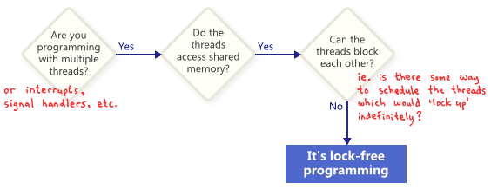
Lock-free programming

Slide 24
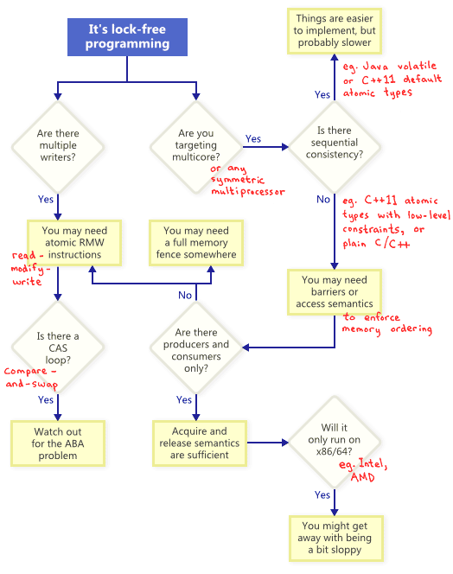
Lock-free programming

Slide 25
CAS loop - Example
for(;;) {
// read critical data to a local var
list_node *old_head = head;
// speculatively modify new data
pushed_member->next = old_head;
// CAS – attempt to write critical data
if(CAS(&head, pushed_member, old_head)==
old_head) return;
}
atomic::compare_exchange_weak
atomic::compare_exchange_strong

Slide 26
ABA problem
Problem in lock-free programming
  Compared data looks same but they are not
  Workarounds
    Tag, counter
      Use free bits, wraparound
      Large CAS
        All modern architectures have 128-bit CAS
    Intermediate nodes
      Expensive, not using pointers directly
    Deferred reclamation
A
10
B
11
C
12
Notes:
T1 →
LL: [A|10] → [B|11] → [C|12]
T1: pop A
T2: pop A, pop B, push([A|13])

Slide 28
Unused Slides

