Slide 1
Advanced Programming in Parallel Environment
Memory models, atomics, lock-free structures
Jakub Yaghob

Slide 2
Content
Memory models
Memory ordering
Fence
Atomics
Lock-free structures
Problems

Slide 3
Memory models
What is it?
What types of memory ordering you may expect for a given CPU or toolchain
Weak
Really weak
Any load and store operations can be reordered with any other load and store, as long as it would never modify the behavior of a single thread
DEC Alpha, C++ 11
Weak with data dependency ordering
If you write A to B, then loading B is as new as A
ARM, PowerPC, SPARC (older models), IA-64 (Itanium)
Strong
Every instruction comes with acquire and release semantics
When one CPU performs a sequence of writes, every other CPU sees those value change in the same order
Usually
In certain cases the strong ordering is lost
x86/64, SPARC in TSO
Sequential consistency
No memory ordering
No HW these days, only SW memory model (Java, C++)

Slide 4
Memory model
Demo memory model for AMD64
Single processor
Out-of-order R are allowed
Speculative R are allowed
R can be reordered ahead of W
R cannot be reordered ahead of W if the R is from the same location as the prior W
Stall the instruction until W completed
Instruction fetch is parallel, asynchronous stream of R that is independent and unordered with loads from instructions
Out-of-order W are not allowed
Speculative W are not allowed
Write buffering is allowed
Write combining is allowed

Slide 5
Memory model
Demo memory model for AMD64
Multiprocessor
All L, S from a single CPU appear in program order
Successive S from a single CPU are committed to memory and visible to other CPUs in program order
S from a CPU cannot be reordered prior L
S can be delayed by buffering, therefore S from s CPU may not appear to be sequentially consistent
Non-overlapping L may pass S
Dependent S between different CPUs appear to occur in program order
Local visibility may differ from the global visibility (data bypass)

Slide 6
Memory model
Examples
Rule 1
L A cannot R 0 when L B reads 1
Rule 3
L A and L B cannot both read 1
Rule 4
Both L A and L B may read 1
CPU0 | CPU1
S A=1 | L B
S B=1 | L A
CPU0 | CPU 1
L A | L B
S B=1 | S A=1
CPU0 | CPU1
S A=1 | S B=1
… | …
S A=2 | S B=2
L B | L A

Slide 7
Memory model
Examples
Rule 5
All combinations (00, 01, 10, 11) may be observed by both CPUs
Rule 6
If CPU1 reads a value from A before carrying out S B, and if CPU2 reads updated value from B, a subsequent R A must also be updated value
Rule 7
L A in CPU0 can read 1 using data bypass, while L A in CPU1 can read 0, similarly for B
CPU0 | CPU1
S A=1 | S B=1
L B | L A
CPU0 | CPU1 | CPU2
S A=1
 | L A (1)
 | S B=1
 |  | L B (1)
 |  | L A (1)
CPU0 | CPU1
S A=1 | S B=1
L A | L B
L B | L A

Slide 8
Memory models
Barriers
Acquire barrier
All loads read after acquire will perform after it (loads do not overtake acquire)
Release barrier
All stores written before release are committed before the release (writes do not delay)

Slide 9
Memory model – totally weak ordering demo
RD B
L reordering
LD A
RD A
LD B
JCOND L1
RD C
Speculative R
ST X
Don’t make speculative W
LD C
L1:
ST Y
S reordering
WR Y
WR X
Delayed W

Slide 10

Memory model – barrier demo
CPU0
CPU1
RD A
ST A
BARRIER
BARRIER
LD A
WR A
WR A
ST.REL A
BARRIER
BARRIER
LD.ACQ A
RD A

Slide 11
Atomic operations
Atomic operations
Header <atomics>
Allows creating portable lock-free algorithms and data structures
Memory ordering
Fences
Lock-free operations, algorithms, data-structures

Slide 12
Atomic operations
Memory ordering
enum memory_order;
memory_order_seq_cst
Sequentially consistent, most restrictive memory model
memory_order_relaxed
Totally relaxed memory model, allows best freedom for CPU and compiler optimizations
memory_order_acquire, memory_order_release, memory_order_acq_rel
Additional barriers, weaker then sequentially consistent, stronger then relaxed

Slide 13
Atomic operations
Easy way to make the demo safe
#include <atomic>
struct Counter {
std::atomic<int> value;
void increment(){ ++value; }
void decrement(){ --value; }
int get(){ return value.load(); }
};

Slide 14
Atomic operations
Template atomic
Defined for any type
Load, store, compare_exchange
Specialized for bool, all integral types, and pointers
Load, store, compare_exchange
Arithmetic and bitwise operations
fetch_add
Wait, notify
Wait on atomic value change
Unblock waiting thread(s)

Slide 15
Atomic operations
Atomic flag
atomic_flag allows one-bit test and set
Atomic operations for shared_ptr

Slide 16
Atomic operations
Fences
Explicit memory barrier
void atomic_thread_fence(memory_order order) noexcept;
memory_order_relaxed
No effect
memory_order_acquire
An acquire fence
memory_order_release
A release fence
memory_order_acq_rel
Both an acquire and a release fence
memory_order_seq_cst
Sequentially consistent

Slide 17
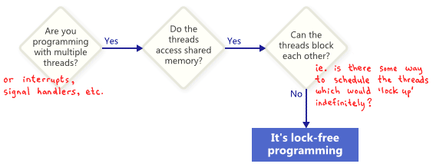
Lock-free programming

Slide 18
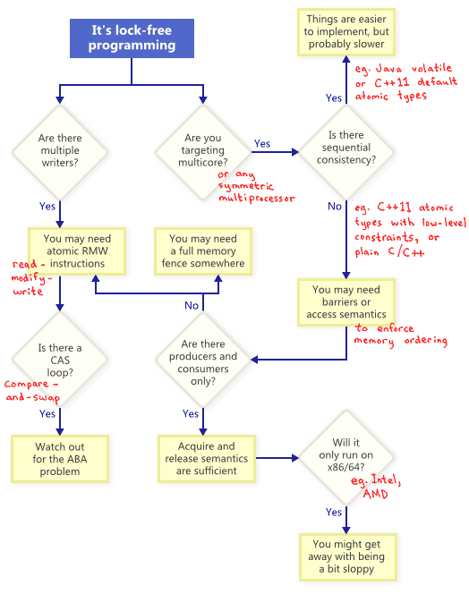
Lock-free programming

Slide 19
CAS loop
Loop example
for(;;) {
// read critical data to a local var
list_node *old_head = head;
// speculatively modify new data
pushed_member->next = old_head;
// CAS – attempt to write critical data
if(CAS(&head, pushed_member, old_head)== old_head) return;
}

Slide 20
ABA problem
Problem in lock-free programming
Compared data looks same but they are not
Workarounds
Tag, counter
Use free bits, wraparound
Large CAS
All modern architectures have 128-bit CAS
Intermediate nodes
Expensive, not using pointers directly
Deferred reclamation
Read head
head
A
B
A
C
CAS head

