Slide 1
Design patterns
Filip Zavoral (et al)
https://teaching.mff.cuni.cz/nprg024-web

Slide 2
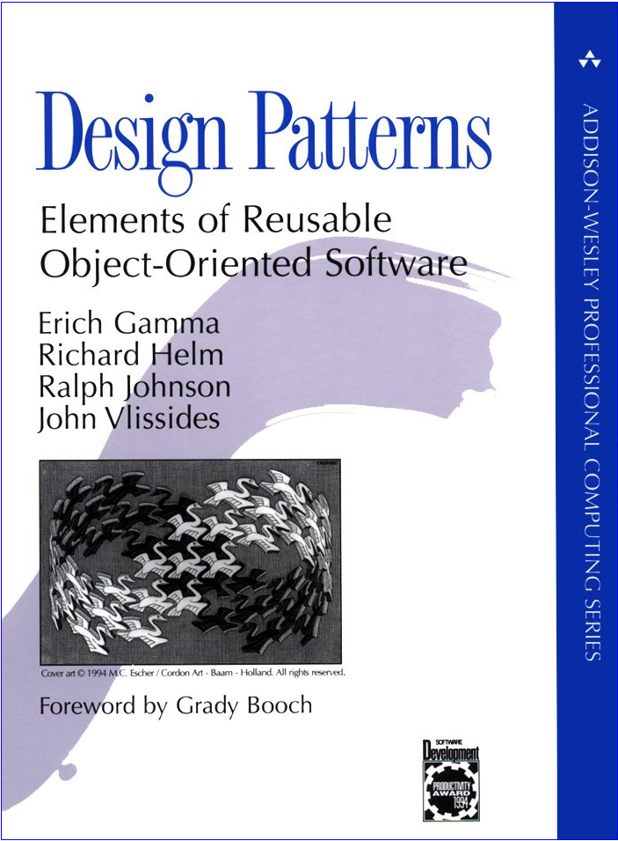

Literature
E. Gamma, R. Helm, R. Johnson, J. Vlissides The Gang of Four (GoF)
Design Patterns Elements of Reusable Object-Oriented Software 1995
Czech version – Grada 2003:
Návrh programů podle vzorů

Slide 3
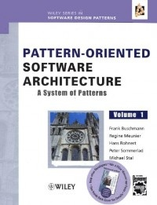
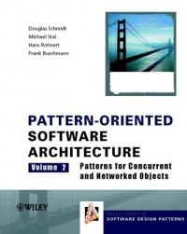

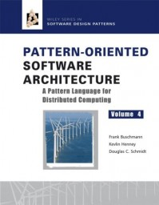

Literature
Design Patterns in C#, Java, VisualBasic, PHP, ..., ...
Pattern Oriented Software Architecture
Vol 1: A System of Patterns
Vol 2: Patterns for Concurrent and Networked Objects
Vol 3: Patterns For Resource Management
Vol 4: A Pattern Language for Distributed Computing
Vol 5: On Patterns and Pattern Languages
wikipedia / google: design patterns

Slide 4

Tasks and semester schedule
Introduction
OOP and design patterns
Requirements, slides, schedule
Summary of individual DP categories
Learn&elaborate a DP, slides
Make a presentation (why?)
Interactive feedback, evaluation
“Extension” DPs
Final “exam”
Implementation
4 pt | slide work
8 pt | presentation
2 pt | implementation
10 pt | exam
1 | 22 pt
2 | 19 pt
3 | 16 pt

Slide 5
Design patterns
OO languages give many technical means for various architectures
Inheritance, polymorphism, templates, references, overloading, ...
How do we use all of this effectively?
Goal: Improve maintainability and extensibility of the „big“ software
Interfaces! Common language with other programmers!
Looser coupling, parametrization!
inheritance × delegation × references × policies
Design patterns
A named and well-described solution for a common problem
Principles exist for a long time already
“Pattern” coined 1977 (Christopher Alexander)
We see patterns everywhere (romantic comedy, action thriller, sysiphic effort)
Software
No other area loves reinventing the wheel so often

Slide 6
Design patterns formally, with use
Design pattern is a description of communicating classes and objects
that solve a general problem in a specific context.
Relative complexity and generality
For bigger systems
These stay around for a long time, we want to avoid incomprehensible design
For new systems
For large modifications and refactors
Major components of a DP:
Name | Coining a name improves communication
Problem | Situation that the DP solves, context, requirements for use
Solution | Static structure, behavior dynamics
Relations and impact | Use, implementation strategies, working principles, alternatives
Examples | Instantiations of the abstract concept & requirements, evaluation
Related patterns | DP chains, ways to choose the right DP

Slide 7
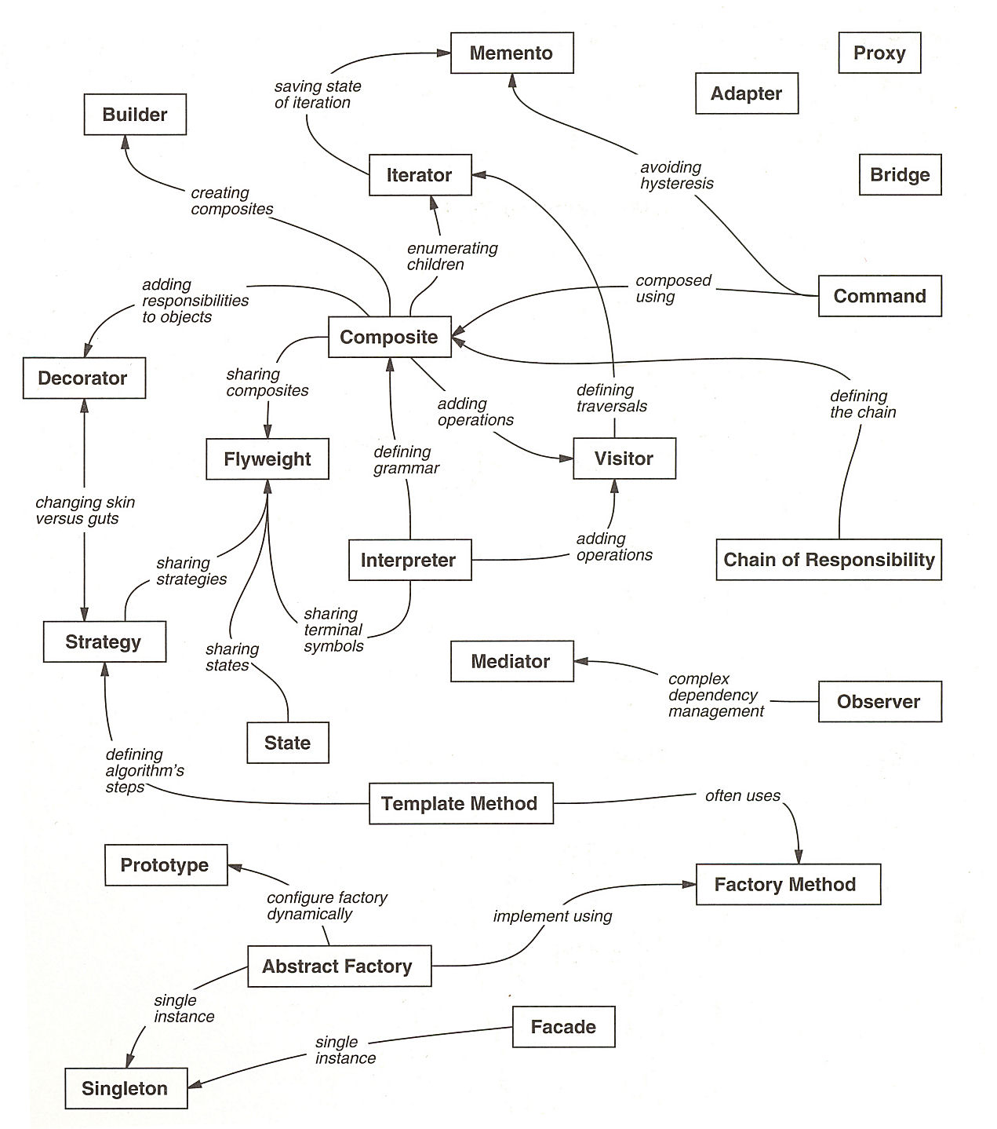
Relations among DPs

Slide 8
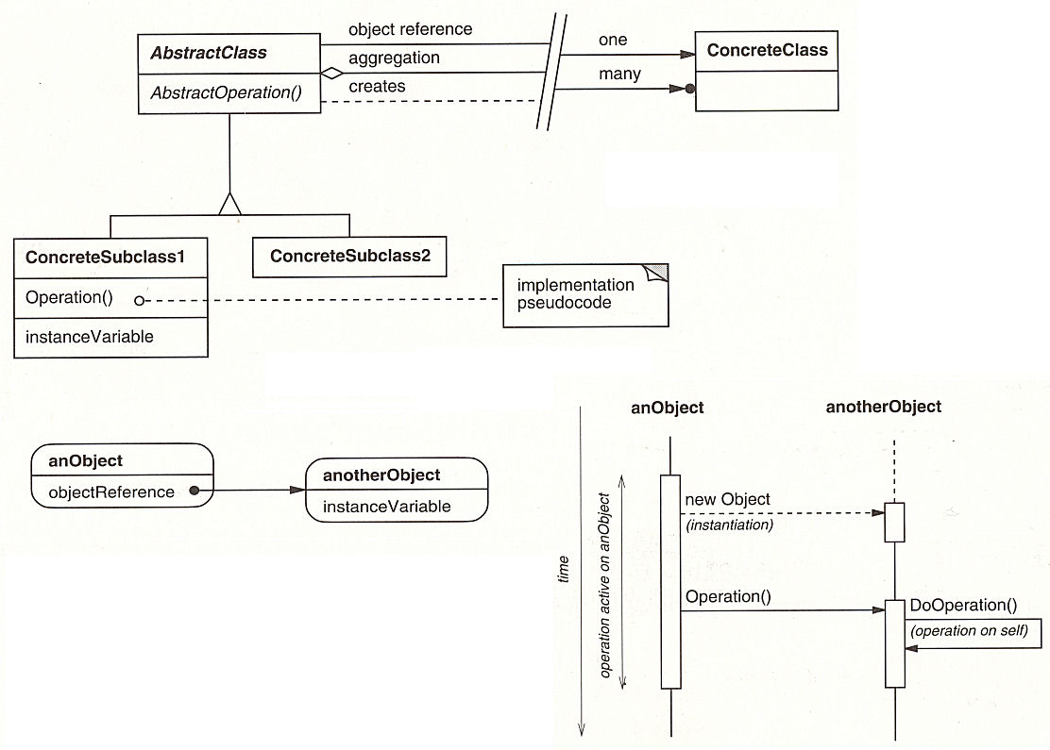
Signage (Object Modeling Techniques)
class diagrams
object diagrams
interaction diagrams

Slide 9
Basic DP categories
 | Creational Make stuff | Structural Hold stuff together | Behavioral Make stuff talk together
Class | Factory Method | Adapter | Interpreter Template Method
Object | Abstract Factory Builder Prototype Singleton | Bridge Composite Decorator Facade Proxy Flyweight | Chain of Responsibility Command Iterator Mediator Memento Observer State Strategy Visitor
Object creation
Organization of classes and objects
Interaction and behavior of objects

Slide 10
Elaboration of DP
Download the slides and materials from the last year
Slides are on the website
Some more links in SIS (!)
At first, try to understand the DP only from the slides
If you fail (which is expected), it’s not your fault :)
Slides are not textbooks
Video from the last years is probably not going to be sufficient
Study the DP
Start from GoF book (ignore Smalltalk!)
Find current, relevant, supplementary, … other information from newer materials
GoF is 30+ years old!
Find a realistic practical use-case
absolutely do not adopt the ones from GoF
Really too old, don’t.
Study the use-case in detail
where&how – examples, code fragments
Ideally show a use-case in your own project
Make (or edit) slides

Slide 11
Making suitable slides
Detail level should match the GoF explanations
Lots of sources on the internet omit important details (mainly the DP relations)
Find an actual contemporary practical use-case
Good slides
Slides are not a book - write keywords and short assertions, say the rest
Text paragraphs are forbidden, erase all text that can be erased
Do not use bright font on dark background
Eyes hurt (also applies to source code)
Do not screenshot the source code!
Pick only the relevant code, add callouts to important&named parts
Design slides that successively show/highlight/unroll what you are talking about
Language: czech or english (not slovak) in pptx (not pdf, odt, ...)
Start early!
Study and slide writing&debuggong takes a long time (> 1 week!)
Update slides
You can use last year’s slides (see website)
Update, improve, beautify, fix formatting, fix design, improve interpunction, ...
Try the rendering in actual PowerPoint (usually very different from online tools)

Slide 12
Presentations
The presentations is an actual topic talk – not a 'reference seminar'
The goal is not to 'say all the information'
...but to make sure that the audience will understand your topic
You must understand the topic in greater detail than the detail of your talk!
In case of questions, you must not: 'I’m not sure what this means', 'I don’t understand this', ...
High talk quality
Think in advance about the main message and points that you want to convey
Avoid mumbling, speaking too fast, ...
speak loudly and clearly
talk to the audience
Look at their eyes, don’t look at the slides
Avoid hands in pockets
Avoid filler words & sounds
Errrr aaaaaaaaaaaaand
So we here actually have eerrrrrrrrrrrrrrrrrrrrrr a pattern called errrrrrrr

Slide 13
Slide prep
class DrawingAPI { // Implementor
virtual drawCircle( x, y, radius) = 0;
};
class WinAPI : DrawingAPI { // Concrete Implementor
drawCircle( x, y, radius) { .... }
};
class XWinAPI : DrawingAPI .... // other Concrete Implementor
class Shape { // Abstraction
virtual draw() = 0;
virtual resize( pct) = 0;
API& api_;
};
class Circle : Shape { // Refined Abstraction
Circle( x, y, rad, API& api) : Shape(api), x_(x), y_(y), radius_(rad) {}
draw() { api->drawCircle( x_, y_, radius_); }
resize( pct) { radius_ *= pct; }
double x_, y_, radius_;
};
main() {
vector<Shape&> {
Circle{ 1, 2, 3, WinAPI()};
Circle{ 5, 7, 11, XWinAPI()};
};
for( s : Shape)
s.draw();
}
Slides
Slides help you and the audience
You can have a quick peek
...but you can’t read word by word
Audience can read
Do not read the slides for them
Do not lose them reading too much
Focus on the important parts
Skip details (audience can think!)
You do not have to read everything on slides!
...esp. if you already said it.
Always comment the meaning of code fragments (audience is not compilers)
Make sure you’re on time
Creative and structural patterns: 15-20 min
Behavioral patterns: 25 min
Rule of thumb: 1 informative slide per minute is usually way too fast
Failure to comply with rules ⇒ ☹

Slide 14
Evaluation
[4 pt] Slide preparation
Get assigned to a DP in the study group rooster in SIS
understand ( ≠ memoize!) the design pattern
Greater detail level than what you are going to present
make/update slides on time
[8 pt] Presentation
Deliver an actual good talk (not a boring slide read)
20-25 minutes at the assigned practicals
Answer the questions with certainty
Attendance at the other presentations
≥ 50%, active participation in the discussion
verbal&grade-based evaluation of others
[2 pt] Implement a design pattern
... different from the basic Singleton version :)
Any language/program that you authored is OK, in any languages
We need a real use-case -- this is not an implementation homework
[10 pt] Credit „exam“
All parts mandatory!

Slide 15
Assignment of DPs to students
Initial handshake
ASAP: Write down the intention in the group roster:
"Yes"
If you have schedule limits
"I can’t do on April 15th; Preferably earlier; Earlest from April 1st, ..."
The assigned patterns will be visible in the group roster
Bachelors: You should have your own design pattern (extension of GoF)
Upload the slides
In SIS until  Monday morning 9 AM before the day of your presentation
In case of deadline issues, let us know by e-mail in advance
Unacceptable: ’I thought I only require to present this’ 
There will be pre-presentation feedback with points to address
Fixed version: Morning 9AM before your presentation
Volunteers
4× first presentations in 2 weeks from now (easiest!)
2× solid understanding of C++ and cooperation on a topic

Slide 16
Creational patterns
Creational Patterns
Abstract away the process of creating objects
Influence of the way the objects get created, their storage and count, their contents
plain new is often undesirable (if the object type depends on many parameters)
More flexibility of what is created when by whom, how exactly, later stored where
Usual goals:
Encapsulation of usage of a class
Hiding of creation and assembly of more complex objects
Creational patterns:
Factory Method – creating class instances, instead of `new`
Abstract Factory – creates objects for a given class group, depending on situation
Builder – separates object creation (often stepwise) from representation/semantics
Prototype – allows easy re-use of well-prepared initialized instance
Singleton – ensures a single instance of a class

Slide 17
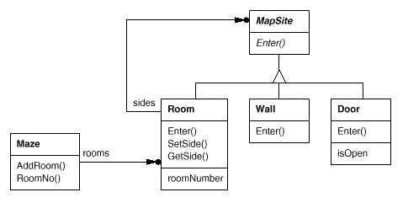
Example: maze
Unified example for creational DPs: create a maze
Rooms with neighbors
Neighbors comprise walls, doors and other rooms
components

Slide 18
Maze – initial implementation
enum Direction {North, South, East, West};
class MapSite {
public:
virtual void Enter() = 0;
};
class Room : MapSite {
public:
Room(int id);
MapSite GetSide(Direction);
void SetSide(Direction, MapSite);
virtual void Enter();
private:
MapSite sides[4];
int roomId;
};
class Wall : MapSite {
public:
Wall();
virtual void Enter();
};
class Door : MapSite {
public:
virtual void Enter();
Room OtherSideFrom(Room);
private:
Room room1;
Room room2;
bool isOpen;
};
class Maze {
public:
Maze();
void AddRoom(Room);
Room GetRoom(roomId);
private: // ...
};
Enter – neighbor is:
Room or door → pass ☺
Wall or closed door → stop ☹

Slide 19
Maze- creation
Maze MazeGame::CreateMaze () {
Maze aMaze = new Maze;
Room r1 = new Room(1);
Room r2 = new Room(2);
Door theDoor = new Door(r1, r2);
aMaze.AddRoom(r1);
aMaze.AddRoom(r2);
r1.SetSide(North, new Wall);
r1.SetSide(East, theDoor);
r1.SetSide(South, new Wall);
r1.SetSide(West, new Wall);
r2.SetSide(North, new Wall);
r2.SetSide(East, new Wall);
r2.SetSide(South, new Wall);
r2.SetSide(West, theDoor);
return aMaze;
}
Make a maze with 2 rooms
Rooms and a door in between
Room borders
Quite complex
Inflexible ‼
Change shape?
Change behavior?
DoorNeedingSpell, SpecialRoom?
Hard-coded data

Slide 20
Possible improvements
Improve the flexibility – remove explicit references to particular classes
Factory Method
CreateMaze creates contents with a virtual function instead of a destructor
child MazeGame can overload the function to create additional class instances
Abstract Factory
CreateMaze gets a parameter object for creating components
Supplying a different object can change behavior
Builder
CreateMaze gets a parameter object with operations that add components
Created parts & creation method can be changed via inheritance
Prototype
CreateMaze gets prototypes of objects that can be cloned
Supplying changed (inherited) objects changes the whole maze
Singleton
Ensures a single instance that can be reached without storing explicit global data

Slide 21
Creational DPs - summary
Singleton
Easy to use ...
If you don’t have to solve dependencies, locks, initialization & destruction order, ...
Many variants for inter-dependent objects
Quite complex, usually not recommended
Factory Method
flexibility for a relatively small price
Usually a virtual method or virtual constructor
Abstract Factory, Builder, Prototype
More complex and more flexible
Use only if required
Abstract Factory
More consistent objects, more classes, store some state (allocator)
Builder
Iterative creation, isolation from internal representation
Prototype
New objects are created by copying, nice for complex defaults

Slide 22
Creational DPs - comparison
aaa
Maze* CreateMaze() {
Maze* aMaze = MakeMaze();
Room* r1 = MakeRoom(1);
Room* r2 = MakeRoom(2);
Door* theDoor = MakeDoor(r1, r2);
Maze* CreateMaze( MazeFactory& f) {
Maze* aMaze = f.MakeMaze();
Room* r1 = f.MakeRoom(1);
Room* r2 = f.MakeRoom(2);
Door* door = f.MakeDoor(r1,r2);
Maze* CreateMaze( MazeBuilder& builder) {
return builder.BuildMaze()
.BuildRoom(1)
.BuildRoom(2)
.BuildDoor(1, 2)
.GetMaze();
Factory Method
Abstract Factory
Wall* MazeProtoFactory::MakeWall() {
return protoWall->Clone();
}
Door* MazeProtoFactory::MakeDoor( Room* r1, Room *r2) {
Door* door = protoDoor->Clone();
door->Initialize(r1, r2);
return door;
}
MazeProtoFactory pf { aMaze, aWall, aRoom, aDoor);
Builder
Prototype

Slide 23
Structural DPs
Ways of composing the classes and objects into larger structures
Adapter
Adapts an interface to a different one
Bridge
Materialized separation of the abstraction from the implementation
Prevents explosive spread of various adapter classes
Facade
Defines a common interface for a whole subsystem
Proxy
A smarter way to reach some object (reference); usually with access controls
Decorator
Adds new properties to an object
runtime, transparent – the decoratee doesn’t need to know
Composite
A hierarchy made of primitive and compound objects
Unified (or correctly orchestrated) operations on all objects
Flyweight
Support for managing large amounts of simple objects

Slide 24
Behavioral DPs
Behavioral design patterns
Separation of functionality and responsibility among objects
Communication between objects
Complex structure of code execution
Abstraction of run-time technical details
Behavioral class patterns
Use of inheritance to separate behavior between classes
Template method
Abstract definition of algorithm by steps
Interpreter
Representation of a grammar as a class hierarchy
Behavioral object patterns
Cooperation among groups of objects to reach functionality goals

Slide 25
Behavioral DPs: objects
Behavioral object patterns
Object composition instead of inheritance
Mediator
Consolidates the reference network into a single object
Chain of Responsibility
Sending of messages via a chain of objects, each responsible only for some property
Observer
Defines dependencies on more objects, spreads events to other objects
Encapsulation of object behavior, access control
Strategy
Object describes an algorithm, it can be easily swapped
Command
Object describes a request for a functionality, separates the request from actual call
State
Object describes a state of some structure; centralizes the storage and management
Visitor
Encapsulates behavior that would otherwise be implemented in multiple classes
Memento
Abstracts ways to reach recoverable state
Iterator
Abstracts methods to successively access a group of objects

Slide 26
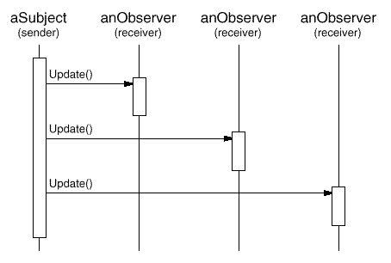
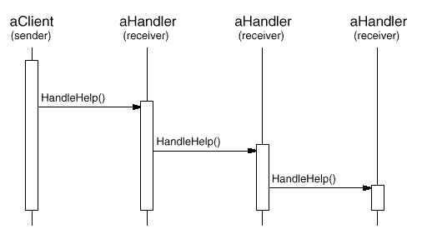
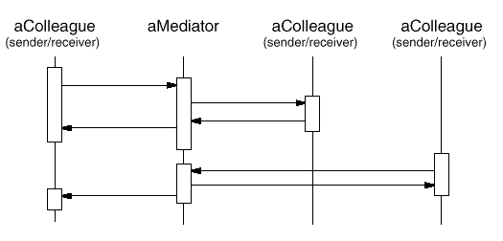
Relations of message senders and receivers
Observer
(unknown receiver no.)
Mediator
Centralizes the communication at a point
Chain of Responsibility
Unknown structure of receivers (even at call)

Slide 27
Conclusion
In summary
'not a rocket science'
... for some.
dictionary!
No wheel reinvention
... and 'no errors'
Composition of DPs
Many more DPs out there!
Often targeted to specific goals

Slide 28
Pattern Oriented Software Architecture
Vol. 1 - A System of Patterns
2. Architectural Patterns
2.2 From Mud to Structure
Layers, Pipes and Filters, Blackboard
2.3 Distributed Systems
Broker
2.4 Interactive Systems
Model-View-Controller, PAC
2.5 Adaptable Systems
Microkernel, Reflection
3. Design Patterns
3.2 Structural Decomposition
Whole-Part
3.3 Organization of Work
Master-Slave
3.4 Access Control
Proxy
3.5 Management
Command Processor, View Handler
3.6 Communication
Forwarder-Receiver, Client-Dispatcher-Server
Publisher-Subscriber
Vol. 2 - Patterns for Concurrent and Networked Objects
2. Service Access and Configuration Patterns
Wrapper Facade
Component Configurator
Interceptor
Extension Interface
3. Event Handling Patterns
Reactor, Proactor
Asynchronous Completion Token
Acceptor-Connector
4. Synchronization Patterns
Scoped Locking
Strategized Locking
Thread-Safe Interface
5. Concurrency Patterns
Active / Monitor Object
Half-Sync/Half-Async
Leader/Followers
Thread-Specific Storage
Vol. 3 - Patterns for Resource Management
Lookup
Lazy / Eager / Partial Acquisition
Caching / Pooling
Coordinator
Leasing / Evictor

