Slide 1
Controlled Vocabularies
NDBI046 - Introduction to Data Engineering
2025/2026
Petr Škoda
https://github.com/skodapetr
https://www.ksi.mff.cuni.cz

Slide 2
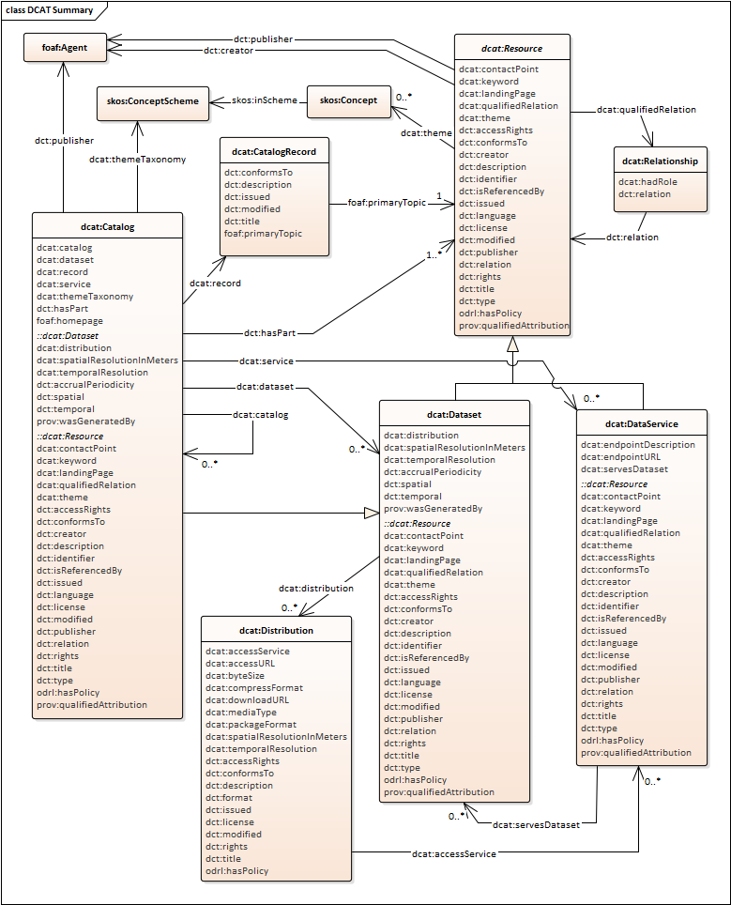
Domain metadata
Domain metadata describe the meaning (semantics) of the dataset.
Relevant properties in DCAT:
title (dct:title)
description (dct:description)
keywords
themes
temporal resolution
spatial resolution
...

Slide 3

Title, description, and keywords ...
Titles and descriptions are unstructured textual characterizations of the meaning. E.g.
"Bus stops positions"
"Positioning data about all bus stops in the Gotham city."
Keywords are free textual characterizations of the meaning structured to phrases.
...
bus stops
Metropolis
public transport
Gotham
JSON
bus stop
position
buses
stations
map
vehicle traffic information system

Slide 4
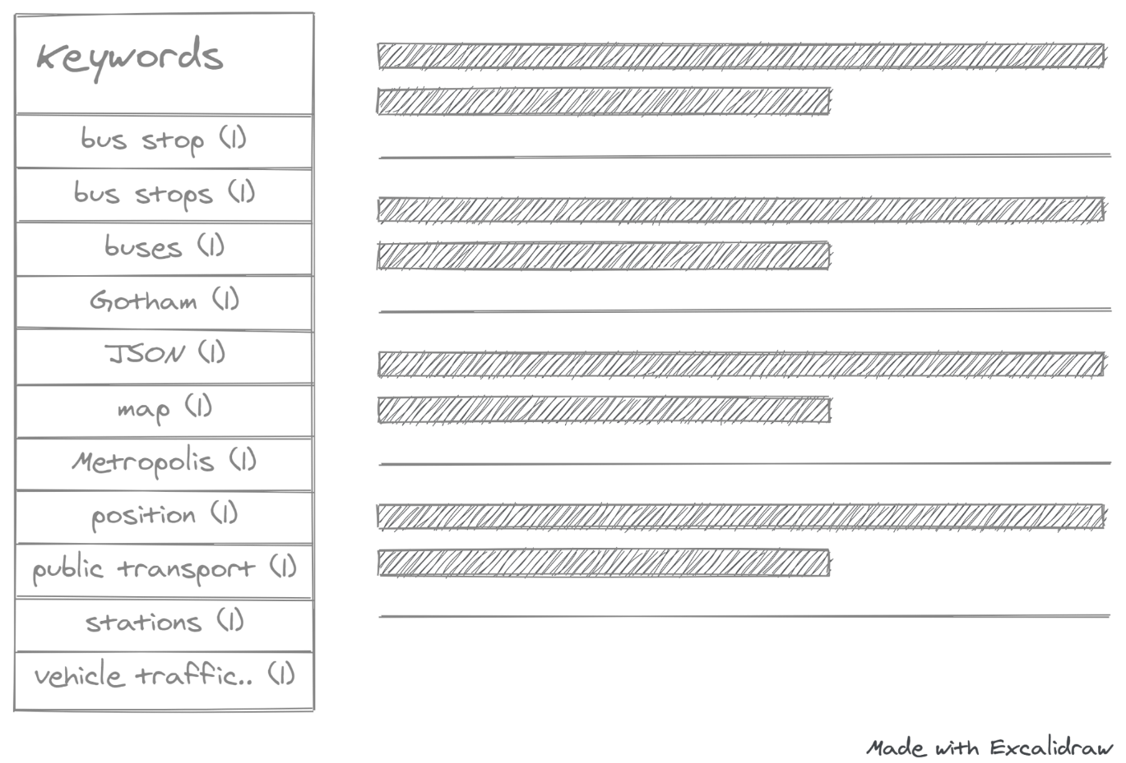
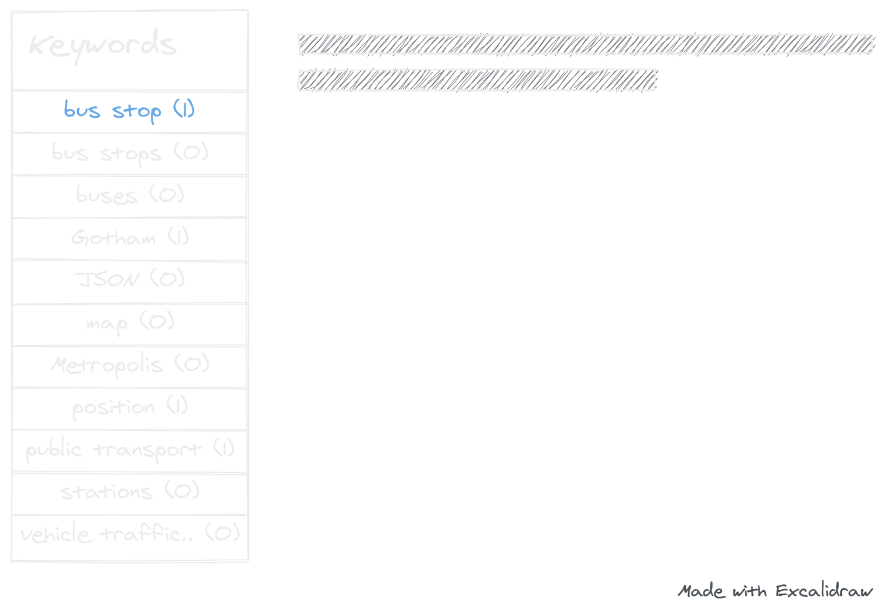
Working with keywords

Slide 5
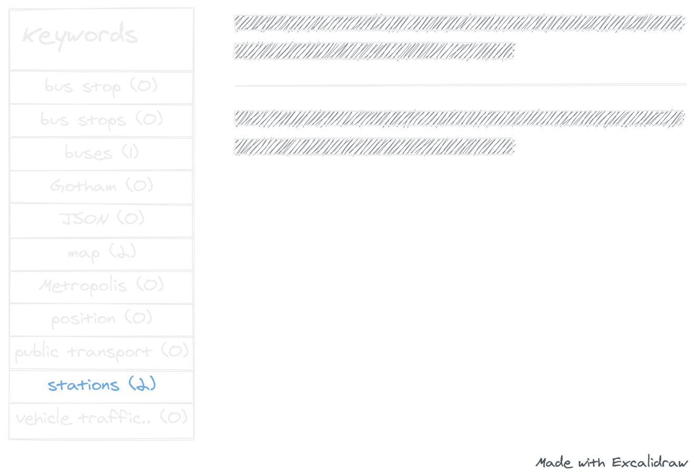
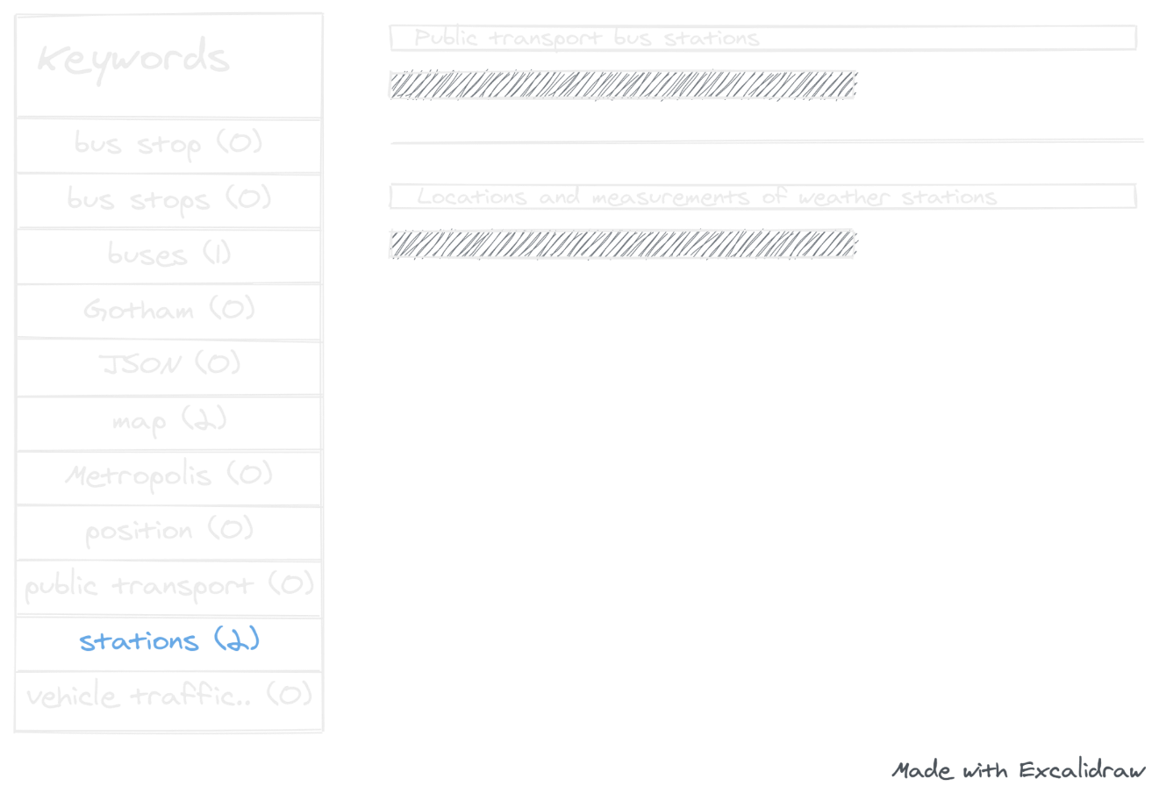
Problems with keywords 1 / 3
Different people choose different keywords for the same meaning.

Slide 6


Problems with keywords 2 / 3
Keywords are only words which need to be translated to other languages.
🤔
😀

Slide 7
Problems with keywords 3 / 3
People tend to characterize not only the meaning e.g., technical formats, data source, etc.
Different people tend to choose keywords at different levels of detail
Keywords are isolated islands with only implicit semantics.

Slide 8
Keywords
Freedom
How much freedom do you have when selecting elements suitable for describing the semantics?
Expressiveness
How well is the machine able to process the semantics expressed by the selected elements?

Slide 9
Themes
Connected to the dataset using dcat:theme predicate. Themes are concepts from a given controlled vocabulary which characterize the meaning.
Controlled vocabularies are standardized and organized arrangements of words and phrases with defined meaning (semantics).
Freedom
Expressiveness

Slide 10
Keywords vs Themes
public transport
Gotham
buses
stations
bus stop
position
map
public transport
bus stop
positions

Slide 11

Controlled vocabularies 1 / 2
Controlled vocabularies
Concept
Term
Instance of
public transport
public transport
bus stop
bus stop
DC Comics Vocabulary
autobusová zastávka
positions
Termpositions

Slide 12
Controlled vocabularies 1 / 2
synonym
preferred term
Controlled vocabularies
Concept
Term
alternative term
Instance of
preferred term
DC Comics Vocabulary
bus stop
bus stop
synonym
bus station
alternative term

Slide 13

Concept 1 / 4
Notation
Concept
Definition
bus
coach
Bus
bus
Notation: C001
Definition: A large motor vehicle carrying passengers by road, typically one serving the public on a fixed route and for a fare.
autobus
autokar

Slide 14
Concept 2 / 4
broader
broader concept
public transport
Concept
bus stop
vehicle
related concept
related
bus
tram
priority seat
city
Gotham
Metropolis

Slide 15
Concept 3 / 4
semantic relation
related
broader transitive
narrower transitive
casual
sequential
disjoint
broader
narrower
causes
precedes
previous
caused by
specializes
is part of
generalizes
has part
succeeds
next
instantiates
has instance
before
temporal
after

Slide 16
Concept 4 / 4
public transport
broader transitive
bus stop
related
bus line
vehicle
is part of
specializes
bus
starting bus stop
related
specializes
tram
precedes
is part of
priority seat
next bus stop
city
follows
Gotham
final bus stop
instantiates
Metropolis

Slide 17
Controlled Vocabulary
Controlled List
Taxonomy
Thesaurus
Classification
Scheme
Ontology

Slide 18
Controlled List 1 / 2
A controlled list is a simple list of concepts without any relations between the concepts. In a controlled list:
Each concept is unique.
Each concept has typically only one term or more terms which are only equivalents in different languages.
Concepts do not overlap in their meaning.
Controlled vocabularies
Concept
1..1
Term

Slide 19
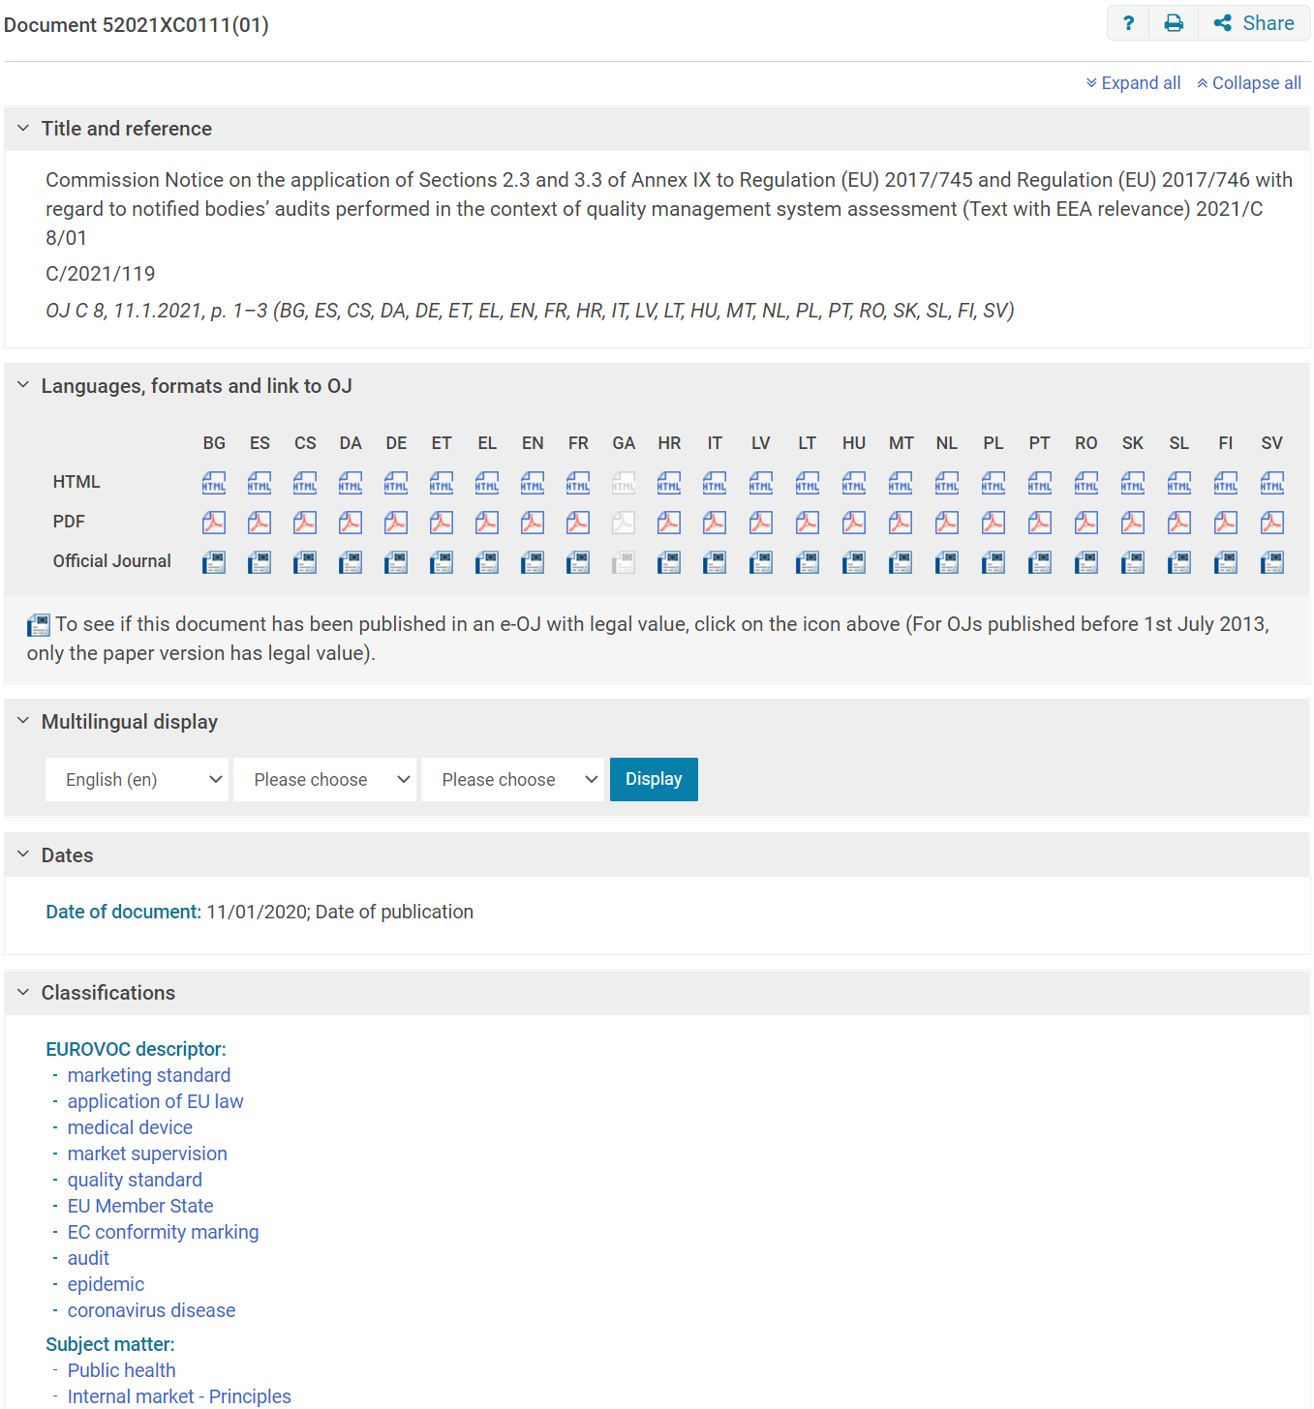
Controlled List 2 / 2
For example, Subject matter authority table. It defines concepts used for the indexation of notices published on EUR-Lex - EU portal providing access to European Union Law. Each concept represents a subject matter which can be used to characterize a notice.
Notes:
Resources:
https://op.europa.eu/en/web/eu-vocabularies/dataset/-/resource?uri=http://publications.europa.eu/resource/dataset/subject-matter

Slide 20
Taxonomy 1 / 2
A taxonomy is a controlled vocabulary which organizes concepts into a hierarchical structure. In a taxonomy:
Each concept is unique.
Each concept has typically only one term or more terms which are only equivalents in different languages.
Concepts may overlap in their meaning.
Hierarchical relationships may be of different types:
broader/narrower, parent/child, whole/part, generic/specific, instance of/instantiates
Controlled vocabularies
Concept
1..1
Term
semantic relation

Slide 21
Taxonomy 2 / 2
For example, The National Center for Biotechnology Information (NCBI) Taxonomy, Common Procurement Vocabulary (CPV). It is a scientific classification of animals and plants. It defines concepts representing classes of animals and plants with specializes hierarchical relationships.
Another example is Common Procurement Vocabulary (CPV). It is a taxonomy of public procurement aimed at standardizing the references used by contracting authorities and entities to describe the subject of procurement contracts.
Mammalia
specializes
Prototheria
specializes
Monotremata
specializes
Theria
specializes
Eutheria
specializes
Metatheria
Notes:
Resources:
https://www.ncbi.nlm.nih.gov/Taxonomy/Browser/wwwtax.cgi
https://op.europa.eu/en/web/eu-vocabularies/dataset/-/resource?uri=http://publications.europa.eu/resource/dataset/cpv

Slide 22
Thesaurus 1 / 2
A thesaurus is a controlled vocabulary which defines preferred and alternative (synonymous) terms and which interlinks concepts with hierarchical broader/narrower relationships and non-hierarchical associative relationships. In a thesaurus:
Each concept is unique.
Each concept has typically a preferred term and one or more alternative terms, each in different languages.
Concepts may overlap in their meaning.
Concept related with hierarchical broader/narrower relationships, non-hierarchical associative relationships.
Controlled vocabularies
Concept
1..1
Term
broader
narrower
related

Slide 23
Thesaurus 2 / 2
For example, EuroVoc. It is a multilingual, multidisciplinary thesaurus covering the activities of the EU used for indexing (legal) documents. Its users include the European Union Institutions, the Publications Office of the EU, national and regional parliaments in Europe, national governments and private users around the world.

Slide 24
Classification Scheme 1 / 2
A classification scheme is a controlled vocabulary which defines concepts for an arrangement of division of objects into groups based on characteristics, which the objects have in common. A classification scheme:
It is similar to taxonomy.
It is used for classification of statistical observations, e.g. number of employees per economic activity.
It is structured to classification levels where hierarchical relationships are only between concepts from two adjacent levels.
Classification Level
Controlled vocabularies
Concept
1..1
Term
semantic relation

Slide 25
Classification Scheme 2 / 2
For example, Statistical Classification of Economic Activities in the European Community (NACE). It is classification of economic activities in the European Union. It is a framework for collecting and presenting a large range of statistical data according to economic activity in the fields of economic statistics, e.g. production, employment and national accounts.
Level 1
Level 2
Level 3
Level 4
A. Agriculture, forestry and fishing
01 Crop and animal production, hunting and related service activities
01.1 Growing of non-perennial crops
01.11 Growing of cereals (except rice), leguminous crops and oil seeds

Slide 26

Representation
Controlled List, Taxonomy, Thesaurus, Classification Scheme, ...

Slide 27
SKOS: Simple Knowledge Organization System
It is a W3C Recommendation from 18 August 2009. It provides a model for expressing the basic structure and content of controlled vocabularies. A good place to start is SKOS primer, there is also SKOS reference.
SKOS representation is intended for sharing and reusing controlled vocabularies by expressing them in the RDF data model and publishing them on the World Wide Web.

Slide 28
SKOS 1 / 3
Preferred lexical label of a concept.
Concept
prefLabel
altLabel
hiddenLabel
Alternative lexical label of a concept.
Useful to represent synonyms or other labels beyond the preferred one.
Units of thoughts (ideas, meanings, objects, events and their categories). Exist in the mind as abstract entities which are independent of the terms used to label them.
Lexical label of a concept accessible to applications performing text-based indexing and search but not visible to humans. E.g., misspelled variants of the other labels.

Slide 29
SKOS 2 / 3
hasTopConcept
A concept scheme refers to its root concepts.
0 ..*
0 ..*
Concept Scheme
0 ..*
inScheme
0 ..*
Concept
The meaning of a concept is not defined just by labels but also by links to other concepts in the vocabulary.
prefLabel
altLabel
hiddenLabel
0 ..*
A concept refers to a concept scheme it belongs to. A concept can belong to zero or more concept schemes .
0 ..*
semantic relation
broader
narrower
related
Controlled vocabularies are represented as concept schemes. Concept schemes are also called knowledge organization systems.
Enables the representation of hierarchical links from a lower to higher (or more abstract) concept. E.g. part/whole, specific/generic, instance of.
The same as broader but in the reversed direction.
Enables to represent associative relationships.

Slide 30
SKOS 3 / 3
Some information, possibly partial, about the intended meaning of a concept. Usually explains how to use the concept.
Concept
Property for general documentation purposes.
scopeNote
A complete explanation of the intended meaning of a concept.
prefLabel
altLabel
hiddenLabel
note
notation
definition
Primary means of access to a concept.
It is a unique identifier of a concept within a controlled vocabulary
independent of term labels in natural language. It is often composed of digits complemented with punctuation and digits
Provides an example of the use of a concept.
example
historyNote
Describes significant changes to the meaning of a concept.

Slide 31
Using SKOS
How to express controlled vocabulary in SKOS?

Slide 32
Using SKOS 1 / 3
information processing
broader
artificial intelligence
broader
artificial neural network
broader
machine learning
related
broader
artificial intelligence
natural and applied sciences
broader
applied sciences
broader
cybernetics

Slide 33
Using SKOS 2 / 3
information processing
broader
artificial intelligence
http://eurovoc.europa.eu/4486
broader
http://eurovoc.europa.eu/3030
http://eurovoc.europa.eu/3030
broader
http://eurovoc.europa.eu/4486
@prefix skos: <http://www.w3.org/2004/02/skos/core#> .
<http://eurovoc.europa.eu/3030>
skos:broader
<http://eurovoc.europa.eu/4486>

Slide 34
Using SKOS 3 / 3
skos:hasTopConcept
0 ..*
0 ..*
skos:ConceptScheme
0 ..*
skos:inScheme
0 ..*
skos:Concept
skos:prefLabel
skos:altLabel
skos:hiddenLabel
skos:note
skos:scopeNote
skos:definition
skos:example
skos:historyNote
skos:notation
skos:semanticRelation
skos:broader
skos:narrower
skos:related

Slide 35
Using controller vocabularies 1 / 3
A resource (data set) can be linked to concepts from one or more controlled vocabularies to specify that the resource is about these concepts.
<https://data.gotham-city.fiction/resource/dataset/bus-lines> a dcat:Dataset ;
dct:title "Bus lines"@en ;
dct:description "Positioning and time data about all bus lines in the Gotham city."@en ;
dcat:keyword "bus line"@en, "timetable"@en, "public transport"@en ;
dcat:theme <http://eurovoc.europa.eu/4197> ;
...
gotham:bus-lines
dcat:theme
eurovoc:4197
skos:broader
eurovoc:2233
skos:prefLabel
"bus"@en
"vehicle fleet"@en
"autobus"@cs
skos:altLabel
"motor coach"@en
"autokar"@cs

Slide 36
Using controller vocabularies 2 / 3
gotham:bus-lines
dcat:theme
eurovoc:4197
skos:broader
eurovoc:2233
"bus"@en
"vehicle fleet"@en
metropolis:pubtrans
skos:related
gotham:stations
eurovoc:7359
eurovoc:847
"bus station"@en
"community facilities"@en
gotham:parking-lots
eurovoc:5429
⛔
"parking area"@en
metropolis:stations
eurovoc:5350
eurovoc:...
"nuclear power station"@en

Slide 37
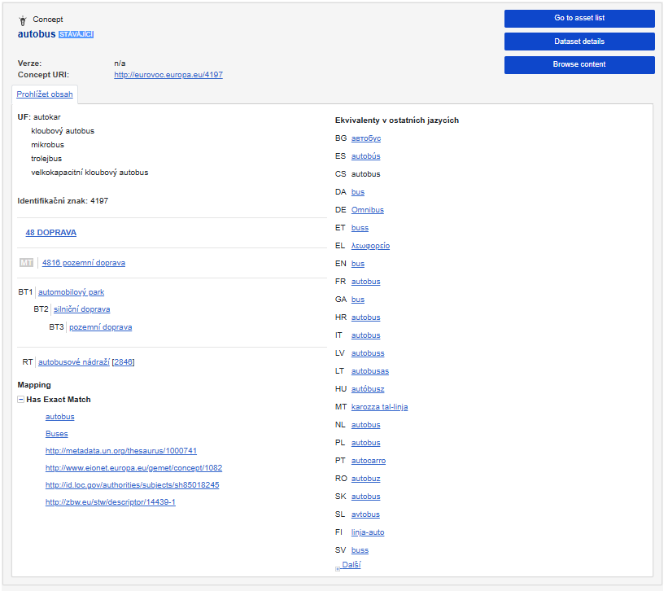
Using controller vocabularies 3 / 3
Specifics of controlled vocabularies expressed as SKOS concept schemes and published on the World Wide Web as a set of RDF triples (statements). As a result, anyone can reuse a concept in any controlled vocabulary or add a concept to a controlled vocabulary published by someone else.
SKOS concept schemes are based on the open world assumption, i.e. you never have a complete information. That is why, missing statement does not mean that it does not exist, you only do not know about it.
Do not forget that different concepts from different concept schemes can be linked on each other to interlink / integrate different concept schemes.

Slide 38
Using SKOS semantic relation
skos:semanticRelation
mapping relation
skos:broader
skos:narrower
skos:related
close match
broad match
narrow match
related match
exact match

