Slide 1
Data catalogs
NDBI046 - Introduction to Data Engineering
2025/2026
Petr Škoda
https://github.com/skodapetr
https://www.ksi.mff.cuni.cz

Slide 2
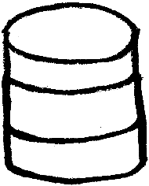

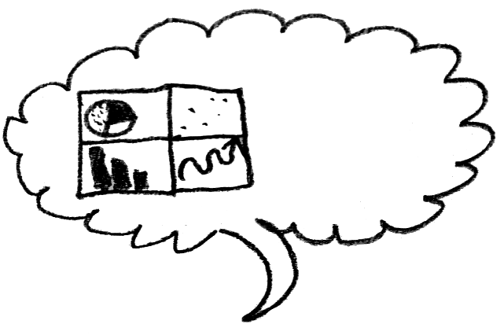
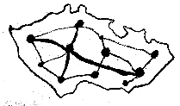
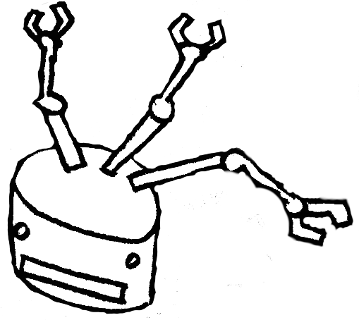




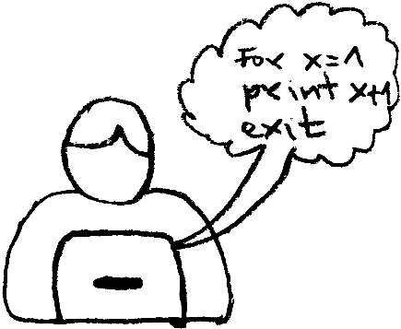
Data engineer in action ...

Slide 3


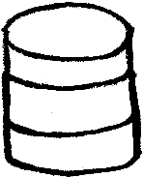
The dependency hell ?
Hairball architecture

Slide 4


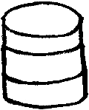
A data Warehouse
as a new data silo?
"A use-case oriented data model, ETL processes extracting data from local sources and loading them to the central warehouse."
ETL

Slide 5
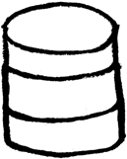
Questions ...
Where we have our data?
What is our data about?
Why is responsible for our data?
How was our data created and how it evolved in time?
How are different data related?
How should we work with our data?

Slide 6
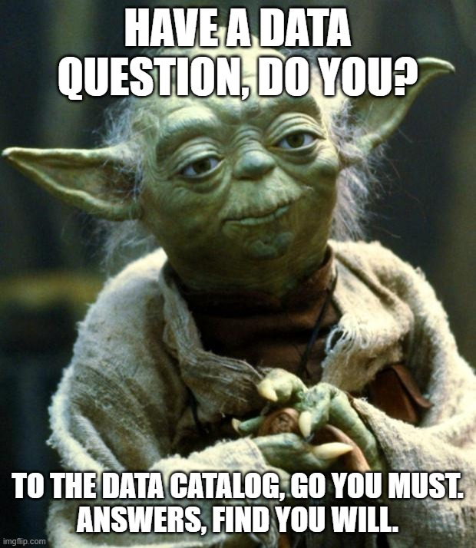
Data catalog
To answer these questions,
you need ...
Notes:
Resources:
https://imgflip.com/memegenerator/Star-Wars-Yoda

Slide 7
Dataset, data source, and a data catalog
"A dataset is a collection of data, published or curated by a single data source, and available for access or download in one or more formats." -- W3C
A data source is a system which maintains data and enables data consumers to access or download the data.
A data catalog is a metadata management tool a company uses to organize its datasets.

Slide 8
Data Catalog
"A data catalog maintains an inventory of data assets through the discovery, description, and organization of datasets. The catalog provides context to enable data analysts, data scientists, data stewards, and other data consumers to find and understand a relevant dataset for the purpose of extracting business value." -- Gartner

Slide 9
Metadata
Metadata is data about data. It describes data assets in a way which makes it easier to locate, understand and use.

Slide 10
Once upon a time ...
Title Bus stop positions
Creator Frodo Baggins
Date 2026-04-13
Bus stop name | Latitude | Longitude
Coldest | -70.73223989321107 | -6.075669999923847
Southwest | -71.42571684411188 | -6.243512854951811
Data Catalog
Metadata
Datasets
Data source

Slide 11
Types of Metadata
Technical metadata
Structural metadata
Provenance metadata
Domain metadata
Business metadata
Technical metadata describe how a dataset can be accessed. This includes where, how and in which formats the dataset is available.
Structural metadata describe data structures in which the dataset is available.
Provenance metadata concern the origin, creation, attribution and version history of the dataset.
Domain metadata describe the meaning (semantics) of the dataset.
Business metadata describe the intended means of using the dataset or warnings of how the dataset should not be used.

Slide 12
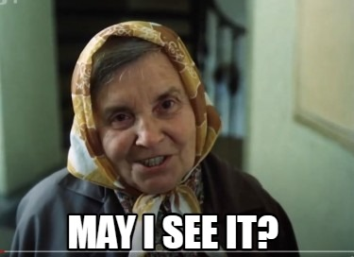
Data Catalog
Data Catalog Vocabulary (DCAT)

Slide 13
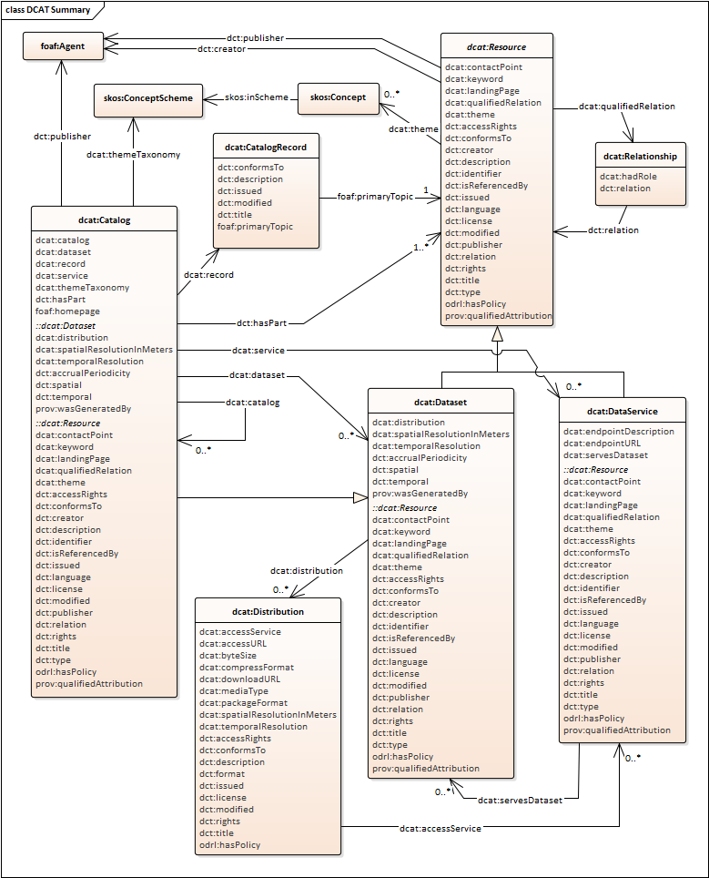
Data Catalog Vocabulary (DCAT)
DCAT is a vocabulary designed to facilitate interoperability of metadata about dataset.
A vocabulary is a formal model of semantic concepts and relationships between them.
A semantic concept represents a real-world concrete or abstract phenomenon.
A semantic concept has a global identifier used by machines and verbose terms used by humans to refer to the concept.

Slide 14
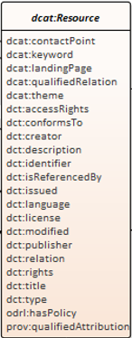
dcat:Resource
It is an abstract semantic concept.
It can represent a dataset, data service, or any other resource that may be a described by a metadata record.

Slide 15
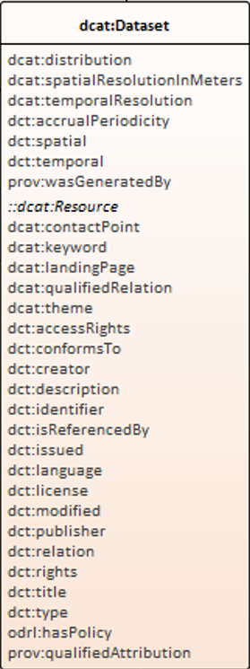
dcat:Dataset
It represents a dataset which is a collection of data, published or curated by a single agent.

Slide 16
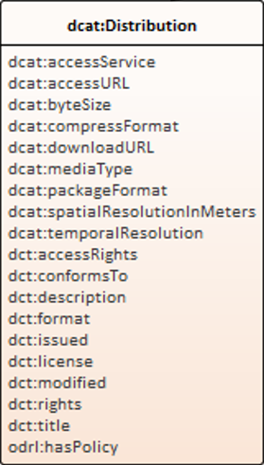
dcat:Distribution
It represents an accessible form of a dataset such as a downloadable file.

Slide 17
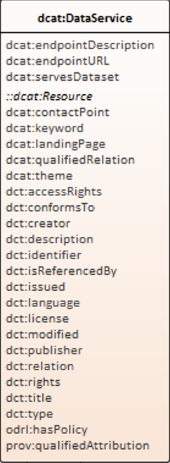
dcat:DataService
It represents a data service which is a collection of operations that provide access to one or more datasets or to data processing functions.

Slide 18
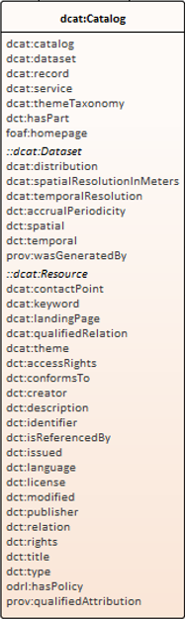
dcat:Catalog
It represents a catalog which is a dataset in which each individual item is a resource.

Slide 19
Technical metadata
Where the data can be accessed or downloaded?
What is its size?
In which format is it available and how it is compressed or packed?
...

Slide 20
Structural metadata
In which data structures is the data available?
Usually expressed as a machine interpretable schema, e.g. JSON Schema, XSD, CSVW, ...

Slide 21
Provenance metadata
When was the data published or modified?
Who produced the data?
Who published the data?
Who are other agents having responsibility for the data?
Which activity generated the data?

Slide 22
Business metadata
Licensing, access rights and policies.

Slide 23

Data Catalog
How to express metadata technically?
Resource description framework (RDF) is a standardized model for sharing and publishing (meta)data.
DCAT is richer
Notes:
Resources:
https://data.gov.cz/%C4%8Dl%C3%A1nky/znalostn%C3%AD-grafy-02-rdf (Czech only)

Slide 24
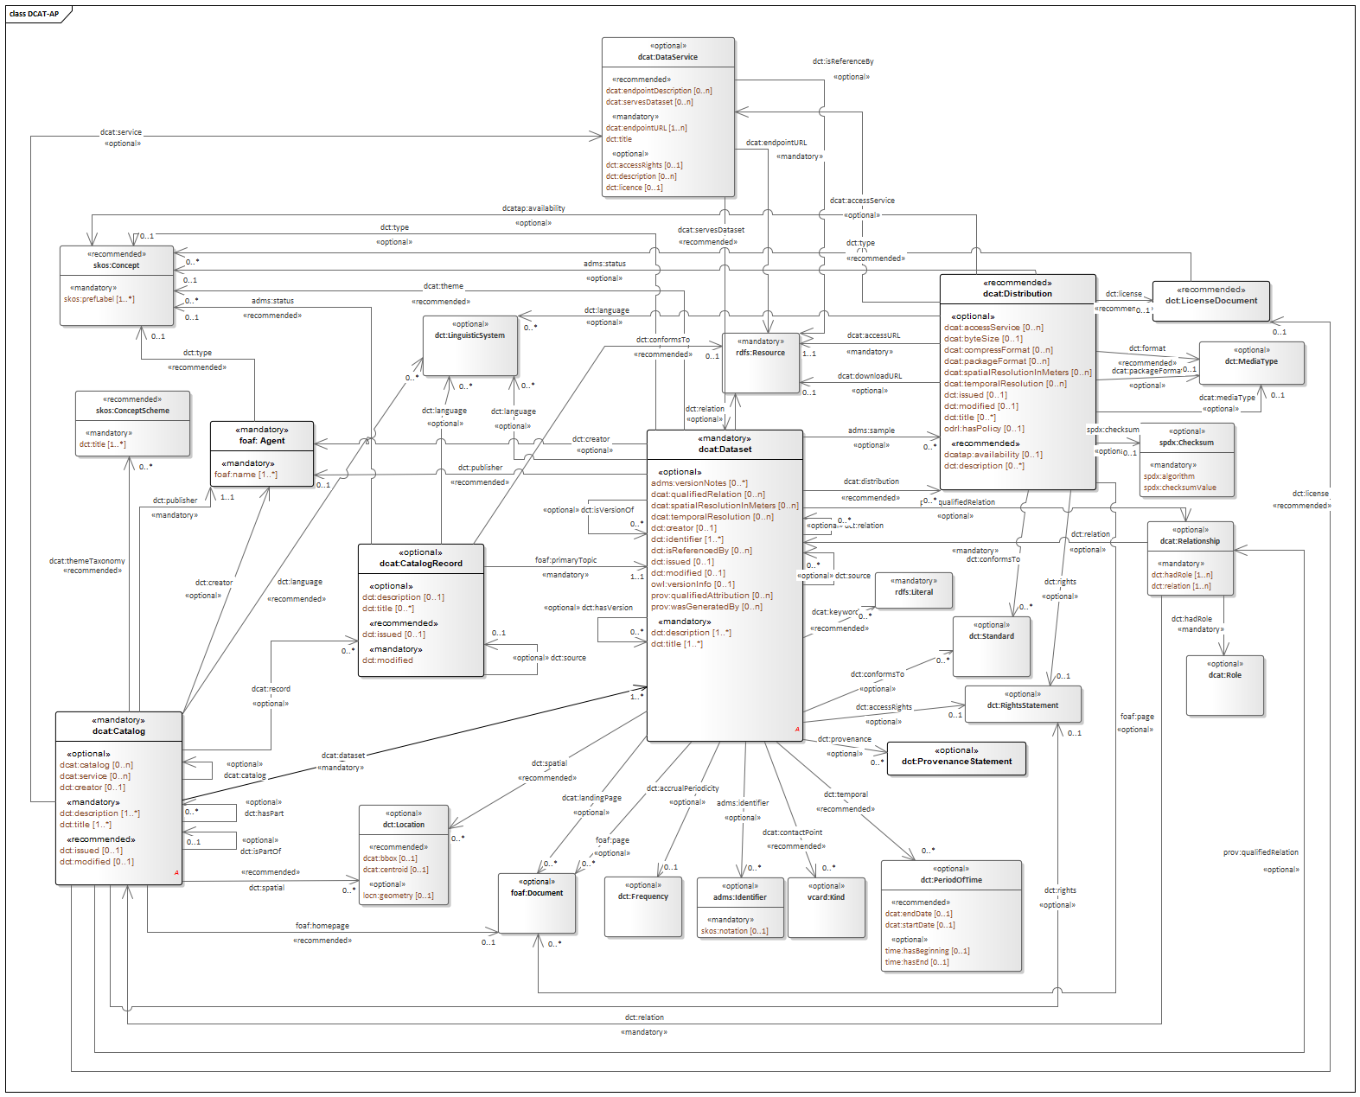
DCAT Profiles
DCAT profiles provides provide even more power. Profiles like EU DCAT-AP, DCAT-AP-CZ, GeoDCAT-AP, ..
See NSWI144 for more details.

Slide 25
Data Catalog
Catalog instances
European Data Catalog, Czech National Open Data Catalog, Charles University Open Data Catalog, ..
Notes:
Resources:
https://data.gov.cz/%C4%8Dl%C3%A1nky/znalostn%C3%AD-grafy-02-rdf (Czech only)

Slide 26
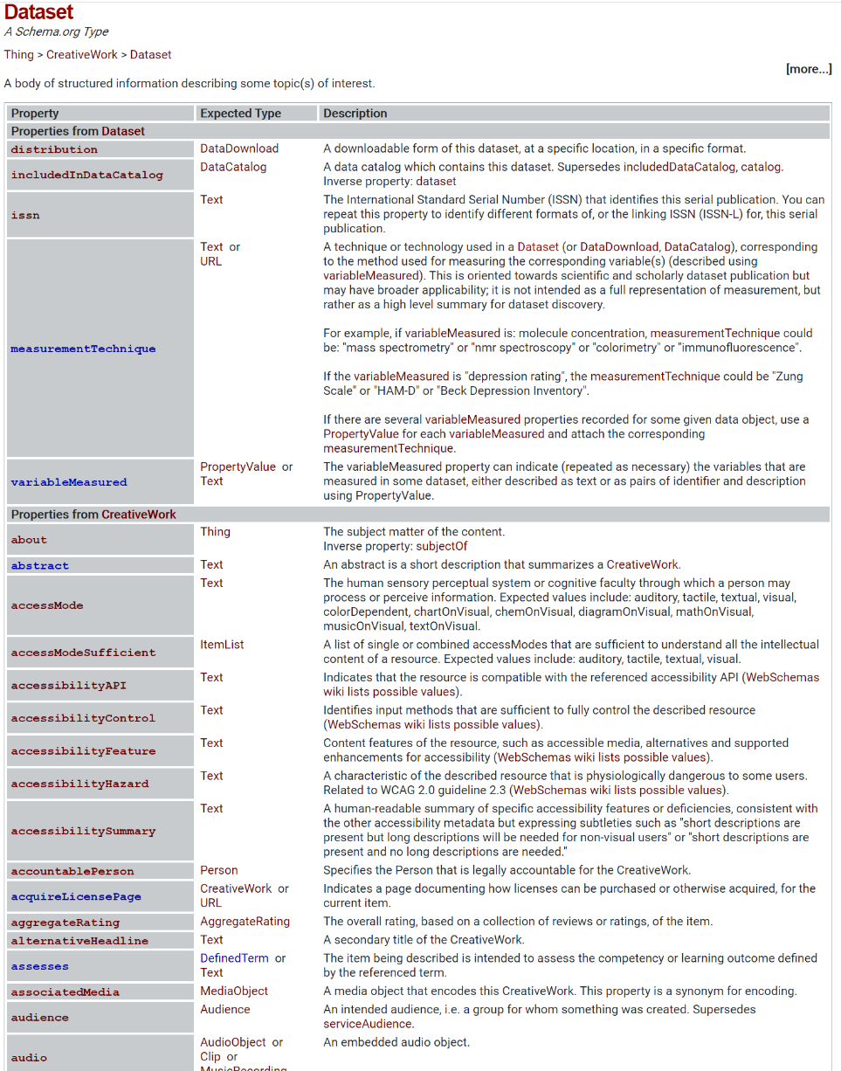
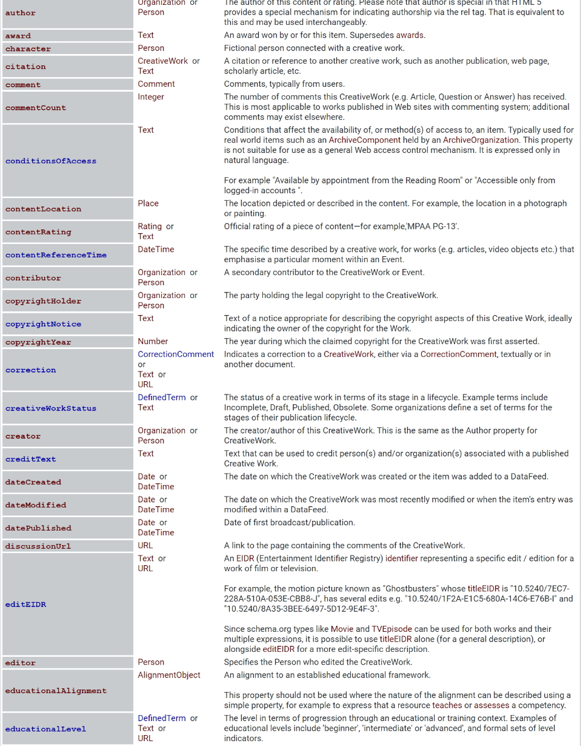
schema.org
Schema.org is
a collaborative, community activity with a mission to create, maintain, and promote schemas for structured data on the Internet, on web pages, in email messages, and beyond.
Notes:
Resources:
https://schema.org/Dataset
https://schema.org/docs/data-and-datasets.html

Slide 27
Big player’s solutions for data cataloging
Atlan
Ataccama
data.world
Talend
Google’s Cloud Data Catalog
Airbnb’s Dataportal
Netflix’s Metacat
Uber’s Databook
LinkedIn’s Datahub
Lyft’s Amundsen
WeWork’s Marquez
Spotify’s Lexikon
...
Notes:
Resources:
https://gradientflow.com/the-growing-importance-of-metadata-management-systems

