Slide 1
Beyond
Data Warehouse
NDBI046 - Introduction to Data Engineering
2025/2026
Petr Škoda
https://github.com/skodapetr
https://www.ksi.mff.cuni.cz

Slide 2
Data Warehouse
Data Source
Staging Area
Data Warehouse
Data Source
Extract
Load
Transform

Slide 3
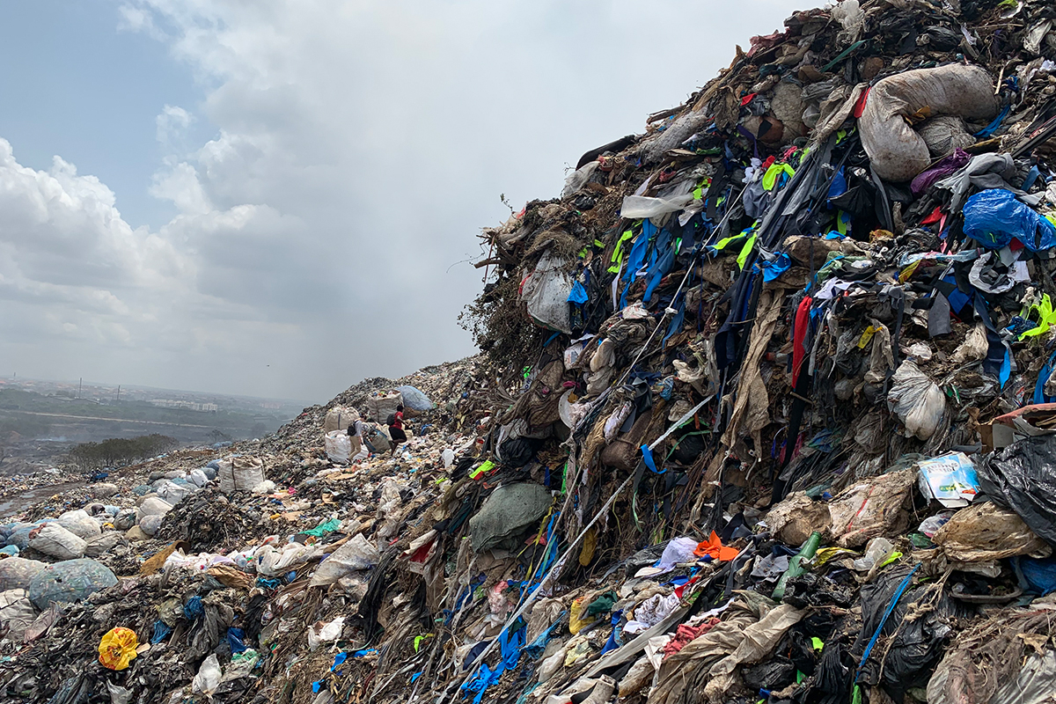
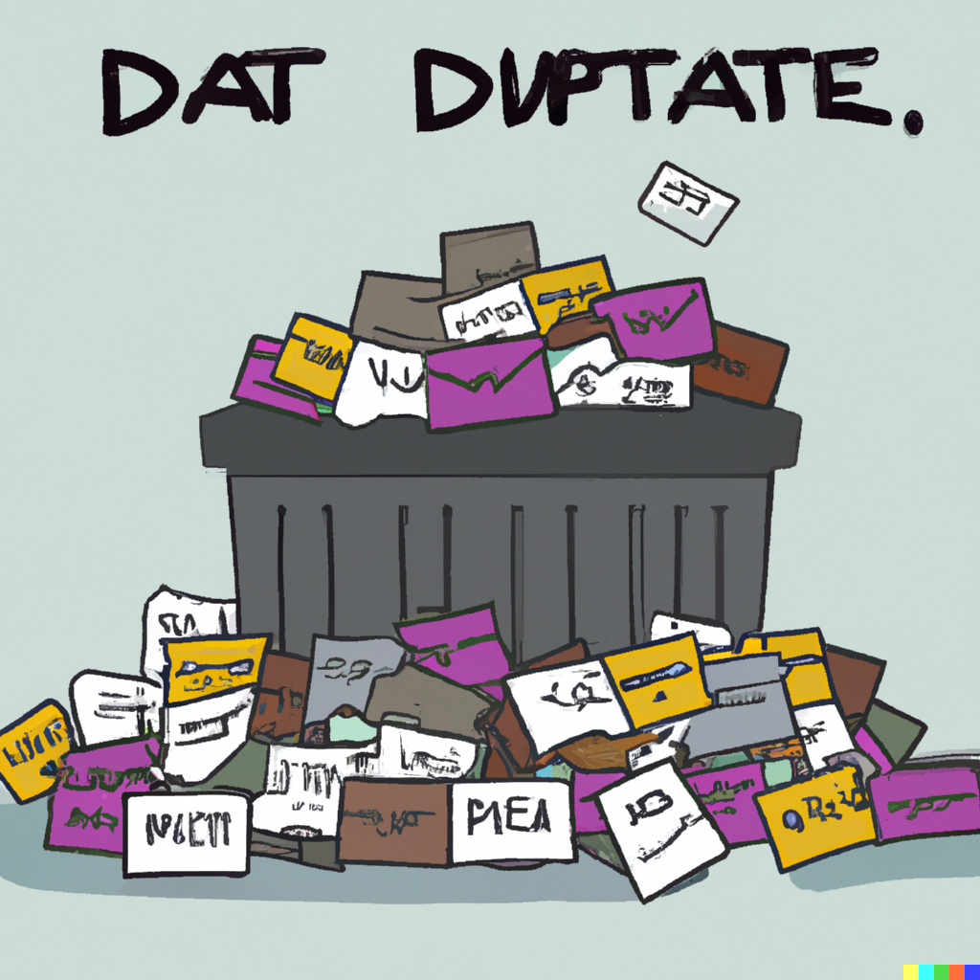
Data Warehouse goes wrong
Data Dump
The landfill site in Kpone is oversaturated with textile waste, Credit: The OR Foundation
Notes:
Left image is by Dall-e for prompt “data dump”, yet that may not capture the big picture.
Resources:
https://dataproducts.substack.com/p/the-death-of-data-modeling-pt-1

Slide 4
Data Lake
What if
we stopped caring about schema before loading?

Slide 5
Data lake 1 / 2
Large amounts of data
Cheaper to construct than Data Warehouse
Schema on read
Structured, semi-structured, non-structured data
Easy to make change
Users with computer science knowledge
Use-case: machine learning, deep analysis, discovery or undefined
"Next-generation hybrid data management solutions that can meet big data challenges and drive new levels of real-time analytics" -- Marketing Department
Notes:
- - - - - - - - - - - - - - - - - - - - - - - - - - - - - - - - - - - -
Resources:
https://aws.amazon.com/big-data/datalakes-and-analytics/what-is-a-data-lake/

Slide 6
Data lake 2 / 2
Opportunities
Moving fast, ELT
Easy data access
Large volumes of data
Risks
No vision
Data governance
Planning and commitment
Authorization

Slide 7

Data Swamp
Data lake goes wrong
Notes:
A magical place where everything is possible.

Slide 8
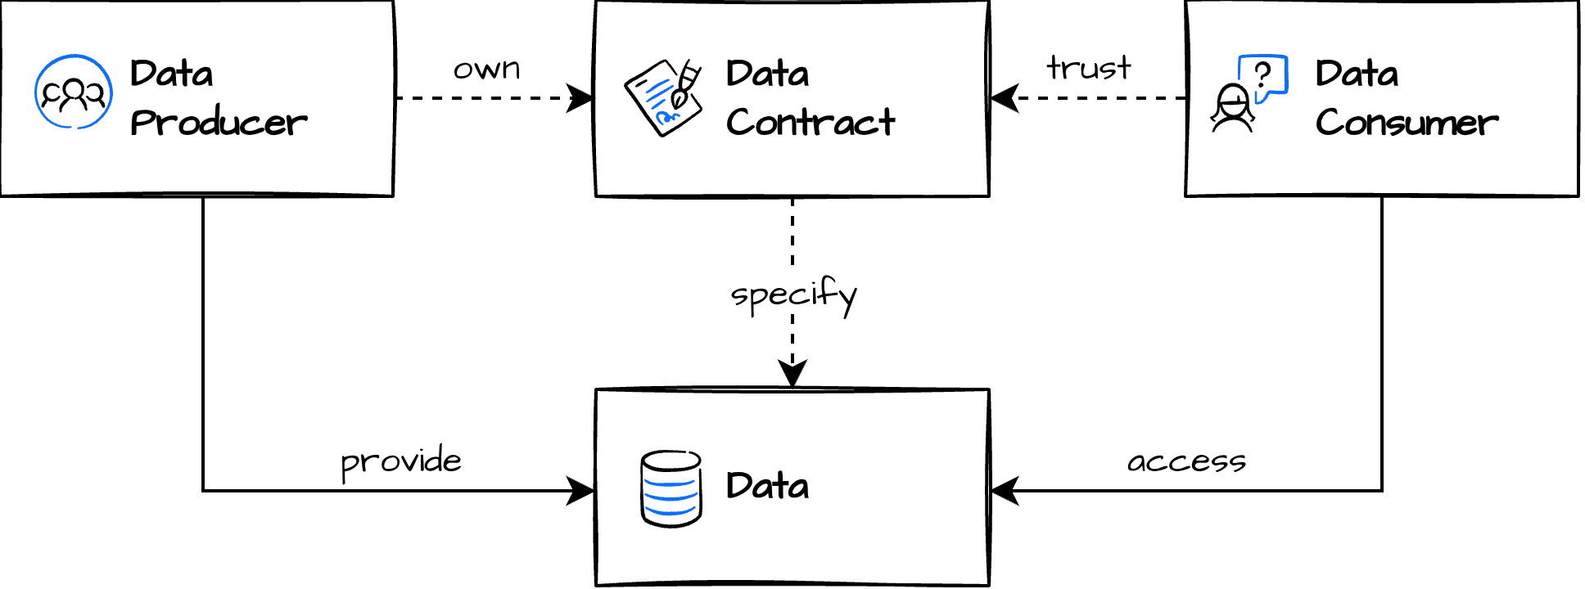
Data Contracts
Notes:
Resources:
https://datacontract.com/

Slide 9

Data Contracts
Data Contract ai an API-like agreements between Data producer and Data Consumers.
PayPal's Data Contract Template:
Demographics
Dataset & schema
Data quality
Pricing
Stakeholders
Roles
Service-level agreement
Other properties
Notes:
Resources:
https://dataproducts.substack.com/p/the-rise-of-data-contracts
https://www.dataengineeringweekly.com/p/data-engineering-weekly-130
https://github.com/paypal/data-contract-template/tree/main/docs
https://dataproducts.substack.com/p/an-engineers-guide-to-data-contracts
https://www.gable.ai/

Slide 10
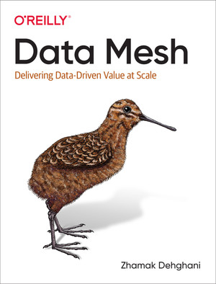
Data Mesh
... Zhamak Dehghani introduces data mesh, a decentralized sociotechnical paradigm drawn from modern distributed architecture that provides a new approach to sourcing, sharing, accessing, and managing analytical data at scale.

Slide 11
Data Mesh
Issues to address:
Changes in the data landscape
Proliferation of sources of data
Diversity of data use cases and users
Speed of response to change
Principles:
Domain-oriented decentralized data
ownership / responsibility and architecture
Data as a product / "first-class citizen"
Self-serve data infrastructure as a platform
Federated computational governance
"I suggest that the next enterprise data platform architecture is in the convergence of Distributed Domain Driven Architecture, Self-serve Platform Design, and Product Thinking with Data." -- Zhamak Dehghani, May 2019
Notes:
Sources:
https://martinfowler.com/articles/data-monolith-to-mesh.html
https://martinfowler.com/articles/data-mesh-principles.html
https://medium.com/@hannes.rollin/six-reasons-why-data-mesh-will-fail-195886c89bdd

Slide 12
Data as a Product
We can see it as an evolution of data contracts.
Discoverable via Data Catalog
Accessible
Trustworthy and truthful
Semantics and syntax
Interoperability
Access control
Teams
Ownership
Notes:
Resources:
https://medium.com/data-mesh-learning/defining-data-products-a-community-effort-77363611e5c5

Slide 13
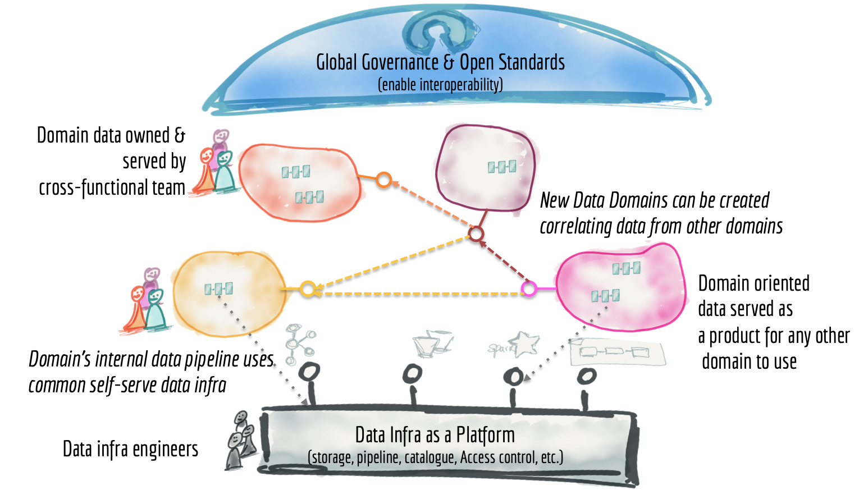
Data Mesh the Big Picture
Notes:
Resources:
https://martinfowler.com/articles/data-monolith-to-mesh.html

