Slide 1
Data Quality
NDBI046 - Introduction to Data Engineering
2025/2026
Petr Škoda
https://github.com/skodapetr
https://www.ksi.mff.cuni.cz

Slide 2
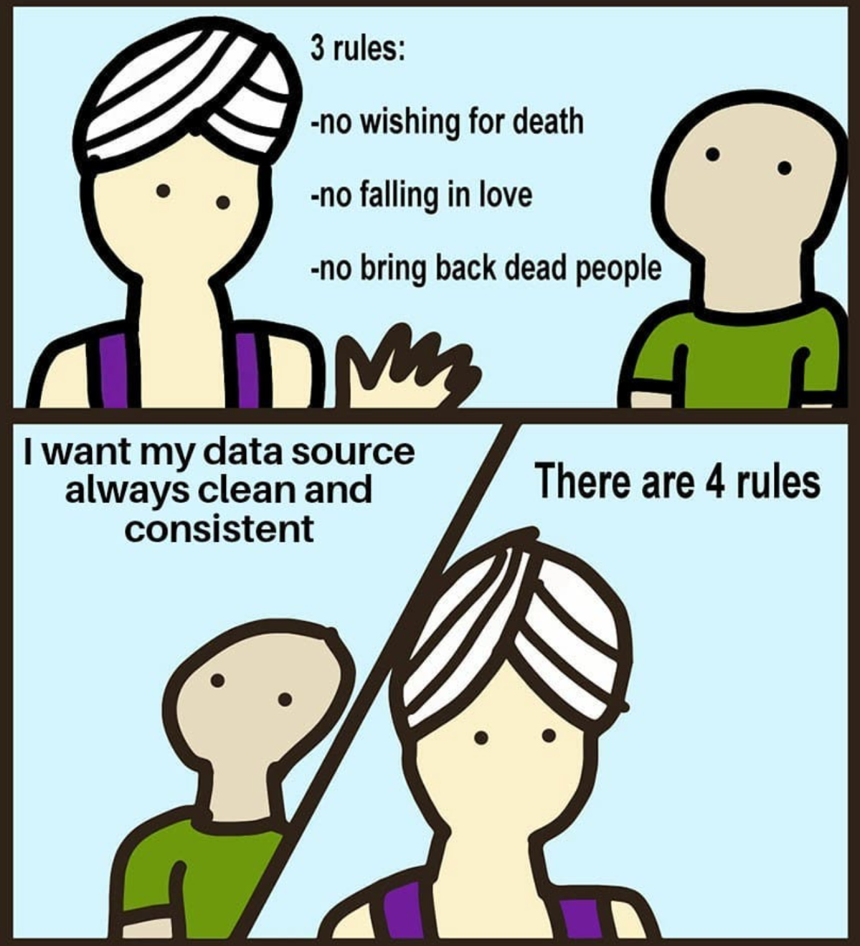
Data Quality is ...
Data Talk Newsletter

Slide 3
Data Quality
Garbage In, Garbage Out (GIGO)
Since 1957 (1960)
Data Quality Issue
Notes:
Resource:
https://www.techtarget.com/searchsoftwarequality/definition/garbage-in-garbage-out

Slide 4
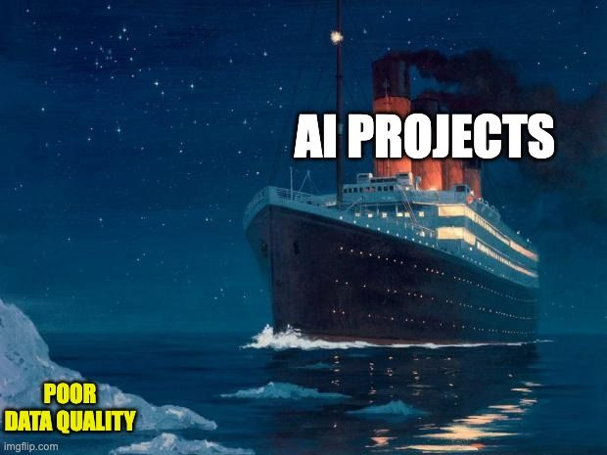
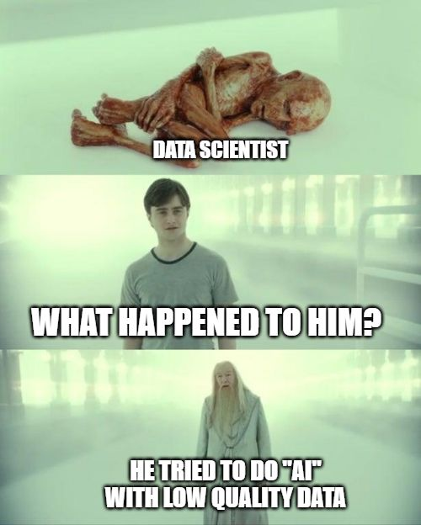
Why? - Marketing edition
Bad data wastes time, increases costs, weakens decision making, angers customers, and makes it more difficult to execute any sort of data strategy.
On average, 47% of newly-created data records have at least one critical (e.g., work-impacting) error.
Only 3% of the data quality scores in our study can be rated "acceptable" using the loosest-possible standard.
Notes:
Resource:
https://hbr.org/2017/09/only-3-of-companies-data-meets-basic-quality-standards
linkedin.com/posts/chad-sanderson_there-is-nothing-more-important-to-aiml-activity-6984932614113550336-8swu
https://www.linkedin.com/posts/jatinsolanki_ai-dataquality-decube-activity-7186560857651179520-BiFU/

Slide 5
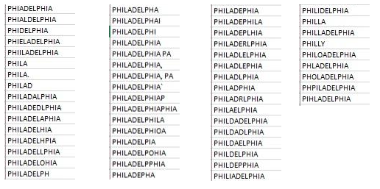
Why? - Science edition
Levels:
  Operational level
  Tactical level
  Strategic level
Issues
  Inaccurate data: 1-5% of data fields are erred
  Inconsistencies across databases
  Unavailable data necessary for certain operations or decisions
Impacts
  Lowered customer / employee satisfaction
  More difficult to implement data warehouses
  Increased organizational mistrust
Notes:
Resource:
https://dl.acm.org/doi/abs/10.1145/269012.269025
https://dl.acm.org/doi/abs/10.1145/1629175.1629210
https://twitter.com/quaesita/status/1283787303886954498

Slide 6
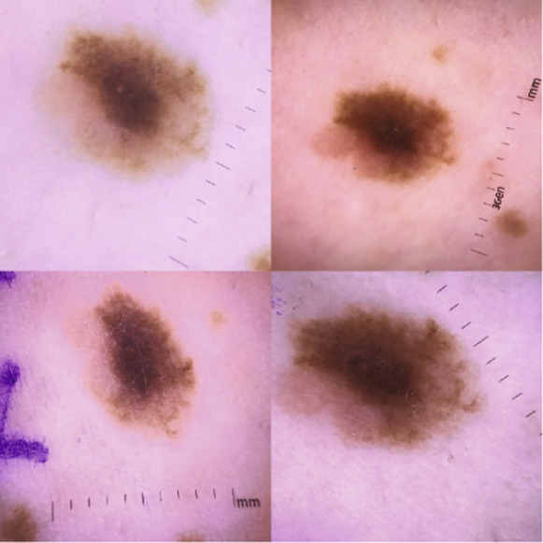
Why? - Machine learning edition
Research
Data Collection / Questionnaires
Initial phases of data-intensive research
Manipulation / Responsible data editing
Machine learning / Data science
Notes:
Resource:
https://doi.org/10.1371/journal.pmed.0020267 [2005]
https://towardsdatascience.com/is-the-medias-reluctance-to-admit-ai-s-weaknesses-putting-us-at-risk-c355728e9028
https://doi.org/10.1016/j.jid.2018.06.175
https://info.ultranauts.co/blog/chatgpt-and-data-quality

Slide 7
Data quality
"The quality of data refers to its ability to satisfy its usage requirements."
"Fitness for use."
Current status
Reporting /
Verifying
Assessment /
Inspection
Action /
Cleaning
Notes:
Resource:
https://docs.google.com/presentation/d/1OB6R9GriyQJd1k7GnNtOnAZE858lL-xvBJpJl1AhFvE

Slide 8
Assessment / Inspection
Quality dimensions groups
Accessibility dimensions
Intrinsic dimensions (completeness, consistency, …)
Contextual dimensions (relevance, timeliness, … )
Representational dimensions (interoperability, …)
Inspection
Data profiling
Visualizations

Slide 9
Quality Dimensions / Screens
Use-case based dimensions.
There is no universal definition.
We need to have measures.
Data quality screens, Data Warehouse:
Column screens
Structure screens
Business rule screens
Notes:
Resources:
Data Quality: The Accuracy Dimension (Morgan Kaufmann, 2002)

Slide 10
Dimension: Accuracy
Definition:
The extent to which data are correct, reliable and certified.
Definition:
The data values stored in the database correspond to real-world values.
Definition:
Trustworthiness is defined as the degree to which the information is accepted to be correct, true, real and credible.

Slide 11
Dimension: Completeness
Definition:
The degree to which a given data collection includes data describing the corresponding set of
real-world objects.
Definition:
Extent to which data are of sufficient breadth, depth, and scope for the task at hand.
Definition:
Completeness refers to the degree to which all required information is present in a particular dataset.

Slide 12
Dimension: Consistency
Definition:
Violation of semantic rules defined over a set of data items.
Definition:
Consistency means that a knowledge base is free of (logical/formal) contradictions with respect to particular knowledge representation and inference mechanisms.

Slide 13
Dimension: Availability
Definition:
Availability of a dataset is the extent to which data (or some portion of it) is present, obtainable and ready for use.

Slide 14
Dimension: Licensing
Definition:
Licensing is defined as the granting of permission for a consumer to re-use a dataset under defined conditions.

Slide 15
Dimension: Timeliness
Definition:
Timeliness measures how up-to-date data is relative to a specific task.

Slide 16
Dimension: Understandability
Dimension:
Understandability refers to the ease with which data can be comprehended without ambiguity and be used by a human information consumer.

Slide 17

Dimension: Interoperability
Definition: Interlinking
Interlinking refers to the degree to which entities that represent the same concept are linked to each other, be it within or between two or more data sources.

Slide 18
Dimension: …

Slide 19
Data Quality
Issues / Data Cleaning

Slide 20
Data type specific issues
String
Standardize casing
Remove whitespaces, new lines
Correcting typos
Standardize encoding
Map to type / categorical variables
Remove stop words
Date and time
Format
Time zones

Slide 21
Missing values
Drop rows and/or columns with missing data
Look for patterns of missing data
  Missing completely at random
  Missing at random
  Non-ignorable
Fill in missing values (imputation)
  Manually
  Use global constant such as N/A or Unknown
  Use imputation method
Imputation Methods
Process of estimating missing data of an observation, based on valid values of other variables.
K-Nearest Neighbors
Mean based imputation
Hot deck imputation
Imputation using decision tree
...

Slide 22
Noisy data
Noise is a random error or variance in a measured variable.
Box plot / scatter plot / ...
Outliers:
  Remove
  Have an extra group / statistical methods
Data smoothing techniques:
  Binning
  Clustering
  Regression

Slide 23
Inconsistent / Invalid data
Example:
"Raspberry", "raspberry", "RASPBERRY", "Raspberry pi", "Raspberry pie"
Solutions:
  Domain/business knowledge
  Levenshtein distance
  Association Rule
  Clustering
  …
  Remove

Slide 24
Data Cleaning Checklist 1 / 2
Irrelevant Data
Duplicates
Type conversions
Syntax errors
Missing values
Normalization
Transformation
Standardize
Outliers
Consistency

Slide 25
Data Cleaning Checklist 2 / 2
Remove missing data
Remove outliers
Recode different versions of the same data to a common denominator. For example, “M”, 1, “male”, “masculine” to “Male”
Convert data types to standard forms. For example, convert DateTime objects and Unix timestamps to the same data type
You need to test:
COUNT of new records added each day > 0
Percent of new records with NULL or 0 values < 99%
SUM of new records = 7-day avg +- 25%
...

Slide 26
Data Cleaning is Analysis, Not Grunt Work
"Existing data cleaning writing is pretty useless"
Data cleaning is not easy, we wouldn’t be spending so much time doing it
Use-case specific
Data cleaning and understanding
Data Cleaning as "Building Reusable Transformations"
Objectives:
  Fix things that break the algorithm
  Reduce Unwanted Variation
  Eliminate Bias
Documentation is essential
Notes:
Source:
https://counting.substack.com/p/data-cleaning-is-analysis-not-grunt
https://counting.substack.com/p/whys-it-hard-to-teach-data-cleaning

Slide 27
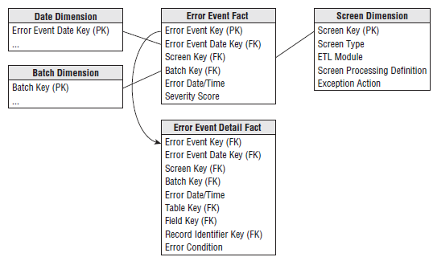
Data Quality ❤️ Provenance ❤️ Data Warehouse
We should provide user access to metadata in form of a dimensional table (Audit dimension) as a part of the data warehouse solution.
Grain is an error thrown (produced) by a quality screen in the transformation.
Error event schema:

