Slide 1
Data (Pre)Processing
NDBI046 - Introduction to Data Engineering
2025/2026
Petr Škoda
https://github.com/skodapetr
https://www.ksi.mff.cuni.cz

Slide 2
The idea of a Data Warehouse
This time we focus on the process and working with the data.
Data Source
Staging Area
Data Warehouse
Data Source
Extract
Load
Transform

Slide 3

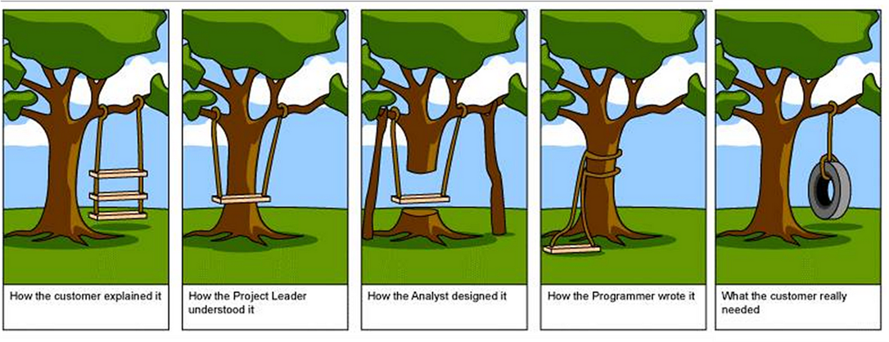
Data transformation 1 / 3
Data Wrangling
Notes:
Resources:
https://missing.csail.mit.edu/2020/data-wrangling/
https://missing.csail.mit.edu/
Data Wrangling : Data transformation from one format to another, focus on bash tools.
https://www.youtube.com/watch?v=sXVP9256JSQ
https://www.youtube.com/channel/UCkRV9I1xz2KwlgvLQ8OadKw
Data Wrangling : Clean, reshape and restructure data using R.
ChatGPT for Data Science image

Slide 4
Data transformation 2 / 3
Data Selection
Keep columns filter rows
SELECT * FROM customer WHERE city = 'Prague’;
Data Projection
Keep rows filter columns
SELECT city, state, zipcode FROM customer;
Data Summarization
Big picture
Data tendency and variance (dispersion) measures
Measures
  Distributive : sum, count, min, max
  Algebraic : mean
  Holistic : median
Visualizations

Slide 5
Data transformation 3 / 3
Data Reduction
Data cube aggregation
Attribute subset selection
Dimensionality reduction
Numerosity reduction
Regression, Histograms, Clustering, …
Sampling
Discretization and concept hierarchy generation
Data Cleaning
"The quality of data refers to its ability
to satisfy its usage requirements."

Slide 6
Discretization and concept hierarchies
Data hierarchy
Discretization / Concept hierarchy as reduction
Discretization generation
  Binning
  Entropy-Based Discretization
  Clustering
  Intuitive Partitioning
Categorical data have no ordering.
Concept hierarchy generation
  Manual definition
  Partial ordering of attributes
  Set of attributes
  Semantics

Slide 7
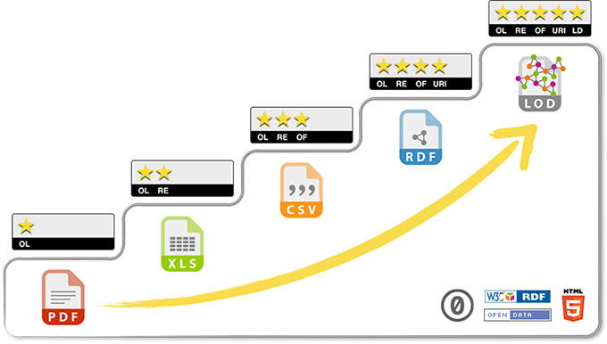
Reaching for the stars
Data Integration
Entity identification
Named-entity recognition
Schema integration
Data Lowering / Lifting
Technical viewpoint
Semantic viewpoint
Notes:
Resource:
https://docs.google.com/presentation/d/17DDuvBo2eldwcuMr0_3JLOz4WPTs5NCrB02vmjeP8T0/edit#slide=id.g84aded2c10_0_209

Slide 8
What and how
Process steps (WHAT):
Data Cleaning
Remove noise, correct inconsistencies.
Data Integration
Merge multiple data sources.
Data Transformation
Normalization, reduction, format.
Process attributes (HOW):
Automation
Performance
Scalability
Robustness
Provenance

Slide 9
Extract Transform Load

Slide 10
Towards Extract Transform Load
Building ETL depends on ... almost everything.
Yet we should not use this as an excuse for an unstructured approach.
Business Needs
Compliance
Data quality
Security
Data Integration
Data Latency
Archiving and Lineage
BI Delivery Interfaces
Available Skills
Legacy Licenses

Slide 11
Extract Transform Load
Category of specialized tools,
not only for a Data Warehouse
ETL / Data Pump / ...
Pipeline / Workflow / Process / ...
Components / Plugins / ...
Benefits:
  Visual representations of a data flow
  Parallelization
  Monitoring
  Failover features
  Information clarity, completeness, quality, velocity
  ...
Users:
  End users
  Business users.
  Designers
  Conceptual modeling, design transformation.
  Developers
  Implementation ETL, plugins.

Slide 12
Extract
Capturing data from *:
Full refresh
Log capture
Time-stamped source
Change transaction files
Stream vs File
Structured vs semi/un-structured data
…
*) anything and anywhere
Challenges:
Data latency / volume / validation
Source limits
Monitoring / errors / reliability
Disparate sources
Limited resources/API
Data encryption and compression
….

Slide 13
Change Data Capture System (CDC)
The ideas is to isolate and transfer the data that has changed since the last load. Building good system is not easy. Data loss or duplicity are off the table.
Ideas:
Isolate the changed data sources to implement a selective processing.
Capture all changes (create, edit, delete).
Time-based vs. index-based.
Think about nonstandard interfaces.
Database log scraping, message-queue monitoring.
Tag changed data to distinguish from error corrections using audit columns.
Notes:
Resources:
The Data Warehouse Toolkit, Chapter 19

Slide 14
Transform / Cleaning and Conforming Data
This is where the value is born as we aim to enhance data quality. It is about integration and dealing with data quality issues.
At the same time DW/BI should provide accurate picture of data captured by the organization's production system.
Techniques and steps:
... you name it
Challenges:
Different formats / ontologies
Business logic
Scaling
Error handling
Monitoring and quality screens.

Slide 15
Load
Loading data to *:
Vendor specific
Full load / Incremental load
Indices
Materialized views
Challenges:
Order of insertions
Schema changes
Limited resources
Availability and consistency

Slide 16
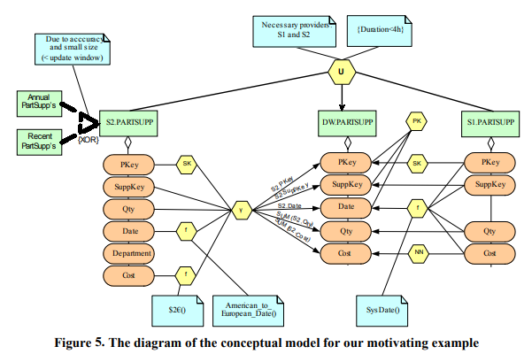
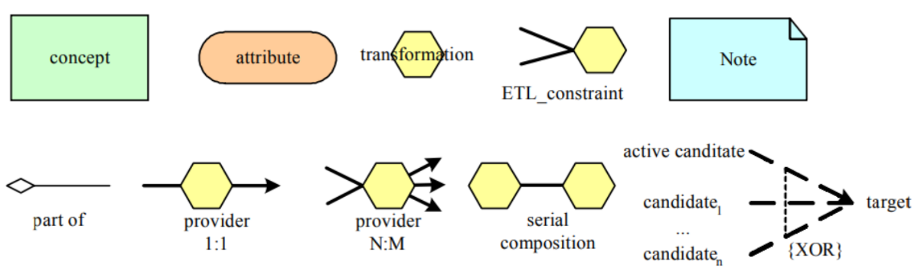
Notation for Extract Transform Load
Graphical notation
Conceptual modeling for ETL processes
Inspired by Business Process Modeling Notation
WOL, Horn clause language
Workflow as a graph
Unified Modeling Language
Semantic design methods
Non-graphical notation:
...
Notes:
Resource:
https://dl.acm.org/doi/abs/10.1145/583890.583893
https://www.semanticscholar.org/paper/Specifying-Database-Transformations-in-WOL-Davidson-Kosky/46f68ba2de84e7894ea0aa09fe0c1c579336bc87
https://dl.acm.org/doi/abs/10.1145/583890.583893
https://link.springer.com/chapter/10.1007/978-3-540-39648-2_25
https://link.springer.com/chapter/10.1007/978-0-387-87431-9_2
https://www.igi-global.com/article/ontology-based-conceptual-design-etl/2840

Slide 17
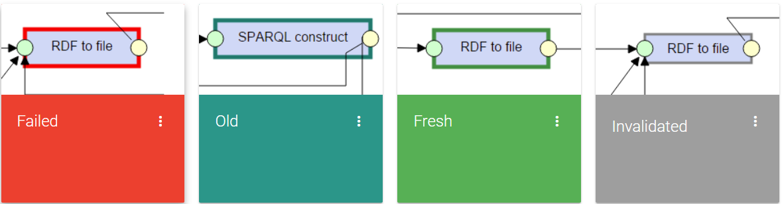
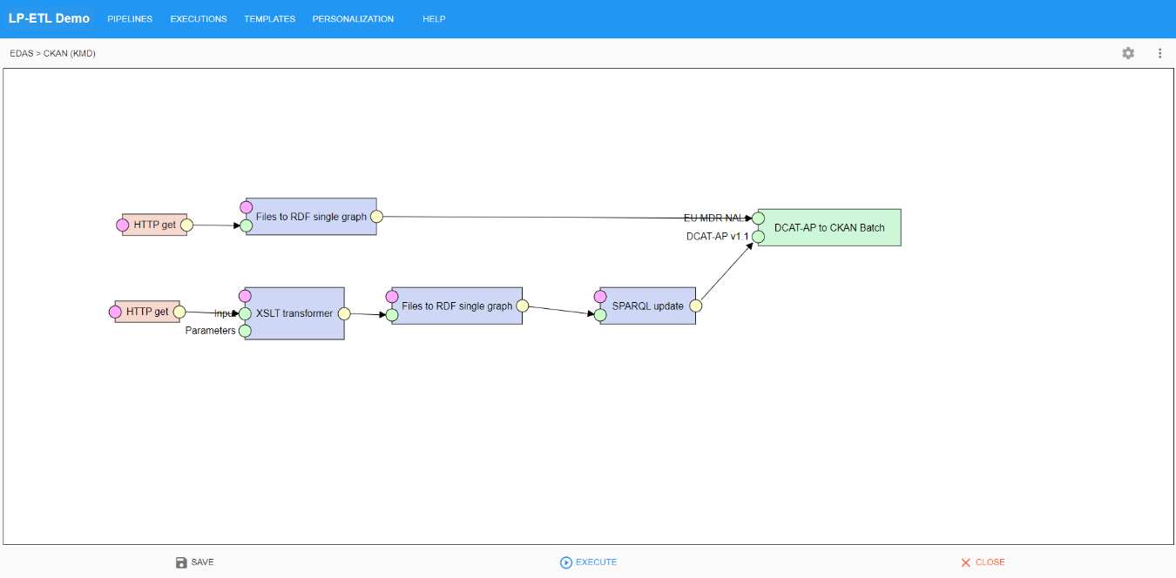
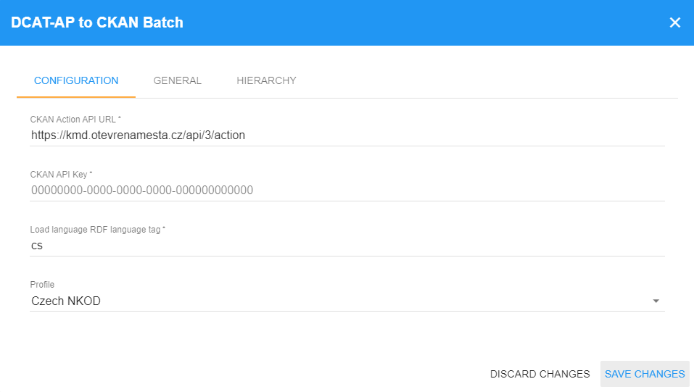
Extract Transform Load
LinkedPipes: ETL
Notes:
Resource:
https://github.com/linkedpipes/etl

Slide 18
ETL with Data Warehouse
The "The Data Warehouse Toolkit" defines 34 ETL sub-systems.
Extraction (1-3)
Data Profiling
Change Data Capture System
Extract System
Cleaning and Conforming Data (4-8)
Data Cleansing System
Error Event Schema
Audit Dimension Assembler
Deduplication System
Conforming System
Delivering (9-21)
Slowly Changing Dimension Manager
Surrogate Key Generator
Hierarchy Manager
...
Managing (22-34)
Job Scheduler
Backup System
Lineage and Dependency Analyzer
...

Slide 19
Alternatives
Extract Transform Load
  Pull approach, works on demand or on schedule.
Extract Load Transform
  Suitable for data lake.
Enterprise Service Bus
  Push model, gets data as needed.
No-ETL
  Initiative https://noetl.org/

Slide 20
Data Provenance
NDBI046 - Introduction to Data Engineering
2025/2026
Petr Škoda
https://github.com/skodapetr
https://www.ksi.mff.cuni.cz

Slide 21

Data Provenance

Slide 22
Data lineage / provenance
“The present invention provides a system and method for tracking the lineage of data within database tables.”
Data lineage Patent, Microsoft, 1998
Level of detail:
Technical lineage
Business lineage
Purpose:
"Where lineage"
Given an output, which inputs did the output come from?
"How lineage"
Given an output, how were the inputs manipulated to produce the output?

Slide 23
Data Provenance
PROV
Notes:
Source:
https://www.w3.org/TR/prov-o/
https://www.w3.org/TR/2013/NOTE-prov-primer-20130430/
https://www.w3.org/TR/2013/REC-prov-o-20130430/

Slide 24
PROV
Provenance is information about entities, activities, and people involved in producing a piece of data or thing, which can be used to form assessments about its quality, reliability or trustworthiness.
The PROV Family of Documents defines a model, corresponding serializations and other supporting definitions to enable the inter-operable interchange of provenance information in heterogeneous environments such as the Web.
The provenance of digital objects represents their origins. PROV is a specification to express provenance records, which contain descriptions of the entities and activities involved in producing and delivering or otherwise influencing a given object.
Notes:
Source:
https://www.w3.org/TR/2013/NOTE-prov-overview-20130430/

Slide 25
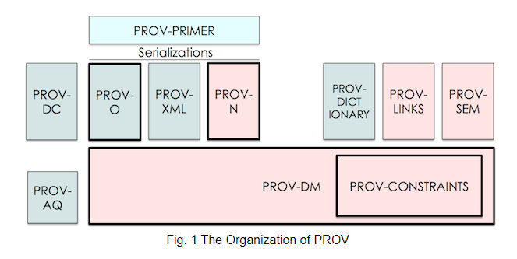
PROV : Documents
Notes:
Source:
https://www.w3.org/TR/2013/NOTE-prov-overview-20130430/

Slide 26
Starting point
prov:DerivedFrom
prov:Entity
prov:wasAttributedTo
prov:wasGeneratedBy
prov:used
prov:Agent
prov:Activity
prov:wasAssociatedWith
Notes:
Source:
https://www.w3.org/TR/2013/NOTE-prov-primer-20130430/

