Slide 1
Data Modelling
NDBI046 - Introduction to Data Engineering
2025/2026
Petr Škoda
https://github.com/skodapetr
https://www.ksi.mff.cuni.cz

Slide 2
Data Modeling
Normalized Modeling, Bill Inmon
...
Denormalized Modeling, Ralph Kimball
...
Consider

Slide 3
Kimball Dimensional Modeling Techniques
Kimball group defines for modeling data in a dimensional way. The outline is:
Gather Business Requirements and Data Realities (Analysis)
Collect business objectives, key performance indicators (KPI), decision making processes, supporting analytical needs, and data realities.
Dimensional Modelling
Should lead by the data modeler in collaboration with the subject matter experts and data governance representatives.
Dimensional Design Process (Design)
There are four steps:
  Select the business process
  Declare the grain
  Identify the dimensions
  Identify the facts

Slide 4

Dimensional Design Process, Star Schema
Fact tables focus on the results of a single business process. How can we create a fact table? We start by defining grain, dimensions and facts.
Business Intelligence
The grain establishes exactly what a single fact table row represents. The grain is the first step, every fact or dimension must be considered in relation to the grain.
Atomic grain refers to the lowest level at which data is captures by a given business process.
Dimension table
Dimension table
Fact table
Dimension table
Dimension table
Notes:
Resources:
https://trueleafmarket.com/pages/gardening-memes

Slide 5
Showcase : Retail Sales
Back story
Receipt
Promotions

Slide 6
Showcase : Dimensional Design Process
Select the Business Process
Managers wants to understand customer purchases.
As a result, the process in question is POS retail sales transactions.
Declare the Grain
Aim for lowest atomic grain, we can always aggregate to get a summary.
We use a single POS item scan, i.e. single item on the receipt.
Identify the Dimensions
...
Identify the Facts
...

Slide 7
Showcase : Retail Sales Fact
Date (FK)
Product (FK)
Store (FK)
Promotion (FK)
Cashier (FK)
Payment method (FK)
Sales quantity
POST transaction identifier
Regular unit price
Discount unit price
Extended Discount Amount USD
Extended Sales Amount USD
Extended Cost Amount USD
Extended Gross Profit Amount USD
Dimensions
Facts / measures
Derived facts
Date
Payment method
Product
Non-Additive Facts
Cashier
Store
Promotion
Transaction Fact Table

Slide 8
Showcase : Date Dimension
Date Key (PK)
Date
Day of Week
Day number in Calendar Month
Last Day In Month Indicator
Fiscal Week
Holiday Indicator
Weekday Indicator
SQL Date Stamp
...
A common dimension in start schema.
Think about the user and how values are shown BI tools.
We can pre-create values.
Why not use just timestamp?
Good dimension for schema partitioning.
ALTER DATABASE Sales ADD FILEGROUP [2024]
ALTER DATABASE Sales ADD FILE (
NAME =
SIZE =
FILEGROWTH =
) TO FILEGROUP [2024]
CREATE PARTITION FUNCTION ...
CREATE PARTITION SCHEME ...

Slide 9
Showcase : Product Dimension
Product key (PK)
SKU Number
Product Description
Brand Description
Department
Category Description
Subcategory Description
Package type Description
Package size
Weight
Shelf Width
Shelf Height
Shelf Depth
...
Size of this table?
Expected number of rows (10k)
and columns (50+).
"Drill down" vs "Drill up"
Business term "the merchandise hierarchy"
SKU < brand < category < departments
"Do not normalize, just be a star"
First Normal Form (1NF)
"Standard list price" column

Slide 10
Showcase : Store Dimension
Store key (PK)
Store number
Store Name
Store Street Address
Store City
Store County
Store City-State
Store Zip Code
Store Manager
Store Region
Total Square Footage
First Open Date
Last Remodel Date
How should we represent date columns?

Slide 11
Showcase : Promotion Dimension
Price reduction
Ads information
Display
Coupons
Price
Start and end
A "causal dimension" describes a probable cause of change in fact table.
This is why we are doing this ... business.
What about items sold outside of a promotion?
Do not use Null in the fact table.

Slide 12
Showcase : ...
Payment method dimension
Degenerate dimensions
Those are dimensions where we have no additional information.
E.g. "POST transaction identifier"
Factless Fact Tables
How do we answer question: "What products were on promotion but did not sell?"
Natural, surrogate, and durable keys
Centipede fact tables
id int unsigned NOT NULL AUTO_INCREMENT

Slide 13
Extensions to a Dimensional Model
The dimensional model should be resilient to change. We can deal with different changes without a need to change a single SQL BI query.
New facts can be added by creating new columns.
We can add new dimension tables.
We can add attributes to dimension tables by adding columns.
We can increase the level of detail, make grain mode atomic, by introducing new columns.
Just keep it true to the grain!

Slide 14
Showcase : Inventory
Backstory
We trace the value chain of key business processes.
Inventory Transactions
Date (FK)
Product (FK)
Warehouse (FK)
Inventory Transaction Type (FK)
Inventory Transaction Number
Inventory Transaction USD Amount
What about daily amounts?

Slide 15
Showcase : Inventory
Inventory Periodic Snapshot
Inventory Accumulating Snapshot
Date (FK)
Product (FK)
Store (FK)
Quantity on hand
Quantity Sold
Inventory Dollar Value at Cost
Inventory Dollar Value at Latest Selling Price
Product Lot Receipt Number
Date Received (FK)
Date Inspected (FK)
Date Bin Placement (FK)
Date Initial Shipment (FK)
Date Last Shipment (FK)
Quality Received
Quality Inspected
...
Receipt to Inspection Lag
Receipt to Bin Placement Lag
...
Milestones:
Receiving
Inspection
Bin placement
Shipping
Semi-Additive Facts
What movement?

Slide 16
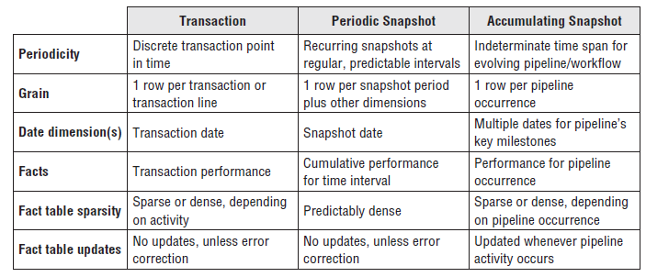
Working with Facts
There basic fact table types ->
Additive, non-additive and derived facts
Centipede fact table
No Null in a fact table
Surrogate, natural and durable keys

Slide 17
Working with Dimensions
Casual dimension
Degenerate dimension
Dimensional Hierarchies
Fixed Depth Positional Hierarchies
E.g. product < brand < category
Variable Depth Hierarchies / Slightly Ragged
Convert to previous by declaring the maximum depth. E.g. geography with 3 - 6 levels.
Variable Depth Hierarchies / Ragged
Recursive dependencies.

Slide 18
Value chain integration
The ideas is we get most from integration of different processes. By this integration we are moving towards Enterprise Data Warehouse.
Data Governance and Stewardship
Conformed / master dimensions and drill across
Conformed facts

Slide 19
Slowly Changing Dimension (SCD)
How can we accommodate changes in the dimension attributes?
Type 0: Retain original
We never change; we are not up to date.
Type 1: Overwrite
The attribute always reflects the most recent assignment. We are losing history.
Type 2: Add new row
Add a new row in to the dimension table. We need to update the primary key.
Type 3: Add new attribute /
alternate reality
Used infrequently, user can select which reality they want to use for grouping.
Type 4: Add mini-dimension /
rapidly changing monster dimension
Move rapidly changing attributes to a separate mini-dimension.
...
Keep the business in mind!

Slide 20
Dimensional Modeling
Snowflake Model
Galaxy Model
Week
Month
Customer
Dimension
Time
Dimension
Customer
Dimension
Time
Dimension
Location
Dimension
Sales
Facts
Sales
Facts
Shipping
Facts
Seller
Dimension
Product
Dimension
Seller
Dimension
Product
Dimension
Shipper
Dimension
Outlet
Region
Type

Slide 21
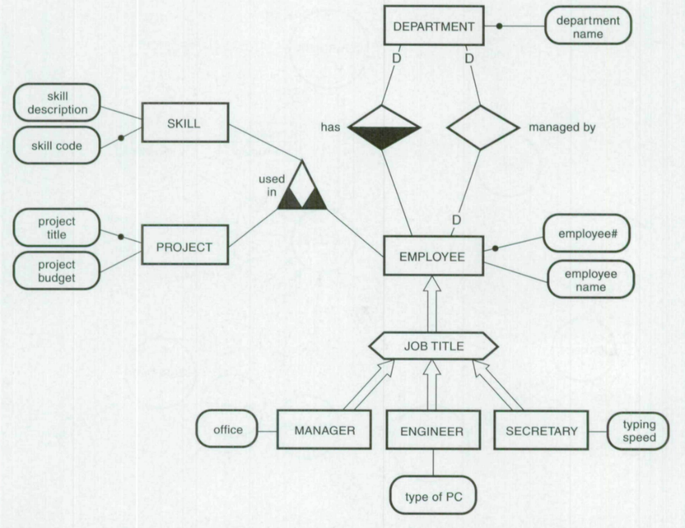
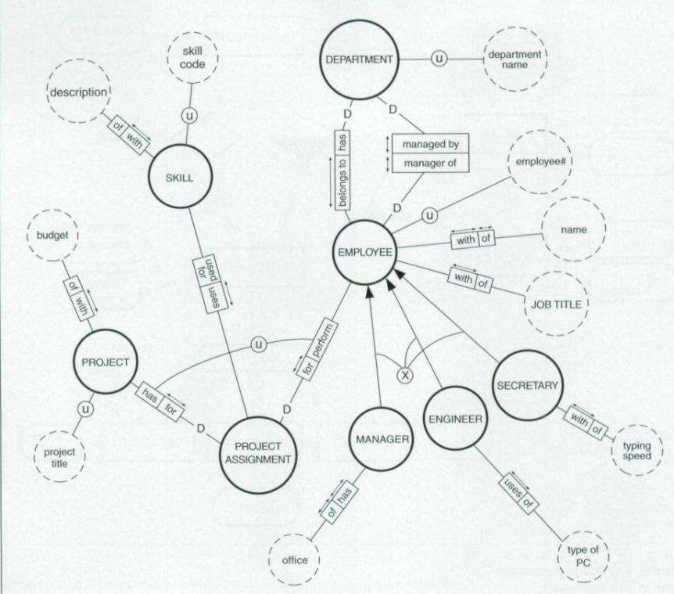
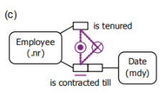
Semantic Data Models
Developed in late 1970 and early 1980
Created by application of data abstraction concepts
“Leitheiser found that a semantic model (LDS) was easier to learn and resulted In higher understanding and recall) of a database schema than a tabular representation”
Consider
Notes:
Semantic data models were developed to provide a precise and unambiguous representation of organizational information requirements.
Images: Extended Entity Relationship model, Nijssen information analysis methodology, exclusive OR constrain in ORM
NORMA’s verbalization language is an output language, designed for validation by business users.
Resources:
Leitheiser, R. An examination of the effects of alternative schema descriptions on the understanding of database structure and the size of a query language. Ph.D. dissertation, Univ. of Minnesota, Minneapolis, 1988
https://doi.org/10.1145/203241.203265
The article compare two semantic models the extended entity relationship (EER), the EER model is a more powerful version of the original entity-relationship (ER) model. The Nijsseii information analysis methodology (NIAM) model (an OR model). Given a small amount of training, users were able to read and validate application data models of nontrivial size and complexity. This is important to make sure that the information systems are right.
https://doi.org/10.4018/jismd.2010092302
Object-Role Modeling (ORM) is a conceptual approach for modeling, querying, and transforming information. Unlike ER modeling and UML class diagrams, fact-oriented models are attribute-free, treating all facts as relationships (unary, binary, ternary etc.). One reason is to ensure that models may be easily verbalized and populated using natural sentences.

