Slide 1
Data Warehouse
NDBI046 - Introduction to Data Engineering
2025/2026
Petr Škoda
https://github.com/skodapetr
https://www.ksi.mff.cuni.cz

Slide 2
Why Data Warehouse ?
"The primary driver for data warehousing is to support operational functions, compliance requirements, and Business Intelligence (BI) activities." -- DAMA DMBOK

Slide 3
Data access
Query driven
Wrappers / Integrators / Mediators / ..
Metadata dictionary
Distributed query
Update driven
Integration into a single data storage
Cloud / Streaming / …
Public
Sales
Customer
Marketing
Sales
Business Intelligence
Social
Accounting

Slide 4
Data Analyst
Scope
Structured data
Static data
Small data
Objective
Answer specific questions
Support business decisions
Output
Data visualization
Story telling
Skill
SQL
Programming : Julia / R / SAS / Python / …
Excel
Data visualization tools
Communication skills
Intermediate statistics
Notes:
Mostly bachelor degree.

Slide 5
Data Scientist
Scope
Un/Semi/Structured data
Dynamic data
Big data
Objective
Define new business opportunities
Output
Data visualization
Story telling
Skill
SQL, NoSQL
Programming : Julia / R / SAS / Python / …
Data visualization tools
Communication skills
Advanced statistics

Slide 6
This is Data Engineering …
Data Warehouse
Business Intelligence
Public
Sales
Customer
Data Lake Custom Pipelines
Data Analyst / Scientist
Marketing
Sales
Use-Case specific
Big Data
Social
Accounting

Slide 7
Data Engineers
Scope
Objective
Build data transformation pipelines
Deploy data transformation pipelines
Skill
SQL, NoSQL, Database Management
Programming : ...
Infrastructure
Data visualization tools
Data modeling
Data governance
Communication skills
Googling / Searching Searching something on internet using google or any other search providers.

Slide 8
Data Warehouse
Place for Your Data Assets

Slide 9
History 1 / 2
1872–1942 The continuous marketing research conducted by Charles Coolidge Parlin
1923 Arthur C. Nielsen, Sr., established ACNielsen
1970s From mainframe, data files, and database to minicomputer
Database management system for parallel processing with multiple microprocessors
1980s Personal Computers, problem islands of data
Distributed database management system (distributed DBMS)
1983 Teradata deploy first relational database management system (relational DBMS)
1986 Ralph Kimball founded Red Brick Systems
Required high-quality data

Slide 10
History
1988 Barry Devlin and Paul Murphy of IBM coined term Business Data Warehouse "ease access to the data and to achieve a coherent framework for such access, it is vital that all the data reside in a single logical repository"
1990s Back to 1970s copy data to one place
1993, 1996 Bill Inmon : Building the Data Warehouse (Wiley) "A data warehouse is a subject-oriented, integrated, time-variant, and nonvolatile collection of data in support of management’s decision-making process"
Kimball defines a warehouse as "a copy of transaction data specifically structured for query and analysis."
2000s Consolidation of vendor community
…

Slide 11
Requirements
What is and what we need to implement data warehouse:
Easily accessible organization’s information.
Consistent and credible presentation of information.
Data warehouse must be adaptive and resilient to change.
Security and controlled access.
Foundation for improved decision making.
Collaboration with business community.
Notes:
Resource:
The Data Warehouse Toolkit Second Edition, Chapter 1, Goals of a Data Warehouse

Slide 12
Data Warehouse
Data Warehouse not Data Dump
Data Warehouse is not another database (OLTP, OLAP, …)
Data Source
Staging Area
Data Warehouse
Data Source
Extract
Load
Transform

Slide 13
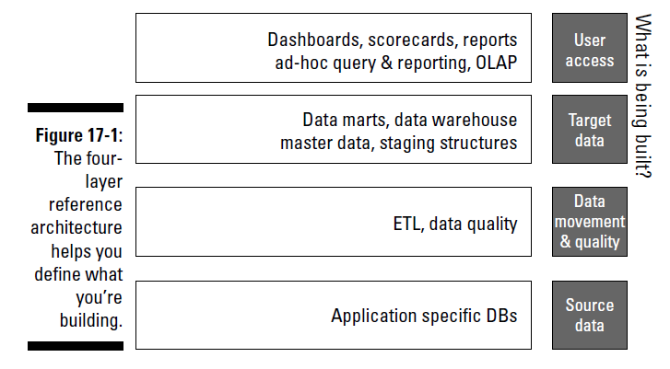
Architecture
Enterprise Data Warehouse

Slide 14
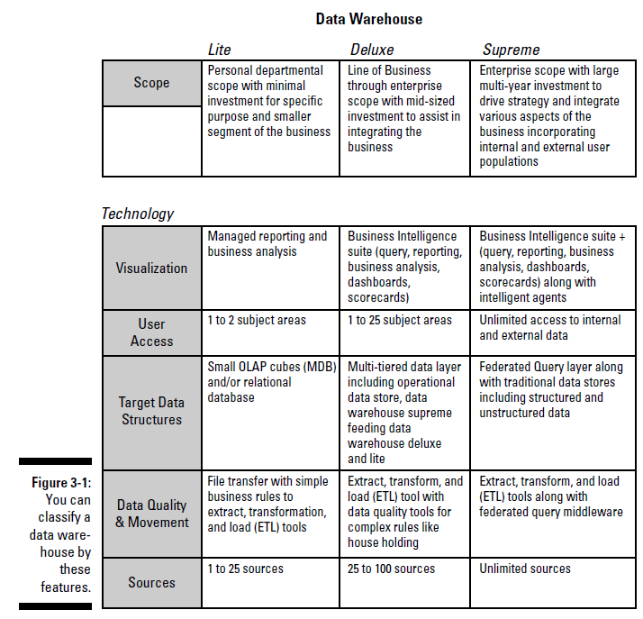
Data Warehousing Classification
Lite
Get the job done with minimum resources.
Deluxe, The Data Warehouse
Accommodate for broader scope.
Prepare for the challenge!
Supreme, Distributed
Basically, a distributed environment.

Slide 15
Data Mart
Data Warehouse lite
Limited scope (subject specific, …)
Can be sourced by Data Warehouse
Top-down implementation
Fast implementation (90 - 120 days)
Lower cost, lower risk
Bottom-up implementation
Vision of distributed Data Warehouse

Slide 16
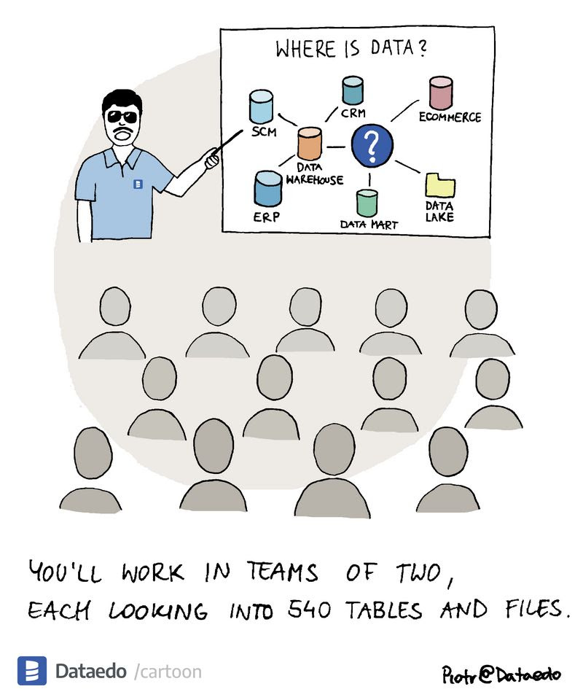
DEMO
SIS
Notes:
Resources:
Data Talk, 2023-09-16

Slide 17
Data Warehousing
How to Data Warehouse?

Slide 18

How to build a ....
Requirements
Design
Development and testing
Deployment
Notes:
Resources:
Image DALL·E 2024-03-04

Slide 19
Building
Top-down
Enterprise Data Warehouse Model
Bottom-up
Integration of smaller projects.
Components may not fit together.
Mixed-mode
Guiding principles
Focus on business goals
Define scope and process
Data integration
Build metadata
Collaborate with other data initiatives Data Governance, Data Quality, …
Security
Maintenance

Slide 20
Data Warehousing
"Data warehousing involves facilitating change in business processes."
Process:
Coordinated, architected, and periodic maintenance the data in a data warehouse
Operational extract, cleansing, transformation, control, and load processes
Enforce business rules and maintain appropriate business data relationships
Interaction with Metadata repositories

Slide 21
Governance
Govern the business-operated discovery or refinement area, it increase business acceptance.
Conceptual Data Model
Data Quality feedback
End-to-end metadata
Data lineage
Service level agreements
Reporting Strategy

Slide 22
Implementation details
Data Warehouse Online Analytical Processing
…

Slide 23
Database
Relational database
1970 E.F.Codd, A Relational Model of Data for Large Shared Data Banks
1970s, 1980s Query Optimizer Online Transactional Processing
Normalization (3.NF)
Online Analytical Processing
Multi-dimensional analytic queries
XML for Analysis (XMLA)
Relational Online Analytical Processing
Start schema
Multi-dimensional Online Analytical Processing
Multidimensional database
Hybrid Online Analytical Processing
Data partitioning
Desktop Online Analytical Processing
Client-side storage
Online Analytical Mining

Slide 24
Enterprise Information Integration
Consider
Notes:
Virtual or federated data access can be another service. Around 1995 vendors start marketing their services virtual data warehousing tools. But just because you can get to data at its source (in almost any database or file structure) doesn’t mean that data provides the necessary business intelligence when it’s in your hands. To solve these data quality issues, many data architects have begun to perform bottom-up data mart construction to develop a component-based data warehouse. Instead of having a single database a multiple databases are employed. Additional components can handle particular functionality. Together, these data marts (or components) comprise a data warehousing environment.
This component-based, dynamic access data architecture is the basis for virtual data warehousing and, more specifically, what Enterprise Information Integration (EII) servers are offering to the market.
Enterprise Information Integration (EII) creates a data warehousing environment in which users can access each component’s contents from a business intelligence tool like they were all stored together, even though they’re not. I highly recommended that you don’t build a virtual data warehousing environment to access source data directly, in its native format. The objective is not to integrate various databases. Each application should therefore be warehouse-enabled and contain a data publisher that’s responsible for all the middleware services (such as extraction and quality assurance), as specified in the environment’s business rules.
When you think of virtual data warehousing, replace the question “Can I get to the data?” with the question “Can I get to usable data?”. We also need to keep data architecture in mind.
Additional EII services
* A unified metadata service: Users see a single logical view of the environment’s contents without having to know the location and particulars of each component.
* A directory service: Individual components within the environment, even if they’re relocated or otherwise modified.
* Security services: These services handle permissions, authentication, and other security needs in a distributed environment.
* Synthesis services: A virtual data warehouse might have to combine facts from one component with facts from another.
* Transaction-management services: In addition to the synthesis service, which is a type of transaction-management function, these services provide routing, load balancing, conflict resolution, and other functions necessary to ensure data integrity. We need those even in read-only situation.
Until an organization’s communications infrastructure can pump the data through, EII services and concepts (such as virtual data warehousing) probably will remain on the fringes, just out of reach.

