Slide 1
Towards Data Warehouse
NDBI046 - Introduction to Data Engineering
2025/2026
Petr Škoda
https://github.com/skodapetr
https://www.ksi.mff.cuni.cz
Notes:
Resources:
Data Warehousing For Dummies ISBN: 978-0-470-40747-9

Slide 2

Data Engineering

Slide 3
ChatGPT 2026
Prompt: Explain data engineering like I am 5.
Imagine you have a huge box of LEGO pieces. 🧱Some are tiny, some are big, some are red, some are blue. They’re all mixed up. Now imagine your friend wants to build: A house, A car, A spaceship. But everything is messy. They can’t find the right pieces! So what does a data engineer do? A data engineer is like the person who: Collects all the LEGO pieces (gets data from different places), Sorts them by color and size (organizes the data), Cleans the dirty ones (fixes mistakes in the data), Puts them into neat boxes with labels (stores the data properly), Builds special shelves so everyone can find pieces fast (creates systems so data is easy to use). Why is that important? Because other people like: Data scientists, Analysts, App developers. Need clean, organized data to: Make charts, Build apps, Train AI, Help companies make decisions. If the LEGO pieces are messy, nobody can build anything! Super simple version: Data engineering is: Making messy information clean and organized so others can use it easily. If you’d like, I can also explain it like you're 15 or like you're starting a startup 🚀
https://chat.openai.com/ 2026.02.17
Notes:
Highlights and formatting added manually.
Source:
https://chat.openai.com/

Slide 4
ChatGPT 2025
Prompt: Explain data engineering like I am 5.
Alright! Imagine you have a big box of LEGO bricks, all jumbled up in different colors, shapes, and sizes. But you want to build a cool castle! Data engineers are like the people who sort the LEGO bricks, organize them by color and shape, and put them in neat little boxes so that when someone wants to build something (like a castle), they can find exactly what they need quickly and easily. Instead of LEGO, data engineers work with information—like numbers, words, and pictures. They take messy data, clean it up, and store it neatly so other people (like scientists, businesses, and apps) can use it to do amazing things! 🚀
https://chat.openai.com/ 2025.02.16
Notes:
Highlights added manually.
Source:
https://chat.openai.com/

Slide 5
ChatGPT 2024
Prompt: Explain data engineering like I am 5.
Alright, imagine you're playing with Lego blocks. You have all these different pieces and you want to build something cool, like a spaceship. Data engineering is like putting those Lego blocks together to make sure they fit just right and that your spaceship doesn't fall apart.
But instead of Lego blocks, we're dealing with lots of information, like numbers, words, and pictures, that we want to organize and use in different ways. Data engineers are like the architects and construction workers who figure out how to arrange all this information so that it's easy to find and use when we need it.
They make sure the data is clean, meaning it doesn't have any mistakes or missing pieces, and they build special structures called databases to store the data securely. They also create pipelines, which are like tunnels that help move the data from one place to another safely and quickly, so we can use it to learn new things, make important decisions, or just have fun!
https://chat.openai.com/ 2024.02.14
Notes:
Highlights added manually.
Source:
https://chat.openai.com/

Slide 6
ChatGPT 2023
Prompt: Explain data engineering like I am 5.
Data engineering is like building a big lego tower. Just like how you take lots of little lego blocks and put them together to make a big tower, data engineers take lots of little pieces of data and put them together to make a big, useful structure.
Data engineers have to make sure the lego blocks fit together perfectly, just like they have to make sure the data fits together perfectly. They also have to make sure the tower is strong and won't fall apart, just like they have to make sure the data is stored securely and can be easily accessed when needed.
Data engineering is important because it helps people and organizations make sense of all the information they have. By putting the data together in a useful way, they can use it to make better decisions and solve problems. Just like how your lego tower can be a castle or a spaceship, the data structure that data engineers create can be used for many different purposes!
https://chat.openai.com/ 2023.02.13
Notes:
Highlights added manually.
Source:
https://chat.openai.com/

Slide 7



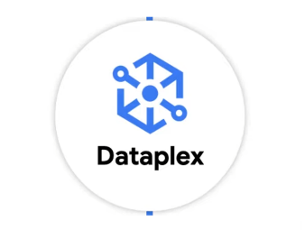



Data Engineer
A data engineer is a practitioner of data engineering.
There is no single roadmap or definition. Yet we can look at various sources and put the pieces together.
Market (*) Building ***** a data analytical and AI platform.
Responsibilities includes:
Data extraction, transformation, loading, archiving
Cloud
Data lake implementation
Data governance: data catalog, data quality, data lineage ...
...
YouTube
Scripting / programming language
SQL
Linux commands
Data warehouse concepts
Docker, Kubernetes, Cloud
Orchestration
Distributed systems
....

Slide 8
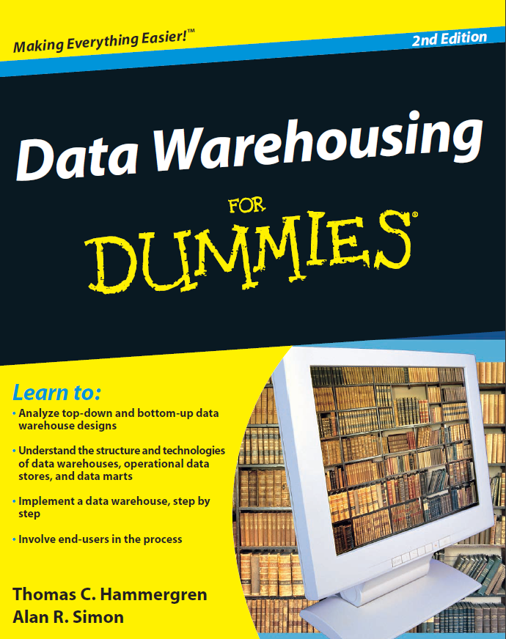
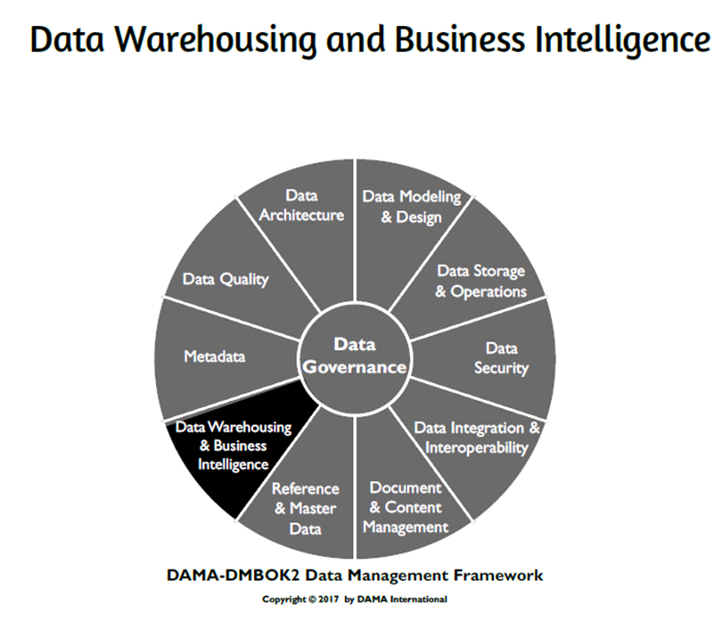
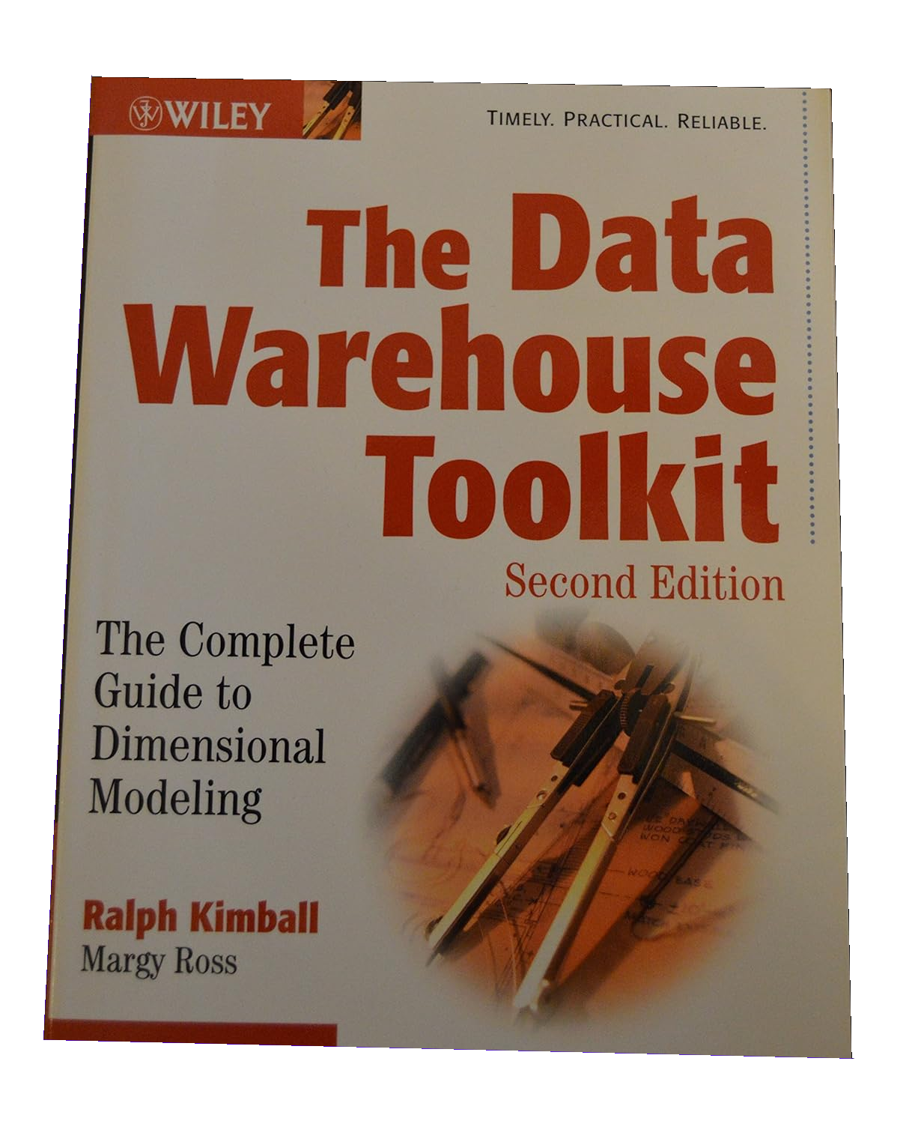
Resources
Notes:
Resources:
Data Warehousing For Dummies ISBN: 978-0-470-40747-9

Slide 9
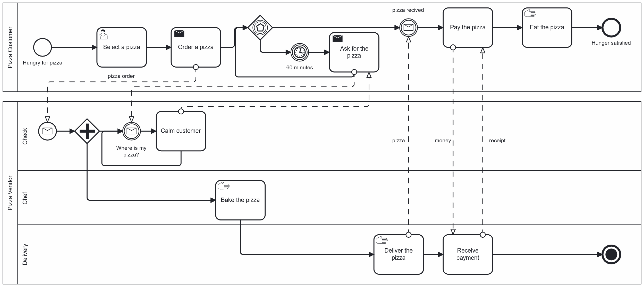

Activity
Supporting the business.
Notes:
Resources:
https://www.bpmn.org/
https://demo.bpmn.io/

Slide 10
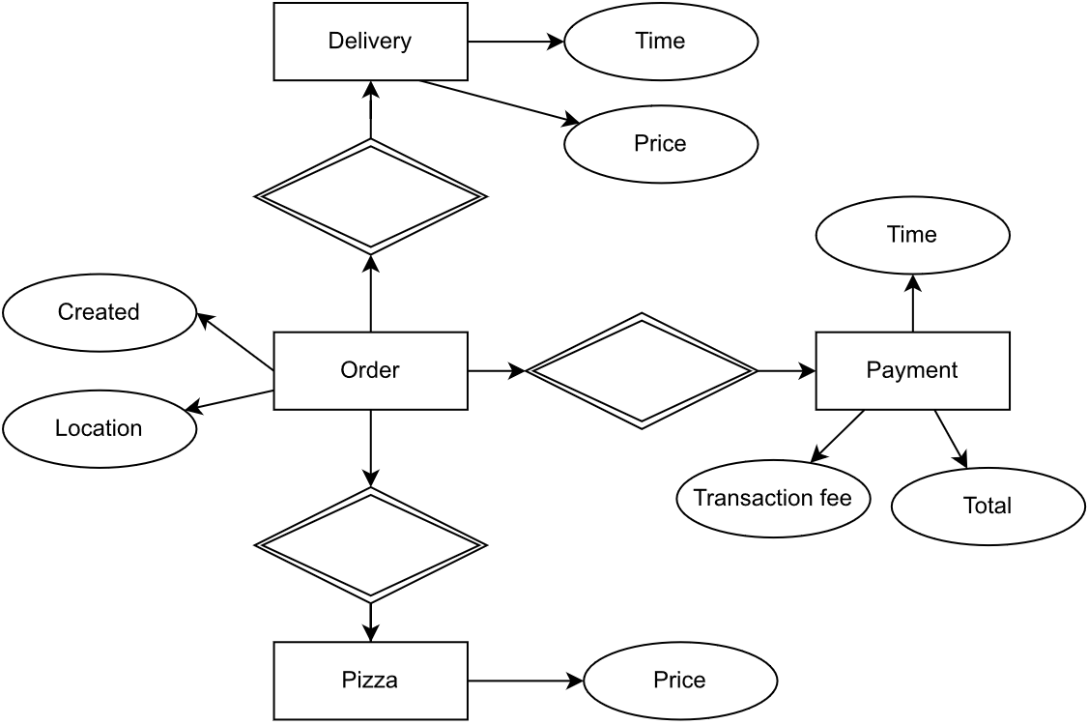
Operational Database Systems
On-line Transaction Processing (OLTP) systems
Support day-to-day operation
Thousands of users, small read / write operations
Transaction oriented
High performance
High availability
Normalized schema

Slide 11
DIKW
There are different definitions of the pyramid:
NDBI025
…
Wisdom
Knowledge
Information
Data
Data are not good enough for management.
E.g.: explanation and reasons
Synthesis of multiple information sources over time.
E.g.: a trend
Symbols that represent properties of objects, events and their environment. Product of observation. E.g.: observations
Add context and interpretation. Classification, calculation, selection, aggregation.
Notes:
Resource:
https://journals.sagepub.com/doi/10.1177/0165551506070706
https://softwarezen.me/wp-content/uploads/2018/01/datawisdom.pdf

Slide 12
Data classification
Run the business data
Produced by day-to-day operation
Run the business data
Place an order
Schedule shipment
Receive payment
Process orders
Process shipments
Process payments
Integrate the business data
Improve business efficiency
E.g.: Master data
Integrate the business data
Customer Master Data
Monitor the business data
High quality data
Support decision making
Monitor the business
Financial dashboard
Customer demographic analysis
Notes:
Resource:
Data Warehousing For Dummies [2016] / page 12
https://www.youtube.com/watch?v=l83bkKJh1wM

Slide 13
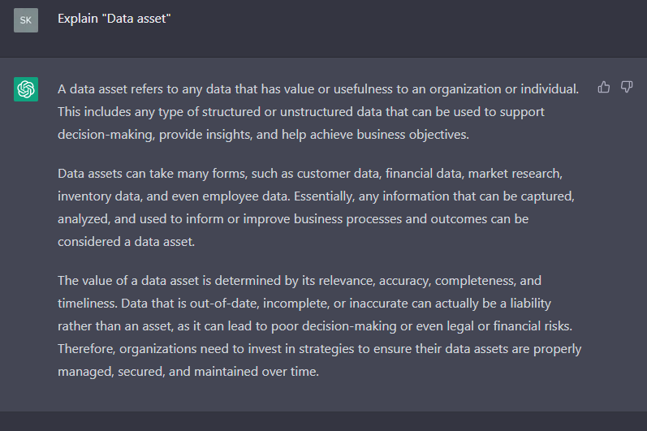
Data asset
A data asset refers to any data that has value or usefulness to an organization or individual.
Data assets can take many forms, such as customer data, financial data, market research, inventory data, and even employee data.
The value of data assets is determined by data quality.
Value is in ability to be used to support decision-making, provide insights, and help achieve business objectives.
2022/2023

Slide 14
Business Intelligence
10000-foot view

Slide 15
Business Intelligence (BI)
Type of data analysis aimed at understanding organizational activities and opportunities. Results of such analysis are used to improve organizational success.
A set of technologies that support this kind of data analysis. An evolution of decisions support tools, BI tools enable querying, data mining, statistical analysis, reporting, scenario modeling, data visualization, and dashboarding.
It is rare to build custom BI tool.

Slide 16
Business Intelligence Categories 1 / 3
Querying and reporting : What happened ?
Standard reports presented in a specific format, on screen or in a printout.
Answer to a particular question, an ad-hoc query, or key performance indicators (KPI).
Little to no interaction, static and predictable.

Slide 17
Business Intelligence Categories 2 / 3
Business analysis : What happened and why?
Visualizing data in a multidimensional manner.
Typically presented as table, with dimensions mapped to columns and rows.
User can manipulate the data and visualization.
Executive Information Systems (EIS): Dashboard, Scorecard, ...
Data mining
Predictive and discovery-oriented.
Requires specific knowledge and education : NDBI023 Data Mining, …

Slide 18
Business Intelligence Categories 3 / 3
Operational reporting
Short and long, year to year, trends and patterns
Support short-term business decisions
Business performance management (BPM)
Metrics aligned with organizational goals
Support long-term business decisions, executive level
Optimize execution of business strategy
Operational analytics (Analytic Applications)
Employ near-real-time analytics to guide operational decisions
Business Intelligence for front lines of the business
Notes:
Resources:
Morris, Henry. “Analytic Applications and Business Performance Management.” DM Review Magazine, March, 1999.

Slide 19
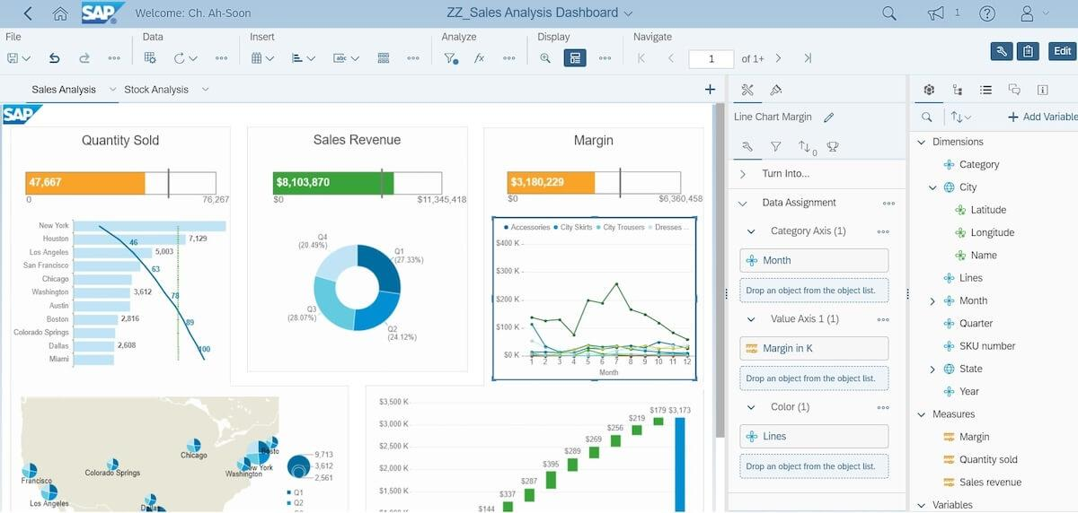
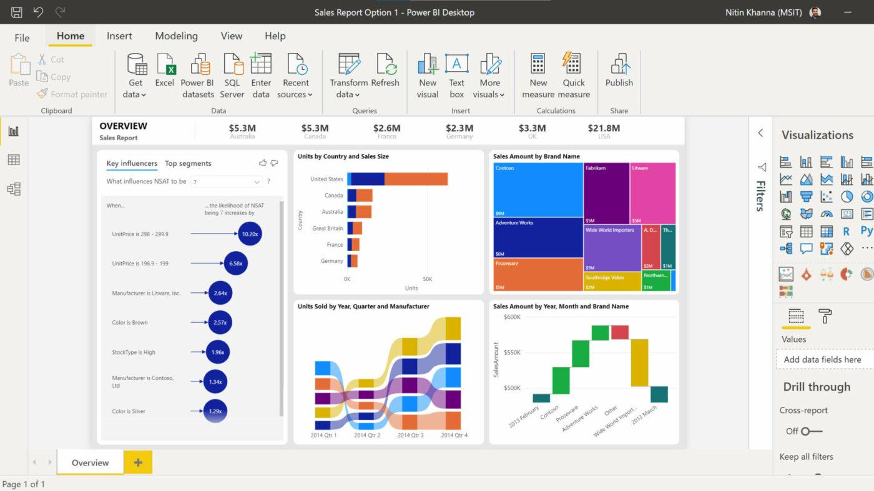
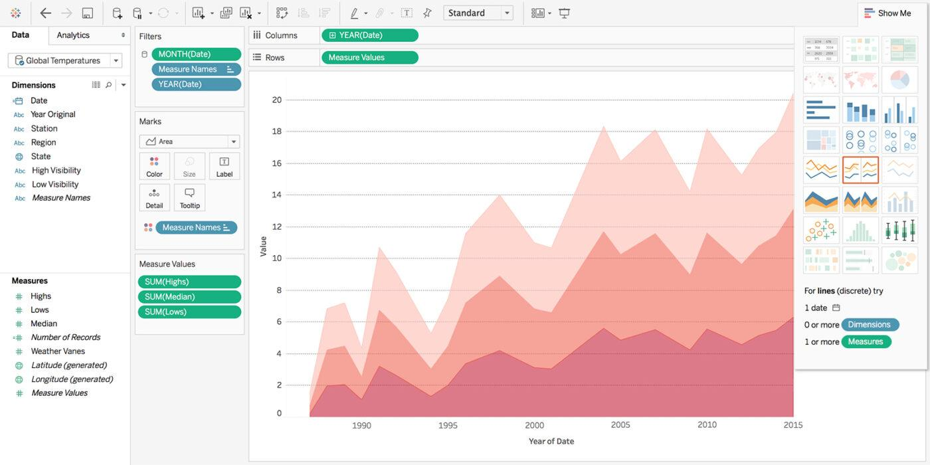
Tools
SAP BusinessObjects Business Intelligence
Microsoft Power BI
Tableau (NPGR023)
Notes:
Resources:
https://clickup.com/blog/business-intelligence-software/ - 2023/2024 screens.

Slide 20

Showcase
Pivot Table

Slide 21
Activity
Business intelligence for everyone?
Notes:
Resources:
https://www.bpmn.org/
https://demo.bpmn.io/

Slide 22
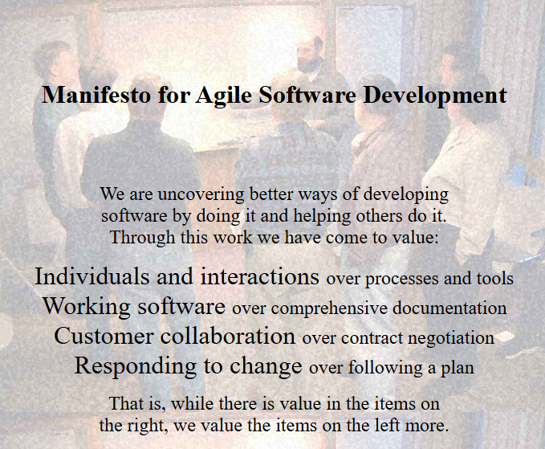
Business perspective
Information Technology
Unrealistic expectations for new applications of enhancements of existing application
Little participation during design
Little participation during testing
Lack of training
Business
IT have no idea about business
Random features
Slow response time
It does not work !
Notes:
Resources:
- https://agilemanifesto.org/

Slide 23
On-Line Analytical Processing (OLAP)
Multidimensional data

Slide 24
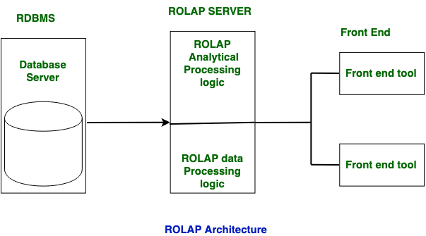
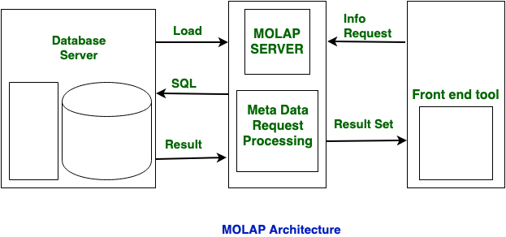
OLAP
OLAP
Definition with 12 rules by Coddem 1993
Fast Analysis of Shared Multidimensional Information 1995
Notes:
ROLAP is used for large data volumes and in this data is stored in relation tables. In ROLAP, Static multidimensional view of data is created.
MOLAP is used for limited data volumes and in this data is stored in multidimensional array. In MOLAP, Dynamic multidimensional view of data is created.
MOLAP does not use relational database to storage. It stores in optimized multidimensional array storage. The storage utilization may be low with multidimensional data stores.
Resources:
https://www.geeksforgeeks.org/difference-between-rolap-and-molap/
https://www.geeksforgeeks.org/difference-between-rolap-molap-and-holap/

Slide 25
OLTP vs. OLAP
On-line Transaction Processing (OLTP) systems
Support day-to-day operation
Thousands of users, small read / write operations
Transaction oriented
High performance
High availability
Normalized schema
On-Line Analytical Processing (OLAP)
Decision support
Hundreds of users, read only
Multi-dimensional analytic queries
High flexibility
Downtime, regular updates
Implementation architectures: ROLAP, MOLAP, HOLAP, …
Query result is a matrix - a data cube.
Notes:
Resources:
https://homel.vsb.cz/~dan11/is_skripta/IS%202010%20-%20Danel%20-%20OLAP.pdf
https://dl.acm.org/doi/10.1145/276305.276386 - The multidimensional database system RasDaMan
https://www.sisense.com/glossary/olap/ - They have custom product ElastiCube

Slide 26
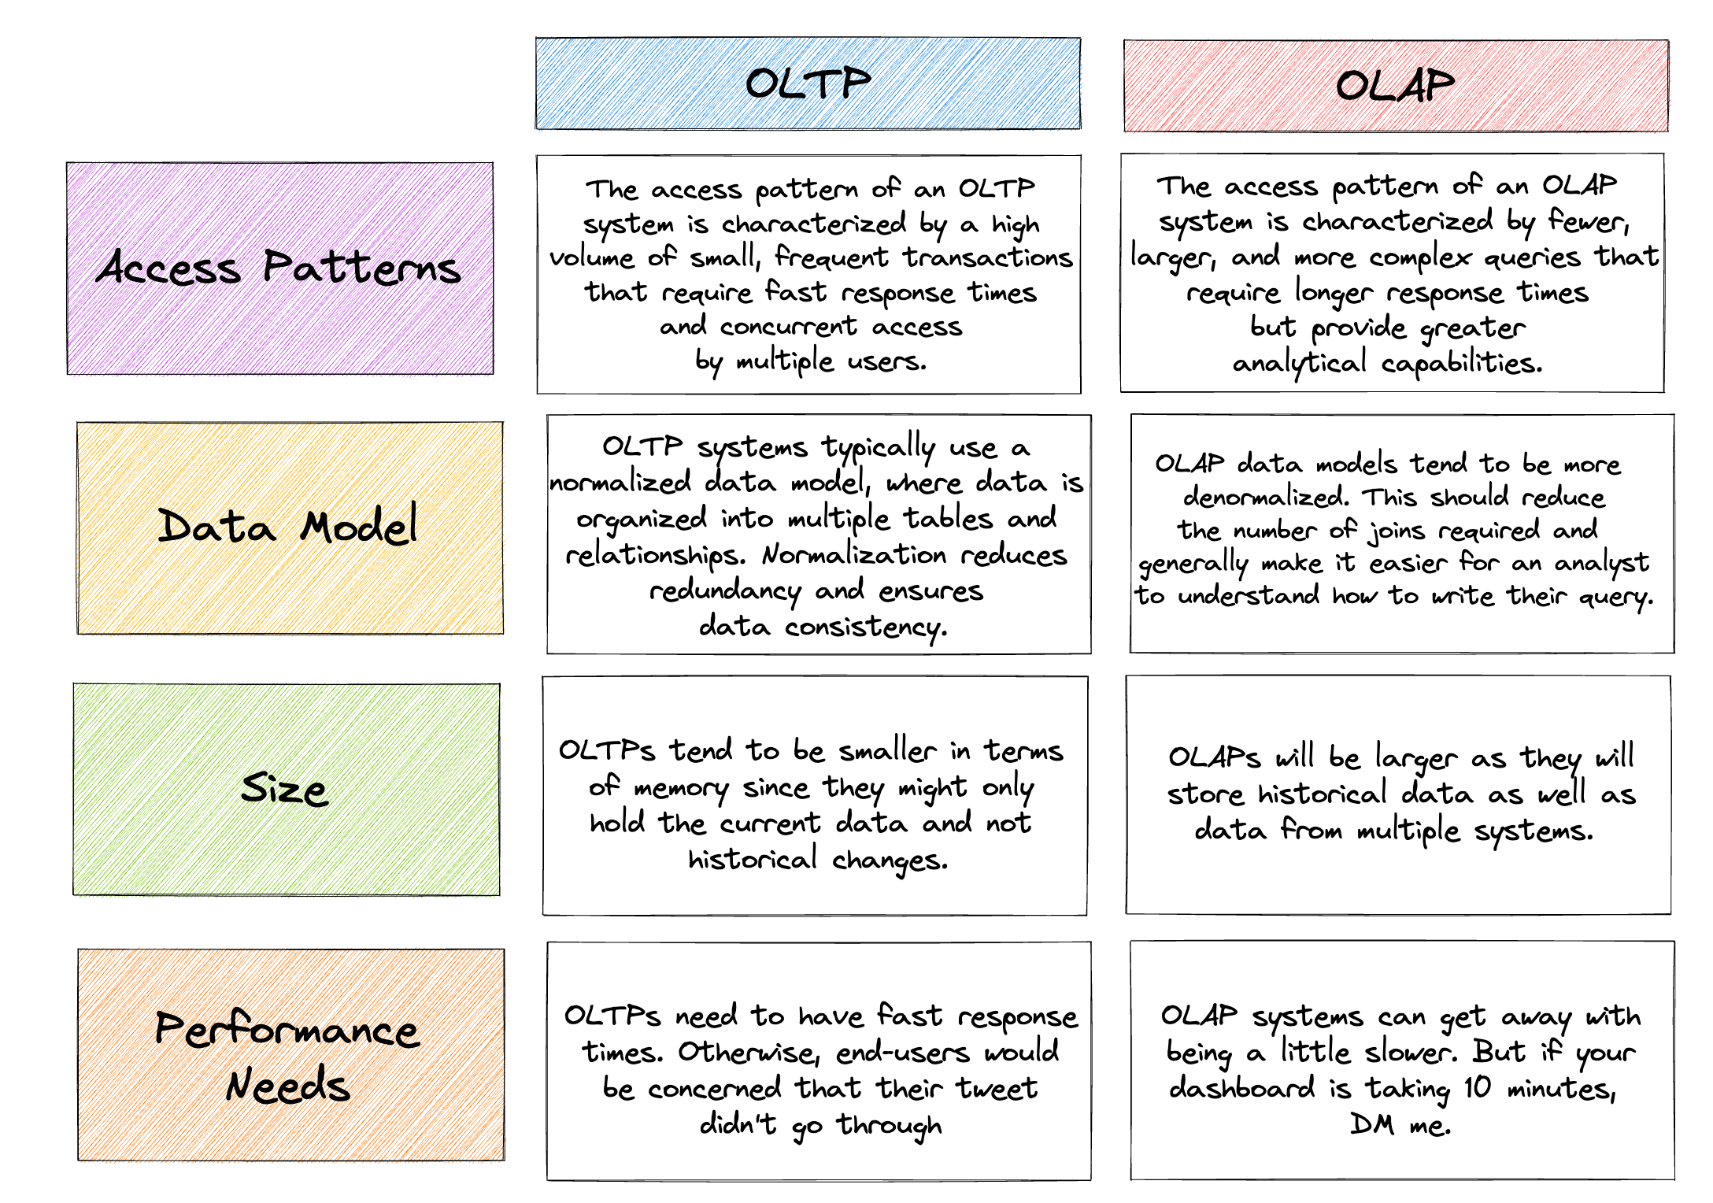
OLTP vs. OLAP
Seattle Data Guy, 2023
Notes:
Resources:
Seattle Data Guy, 2023

Slide 27
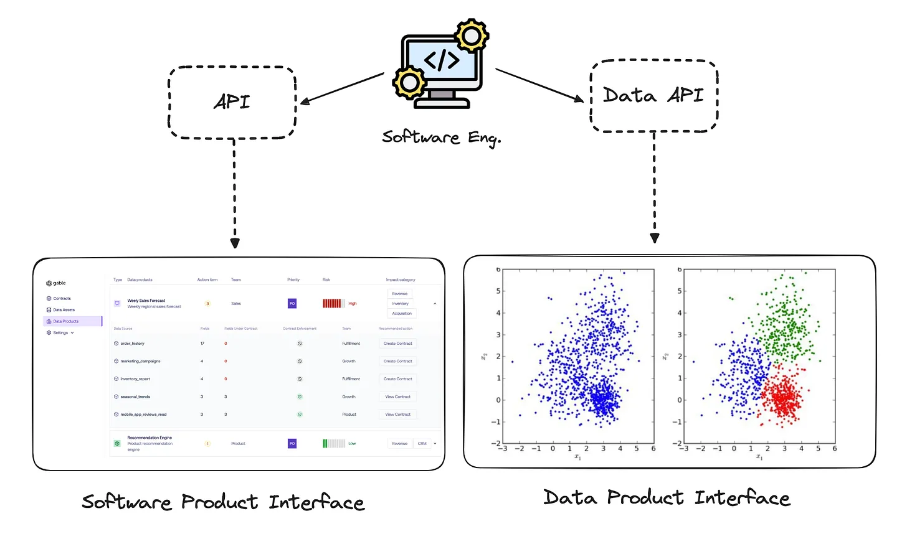
OLTP vs. OLAP
We can see similar for products
Notes:
Resources:
https://dataproducts.substack.com/p/the-consumer-defined-data-contract

Slide 28
Multidimensional Data
Multidimensional data
Dimensions
Dimension hierarchy
Facts
Measures
Time
time = Monday
product = Pizza Hawaii
units sold = 4
Dimension
Fact
Product
Dimension
Measure: total units sold in … = 45

Slide 29
Data cube operations 1 / 3
Hierarchical dimensions
Additional dimensions
 | 2019 |  |  |  | 2020
 | 1. Q | 2. Q | 3. Q | 4. Q | 1. Q | 2. Q | 3. Q | 4. Q
Hawaii | 10 | 14 | 12 | 9 | 15 | 18 | 3 | 8
Drill Down
Drill Up
 | 1. Quarter |  |  | 2. Quarter |  |  | …
 | January | February | March | April | May | June | …
Hawaii | 2 | 4 | 4 | 7 | 3 | 4 | …

Slide 30
Data cube operations 2 / 3
 | 1. Quarter |  |  | …
 | January | February | March | …
Hawaii | 2 | 4 | 4 | …
Slice
Slice
Dice
 | 1. Quarter |  |  | …
 | January | February | March | …
Hawaii | 1 | 2 | 2 | …
Monday
Slice

Slide 31
Data cube operations 3 / 3
Pivot
Nesting
Drill-across
Drill-through / reach-through
Trending
…

Slide 32
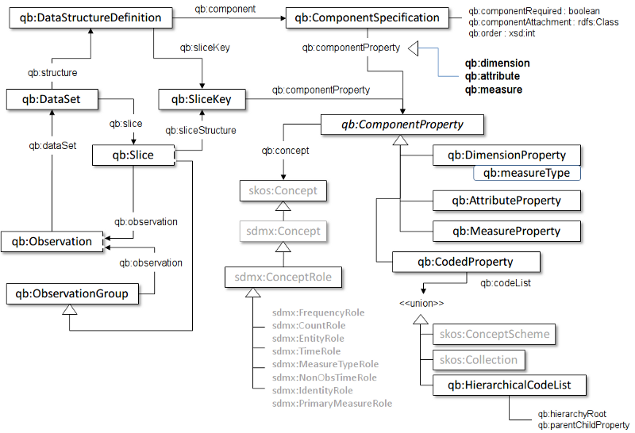
Data cube vocabulary
W3C recommendation from January 2014
RDF vocabulary
Based on Statistical Data and Metadata eXchange (SDMX)
Notes:
Resource:
https://www.w3.org/TR/vocab-data-cube/
https://www.youtube.com/watch?v=af0gpvesWaY

Slide 33
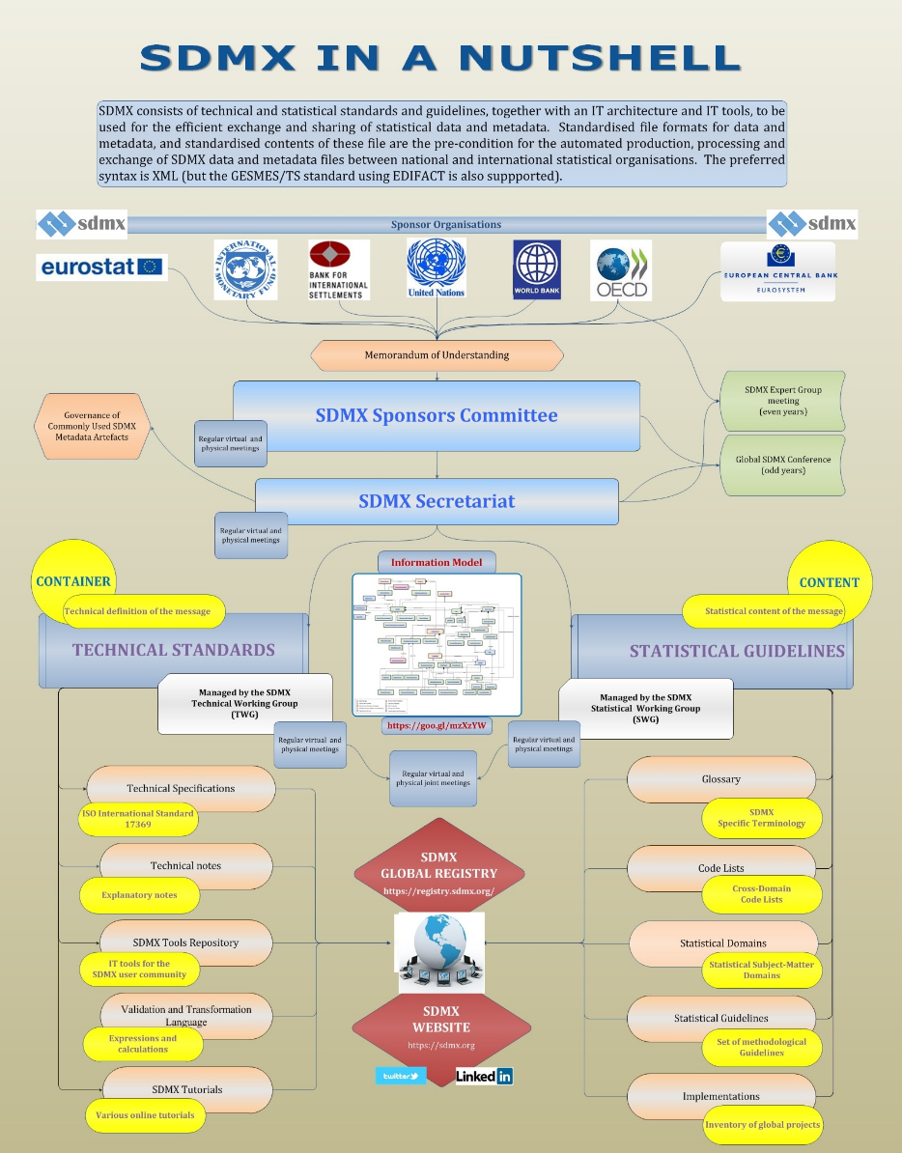
Common statistical concepts
The SDMX set of Content-Oriented Guidelines (COG) as RDF resources
http://purl.org/linked-data/sdmx/2009/concept#
http://purl.org/linked-data/sdmx/2009/code#
http://purl.org/linked-data/sdmx/2009/dimension#
http://purl.org/linked-data/sdmx/2009/attribute#
http://purl.org/linked-data/sdmx/2009/measure#
Statistical Data and Metadata eXchange (SDMX)
Technical standards and guidelines
Statistical standards and guidelines
Tools and architecture
Notes:
Resource:
https://sdmx.org/
https://www.ecb.europa.eu/stats/ecb_statistics/co-operation_and_standards/sdmx/html/tutorial.en.html

Slide 34
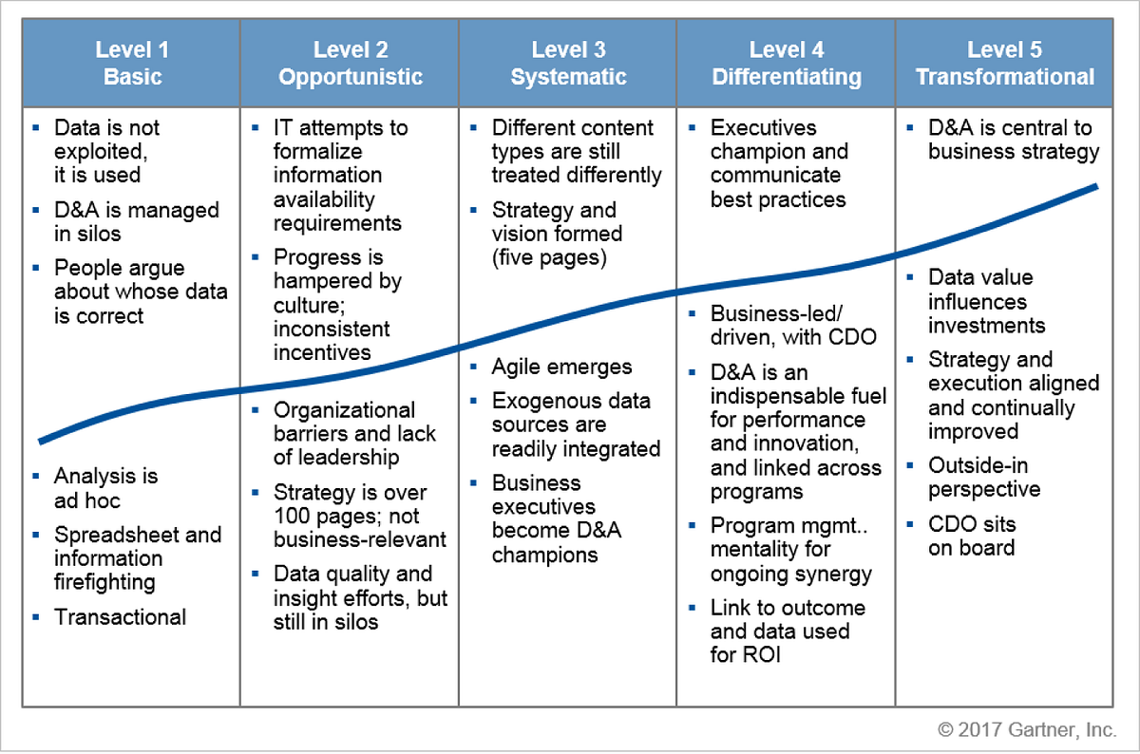
Data adoption levels

Slide 35
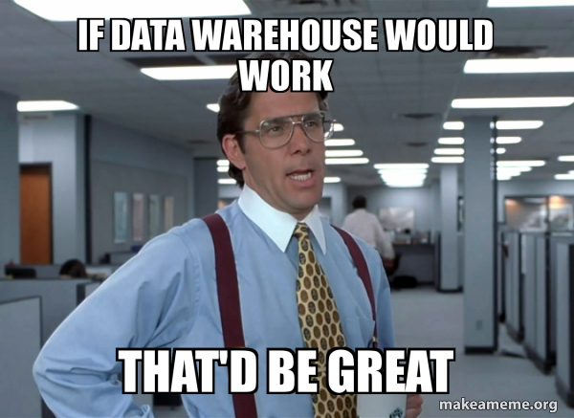
Data warehouse
Notes:
Resources:
- https://makeameme.org/meme/if-data-warehouse

