Slide 1
Introduction
NDBI046 - Introduction to Data Engineering
2025/2026
Petr Škoda
https://github.com/skodapetr
https://www.ksi.mff.cuni.cz

Slide 2
Outline
Prerequisites Web and Data-Oriented Programming, 3rd year
Programming 1 (NPRG030)
Programming 2 (NPRG031)
Programming in Java / C++ / C# / Web ...
Database Systems (NDBI025)
Individual Software Project (NPRG045)
Database Access Methods (NDBI046)
Optional
Software System Architectures (NSWI130)
Outcomes
Business process
Data use-case(s)
Data management
Data engineering and data engineer

Slide 3
Activity
Why?

Slide 4
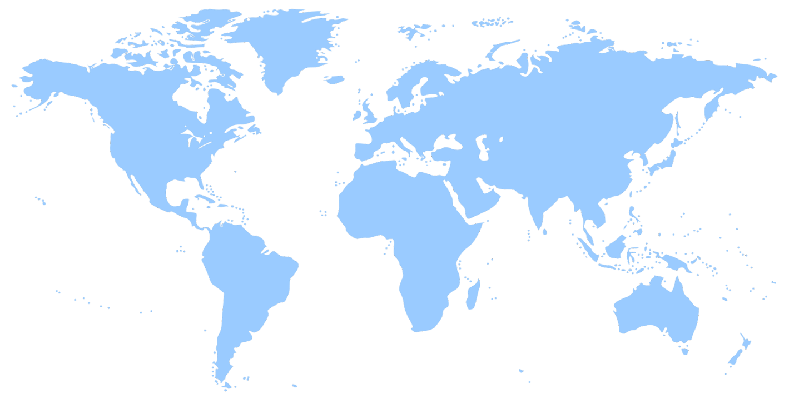
Data use-cases
Private sector
What is the best way to recommend a product to a customer?
Public sector
How can we detect fraud?
Each area has specific needs and requirements. Yet the ideas and principles are shared.
Science
Have we rightfully rejected the hypothesis?
https://openclipart.org/detail/1733/world-map

Slide 5

Motivation
Positive
… the amount of information generated will increase 10-fold by 2025. (*)
Provides the structure for information to be easily shared with others. (*)
Makes it easier for your employees to find and understand the information that they need to do their job. (*)
…
Negative
… computer attacks which led to the theft of over 77 million … users’ bank details. (*)
93% of companies that lost their data center for 10 days or more due to a disaster filed for bankruptcy within one year of the disaster. (*)
IBM estimated the cost of poor-quality data in the US in 2016 was $3.1 Trillion (DMBoK)
The $500mm+ Debacle at Zillow Offers – What Went Wrong with the AI Models? (*)
…
https://www.meme-arsenal.com/en/create/meme/1647212

Slide 6
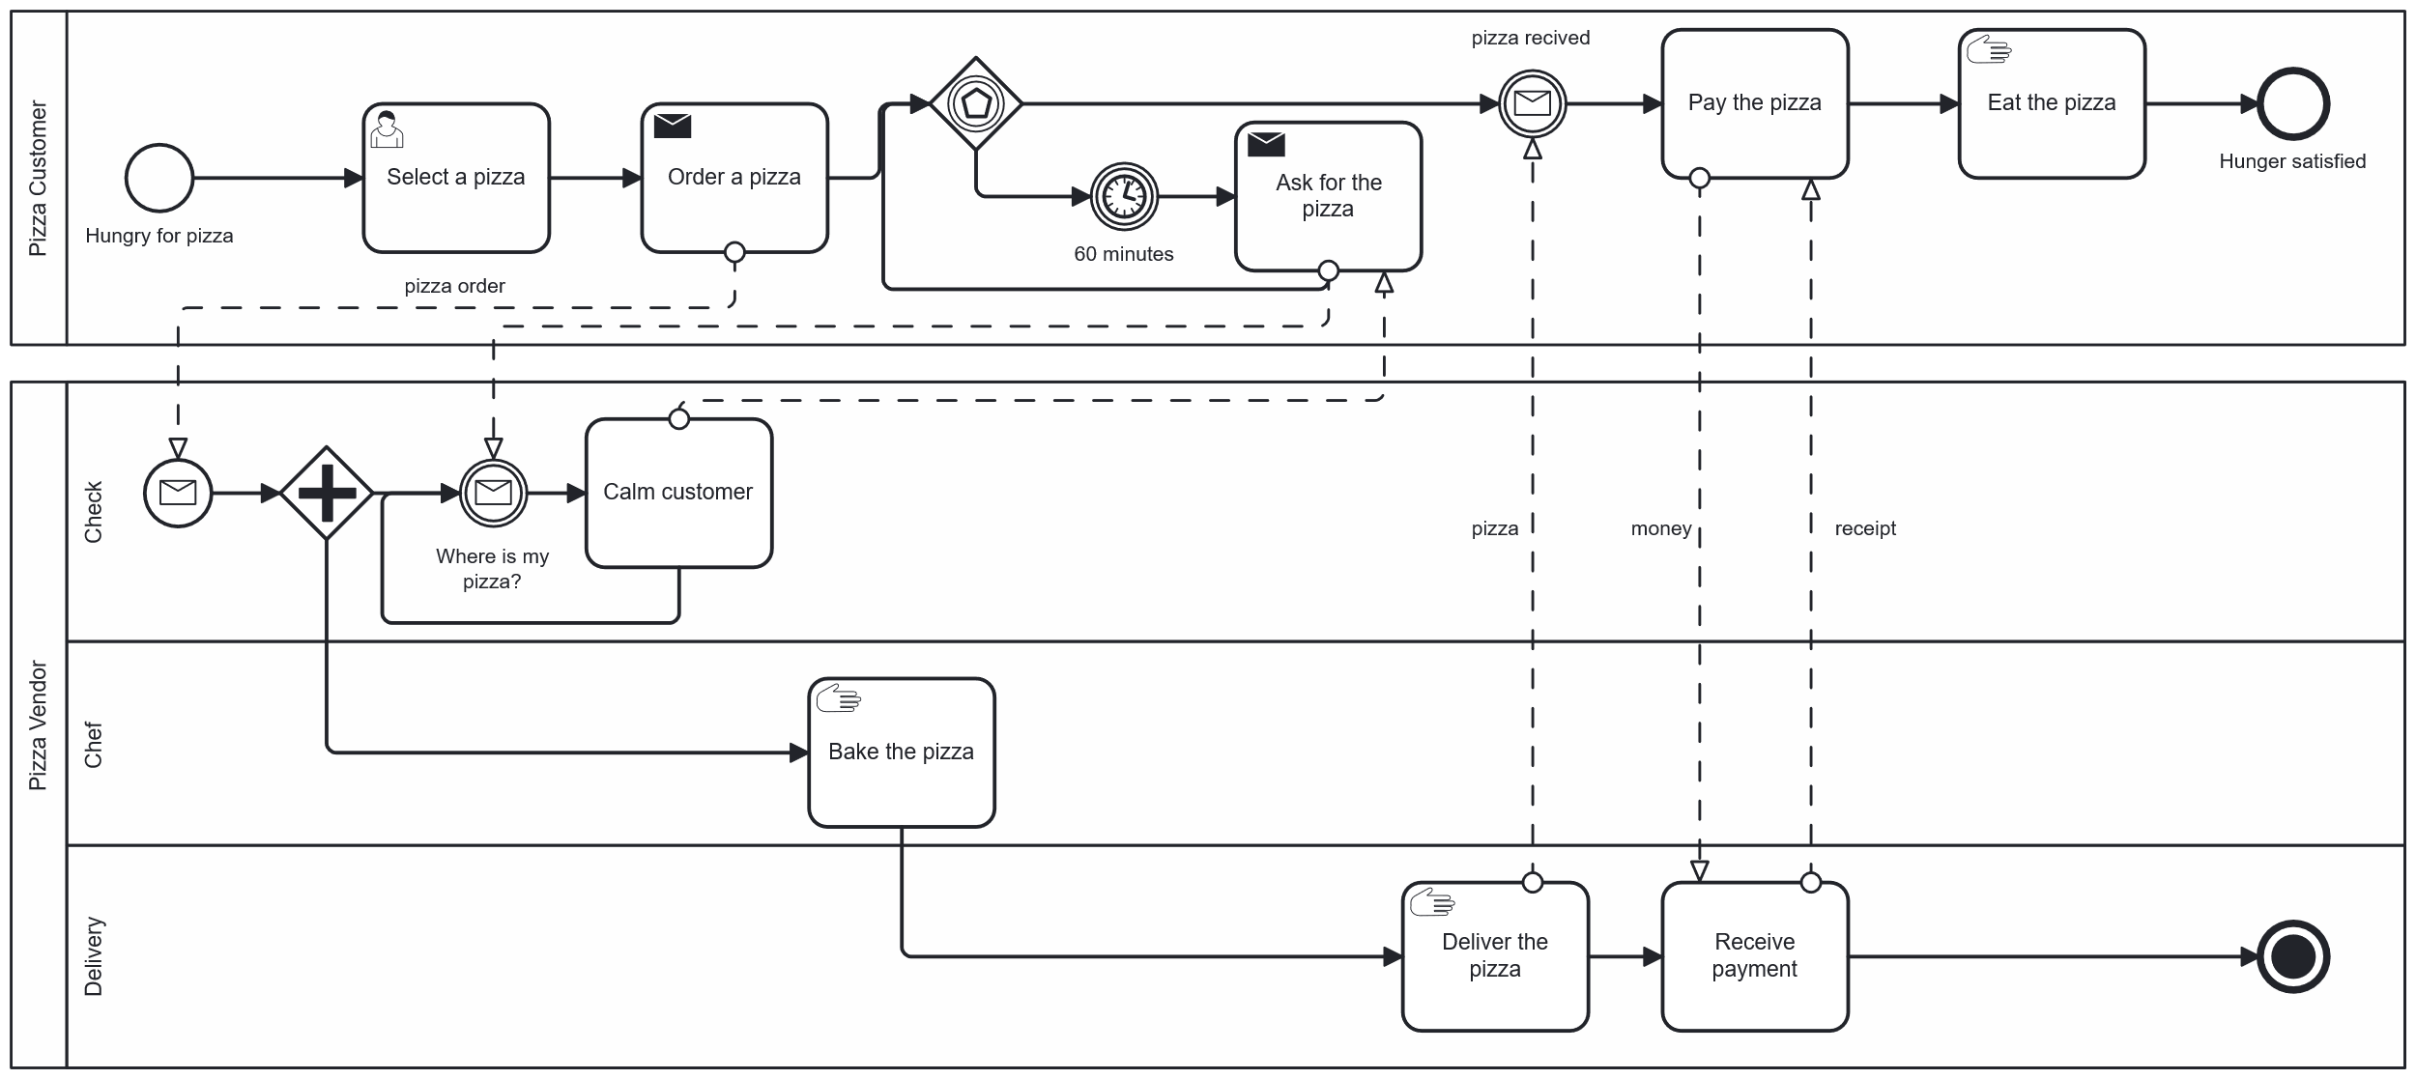
Business
Business Process Model and Notation (BPMN)
https://www.omg.org/cgi-bin/doc?dtc/10-06-02.pdf, 5.2 The Pizza Collaboration
Notes:
Resources:
https://www.bpmn.org/
https://demo.bpmn.io/

Slide 7

Motivation Story
Ailish in the Wonderland Dataland
https://openclipart.org

Slide 8
Story: Setup
MyFood is a fictional pizza company focusing on delicious eco-friendly meals and monthly promotions. Area managers have suggested that retail shops near public transport stops can use additional personnel. From their personal experience, those shops are unable to serve customers fast enough. As a result, MyFood is losing money and position on the market.
Decision
Should MyFood provide local shops with money for additional employees?
Question
Sales of promoted products per local shop, for each shop that is at most 100 meters from a public transportation stop.
https://openclipart.org

Slide 9
Story: Now what?
What data do we need?
What data sources are available?
What is the meaning of the data?
What data sources should be used?
What transformation should be used?
How should the data be published?
https://openclipart.org

Slide 10
Activity
Data Sources

Slide 11
Data sources
My computer
Paper
People
Internal network
Internet
Another department
…
File system
NoSQL
Data warehouse
Data lake
Data mesh
API
…
Text
PDF
JPEG
JSON
XML
Domain specific formats
…

Slide 12

Data is all you need, right?
0111101100100010011101100110000101101100011101010110010100100010001110100010000000100010001100010011100000101110001100100010001001111101
ASCII, ...
There is more!
Temperature
Two devices next to each other
Prague, Czechia, Living room
15:00 UTC+01:00
2026-02-18
TFA 30.5027.02, Honeywell CM927
...
{"value": "18,2-19"}
JSON
Range 18.2 to 19.0
....

Slide 13
Data types
Java
int
float
char
double
String
…
JavaScript
Number
String
Boolean
null
undefined
…
C
int
long int
unsigned int
…
SQL
INT
VARCHAR
DECIMAL
TEXT
BLOB
…
CSV
Text
…
GraphQL
String
…
XML
xsd:Date
…

Slide 14
Three layers of modeling
Physical Data Model Add details, like data types or stored procedures, required for a particular database. Names are database compatible. Specifies how logical structures are implemented at given technical level.
Logical Data Model Add more details such as attributes, foreign keys, key attributes. It is database agnostic. Specifies how conceptual components are represented in a database structure.
Conceptual Data Model They are also referred to as domain models and offer a big-picture view of what the system will contain, how it will be organized, and which business rules are involved. Capture entities, without details, and their relations.
NDBI025 lecture 2

Slide 15


Three layers of modeling - meeting

Slide 16
Story: Now what?
What data do we need?
What data sources are available?
What is the meaning of the data?
What data sources should be used? Ask colleagues, internal regulations, law, international law, data quality, …
What transformation should be used?
How should the data be published?
Data Management
Data Catalog
https://openclipart.org

Slide 17

Story: Now what?
What data do we need?
What data sources are available?
What is the meaning of the data?
What data sources should be used?
What transformation should be used?
How should the data be published?
ETL or not to ETL?
Shadow IT
https://share.google/rwzNwusxZyPFO4Ky0
https://openclipart.org

Slide 18
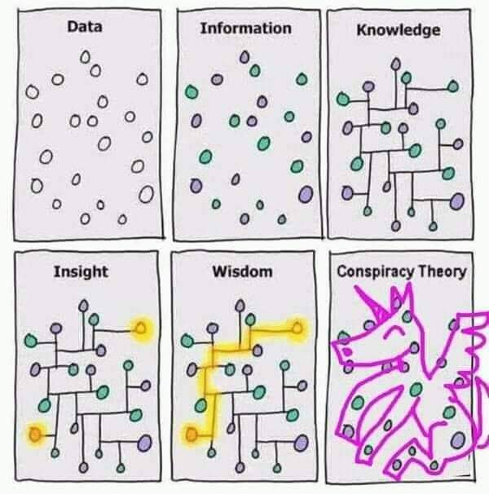

What are we building, and why?
Data-Information-Knowledge-Wisdom pyramid
https://makeameme.org/meme/ooooh-business-intelligence-31d5165b21
https://twitter.com/PaulTubb1/status/1294204993290080256

Slide 19
Story: Now what?
What data do we need?
What data sources are available?
What is the meaning of the data?
What data sources should be used?
What transformation should be used?
How should the data be published? Print excel file, scan and send, expose as a service, load to database, register to data catalog ...
https://openclipart.org

Slide 20
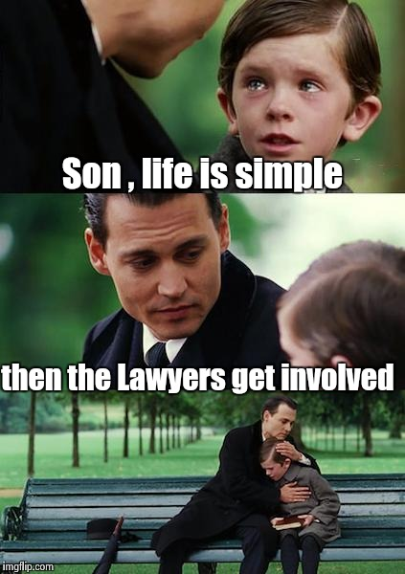
Law(s) and regulations
GDPR (2018)
Fairness
Lawfulness
Transparency
Purpose Limitation
Data Minimization
Accuracy
Storage Limitation
Integrity and Confidentiality
Accountability
NIS (2016), NIS2 (2023)
Final legislation ready Dec. 2022.
Transposition Oct. 2024
Implementation One year period
EU AI Act (2024)
Risk-based approach:
Unacceptable
High-Risk - regulated
... - unregulated
https://imgflip.com/i/1rfxwa
Notes:
Resources:
- https://osveta.nukib.cz/course/view.php?id=145
- https://artificialintelligenceact.eu/
- https://digital-strategy.ec.europa.eu/en/policies/regulatory-framework-ai

Slide 21
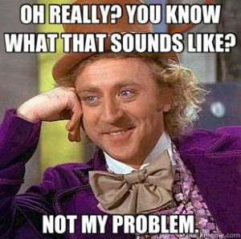
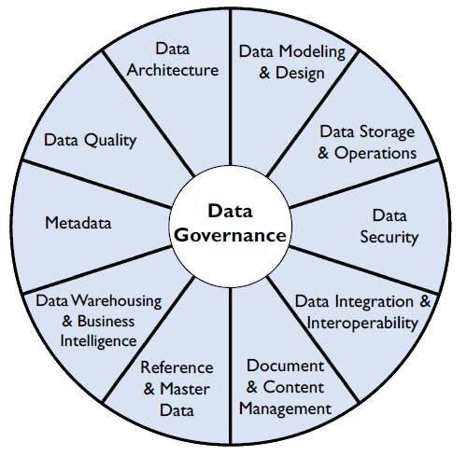
Data management
The Global Data Management Company
https://dagny.com/whose-job-is-qa/
Notes:
Resources
https://cdmp.info/

Slide 22
Activity
Software Engineer Civil Engineer Nuclear power plant Engineer * Engineer

Slide 23

Data Engineering

